Slide 1

MACHINE LEARNING
End-to-end Workflow

Slide 2

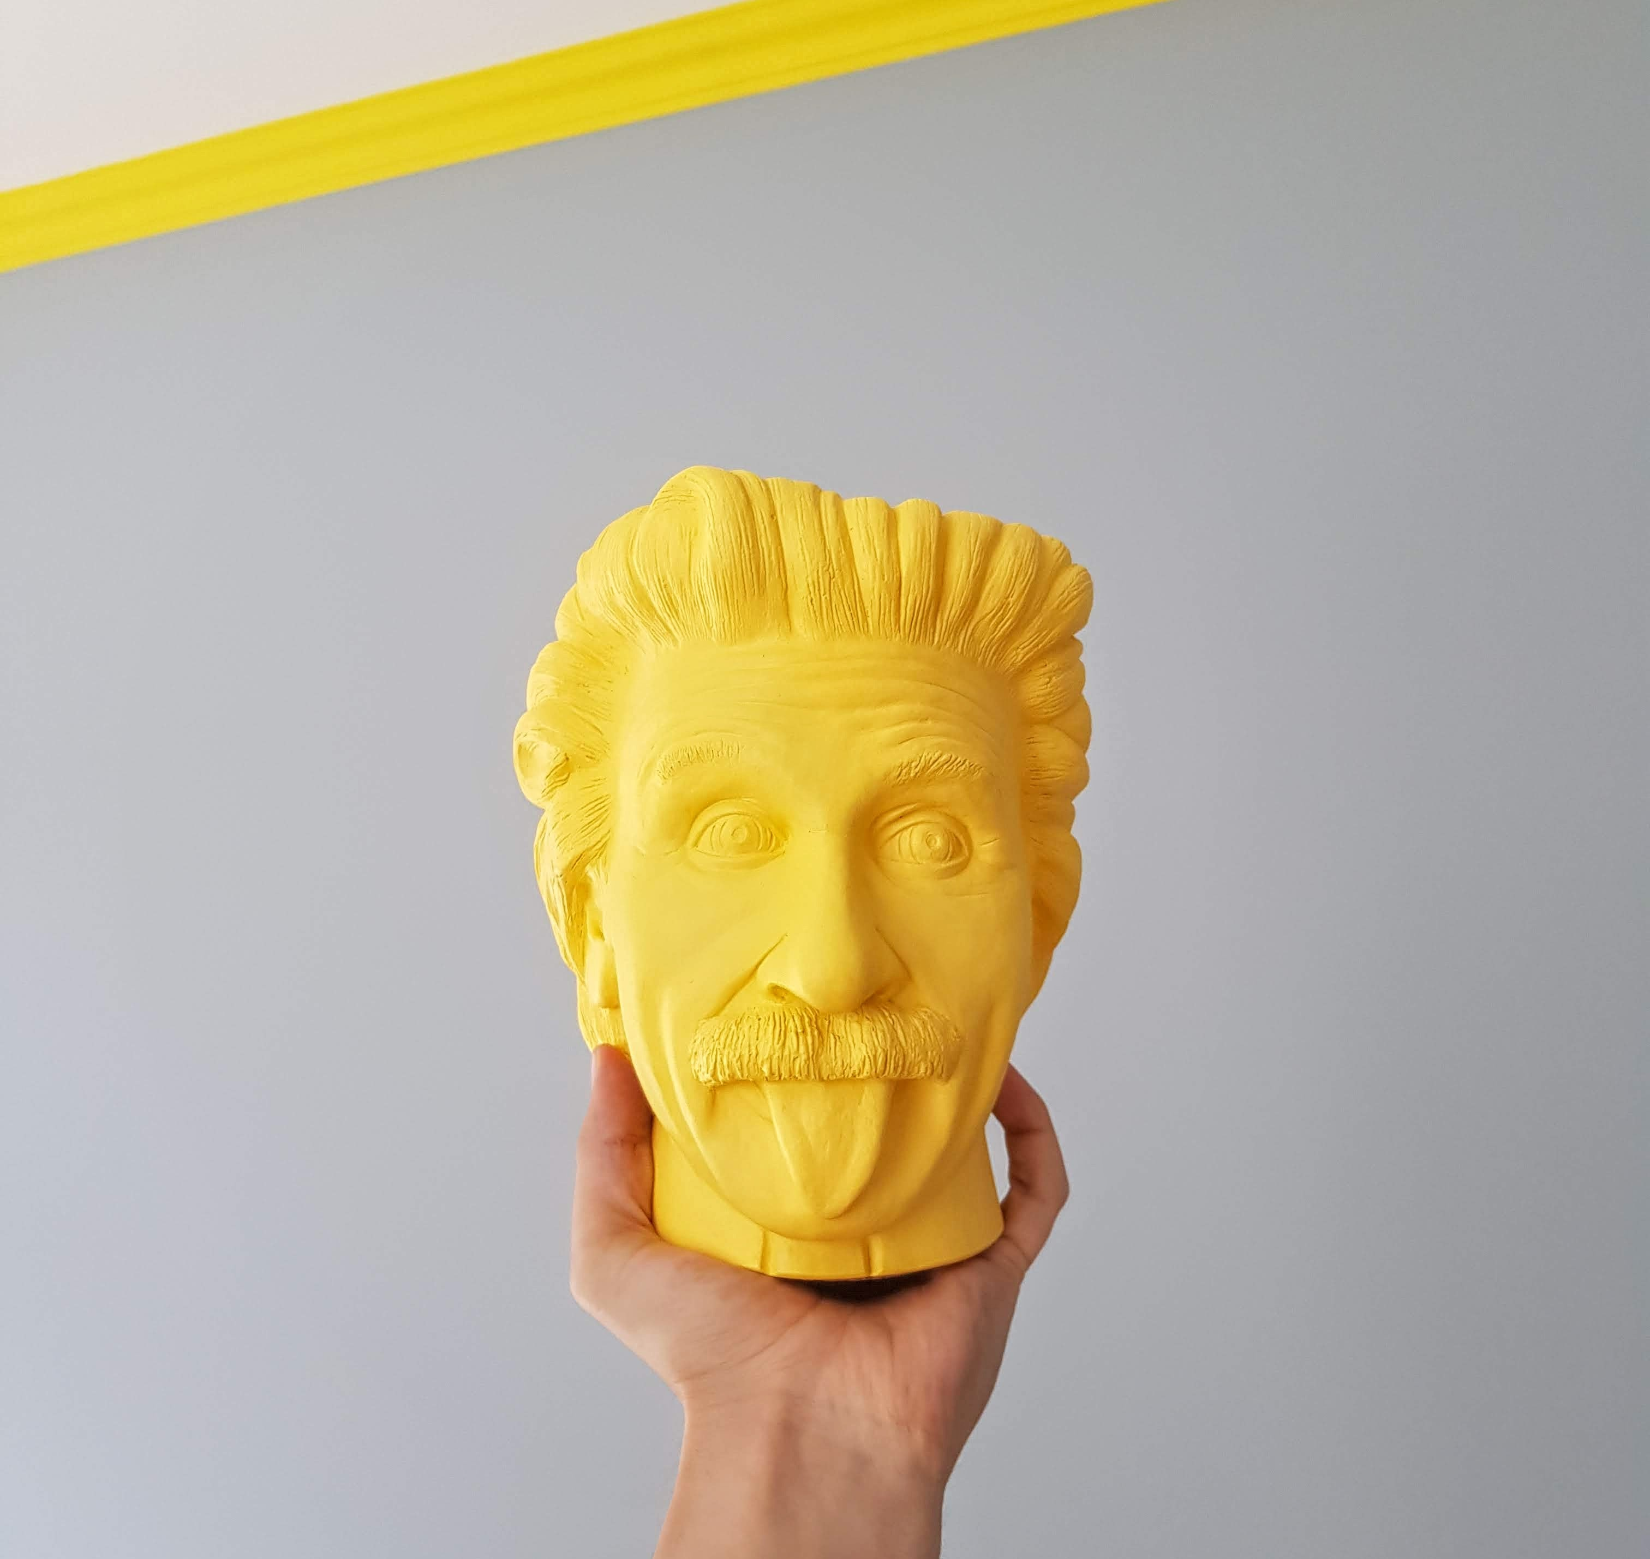
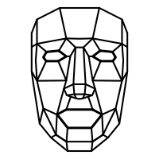
Before we start,
What does a machine workflow look like?
Notes:
https://unsplash.com/photos/P5nZwlbTngI icon-library.com/images/facial-recognition-icon/facial-recognition-icon-23.jpg

Slide 3
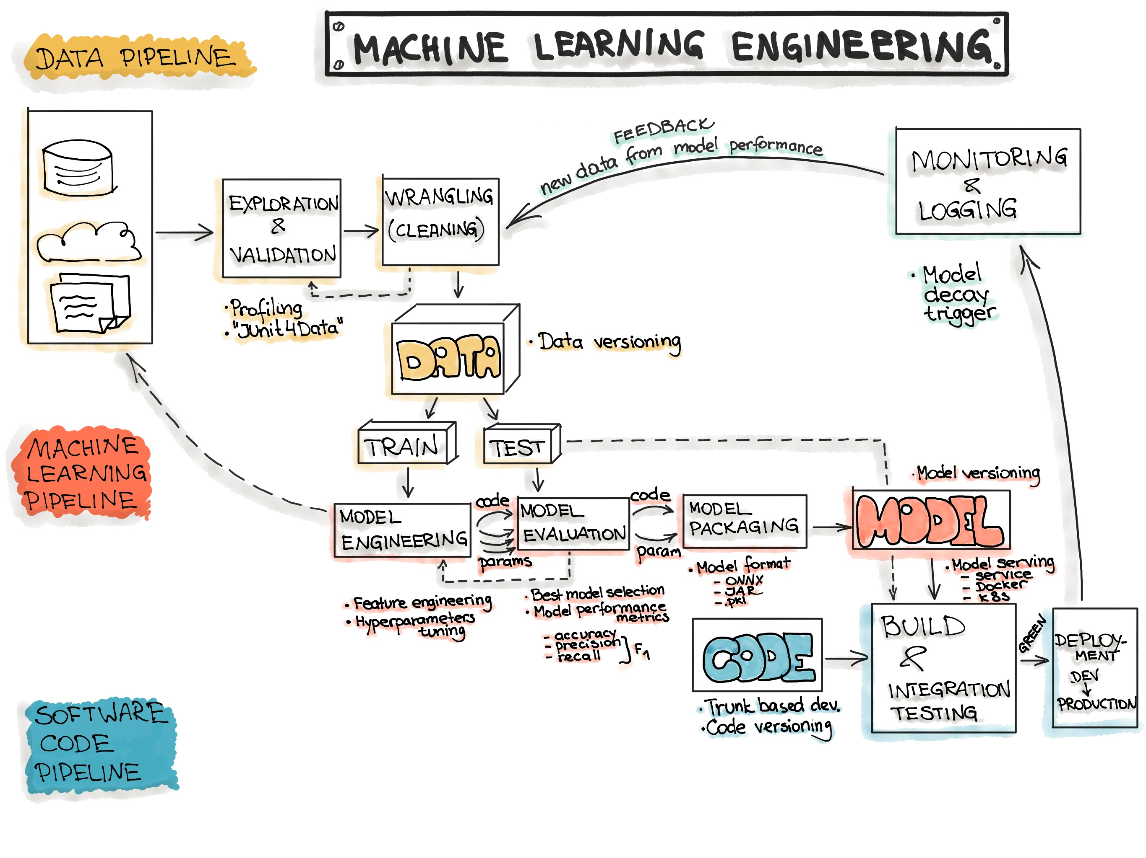
https://ml-ops.org/content/end-to-end-ml-workflow
Notes:
https://ml-ops.org/content/end-to-end-ml-workflow

Slide 4
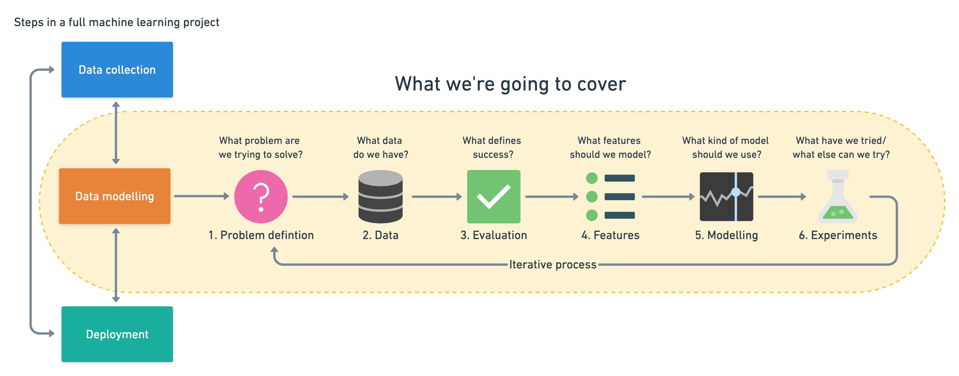
Notes:
https://zerotomastery.io/courses/machine-learning-and-data-science-bootcamp/

Slide 5
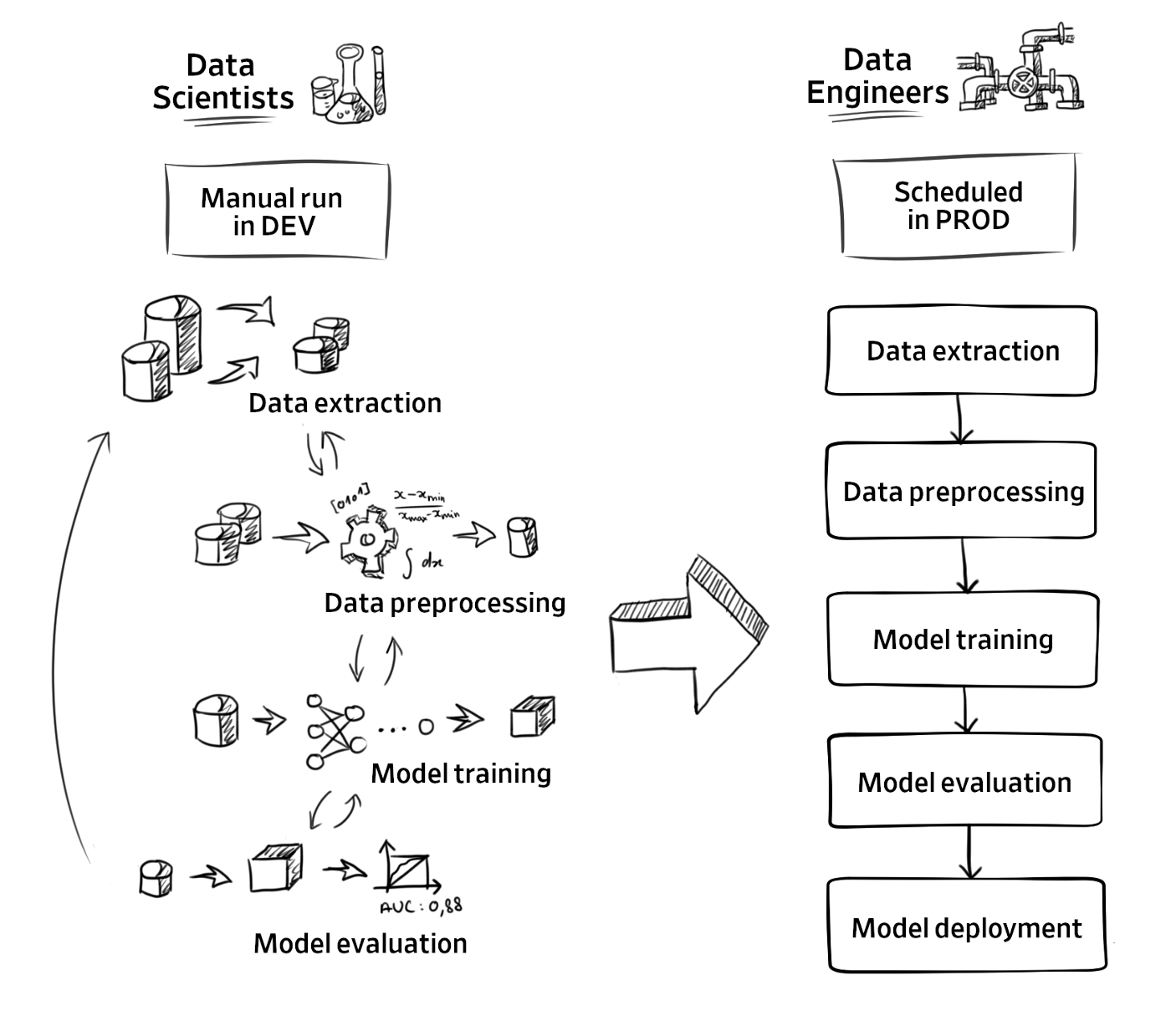
Notes:
https://blogs.halodoc.io/build-end-to-end-machine-learning-workflows-with-kubernetes-and-apache-airflow/

Slide 6



3-Step ML Model
1. Data Wrangling
2. Model Creation
3. Deployment
Understanding our data
Data Preprocessing
Feature Engineering
Notes:
https://blogs.halodoc.io/build-end-to-end-machine-learning-workflows-with-kubernetes-and-apache-airflow/

Slide 7
Training Objectives
What does it take to start and deploy an ML model?
Data Preprocessing
Model Creation
Deployment

Slide 8

3-Step ML Model
Data Wrangling
Model Creation
Deployment
Test
Notes:
https://unsplash.com/photos/Wpnoqo2plFA https://unsplash.com/photos/LqKhnDzSF-8
https://unsplash.com/photos/BfrQnKBulYQ

Slide 9
What does a machine workflow look like?

Slide 10

Topics
What does it take to start and deploy an ML model?
Data Pre-processing

