Slide 1

MACHINE LEARNING
End-to-end Workflow
Notes:
https://upsystem-my.sharepoint.com/:p:/g/personal/macabanlit_outlook_up_edu_ph/ET0Eu47aIlZCqAUbnSU5Sp0B4_kQznmd2_izgCSTEzi3-w?e=PgQt8V PW: lanex-ai

Slide 2

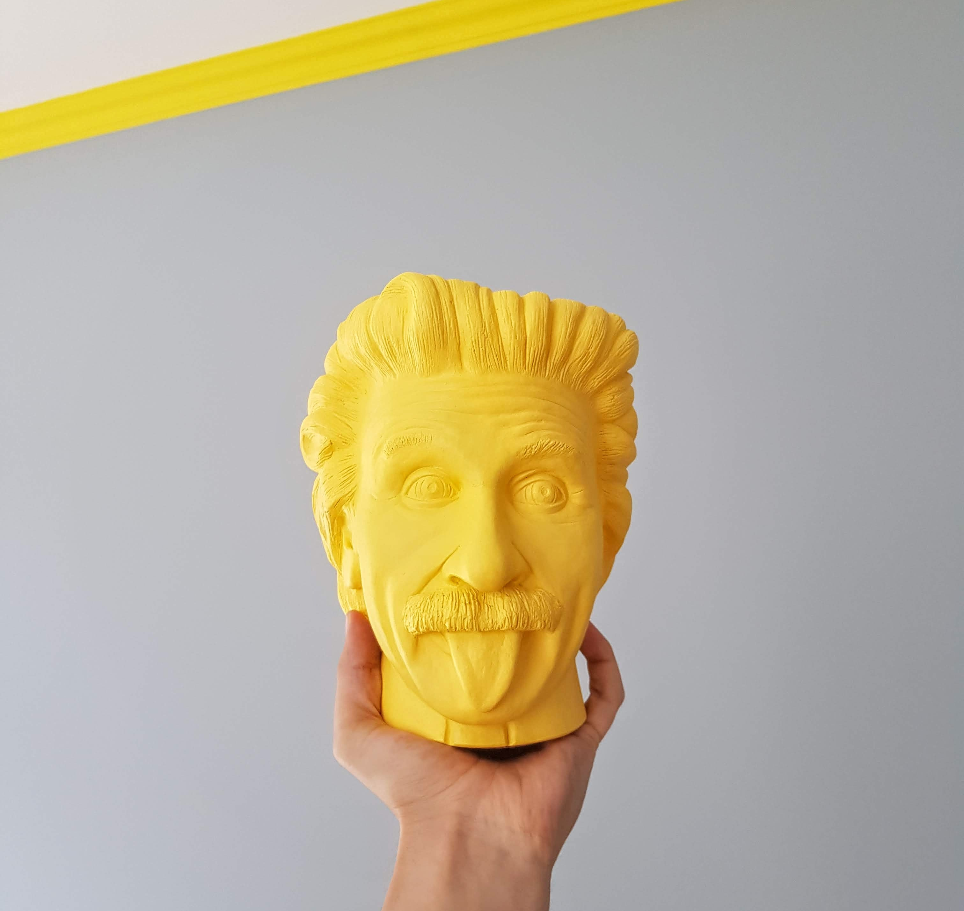
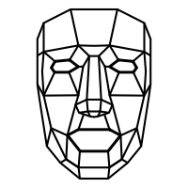
Before we start,
What does a machine workflow look like?
Notes:
https://unsplash.com/photos/P5nZwlbTngI icon-library.com/images/facial-recognition-icon/facial-recognition-icon-23.jpg

