Slide 1
Breast Cancer Detection with Convolutional Neural Network (CNN)
EEM305 Signals & Systems
Prof.Dr. Ömer Nezih GEREK
EEM 304 Signals & Systems Lecture Final Project
Mehmet Çağrı Aksoy – Onur Aydın – Umut Can Altın – Halil İbrahim Tetik – Ertuğ Keskin

Slide 2
Introduction
EEM305 Signals & Systems
Deep learning is a sub-field of machine learning dealing with algorithms inspired by the structure and function of the brain called artificial neural networks.
In other words, It mirrors the functioning of our brains.

Slide 3
What we need ?
EEM305 Signals & Systems

Slide 4
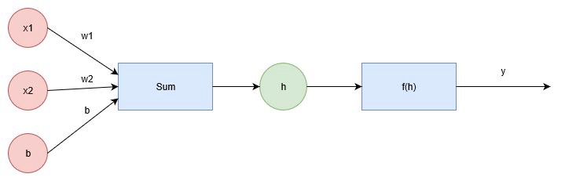
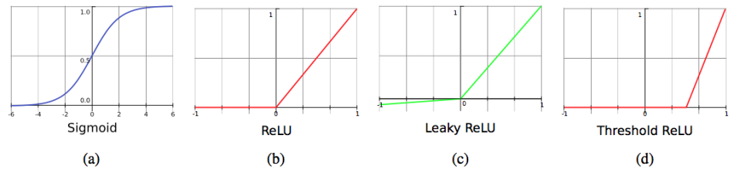

Neural Networks
EEM305 Signals & Systems
The diagram below shows a simple network. The linear combination of the weights, inputs, and bias form the input h, which passes through the activation function f(h), giving the final output, labeled y.

Slide 5
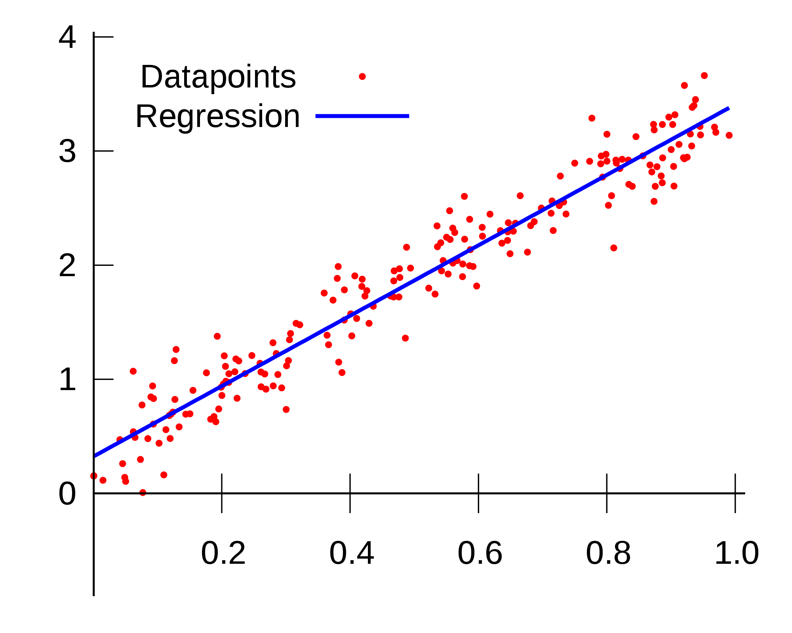
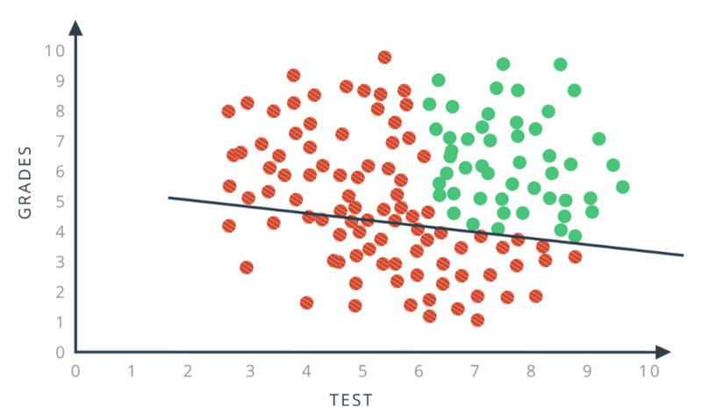
Linear/Logistic Regression
EEM305 Signals & Systems
We cannot start deep learning without linear and logistics regression which is the basis of deep learning. These statistical methods that allows us to summarise relationships between variables.

Slide 6
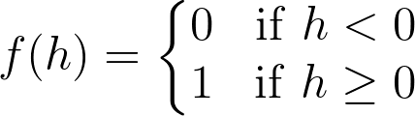
Activation Functions
EEM305 Signals & Systems
Activation functions are functions that decide, given the inputs into the node, what should be the node’s output?
One of the simplest activation functions is the Heaviside step function. This function returns a 0 if the linear combination is less than 0. It returns a 1 if the linear combination is positive or equal to zero.

Slide 7
Other Activation Functions
EEM305 Signals & Systems

Slide 8
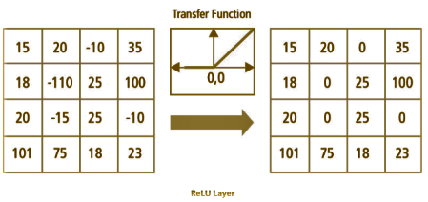
EEM305 Signals & Systems
This is another example of transfer function:

Slide 9
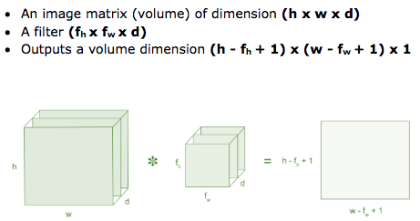
Convolutional Layer
EEM305 Signals & Systems
Convolution is the first layer to extract features from an input image.
Convolution preserves the relationship between pixels by learning image features using small squares of input data.

Slide 10
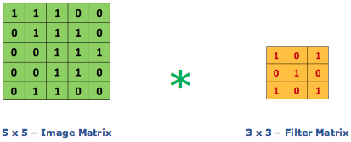
Consider a 5 x 5 whose image pixel values are 0, 1 and filter matrix 3 x 3 as shown in below
Convolution of an image with different filters can perform operations such as edge detection, blur and sharpen by applying filters.

Slide 11
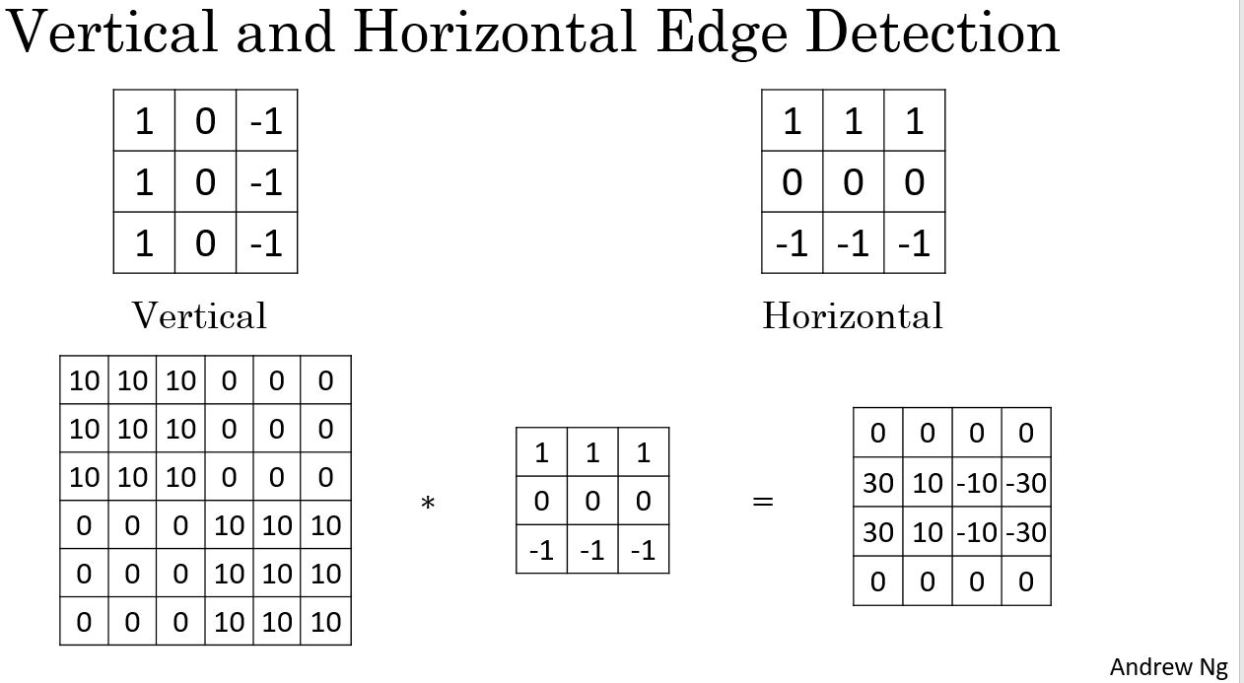
Edge Detection
EEM305 Signals & Systems

Slide 12
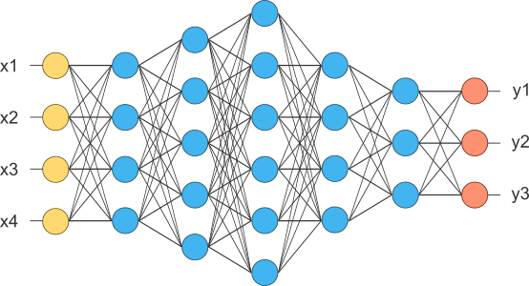
Fully Connected Layer
EEM305 Signals & Systems

Slide 13
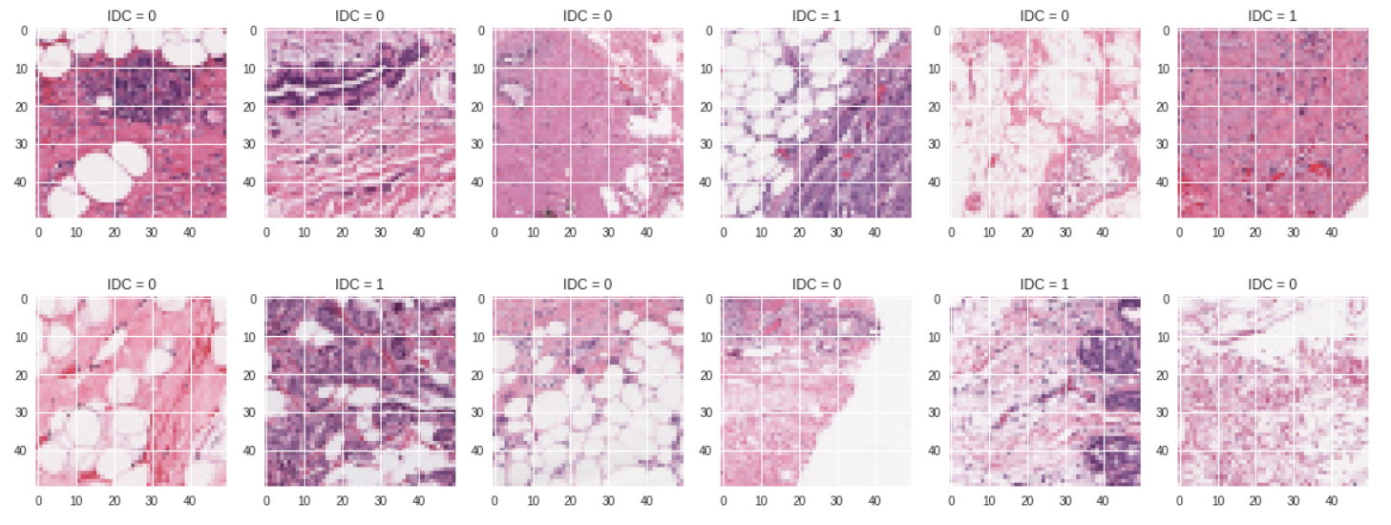
Dataset
EEM305 Signals & Systems

Slide 14
EEM305 Signals & Systems
About this Dataset :
This dataset consists of 5547 breast histology images of size 50 x 50 x 3, curated from Andrew Janowczyk website and used for a data science tutorial at Epidemium. The goal is to classify cancerous images (IDC : invasive ductal carcinoma) vs non-IDC images.

Slide 15
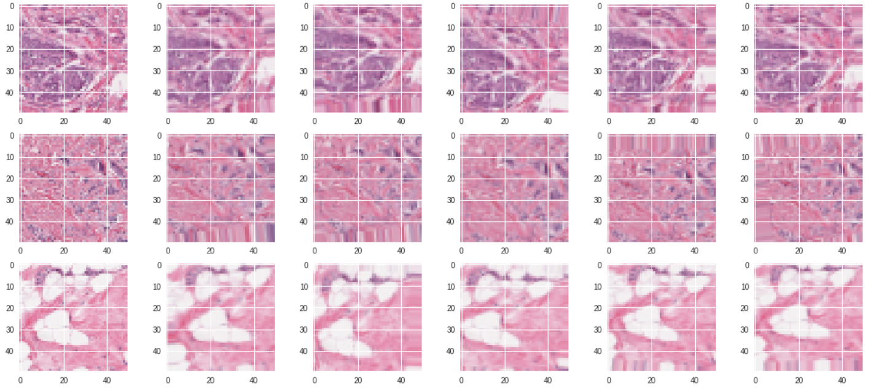
EEM305 Signals & Systems

Slide 16
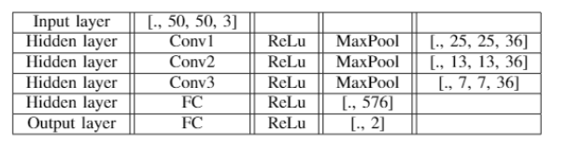
EEM305 Signals & Systems

Slide 17
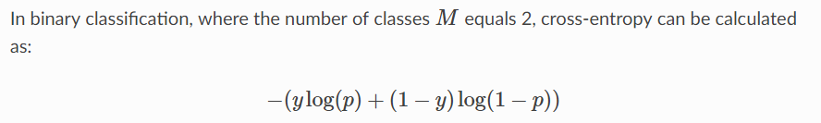

Slide 18
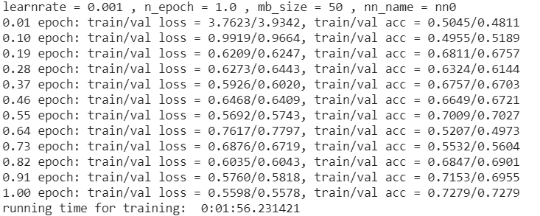
EEM305 Signals & Systems

Slide 19
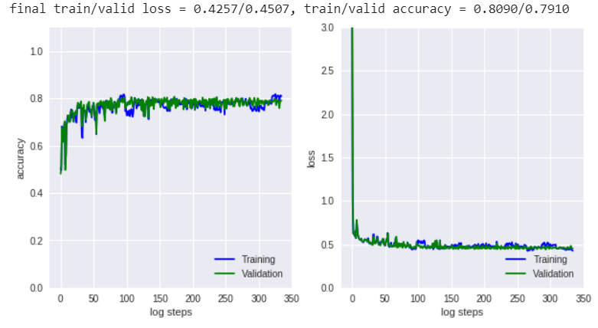

Slide 20
Q & A
EEM305 Signals & Systems

