Slide 1



Cost-Sensitive
Cache Replacement Algorithms
CPSC 614
By
Jaeheon Jeong and Michel Dubois
Olusegun Adekile, Jongyoon Choi

Slide 2

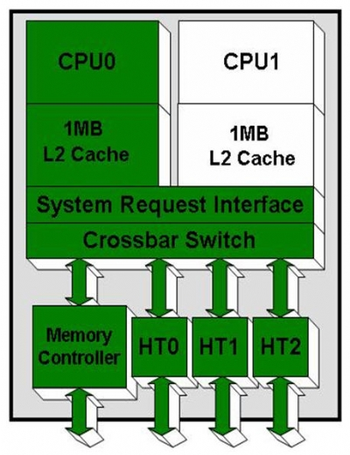
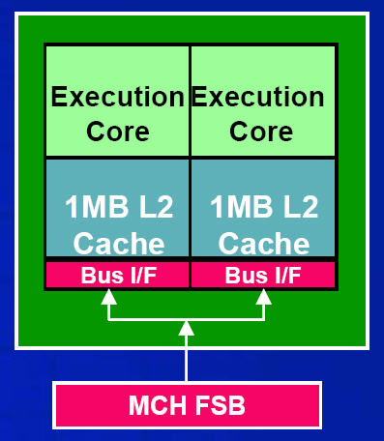
Problem Statement
Most of replacement policies are based only on locality
LRU
Choose block by location
FIFO
Random
We expect to reduce number of miss
AMD Opteron
Assume same cost; latency, power consumption, and so forth
What if cost is not same inside cache ?
It is really true on multi-CPU processing environments
But we also need locality
Intel Pentium XE 840
Consider Both

Slide 3
Replacement Policies
Based on GD and LRU, we can choose different policies
Least Recently Used
Replace least recently used
Base
Greedy Dual
Replace lowest cost
Composite
Simple
Cost-sensitive LRU
Consider location first and compare cost
Enhance
Basic cost-sensitive LRU
Add concept of reducing the cost by Acost
Main
Idea
Dynamic cost-sensitive LRU
Use ETD to check previously accessed
Adaptive cost-sensitive LRU
Use counter and change mode
<reserve or not>

Slide 4

Design of Cost Function
Most difficult problems on replacement policies are defining the proper cost.
Problems
What to use
How to define
Author’s approach
Physical Address Mapping
Not change during execution
Use Latency
Random Cost Mapping
…
First-Touch Cost Mapping (Correlated)
Our choice
First-Touch Cost Mapping
cost increases by each 256 * block size

Slide 5


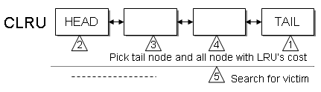
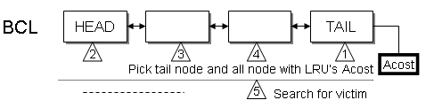
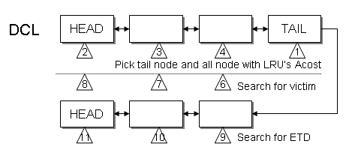
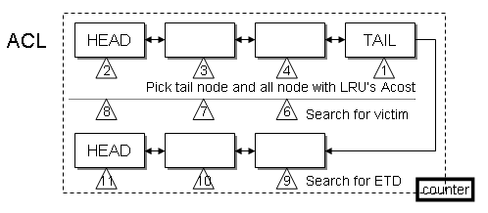
Implementation
The Simple Scalar uses linked list to hold cache set and we extend those

Slide 6
Implementation
DCL
  BCL’s weakness is that it assumes LRU provides a
  perfect estimate of relative forward distances
  Cost of reserved LRU block should only be depreciated if
  victimized block is actually accessed before it
  Solution
    Attach ETD structure to each set
    On a miss, insert ETD entry
    Checked in parallel with cache access
    If an access misses in cache but hits in ETD, only then decrement reserved LRU block as in BCL
    When an access hits on LRU block, invalidate all ETD

Slide 7
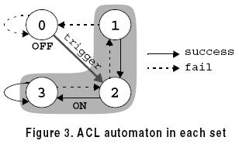
Implementation
ACL
  Reservations are triggered by a history of cost savings in each set
  We associate a counter to enable and disable
  reservations in each cache

Slide 8
Implementation
ACL
  Counter is incremented by hits in ETD and decremented by misses in ETD
  Reservations triggered when a counter threshold is
  reached

Slide 9
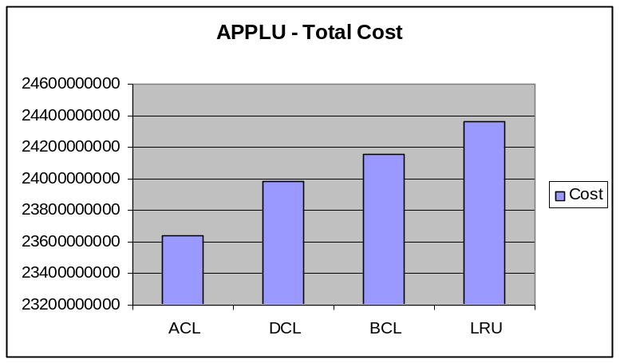
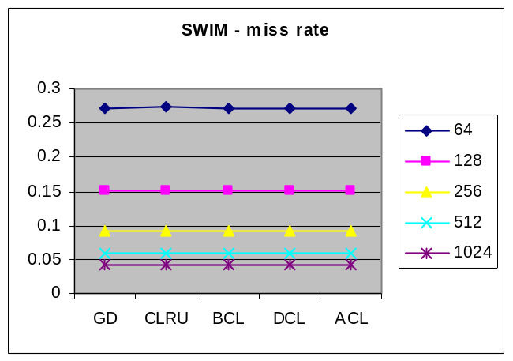
Analysis
It shows cost saving with less sacrificing the miss rate
Change # of set
Cost & Miss rate decreases
Miss rate of MCF is not affected
Change block size
64KB and 128KB has big gap
Change associativity
Not so much effect

Slide 10



Conclusion
Using the concept of cost on replacement is reasonable choice
It works!
Pursuit cost saving with cost saving
More to go!
valuable on only multi processing environment
concept of cost is still not clear
may requires additional computation effort

Slide 11
Appendix. List of Replacement Policies
CPSC 614

Slide 12
Greedy Dual (GD)
Replace lowest cost
MRU
LRU
Request for 0x16(miss)
Index
0x94
0x96
0x64
0x04
0x08
0x32
Cost
1
2
4
3
2
10
Victim with the least cost
Reduce each cost by Victim’s(1)
Index
0x16
0x96
0x64
0x04
0x08
0x32
Cost
6
1
3
2
1
9
Request for 0x04(hit)
Index
0x16
0x96
0x64
0x04
0x08
0x32
Cost
6
1
3
2
1
9
Restore 0x04 to original cost(7)
Index
0x04
0x16
0x96
0x64
0x08
0x32
Cost
7
6
1
3
1
9

Slide 13
Least Recently Used (LRU)
Replace least recently used
MRU
LRU
Request for 0x16(miss)
Index
0x94
0x96
0x64
0x04
0x08
0x32
Victim which least
recently used
Index
0x16
0x96
0x64
0x04
0x08
0x32
Request for 0x04(hit)
Index
0x16
0x96
0x64
0x04
0x08
0x32
Restore 0x04 to MRU position
Index
0x04
0x16
0x96
0x64
0x08
0x32

Slide 14
LRU-based Cost-sensitive Replacement
Consider location first and compare cost
MRU
LRU
Request for 0x16(miss)
Index
0x94
0x96
0x64
0x04
0x08
0x32
Cost
1
2
4
3
2
10
Victim with less cost than LRU
Index
0x08
0x94
0x96
0x64
0x04
0x32
Cost
6
1
2
4
3
10
Request for 0x04(hit)
Index
0x16
0x94
0x96
0x64
0x04
0x32
Cost
6
1
2
4
3
10
Move 0x04 to MRU position
Index
0x04
0x16
0x94
0x96
0x64
0x32
Cost
3
6
1
2
4
10

Slide 15
Basic Cost-sensitive LRU Algorithm (BCL)
Add concept of reducing the cost by Acost
MRU
Assume Acost is 10
LRU
Request for 0x16(miss)
Index
0x94
0x96
0x64
0x04
0x08
0x32
Cost
3
4
3
5
4
10
Victim with less cost
than Acost at LRU
Index
0x16
0x94
0x96
0x64
0x04
0x32
Cost
6
3
4
3
5
2
Reduce Acost by 2*Victim’s(4)
Request for 0x14(miss)
Index
0x16
0x94
0x96
0x64
0x04
0x32
Cost
6
3
4
3
5
2
Replace LRU
Index
0x14
0x16
0x94
0x96
0x64
0x04
Cost
1
6
3
4
3
10
Set Acost

Slide 16
Dynamic Cost-sensitive LRU Algorithm (DCL)
Use ETD to check previously accessed
MRU
Assume Acost is 10
LRU
Request for 0x16(miss)
Index
0x64
0x04
0x08
0x32
ETD
Cost
3
5
4
10
Victim with less cost
than Acost at LRU
0x96
4
0x16
4
0x04
10
Hit
Index
0x16
0x64
0x04
0x32
Cost
4
3
5
2
Reduce Acost by 2*Victim’s(4)
Request for 0x32(hit)
Index
0x96
0x64
0x04
0x32
ETD
Cost
4
3
5
2
Index
0x32
0x96
0x64
0x04
Cost
5
4
3
10
Invalidate
Set original cost
Set Acost

Slide 17
Adaptive Cost-sensitive LRU Algorithm (ACL)
Use counter and change mode; reserve or not
MRU
Assume Acost is 10
LRU
Request for 0x16(miss)
Index
0x64
0x04
0x08
0x32
ETD
(reservation disabled)
Cost
3
5
4
5
Victim with LRU
0x32
10
0x16
4
store
0x04
10
Index
0x16
0x64
0x04
0x08
Cost
4
3
5
4
Request for 0x32
(hit on ETD)
Index
0x16
0x64
0x04
0x08
ETD
Cost
4
3
5
2
0x32
10
(reservation enabled)
0x16
4
Request for 0x78(miss)
Index
0x32
64
0x64
0x04
0x04
10
Cost
5
4
3
10
Invalidate
Victim with less cost than LRU

