Slide 1
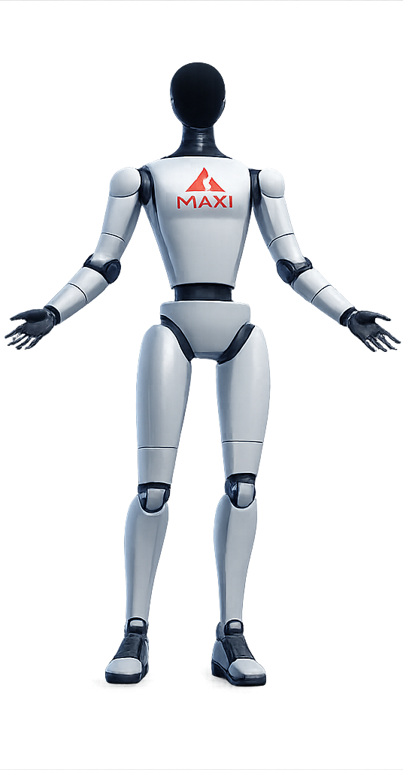
MEET MAXI
Maxi
A robot that listens, talks back,
and teaches a child using its fingers
Tablet face · cloud brain · two robotic hands
Python
Flask + Socket.IO
Groq LLM
Raspberry Pi
6-Month Coding Bootcamp · Secondary School Cohort
Presented by Student One, Student Two, Student Three, Student Four
4 August 2026
Notes:
[SPEAKER 1 — 10 sec]
"Good morning. We are the Secondary School Cohort of the 6-Month Coding Bootcamp. Over six months we built Maxi — a
robot that listens to a child, talks back in a friendly voice, and even counts
maths out on real robotic fingers."
Gesture to the robot on the table. Hold a beat, then advance.

Slide 2
AGENDA
How the next 10 minutes go
😀
Meet Maxi
Student One
2 min
What it is and why we built it
🛠️
The build & the brain
Student Two
2 min
Hands, board, and the cloud that thinks
🧠
How it thinks
Student Three
2 min
The state machine, the code, the wiring
🚀
Live demo
Student Four
3 min
We talk to Maxi and its fingers move
💡
Lessons & limits
Student One
1 min
What broke, what we learned, what's next
We each built a different part, so we will each explain our own part.
Maxi · 6-Month Coding Bootcamp · 4 August 2026
02
Notes:
[SPEAKER 1 — 25 sec]
Point at each row as you name the teammate who owns it, so the audience knows who
speaks when. Keep it to one line per row — do not read the descriptions out.
"We split into hands, brain and app, so you will hear from all four of us."
Then continue straight into the problem.

Slide 3
01 · THE PROBLEM
One teacher, a whole classroom of students
👩‍🏫
✋
🔁
Not enough one-on-one
Learning is physical
A robot never gets tired
In a big class, a child who is stuck rarely gets a patient, private explanation. The quiet ones fall behind first.
A six-year-old understands "three" by seeing three fingers, not by reading it. Numbers need to be shown, not just said.
A child can ask the same question ten times. A patient machine answers the tenth time exactly like the first.
💡
Our question:
could we build a friendly robot that listens, talks back, and teaches a child patiently — one-on-one — using its own hands?
Maxi · 6-Month Coding Bootcamp · 4 August 2026
03
Notes:
[SPEAKER 1 — 35 sec]
"Before the tech, here is why we built this."
One sentence per card — do NOT read them word for word. The middle card is the heart
of it: young kids learn numbers physically, on fingers. That is why Maxi has hands.
Land hard on the bottom line — that is the question the whole project answers.
IMPORTANT: we are not replacing teachers. Say it here; it earns trust for the rest.

Slide 4
02 · MEET MAXI
One loop: sense → think → act
Everything Maxi does is this loop, running over and over
👂
SENSE
🧠
THINK
🗣️
ACT
It hears you
It understands
It responds
The tablet microphone catches the child's voice and the wake word "Hey Maxi".
A cloud brain turns speech into an answer — chat, a maths step, a story — and decides what to do.
Maxi talks back in a warm voice, moves its 12 finger servos, and shows a feeling on its face.
📱
Android tablet
🤲
Two robotic hands
🍓
Raspberry Pi
☁️
Cloud brain
face, voice & ears
12 servos, 10 fingers + 2 wrists
drives the hands
on Railway
Maxi · 6-Month Coding Bootcamp · 4 August 2026
04
Notes:
[SPEAKER 1 — 40 sec]
This is the mental model for the whole talk. Point across the three cards:
"Maxi senses with its ears, thinks in the cloud, and acts with its voice and hands.
Sense, think, act — that is the whole robot."
Then the bottom strip: the four physical pieces. "The face is a tablet. The hands are
real servos. A Raspberry Pi drives the hands. And the thinking happens in the cloud."
HAND OFF: "Student Two will show you how we actually built the body."

Slide 5
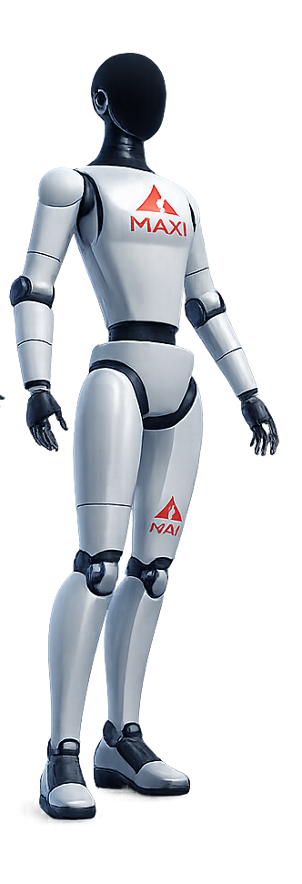
03 · THE BUILD
What Maxi is made of
Two hands, 12 servos
🤲
5 fingers + 1 wrist per hand. Servo channels 0–11 on one driver board.
Adafruit PCA9685
🎛️
A 16-channel PWM board that turns the Pi's commands into servo movement over I²C.
Calibrated per finger
📐
Every finger has its own open/closed angles — e.g. right pinky 0–90°, wrist 20–160°.
LIST OF MATERIALS
Raspberry Pi — · 12 × micro-servos — ( SG90 / MG90S) — (external 5V supply)
Maxi · 6-Month Coding Bootcamp · 4 August 2026
05
Notes:
[SPEAKER 2 — 40 sec]
Hold the robot's hand up if you can.
"Each hand has five fingers and a wrist — six little servo motors — so twelve motors
in total, all driven by one board: the Adafruit PCA9685."
"Every finger is slightly different, so we measured and saved open-and-closed angles
for each one. That calibration is why the fist actually looks like a fist."
NOTE TO TEAM: fill the yellow bill-of-materials line (Pi model, servo model, power,
cost) in the CONFIG block before you print — those are not read off the code.
HAND OFF continues to the brain slide, still Speaker 2.

Slide 6
04 · THE BRAIN
Where Maxi actually thinks
A cloud service on Railway — not a chip inside the robot
🚪
Flask + Socket.IO
💬
language model
🎓
We first trained our OWN model
The gateway the tablet talks to. Messages fly back and forth over a live connection.
llama-3.1-8b-instant turns the child's words into a friendly, kid-safe answer.
At the start of the project, we trained our own language model from scratch. But we could not run it — we did not have the computing power, and no funding to buy the hardware it needed. So, we made an engineering choice: use a free cloud model instead, and put our effort into the robot. Same brain-in-the-cloud idea, zero license cost.
🧩
Skills router
💾
Long-term memory
Chat, maths, spelling, stories, quizzes, time & date — each is a small "skill".
A tiny SQLite store so Maxi remembers a child's name and what they like, next time too.
Python
Flask 2.3
Socket.IO
Edge-TTS voice
Railway cloud
Maxi · 6-Month Coding Bootcamp · 4 August 2026
06
Notes:
[SPEAKER 2 — 50 sec]
"Maxi's brain is not a chip inside the robot — it lives in the cloud."
Walk the four blocks fast: a gateway, a language model, a set of skills, and a memory.
THEN slow down for the yellow box — this is a highlight, tell it as a story:
"We actually trained our OWN model first. We were proud of it. But we could not run it —
we did not have the compute, and no funding to buy the hardware. So we made a real
engineering decision: use a free cloud model, and spend our time on the robot itself."
Judges and technical guests respect that honesty. HAND OFF stays with Speaker 2.

Slide 7
05 · THE SENSES
How Maxi takes the world in
🎤
🔑
👆
Microphone — hearing
Wake word — "Hey Maxi"
Touch — the screen & head
The tablet's mic is Maxi's main sense. The browser turns speech into text; that text is what the brain reads.
A small on-device model (Vosk, ~41 MB) listens for its name, so it only wakes when spoken to.
Tapping the screen, or Maxi's head, is a second input: a tap plays; a 3-second hold refreshes and resets it.
Web Speech API
confidence ≥ 0.6
tablet touchscreen
⚠️
Being honest:
Maxi has no camera and no distance sensors yet. Hearing is its main sense — giving it eyes is on our roadmap.
Maxi · 6-Month Coding Bootcamp · 4 August 2026
07
Notes:
[SPEAKER 2 — 35 sec]
"Maxi mostly senses the world by listening."
Card 1: the tablet mic + speech-to-text is the main sense. Card 2: a small model on the
tablet listens just for the wake word, so it is not recording everything. Card 3: touch —
tapping the screen or its head.
Read the honesty strip out loud: "No camera yet — hearing is its main sense. Eyes are on
the roadmap." Do NOT pretend it has sensors it does not.
HAND OFF: "Student Three will show you how all of that turns into a decision."

Slide 8
06 · HOW IT THINKS
A state machine, not a tangle of if-statements
Maxi is always in exactly one state, and moves between them on clear events
IDLE
LISTENING
THINKING
SPEAKING
waiting
hearing you
asking the brain
talking + moving
…then back to IDLE. It is wake-gated: it only listens after you say "Hey Maxi" or tap — never on its own.
🛡️
It ignores its own voice
✋
Answer 0–10 → real fingers
🎚️
Smooth, not snappy
Speech is accepted ONLY while the state is LISTENING. That one rule stops Maxi from hearing itself and answering itself in a loop.
If a maths answer is ten or less, Maxi counts it out on its hands. Bigger than ten, it shows it on the screen instead.
Servos don't jump. Each move eases in and out with a cubic curve, ~67 updates a second — so movement looks natural, not robotic.
Maxi · 6-Month Coding Bootcamp · 4 August 2026
08
Notes:
[SPEAKER 3 — 45 sec]
"People expect a robot to be a giant pile of if-statements. Ours is not. It is a state
machine — it is always in exactly ONE of four states."
Trace the top row: idle, listening, thinking, speaking, back to idle.
Then the three rules — pick the first one to dwell on: "Maxi only accepts what it hears
while it is in the listening state. That single rule is what stops it from hearing its own
voice and talking to itself forever — which is exactly the bug we hit first."
Mention: not PID, no motors racing — smooth cubic easing on the servos.

Slide 9
07 · THE CODE
Two real pieces of Maxi, straight from the repo
1 · The brain ignores its own echo
2 · Angle → servo pulse → movement
# only accept speech while LISTENING
if self.session.phase != Phase.LISTENING:
return # <- drop Maxi's own voice
pulse = 500 + (angle/180)*(2500-500)
duty = int(pulse / 20000 * 65535)
pca.channels[ch].duty_cycle = duty
Three lines that killed the "robot talks to itself" bug.
0–180° becomes a 500–2500 µs pulse at 50 Hz.
🔎
No magic, no AI here — just clear rules.
The left snippet is the safety rule for listening; the right one is the maths that turns an angle into an electrical pulse the servo understands. We wrote both.
Maxi · 6-Month Coding Bootcamp · 4 August 2026
09
Notes:
[SPEAKER 3 — 45 sec]
Do NOT read the code character by character. Explain each block in one breath.
LEFT: "A robot that talks can hear itself. These three lines say: only listen to new
speech while we are actually in the listening state. That fixed our first big bug."
RIGHT: "A servo does not understand 'ninety degrees'. It understands an electrical pulse.
This is the little bit of maths that converts an angle into a pulse width — 0 to 180
degrees becomes a pulse between 500 and 2500 microseconds."
Bottom line: this part is not AI, it is ordinary programming, and we wrote it ourselves.

Slide 10
08 · WIRING
How the three parts talk to each other
Socket.IO
REST · X-API-Key
I²C · SCL/SDA
PWM · 50 Hz
📱
☁️
🍓
🎛️
🤲
Tablet
Cloud brain
Raspberry Pi
PCA9685
12 servos
face · mic · speaker
Flask + Socket.IO
on Railway
hand controller
Flask REST · :5001
16-ch PWM driver
fingers + wrists
Tablet ⇄ Brain
Socket.IO messages over HTTP polling (Railway's server can't do raw WebSockets yet).
Brain ⇄ Pi
The brain POSTs commands like /show_number to the Pi, signed with a secret X-API-Key.
Pi ⇄ Servos
The Pi speaks I²C to the PCA9685, which sends a 50 Hz PWM pulse to each of the 12 servos.
Maxi · 6-Month Coding Bootcamp · 4 August 2026
10
Notes:
[SPEAKER 3 — 35 sec]
Trace the chain left to right with your finger:
"Tablet talks to the cloud brain. The brain sends hand commands to the Raspberry Pi.
The Pi speaks I²C to the servo board, and the board drives the twelve motors."
Name one real detail so it lands as real engineering: the Pi commands are signed with a
secret key, and the servos run on a 50 Hz pulse.
HAND OFF: "Student Four will show you everything Maxi can actually do — then the live demo."

Slide 11
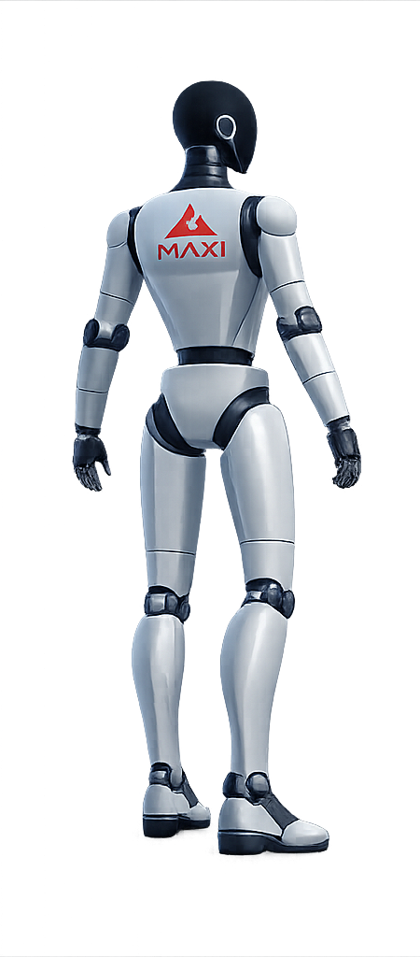
09 · WHAT IT CAN DO
Maxi's skills today
💬
Talk & tutor
🔢
Maths on fingers
🔤
Spelling
📖
Storytelling
❓
Quizzes
🕐
Time & date
💾
Remembers you
😊
Face feelings
✌️
Hand gestures
🗣️
"Hey Maxi" wake
Gestures the hands know: fist · peace · wave · count 1–5. Maths ≤ 10 is counted out on real fingers.
Maxi · 6-Month Coding Bootcamp · 4 August 2026
11
Notes:
[SPEAKER 4 — 35 sec]
Do not read all ten tiles. Pick three or four and say them like a child would ask:
"Hey Maxi, what's seven take away two? — and it counts five on its fingers." "Tell me a
story." "How do you spell banana?" "What time is it?"
Mention the one that always gets a reaction: "It remembers your name between sessions."
Then: "Rather than list them — let me show you." → advance to the demo.

Slide 12
10 · TESTING
How we know it actually works
✅
Automated tests
🎭
Simulation mode
We wrote tests that run with no robot attached — the voice engine, the memory, the maths and the interrupt logic all have their own checks that must pass.
The whole brain runs on a plain laptop with the hands simulated, so we could build and debug without the physical robot in front of us.
🎚️
Calibration screen
📱
Real-device passes
A settings page lets us drag each joint to its real open and closed angle and save it — that is where the per-finger numbers come from.
Then we test on the actual tablet and hands, and tune the thresholds — wake sensitivity, timing — until it feels right.
Honest status:
the software is well tested; the physical hands still need the most tuning. We are up-front about what is solid and what is still rough.
Maxi · 6-Month Coding Bootcamp · 4 August 2026
12
Notes:
[SPEAKER 4 — 25 sec]
"How do you know it works and we are not just hoping? Two ways."
Point left: "We wrote tests that run without the robot — the brain checks itself." Point
right-top: "The whole thing runs in a simulation on a laptop, so we did not need the robot
to build it." Calibration: "this screen is where the real finger angles come from."
Read the honest status line — software solid, hands still need tuning. Then set up the demo:
"Speaking of the hands — let's see them."

Slide 13
🚀
LIVE DEMO
We say "Hey Maxi", ask a maths question, and its fingers answer
1
Say "Hey Maxi"
2
Ask a sum ≤ 10
3
Watch the fingers
4
Try a word / story
If anything misbehaves: we do NOT debug on stage — we cut to the photo and keep talking.
Maxi · 6-Month Coding Bootcamp · 4 August 2026
13
Notes:
[SPEAKER 4 — 100 sec. THE MOST IMPORTANT SLIDE.]
PRE-FLIGHT CHECKLIST (do ALL of this BEFORE walking on stage):
- Batteries: tablet fully charged; servo power pack fully charged; SPARE batteries in pocket.
- Power the robot ON and let the hands finish their startup twitch BEFORE the talk.
- Pair / connect the tablet to the brain and confirm the status says Connected.
- Do ONE full dry run backstage: "Hey Maxi, what is three plus two?" and watch the fingers.
- Open the chat screen already; wake word ON (or plan to tap the mic).
- Clear the table around the hands — nothing for the fingers to catch on.
- Volume up. Wi-Fi / hotspot confirmed (the brain is in the cloud — no internet, no Maxi).
ON STAGE (calm, slow):
1. "Hey Maxi." Wait for the face to react and the beep. Do not rush it.
2. "What is three plus two?" Let it think, speak, and COUNT FIVE ON ITS FINGERS. Stay quiet
and let the audience watch the hand move — that silence is the whole show.
3. Then a word: "How do you spell banana?" — it spells it out, letter by letter.
4. Optional if time: "Tell me a story." Cut it off after one line.
IF IT MISBEHAVES — the recovery, rehearsed:
Do NOT debug on stage. Say, warmly: "Maxi is being a little shy — here it is working
earlier," then Alt-Tab / advance to the robot photo and KEEP TALKING. Tap-and-hold Maxi's
head for 3 seconds to reset it while you speak; if it comes back, try once more. If not,
move on. Nobody remembers a hiccup; they remember panic. So do not panic.

Slide 14
11 · WHAT WE LEARNED
The parts that did not go smoothly
🎓
Our own model wouldn't run
🔁
It talked to itself
🔊
The mic beeped non-stop
We trained one first, but had no compute and no funding for the hardware — so we moved to a free cloud model.
The robot heard its own voice and answered itself in a loop. We fixed it by only listening in the LISTENING state.
Always-on listening beeped on every phrase. We switched to wake-word + tap-to-talk so it is quiet until spoken to.
🔑
A tool went paid overnight
💾
The cloud forgot the child
🔤
Spelling came out garbled
Our first wake-word engine started requiring a company account, so we swapped in a free, offline one (Vosk).
Railway wipes its disk on every deploy, so Maxi's memory reset. We attached a permanent volume to keep it.
The voice ran letters together. With no SSML available we found a trick — "B! A! N!" — that forces clean letters.
Maxi · 6-Month Coding Bootcamp · 4 August 2026
14
Notes:
[SPEAKER 1 — 30 sec]
You are back. Do NOT read six boxes. Tell TWO as short, real stories:
1. "We trained our own model and could not run it — no compute, no funding. Choosing to
let that go and use the cloud was the hardest, most grown-up decision we made."
2. "For a whole afternoon, the robot kept interrupting itself — it could hear its own
voice. The fix was one rule about when it is allowed to listen."
End with the line that ties it together: "The parts that broke taught us more than the
parts that worked."

Slide 15
12 · LIMITS & NEXT
Being honest about what Maxi is — and isn't
⚠️
What it can't do yet
🔭
Where we'd take it next
It needs the internet — the brain is in the cloud.
Run our own model —
when we have the compute and the funding for it
It talks to one child at a time, not a group.
Give it eyes —
a camera, so it can see the child and the page
Hearing only — no camera, no eyes yet.
More of the body —
arms and a moving head, not just hands
The brain is a shared cloud model, not our own.
Work offline —
so, it runs without the internet
The hands need calibrating; a servo can mis-move.
Speak local languages —
Hausa and Kanuri, not only English
It is a learning aid, not a certified teacher.
Teach a whole group —
more than one child at once
The point was never a finished product.
It was to build something real that could one day help a child learn — and to prove to ourselves that we could.
Maxi · 6-Month Coding Bootcamp · 4 August 2026
15
Notes:
[SPEAKER 2 — 30 sec]
Say the left box and mean it: "This is a school project. It needs the internet, it works
with one child, it has no eyes yet, and the brain is a shared cloud model, not our own. It
is a learning aid, not a teacher." Owning that earns you respect.
Then three from the right box, fast — running our own model, giving it eyes, local
languages. Land on the purple line, then advance to thank you.

Slide 16
🤖
Thank you
Six months ago most of us had never written a line of code.
Today we built a robot that listens, talks, and teaches on its fingers.
QUESTIONS?
Student One, Student Two, Student Three, Student Four
6-Month Coding Bootcamp · Secondary School Cohort · 4 August 2026
Maxi · 6-Month Coding Bootcamp · 4 August 2026
16
Notes:
[ALL FOUR SPEAKERS — 20 sec, then Q&A]
Everyone comes to the front. One person says the two lines, then: "We are happy to take
questions." Decide NOW who answers what.
LIKELY QUESTIONS & PREPARED ANSWERS:
Q: "Is Maxi's brain running inside the robot?"
-> No. The thinking happens on a cloud server; the tablet and Pi talk to it over the
internet. That is also why it needs a connection.
Q: "You said you trained your own AI — why aren't you using it?"
-> We trained one, but we did not have the computing power to run it, and no funding to
buy the hardware. We chose to use a free cloud model and spend our time on the robot.
Q: "How is this different from a talking toy or ChatGPT?"
-> A toy plays fixed recordings. ChatGPT is just text. Maxi listens, decides, speaks AND
moves real fingers to teach — and it remembers the child.
Q: "How does it count on its fingers?"
-> Each finger is a servo motor on a driver board. If a maths answer is ten or less, the
software opens exactly that many fingers.
Q: "What was the hardest part?"
-> (your real answer) Letting go of our own model; and the day the robot kept
interrupting itself because it could hear its own voice.

