Slide 1
Two kinds of rules, in plain English
Rule languages · Logical English · Logic Production Systems
Robert Kowalski · Imperial College London
JURIX 2026 tutorial · Toulouse · 8 December 2026
Notes:
30 minutes, three parts. The clock, from the start of this slide:
- 0:00 The notice, and two kinds of rules (8 minutes).
- 0:08 Controlled natural language and Logical English (12 minutes).
- 0:20 Logic Production Systems (8 minutes).
- 0:28 What to take away, and hand over to Miguel.
One example carries the whole talk: the Emergency Notice of the London Underground.

Slide 2
A notice on the London Underground
Emergencies
Press the alarm signal button to alert the driver.
The driver will stop if any part of the train is in a station.
If not, the train will continue to the next station, where help can more easily be given.
There is a 50 pound penalty for improper use.
Millions of passengers have read it. It is a program, written to be executed by people.
Logical English as a Lingua Franca · JURIX 2026 tutorial · Toulouse, 8 December 2026
Notes:
The notice is the first example of my book, Computational Logic and Human Thinking.
It is not a legal text. But it has everything that a legal text has: conditions, an exception, an instruction, a penalty, and words that it does not define.
Four sentences. We shall read each of them as logic.

Slide 3
1 · Rule languages
Two kinds of rules
Logical English as a Lingua Franca · JURIX 2026 tutorial · Toulouse, 8 December 2026
Notes:
Time: 0:01.

Slide 4
The notice has two kinds of sentence
WHAT IS THE CASE
WHAT TO DO
The driver will stop if any part of the train is in a station.
Press the alarm signal button to alert the driver.
It describes the world.
It does not describe the world.
It is true or it is false.
It asks for the world to be changed.
It is a belief.
It is a goal.
Logical English as a Lingua Franca · JURIX 2026 tutorial · Toulouse, 8 December 2026
Notes:
This is the one distinction of the first part. Every rule language makes it, or hides it.
The second sentence of the notice is a prediction about the driver. The first sentence is an instruction to the passenger.

Slide 5
Belief rules
conclusion if conditions
the train stops in a station
if the driver is alerted
and a part of the train is in the station.
A belief rule defines its conclusion in terms of its conditions
A set of belief rules is a logic program
The same rule is used backwards, to answer a question, and forwards, to derive a consequence
Logical English as a Lingua Franca · JURIX 2026 tutorial · Toulouse, 8 December 2026
Notes:
Backwards: will the train stop? It will, if the driver is alerted and a part of the train is in a station. Two smaller questions.
Forwards: the driver is alerted, and the last carriage is in the station. So the train stops.
Prolog reasons backwards. Datalog reasons forwards. The rule is the same.

Slide 6
Goal rules
if conditions then conclusion
if there is an emergency
then the driver is alerted.
it must not be true that
the driver stops the train
and it is not the case that the train is in a station.
A goal rule does not define anything. It must be made true, by acting
The first kind is a reactive rule. The second kind is a constraint
An obligation is a goal. A prohibition is a constraint
Logical English as a Lingua Franca · JURIX 2026 tutorial · Toulouse, 8 December 2026
Notes:
A belief can be false. A goal cannot be false: it can only be violated.
Production rules, event-condition-action rules and the obligations of deontic logic are all goal rules.
The constraint is the "If not" of the notice: the driver does not stop between stations.

Slide 7
Goals say what. Beliefs say how.
THE GOAL
THE REASONING
if there is an emergency
then the driver is alerted.
There is an emergency. An observation.
So the driver must be alerted. Forwards, with the goal.
The driver is alerted if I press the button. Backwards, with the belief.
I press the button. An action.
A BELIEF
the driver is alerted
if a passenger presses
the alarm signal button.
"Press the alarm signal button to alert the driver" is the belief, written backwards.
Logical English as a Lingua Franca · JURIX 2026 tutorial · Toulouse, 8 December 2026
Notes:
This is how a passenger executes the notice. A goal is triggered by what the passenger sees. A belief reduces the goal to something that the passenger can do.
The whole of the third part, LPS, is this cycle: observe, think, act.
Time check: 0:06.

Slide 8
Rule languages take sides
Mostly belief rules | Mostly goal rules
Prolog, Datalog, answer set programming, s(CASP) | Production rules: Drools
Catala, OpenFisca, RuleSpec | Event-condition-action rules
Decision tables | Obligations and prohibitions: LegalRuleML, L4
Blawx, Epilog, Oracle Intelligent Advisor | Smart contracts: Solidity, Daml
A language with one kind of rule must imitate the other kind.
Logical English writes belief rules. Logic Production Systems adds goal rules, and time.
Logical English as a Lingua Franca · JURIX 2026 tutorial · Toulouse, 8 December 2026
Notes:
The table is a simplification, and each community will object to its own row. That is a good discussion to have at the end.
The point: when two languages differ, ask first which kind of rule each one has. Miguel's tour shows sixteen of them.
Time: 0:08.

Slide 9
2 · Controlled natural language and Logical English
English that a computer can read as logic
Logical English as a Lingua Franca · JURIX 2026 tutorial · Toulouse, 8 December 2026
Notes:
Time: 0:08.

Slide 10
English is expressive. It is also ambiguous.
The driver will stop if any part of the train is in a station.
If not, the train will continue to the next station.
There is a 50 pound penalty for improper use.
A CONTROLLED NATURAL LANGUAGE
A part of English with one reading only.
LOGICAL ENGLISH
conclusion if conditions
No pronouns: a train, then the train
One word, one meaning
Time, but no tense
Stop what? And where?
If not what?
Improper use of what?
It is another way to write a logic program.
Logical English as a Lingua Franca · JURIX 2026 tutorial · Toulouse, 8 December 2026
Notes:
A person resolves these ambiguities without noticing. "If not" could mean: if the driver does not stop. It means: if no part of the train is in a station.
Logical English gives up elegant variation. It keeps the meaning.
It can be read without training in mathematics, in computing or in logic.

Slide 11
Templates
the templates are:
*a person* presses the alarm signal button of *a train*.
the driver of *a train* is alerted.
*a part* of *a train* is in *a station*.
*a train* stops in *a station*.
*a train* continues to the next station.
A template is the pattern of a sentence
The words between asterisks are places. Each place stands for one thing
In logic, a template is a predicate, and a place is an argument
Logical English as a Lingua Franca · JURIX 2026 tutorial · Toulouse, 8 December 2026
Notes:
The templates are the vocabulary of the program. Everything else is written with them.
"stops in" has two places: it is a relation between a train and a station.

Slide 12
The notice, in Logical English
the driver of a train is alerted
if a person presses the alarm signal button of the train.
a train stops in a station
if the driver of the train is alerted
and a part of the train is in the station.
a train continues to the next station
if the driver of the train is alerted
and it is not the case that
a part of the train is in a station.
a train introduces a variable. the train refers back to it. Nothing else is needed.
Logical English as a Lingua Franca · JURIX 2026 tutorial · Toulouse, 8 December 2026
Notes:
Read it aloud. It is longer than the notice, and it says exactly one thing.
"it is not the case that" is negation as failure: no part of the train can be shown to be in a station.
The first two words of each rule, "a train", mean "every train".

Slide 13
A scenario is a case. A query is a question.
scenario between stations is:
alice presses the alarm signal button of the 8:15.
stops expects answers [].
continues expects answers ["the 8:15 continues to the next station"].
query stops is:
which train stops in which station.
query continues is:
which train continues to the next station.
A scenario gives the facts of one case
A scenario can say which answers it expects. Then the scenario is also a test
Logical English as a Lingua Franca · JURIX 2026 tutorial · Toulouse, 8 December 2026
Notes:
The facts are sentences of the same templates.
The tests stay with the program. When somebody changes a rule, the scenarios say what the change broke. The hands-on exercise does exactly that.
Time check: 0:14.

Slide 14
Every answer has an explanation
WHY?
WHY NOT?
the 8:15 continues to the next station
the driver of the 8:15 is alerted
alice presses the alarm signal
button of the 8:15
it is not the case that
a part of the 8:15 is in a station
not: a train stops in a station
the driver of the 8:15 is alerted
alice presses the alarm signal
button of the 8:15
not: a part of the 8:15
is in a station
The explanation is the proof. It uses the sentences of the program, so the reader of the rules can read it.
Logical English as a Lingua Franca · JURIX 2026 tutorial · Toulouse, 8 December 2026
Notes:
Both explanations come from the system as shown, for the scenario "between stations".
Why not is as important as why. In law, the party who loses wants the reason.

Slide 15
The fourth sentence: a citation, and a conditional answer
the templates are:
*a person* is liable to a penalty of *an amount*.
*a person* uses the alarm signal button improperly; unknown.
rule sentence_4 with provenance the Emergency Notice,
confer "There is a 50 pound penalty for improper use":
a person is liable to a penalty of 50
if the person presses the alarm signal button of a train
and the person uses the alarm signal button improperly.
Answer: alice is liable to a penalty of 50, assuming alice uses the alarm signal button improperly.
The notice does not say what is improper. The program does not pretend to know.
Logical English as a Lingua Franca · JURIX 2026 tutorial · Toulouse, 8 December 2026
Notes:
The label of the rule cites its source, and quotes it. An explanation shows the citation.
"unknown" marks a template whose sentences may be assumed. In logic it is an abducible predicate, and the reasoning is abductive logic programming.
Law is full of such terms: reasonable, improper, without undue delay. The answer says which of them it depends on.
Time: 0:20.

Slide 16
3 · Logic Production Systems
Rules in a world that changes
Logical English as a Lingua Franca · JURIX 2026 tutorial · Toulouse, 8 December 2026
Notes:
Time: 0:20.

Slide 17
The notice is about change
the events are:
a fire starts.
the train leaves the station.
the train arrives at the next station.
the actions are:
*a person* presses the alarm signal button.
the driver stops the train.
*a person* pays a penalty of *an amount*.
the fluents are:
there is an emergency.
*a person* is on the train.
the driver is alerted.
the train is in a station.
the train is stopped.
A fluent is a fact that changes over time
An event happens, and changes the fluents
An action is an event that an agent chooses
The same language. One new first line:
the target language is: lps.
Logical English as a Lingua Franca · JURIX 2026 tutorial · Toulouse, 8 December 2026
Notes:
The Logical English of part 2 described one state of the world. The notice describes a short history.
LPS: Logic Production Systems, with Fariba Sadri. It combines logic programs with production rules, and gives them one logical meaning.

Slide 18
Causal laws: what an event does
when a fire starts
then there is an emergency.
when a person presses the alarm signal button
then the driver is alerted.
when the train leaves the station
then it is not the case that the train is in a station.
when the train arrives at the next station
then the train is in a station.
A causal law says which fluents an event starts, and which fluents it ends
Causal laws are beliefs. A fluent that no event changes stays as it is
Logical English as a Lingua Franca · JURIX 2026 tutorial · Toulouse, 8 December 2026
Notes:
"A fluent that no event changes stays as it is" is the frame axiom. In LPS nobody writes it, and nobody computes it: the state is simply updated.

Slide 19
Goals: two reactive rules and a constraint
if there is an emergency
and a person is on the train
and it is not the case that the driver is alerted
then the person presses the alarm signal button.
if the driver is alerted at a first time
and it is not the case that the train is stopped at the first time
then the driver stops the train from a second time to a third time.
it must not be true that
the driver stops the train
and it is not the case that the train is in a station.
The driver must stop the train at some later time. The constraint says when the driver may.
Logical English as a Lingua Franca · JURIX 2026 tutorial · Toulouse, 8 December 2026
Notes:
The first rule is the passenger. The second rule and the constraint are the driver.
Times are written only where a rule relates two moments. The driver's goal has no deadline; the constraint delays the action until the train is in a station.
Together, the second rule and the constraint are sentences two and three of the notice.

Slide 20
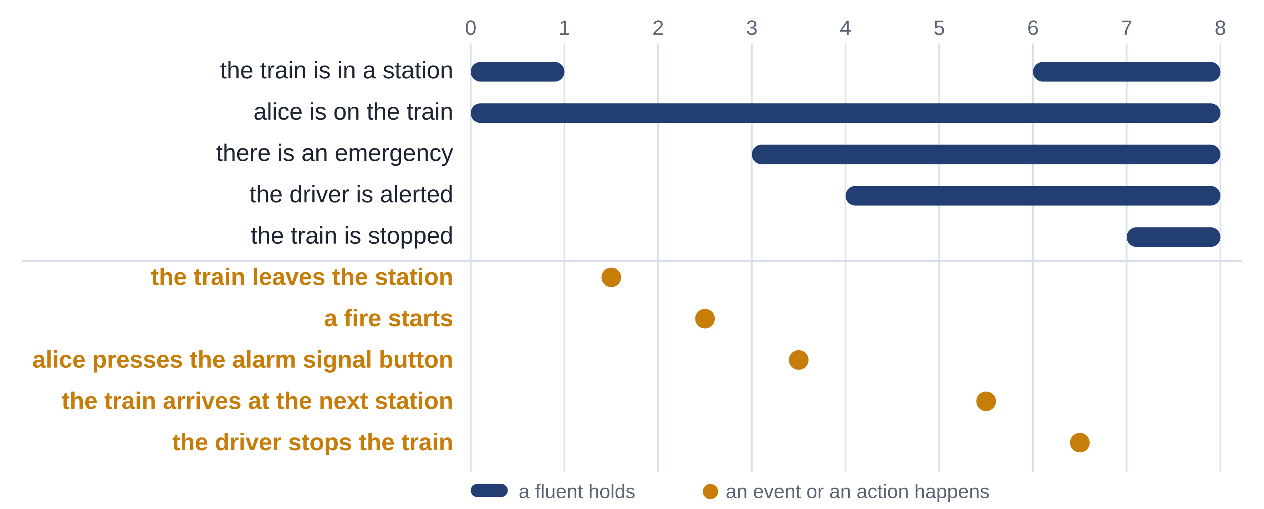
A fire between two stations
The events come from outside. The rules choose the actions. The timeline is the model that makes the goals true.
Logical English as a Lingua Franca · JURIX 2026 tutorial · Toulouse, 8 December 2026
Notes:
Read it from left to right. The train leaves the station. A fire starts. Alice presses the button, because of the first rule. The driver is alerted, because of a causal law. The driver cannot stop yet. The train arrives at the next station. The driver stops the train.
Nobody programmed "continue to the next station". It follows from a goal and a constraint.
Time check: 0:26.

Slide 21
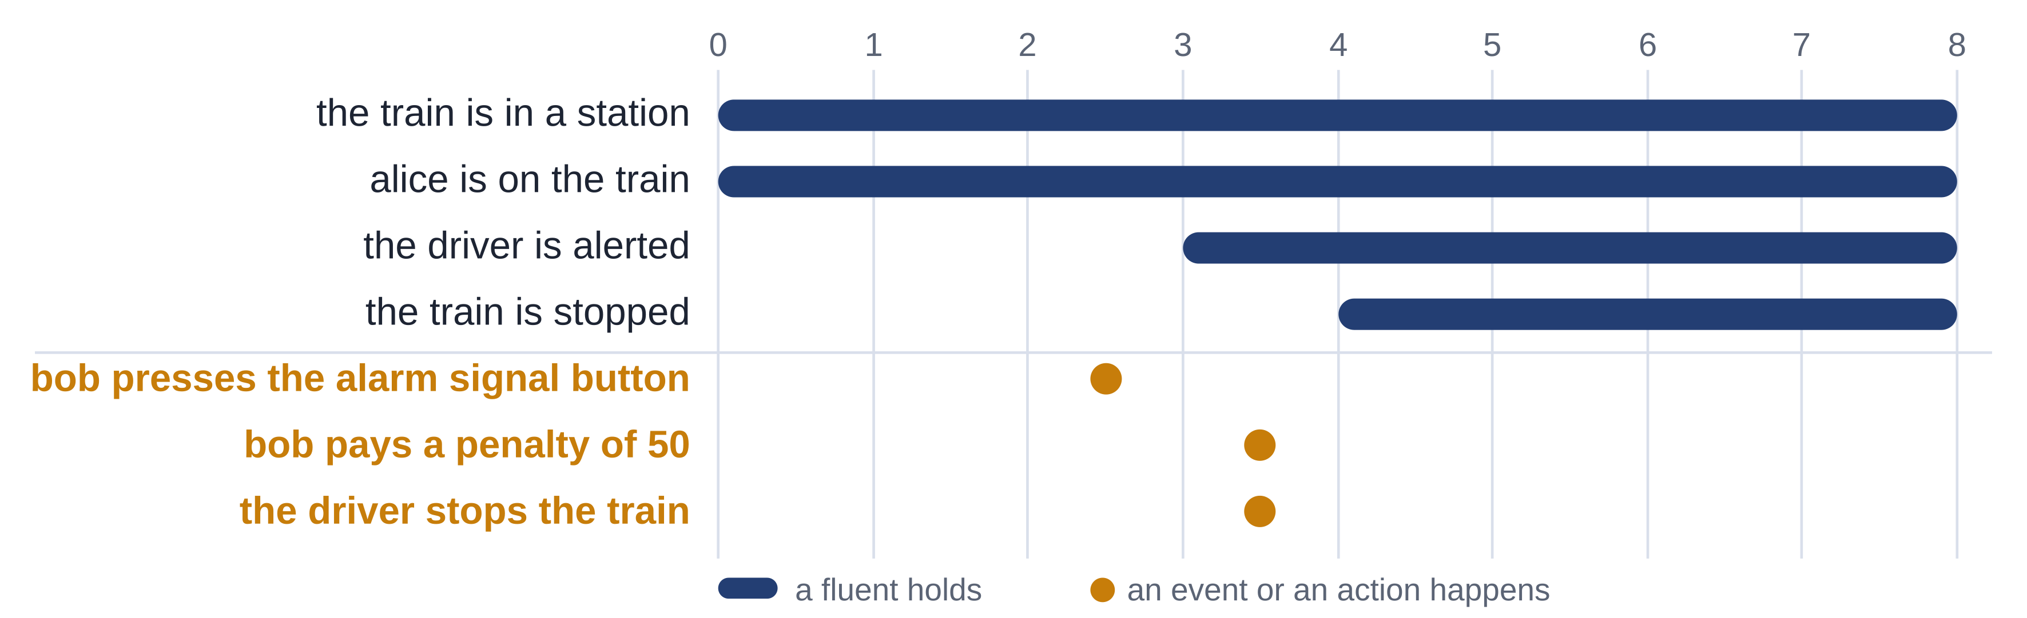
The penalty is a goal too
if it is not the case that there is an emergency
and a person presses the alarm signal button
then the person pays a penalty of 50.
An obligation is a reactive rule: when its conditions happen, an action must follow.
Logical English as a Lingua Franca · JURIX 2026 tutorial · Toulouse, 8 December 2026
Notes:
A second scenario of the same program: bob presses the button, and there is no emergency.
The driver stops the train all the same: the driver cannot know. And bob pays.
In part 2 the penalty was a belief: who is liable. Here it is a goal: what must happen. A legal text often needs both readings.

Slide 22
What to take away
Belief rules say what is the case: conclusion if conditions
Goal rules say what must be made true: if conditions then conclusion
Logical English writes rules in English that has one reading only
Logic Production Systems makes the goals true in a world that changes
Next: sixteen other rule languages, read in the same English.
Logical English as a Lingua Franca · JURIX 2026 tutorial · Toulouse, 8 December 2026
Notes:
Time: 0:28. Hand over to Miguel for the tour.
If there is one sentence to remember: when you meet a rule, ask whether it is a belief or a goal.

