Slide 1

Programming on purpose with python #1 GUI DISCOUNT CALCULATOR
Mike Callahan
STEM Educator
4/18/2019

Slide 2
Purpose
Using Python, we will design a GUI interface discount calculator, which can run on any platform with Python installed
We will learn about Python variables, functions, GUI design, and event driven programming
That is asking a lot out of two hours but we will concentrate only on the parts of Python we need for this task
This should get us started in the right direction
At the end, we will discuss further educational options

Slide 3
programming on purpose
Most methods of learning computer languages teach you a part of the language, and then you give examples that use that part of the language
Here, we are focused on developing an application
We will introduce the parts of the Python programming language we need to accomplish our task
We will teach these sections when we need them
Thus, the application development and learning the Python language will occur at the same time
We will introduce graphical user interface design (GUI) much earlier than usual for this reason
This should make programming more useful and fun

Slide 4
Sections
Defining the tasks
Developing the code to accomplish the task
Organizing code into functions
GUI design
Assembling functions into an application
Creating a shortcut

Slide 5
Defining TASKs
Designing a calculator that can handle sales and coupons (commonly called a "double play")
Designing a graphical user interface (GUI)
Connecting the GUI to the actions of the calculator

Slide 6
creating a DISCOUNT Calculator
What does a discount calculator need to do?
It must handle double discounting (sales and coupons)
One cannot simply add discounts together
Return the sale and final prices and the total discount

Slide 7
discount math
A shirt cost $39.95, however, this week these shirts are on sale for 30% off. What is the final price?
$39.95 x (1 – 30/100) = $27.97 - Sale price

Slide 8
double discount math
A shirt cost $39.95 normally, however, this week these shirts
are on sale for 30% off. Also, you have a coupon that allows you an additional 15% off. What is the final price?
$39.95 x (1 – 30/100) = $27.97 - Sale price
$27.97 x (1 – 15/100) = $23.77 - Final price
($39.95 - $23.77)/$39.95 = 40.5% - Total savings (not 45%!)

Slide 9
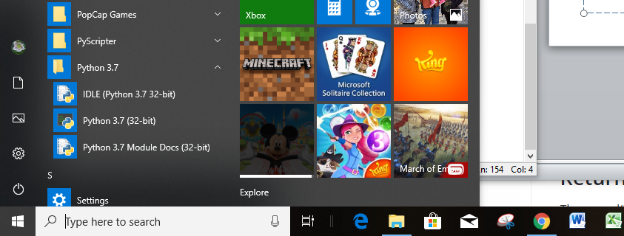
interactive pythyon
Python is an interactive interpreted language
This means that you can type anything at the prompt, and Python will do it
There is no better way to learn about a programming language
Select IDLE

Slide 10
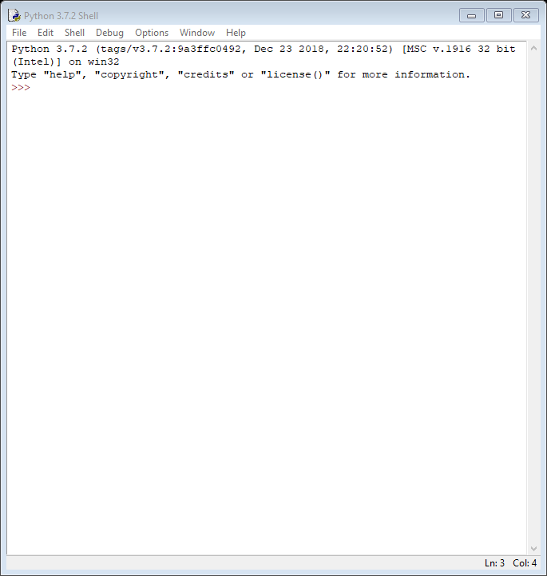
idle
IDLE is included in almost every Python installation
It contains a shell and editor windows
While it is not the best development system available, it will work for our purposes and is a good introduction to coding.

Slide 11
objects and VARIABLES
Everything in Python is an object
Objects can labels called variables
In Python variables must start with a letter or an underscore (_)
Case IS important

Slide 12
variables and objects
The variable acts as a label for the object
variable
object

Slide 13
DEFINING OUR VARIABLES
The initial price is initial
The sale percentage is sale
The discounted price is discount
The coupon percentage is coupon
The final price is final
The total percentage savings is total

Slide 14
assigning variables to objects (BINDING)
variable = object expression
Variable name is on the left followed by a space
Even though it looks like an equation, IT IS NOT
The equals sign (=) can be thought of <-
Object is on the right preceded by a space
(The spaces are optional, but show good style)
The expression can be simple, very complex, or anything in between
You do not have to "declare" the variable before using it
The type of the variable is defined by the object expression

Slide 15
Our Variables
inital
sale
input
input
discount
coupon
final
total
calculated
input
calculated
calculated

Slide 16
Python NUMBERS
integers - no decimal point, no limit, precise
ex. 1, -23, 2147483647, -2147483648
float - decimal point and optional power of ten, not precise
ex. 1.23, -234.34, 6.02E24, 3.0e10
others
Not important now

Slide 17
Python Sequences - for data referenced by index
Strings
An immutable (constant) sequence of alphanumeric characters
Ex. 'Mike'
Lists
A mutable sequence of objects
Ex. [‘a’, 1, 3.14]
Tuples
An immutable sequence of objects
Ex. ('one', 'small', 'step')
M
i
k
e
a
1
3.14
one
small
step

Slide 18
Index operator [] - for selecting a single object
Count from 0
If index is negative, count from back
Index too large is an error
>>> seq = 'abcdefg'
>>> seq[0]
'a'
>>> seq[1]
'b'
>>> seq[-1]
'g'
>>> seq[-2]
'f'
>>> seq[10]
Traceback (most recent call last):
File "<pyshell#9>", line 1, in <module>
seq[10]
IndexError: string index out of range
>>>

Slide 19
Mapped Type - Dictionaries
Dictionaries – data referenced by keys
{key1:object1, key2:object2, …}
Keys must be immutable (usually a string)
>>> ages = {'Jimmy':34, 'Billy':32, 'Sue':36}
>>> ages['Jimmy']
34
>>> ages['Billy']
32
>>> ages['Sue']
36
>>>
ages
Jimmy
34
Billy
32
Sue
36

Slide 20
differences between sequences and mapped
Sequences are referenced by an index number, the order is fixed
Mapped are referenced by a key, the actual order is undefined
The programmer does not need to worry about the order

Slide 21
computer math
Since we are working in floating point numbers, make all constants floating point as well
Multiplication is an * in all computer languages, because X or x is a common variable name
Division is a slash in all computer languages because ÷ is not a standard character
We must convert percentages to decimal fractions and vice versa by dividing/multiplying by 100
We must round to the nearest cents for prices and tenth for total percentage discount

Slide 22
functions
Functions take objects and either change them or create new objects
They can be thought of like "black boxes"
Python includes many functions built-in and other functions can be added by importing libraries
object
function
object

Slide 23
calling functions
var = function(object1, object2)
Function name is followed by a parenthesis with no space
Objects that are used are separated by commas and spaces, called arguments or parameters
The function "returns" an object
The new object is frequently assigned to a variable
If the variable is already assigned, the old object is destroyed and replaced with the new object.
The space is automatically reclaimed (garbage collected)

Slide 24
round function
We need a function that rounds numbers
Round is built-in, no need to import
It works a little differently than what we were taught by rounding to the nearest even number
This is what some mathematicians prefer

Slide 25
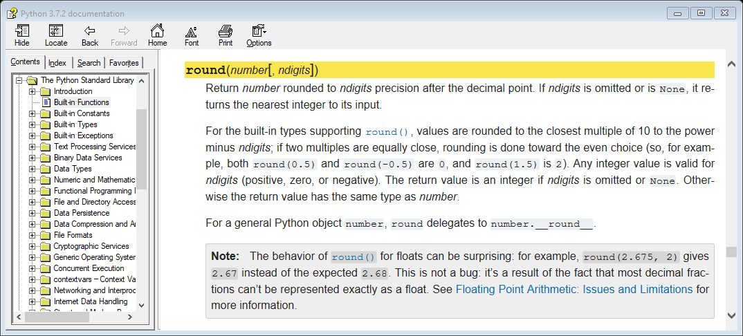

documentation on round

Slide 26
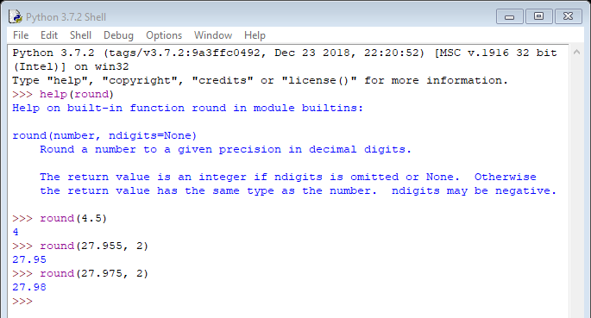
INTERACTIVE HELP and testing round

Slide 27
discount math to python code
$39.95 x (1 – 30/100) = $27.97 - Sale price
$27.97 x (1 – 15/100) = $23.77 - Final price
($39.95 - $23.77)/$39.95 = 40.5% - Total savings (not 45%!)
initial = 39.95 # (comment) starting price
sale = 30.0 # sale percentage
coupon = 15.0 # coupon percentage
discount = round((initial*(1.0–sale/100.0)), 2) # sale price
final = round((discount*(1.0–coupon/100.0)), 2) # final price
total = round(((initial-final)/initial)*100.0), 1)
# total percentage discount (sale & coupon)

Slide 28
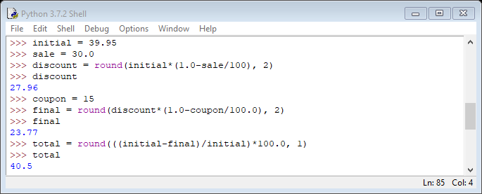
interactive python

Slide 29
creating our own function
In order for our program to be useful, we must create our own function
In Python you this syntax:
def function(object1, object2):
# code goes here
# indented 4 spaces
return object
# is a comment line, Python ignores it
parameters

Slide 30
our function
def doubleDiscount(initial, sale, coupon):
# calculates a double discount
discount = round((initial*(1.0–sale/100.0)), 2)
final = round((discount*(1.0–coupon/100.0)), 2)
total = round((1–(1.0–sale/100.0)*(1.0–coupon/100.0))*100, 1)
return (final, total)
Since our function has to return two objects, we can bundle them into a tuple
A tuple is an object which contains other object

Slide 31
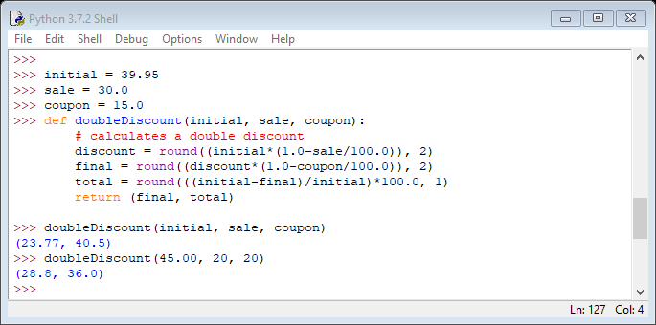
coding and testing our function

Slide 32
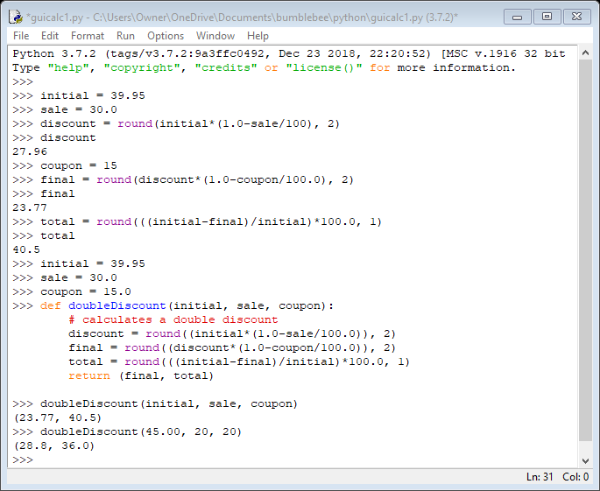
writing code in an editor
Notice, the function will disappear when we exit Python
We need to place the function into a file
There is an easy way to move code from the shell into an edit window
File/Save As

Slide 33
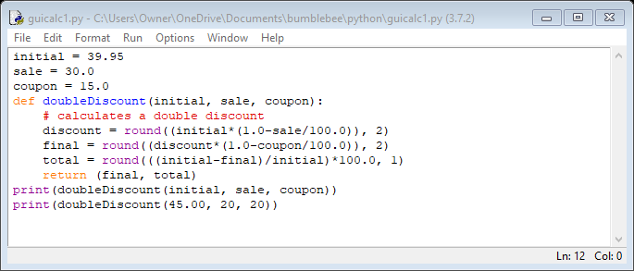
cleaning up code
Just keep the code you need
Format/Dedent or Indent region can be very useful
In order to see our output in the shell window we need to add the print function
The print lines and the initialization code will be removed in the final application

Slide 34
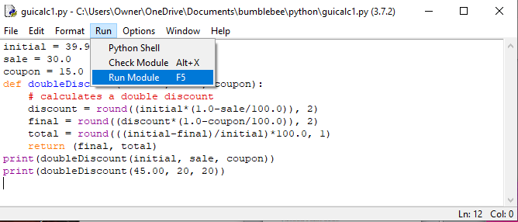
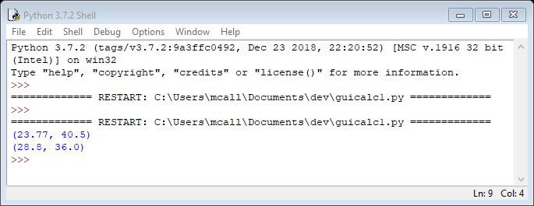
testing code

Slide 35
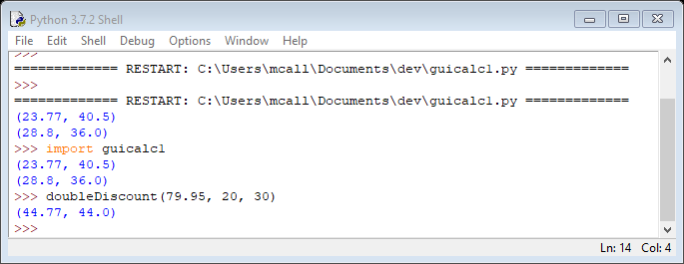
interactive testing
Running the module lets you test the code with your imbedded tests
Importing the module adds the function to Python which allows you to run other tests

Slide 36
Graphical user interface (GUI)
Our function works but users expect modern GUIs, not command line applications
Writing GUIs can be complicated but a library exists that makes simple GUIs easy
It is called Tkintertoy since it is based on a standard library in Python called Tkinter
Tk (toolkit) or Ttk was the first easier to use library for making GUIs based on TCL (tool control language)
TCL is hardly used anymore but many languages have interfaces to Tk which keeps TCL alive.
TCL and Tk are included in the Windows and Mac versions of Python. TCL and Tk are already included in Linux
Tkinter is the Python interface to Tk and Ttk
While all this sounds complicated, Tkintertoy hides the complexity
Tkintertoy is free and available on PyPI, the Python respository
pip install tkintertoy

Slide 37
library structure
Tkintertoy
Tkinter
Tk and Ttk
TCL
Operating System

Slide 38
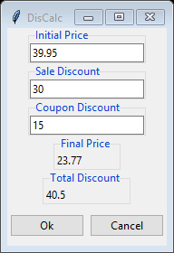
GUI BASICs
Title
Window
Entry Widget
Label Widget
Button Widget

Slide 39
GUI Definitions
Window – The window that contains the application. All widgets are inside the window.
Title – The title of the window. This lets the user know which application they have started.
Widget – An object that holds some part of the interface. Widgets have specific purposes and limit the user into making the correct input.
Entry – The user types in a value into a box. All entries are strings, even numeric values
Label – The application places a string into a box. The user cannot access this box.
Button – The user clicks on these to make something happen. Buttons are connected to functions or methods.

Slide 40
tkintertoy GUI CREATION basics
All GUI creation code is contained in a separate function or class. This way the design of the GUI is independent to the function that is doing action
A window is created which will contain all the widgets, usually labeled gui
The window is usually given a title
The desired widgets are created
The widgets are placed in the window at the desired location
The function returns the gui variable which will be used by other functions

Slide 41
methods
Some objects have methods
Unlike functions, methods are attached (bound) to their object with a period
>>> name = 'Mike'
>>> name.upper()
'MIKE'
>>> name.index('i')
1
>>>

Slide 42

creating a Tkintertoy widget
Call the addWidget method of the gui with a tag and a label
The tag will be key for the widget in the gui.contents dictionary, all widgets must have a tag
The label will be the text on the widget frame that the user will see, not all widgets have frames or labels
gui.addEntry('initial', 'Initial Price')
From now on we can get the contents of the widget by using
value = gui.get('initial')
and place contents in the widget by using
gui.set('initial', value)

Slide 43
plotting widgets
Creating a widget does not make it appear, you must plot it
Plotting requires a row and column, which default to zero
There are many other optional parameters which we will discuss later
gui.plot('commands', row=5)
This will place the button widget in the 6th row (we start at 0)

Slide 44
optional keyword parameters
The only required parameter for plot() is the widget tag
However, there are many optional parameters
If the programmer had to supply all the optional parameters or remember the order of the parameters, the task would be immense and the code would be ugly
Python makes this easy by using keyword parameters
After the required tag parameter is listed, the programmer only needs the supply the optional parameters they need by using the keywords
The order of the keyword parameters is not important
gui.plot('commands', row=5, pady=10)

Slide 45
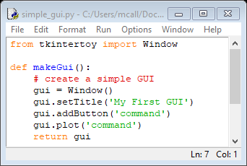
Our First GUI
Lets try out Tkintertoy by creating a window with one widget, a command button row
Import Window from tkintertoy (this is usually the first line in all tkintertoy applications
Create a function that creates the GUI
Create a Window
Title the Window
Add a Button widget row
Plot it
tag must match

Slide 46
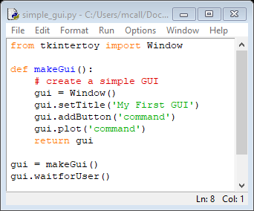

Running the GUI
We must call the function that creates the GUI
After the GUI is created, the application runs waitforUser, which loops until the user clicks on a command button
This is called an event loop
In this case, there are no further instructions so the application will exit

Slide 47
Event-driven programming
gui.waitforUser()
Unlike procedure-driven programming, there is no way the programmer will know what the user is going to do when using a GUI
The application will have to respond to whatever the user does whenever he does something
These are called events
For example
If the user moves the mouse, the mouse pointer on the screen must move
If the user clicks on a entry widget, then the input cursor will blink in that widget
If the user press a key, then the value of that key will appear in the widget
There is an amazing number of possible events that the application must keep tract of
Fortunately, Tkintertoy includes an event processing loop that takes care of most of these events

Slide 48
GUI DESIGN
Now lets design the GUI for the Discount Calculator
In addition to the previous window, we need:
Three Entry widgets
Initial Price
Sale Discount
Coupon Discount
Two Label widgets
Final Price
Total Discount
One Button row widget
Entry
Entry
Entry
Label
Label
Buttons

Slide 49

The gui grid
There is only one column so we don't need the column parameter (everything will default to column 0)
Row 0
Row 1
Row 2
Row 3
Row 4
Row 5

Slide 50
gui creation code
Create the window
def makeGui():
# create the GUI
gui = Window()
gui.setTitle('Discount Calc')
gui.addEntry('initial', 'Initial Price')
gui.addEntry('sale', 'Sale Discount')
gui.addEntry('coupon', 'Coupon Discount')
gui.addLabel('final', 'Final Price')
gui.addLabel('total', 'Total Discount')
gui.addButton('commands')
gui.plot('initial', row=0)
gui.plot('sale', row=1)
gui.plot('coupon', row=2)
gui.plot('final', row=3,)
gui.plot('total', row=4,)
gui.plot('commands', row=5, pady=10)
return gui
Set the title
Add the initial entry widget
Add the sale entry widget
Add the coupon entry widget
Add the final label widget
Add the total label widget
Add the button widgets, defaults to Ok and Cancel
Plot the widgets in the window
Return the GUI object

Slide 51
button commands
Once the GUI is created, the application loops until the user clicks on a command button
If the user clicks on Ok, we want to get the contents of the initial, sale, and coupon entry widgets, call doubleDiscount, and place the results in the final and total widgets
If the user clicks on Cancel, the application closes

Slide 52
Python Decisions
if condition:
block
elif condition:
block
else:
block
Python marks blocks of code with indents (no more {})
Standard indenting is 4 spaces, DON'T USE TABS!
Don’t forget the colons
if action == 1:
do_something()
else:
do_something_else()

Slide 53
Python Loops - Conditional
while condition:
block
else:
block
Exit loops using break
Continue loops using continue
else part runs if loop ends normally, ie. no break
while True:
do_something()
if condition:
break

Slide 54
Boolean
A variable that can be True or False
True = 1
False = 0
All objects with the value of zero, or empty are logically interpreted as False
0, [], (), {} are all False
None is a special value which is also False
Everything else is True
This is an extremely useful feature that can lead to easy to read code!

Slide 55
Packing and Unpacking Tuples
>>> verb, prep, value = 'count', 'to', 3
>>> verb
'count'
>>> prep
'to'
>>> value
3
>>> a = 1
>>> b = 2
>>> a, b = b, a
>>> a
2
>>> b
1
>>>
Tuples can be used to quickly fill variables
Tuples can also be used to swap variables
sometimes you can drop the ()

Slide 56
COMMand BUTTONs
gui.waitforUser()
if gui.contents:
…
else:
break
The event processing loop will run until one of two things happen
The user clicks on the Ok button
The user clicks on the Cancel button (or clicks on the close window widget)
If the user clicked on the Ok button, gui.contents will contain all the widgets in the window
If the user clicked on the cancel button, gui.contents will be empty

Slide 57
The code behind OK and cancel
def breakout(self): # for Ok
""" Exit the mainloop but don't destroy the master.
This stops the event loop, but window remains displayed.
"""
self.master.quit() # break out of mainloop
def cancel(self): # for Cancel
""" Clear contents and exit mainloop.
This stops the event loop, removes the window, and deletes the widget
structure.
"""
self.content = None # clear content
self.master.destroy() # close the window

Slide 58
GUI.contents
{'initial': {'type': 'entry',
'value': <tkinter.StringVar object at 0x034F3E50>,
'frame': <tkinter.ttk.Labelframe object .!labelframe>,
'widget': <tkinter.ttk.Entry object .!labelframe.!entry>},
'sale': {'type': 'entry',
'value': <tkinter.StringVar object at 0x0350E430>,
'frame': <tkinter.ttk.Labelframe object .!labelframe2>,
'widget': <tkinter.ttk.Entry object .!labelframe2.!entry>},
'coupon': {'type': 'entry',
'value': <tkinter.StringVar object at 0x035309D0>,
'frame': <tkinter.ttk.Labelframe object .!labelframe3>,
'widget': <tkinter.ttk.Entry object .!labelframe3.!entry>},
'final': {'type': 'label',
'frame': <tkinter.ttk.Labelframe object .!labelframe4>,
'widget': <tkinter.ttk.Label object .!labelframe4.!label>},
'total': {'type': 'label',
'frame': <tkinter.ttk.Labelframe object .!labelframe5>,
'widget': <tkinter.ttk.Label object .!labelframe5.!label>},
'commands': {'type': 'buttons',
'frame': <tkinter.ttk.Frame object .!frame>,
'widget': [<tkinter.ttk.Button object .!frame.!button>, <tkinter.ttk.Button object .!frame.!button2>]}}
Don't worry about what all these means, just note that each widget is a dictionary with a type, frame, and widget key, entries also have a value key. You can also see how tkintertoy is built upon tkinter which is built upon ttk

Slide 59
WORKING with widgets
initial = float(gui.get('initial'))
…
To get the contents of a widget, use the get() method using the widget tag
Get() always return a string
We must convert the string into a float in order to use it
gui.put('final', str(final))
…
To change the contents of a widget, use the put() method using the widget tag
Put() always needs a string
We must convert the float into string in order to use it
initial
final

Slide 60
main function
It is common practice to place all the code that actually executes the steps for an application into a function called main()
Create the GUI
Start the application loop
Start the event loop
If the user clicked on OK
Gather the contents from the widgets
Calculate the final price and total discount and update the widgets
Repeat the loop
Else
Exit the application

Slide 61
The main function
def main():
# run the script
gui = makeGui() # create the GUI
while True: # loop until the user clicks on Cancel
gui.waitforUser() # start the event loop
if gui.content: # user clicked on Ok
initial = float(gui.get('initial')) # get contents and convert to float
sale = float(gui.get('sale'))
coupon = float(gui.get('coupon'))
final, total = doubleDiscount(initial, sale, coupon) # calc discount
gui.set('final', str(final)) # convert to string and set contents
gui.set('total', str(total))
else: # user clicked on Cancel
break # exit application

Slide 62
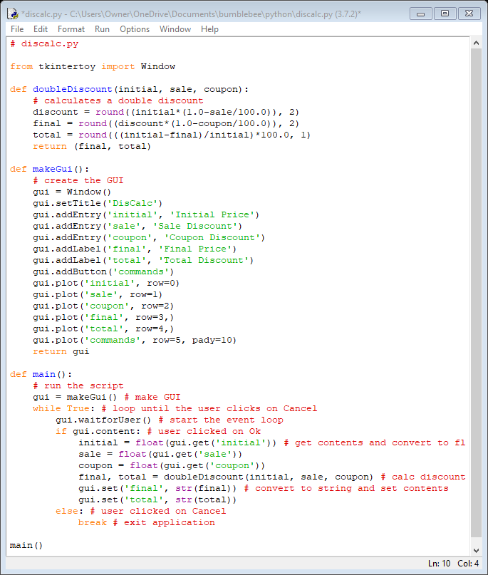
DISCALC

Slide 63
A Better GUI?
This GUI works but it is not as balanced as it should be
Label widgets are not the same size
Tkintertoy plot() options allow for a 2-dimensional design
Lets look at a better GUI

Slide 64
GUI DESIGN #2
Place all Entry widgets on the right side
Place all Label widgets on the left side
Draw a line between the groups
Place the button widgets in the middle of the groups at the bottom
Entry
Label
Entry
Label
Entry
Buttons

Slide 65
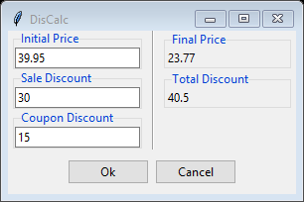
DISCALC v2
Notice, this is better balanced
A line separates the input from the output
The window title is viewable

Slide 66
addlabel WIDTH parameter
addLabel() sizes the widget to hold the frame title
You can force a larger frame by using the width parameter
Width is based on characters
addEntry() width defaults to 20
To make labels the same width as entries just set width to 20
gui.addLabel('final', 'Final Price', width=20)

Slide 67
more plot() optional labeled parameters
row – The row number counting from 0, defaults to 0
column – The column number counting from 0, defaults to 0
rowspan – The number of rows to stretch across, defaults to 1
columnspan – The number of columns to stretch across, defaults to 1
padx – Number of pixel spaces in the horizontal around the widget frame
pady – Number of pixel spaces in the vertical around the widget frame
sticky – The directions to stretch across to fill a space, defaults to 'c' for center
There are even more

Slide 68
NEW GUI grid
Column 0
Column 1
Column 2
Row 0
Row 1
Row 2
Row 3

Slide 69
New makegui
def makeGui():
# create the GUI
gui = Window()
gui.setTitle('DisCalc')
gui.addEntry('initial', 'Initial Price')
gui.addEntry('sale', 'Sale Discount')
gui.addEntry('coupon', 'Coupon Discount')
gui.addLine('sep', orient='vertical')
gui.addLabel('final', 'Final Price', width=20)
gui.addLabel('total', 'Total Discount', width=20)
gui.addButton('commands')
gui.plot('initial', row=0, column=0, padx=5)
gui.plot('sale', row=1, column=0, padx=5)
gui.plot('coupon', row=2, column=0, padx=5)
gui.plot('sep', row=0, column=1, rowspan=3, sticky='ns', padx=5)
gui.plot('final', row=0, column=2, padx=5)
gui.plot('total', row=1, column=2, padx=5)
gui.plot('commands', row=5, columnspan=3, pady=10)
return gui

Slide 70
plot parameters for line
row and column: where the line begins
rowspan: how many rows the line has the stretch
sticky: the line stretch from top ('n') to bottom ('s')
padx: 5 pixel space around the line
Lines don't have a frame or label, but do have a tag
gui.plot('sep', row=0, column=1, rowspan=3, sticky='ns', padx=5)
short for separator

Slide 71
final comments
Notice, in order to change the GUI, we only needed to change makeGUI(), and in there mainly the plot method calls.
All other code remains the same
This allows us to play with design without worrying about function
This is called "modular coding".
Each function is independent of other functions except the input and output that they share
This should be limited to the very least amount of information as possible
An even better way is using object-oriented coding but that is beyond the scope of this session
We also need to trap errors better

Slide 72
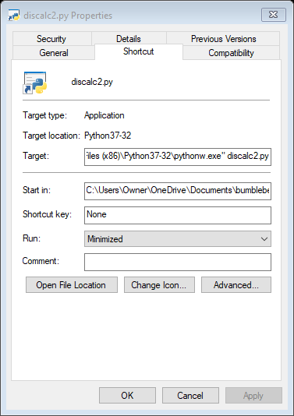

Final step
In order to make this application easy to reach, we need to make a shortcut
Here is how Windows works
pythonw location followed by discalc2.py
Location of discalc2.py

Slide 73
mission accomplished!
While it would be an stretch to say you are a Python programmer, you did write an truely useful GUI application in 2 hours.
This is just a start into an entire new world.
There are plenty of sources on-line to further your education.
Python includes a tutorial.
Many of them are free: python.org, code.org, www.khanacademy.org
There are also numerous books you can buy to guide you.
The next slide tutorial will be an application that calculates NFL passer ratings.
Good luck and "may the source (code) be with you"

Slide 74

thank you for your time

