Slide 2
Panel data methods can be used to data structures that do not involve time
Hierarchical data structures contain clusters of observations that share common characteristics
When these characteristics are unobservable and correlated with other explanatory variables, pooled OLS will give us estimates that are biased and inefficient
Panel methods can control for the unobserved heterogeneity between groups and give us a less biased and more efficient estimator

Slide 3
Consider a geographical dataset that observes variables at the MSOA (Middle Layer Super Output Area – a small geographical unit used for neighbourhood statistics) level
Each observation is part of a local authority and a region – if there is variation in characteristics between local authorities that is correlated with our other variables (an unobserved local authority effect), we will get biased and inefficient estimates with pooled OLS

Slide 4
We can control for any unobserved local authority effects using panel techniques
With a Fixed Effects model, we add local authority specific intercepts to the model
The unobserved variable α changes only between local authority (j), and accounts for the unobserved local authority effect, or local authority fixed effect
We can therefore interpret the coefficient β₁ as the effect of income within local authorities

Slide 5
 | Model 1 | Model 2
(Intercept) | 16142.067 (139.382)***
income_est | 11.681 (0.222)*** | 20.111 (0.237)***
factor(LA_NAME)Adur |  | 8565.306 (788.001)***
factor(LA_NAME)Allerdale |  | 14011.637 (644.481)***
... |  | ...
factor(LA_NAME)Wyre Forest |  | 11827.033 (600.448)***
factor(LA_NAME)York |  | 11895.069 (467.120)***
R2 | 0.280 | 0.992
Adj. R2 | 0.279 | 0.991
Num. obs. | 7133 | 7133
RMSE | 3119.431 | 2192.678
***p < 0.001, **p < 0.01, *p < 0.05

Slide 6
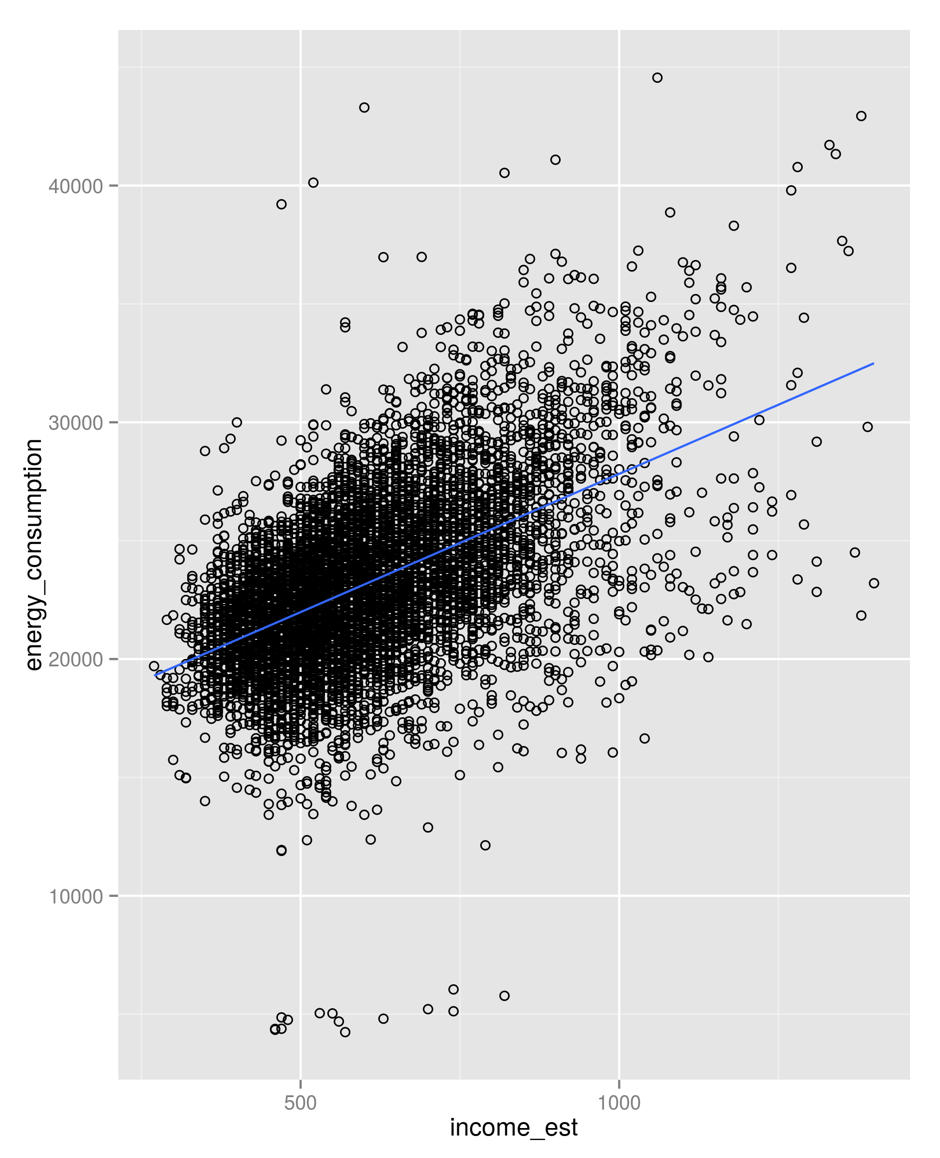
Pooled OLS

Slide 7
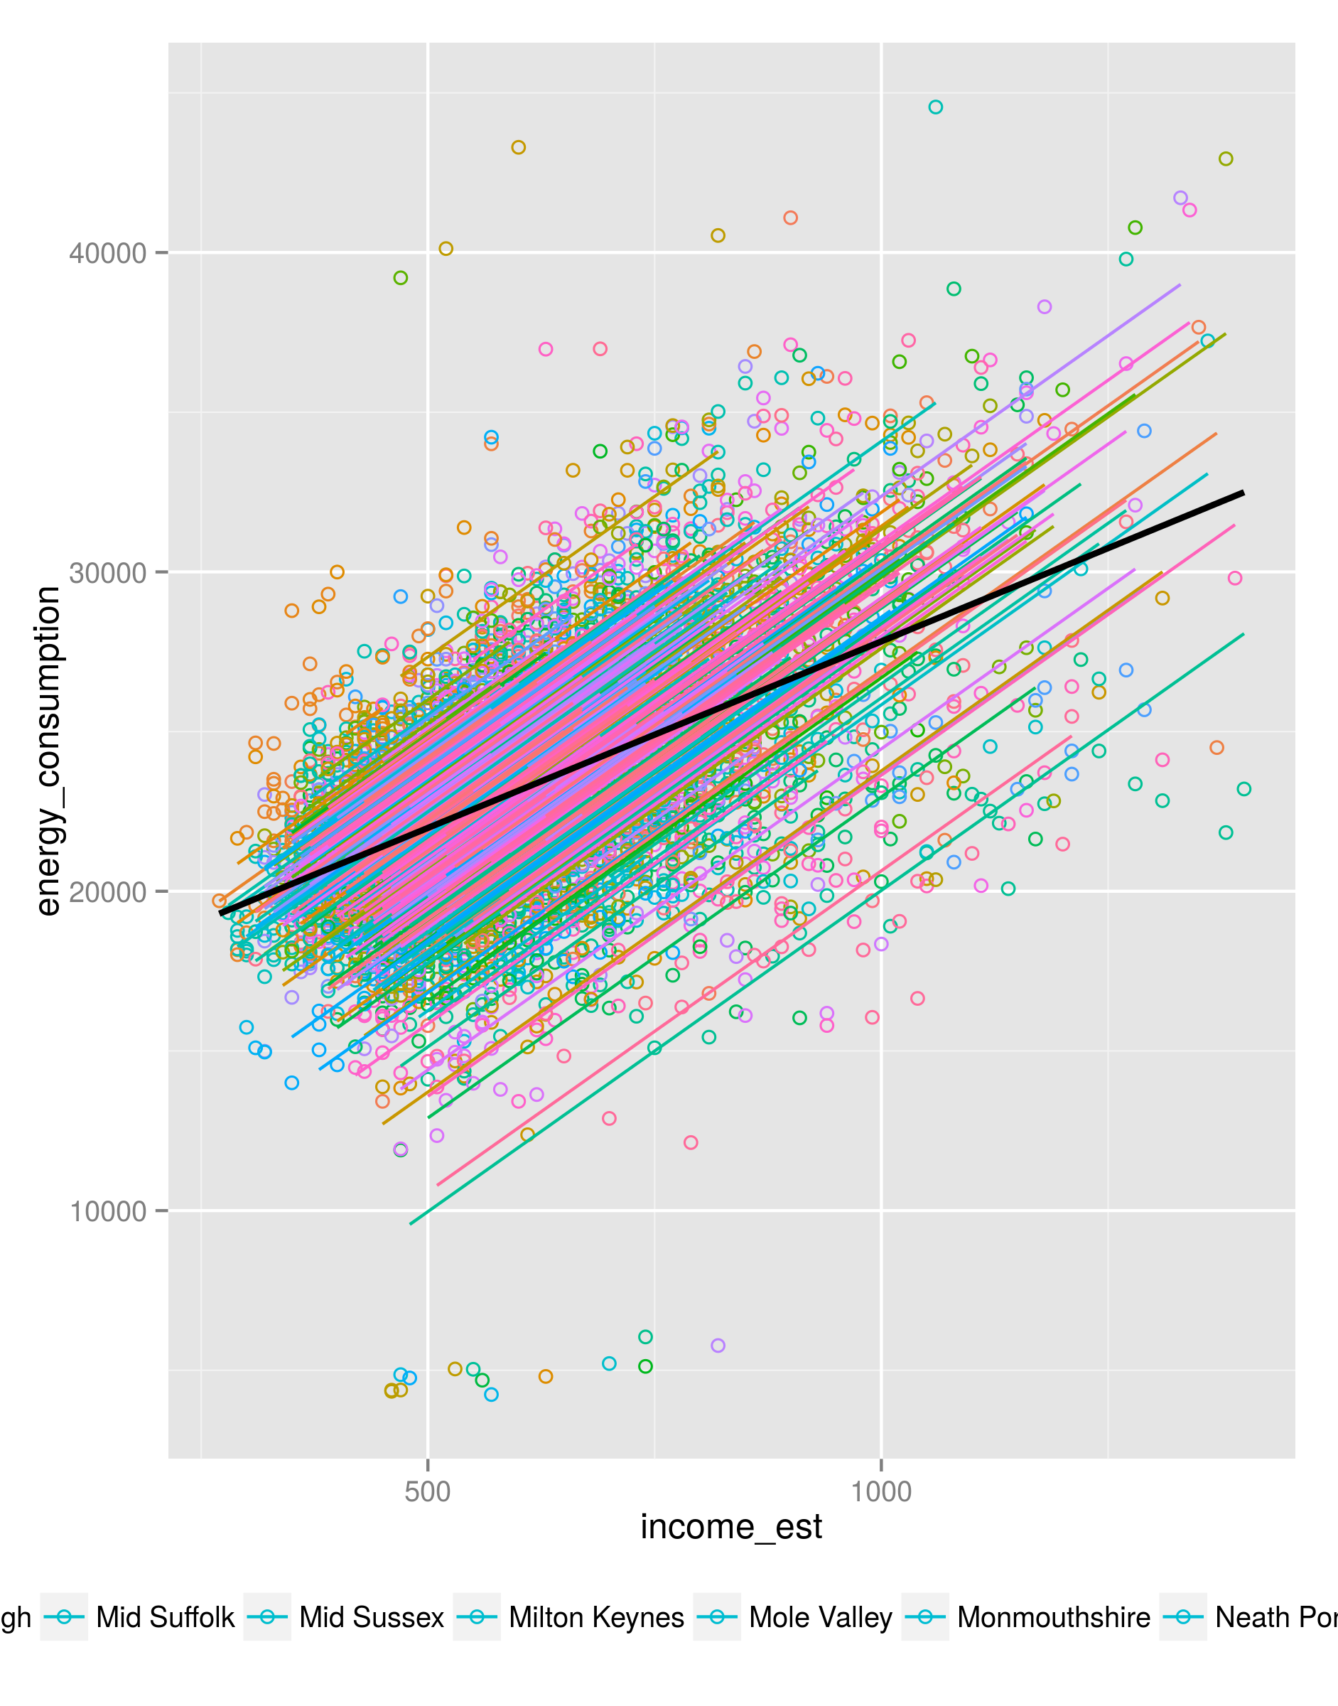
Fixed Effects

Slide 8
Questions
Did you use total energy consumption? Divided by number of meters?

