Slide 1
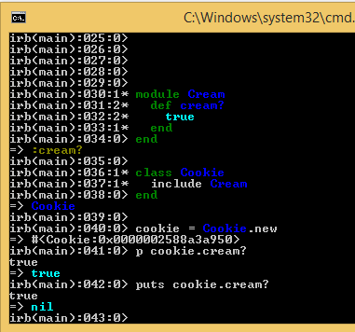
puts vs p

Slide 2
