Slide 1
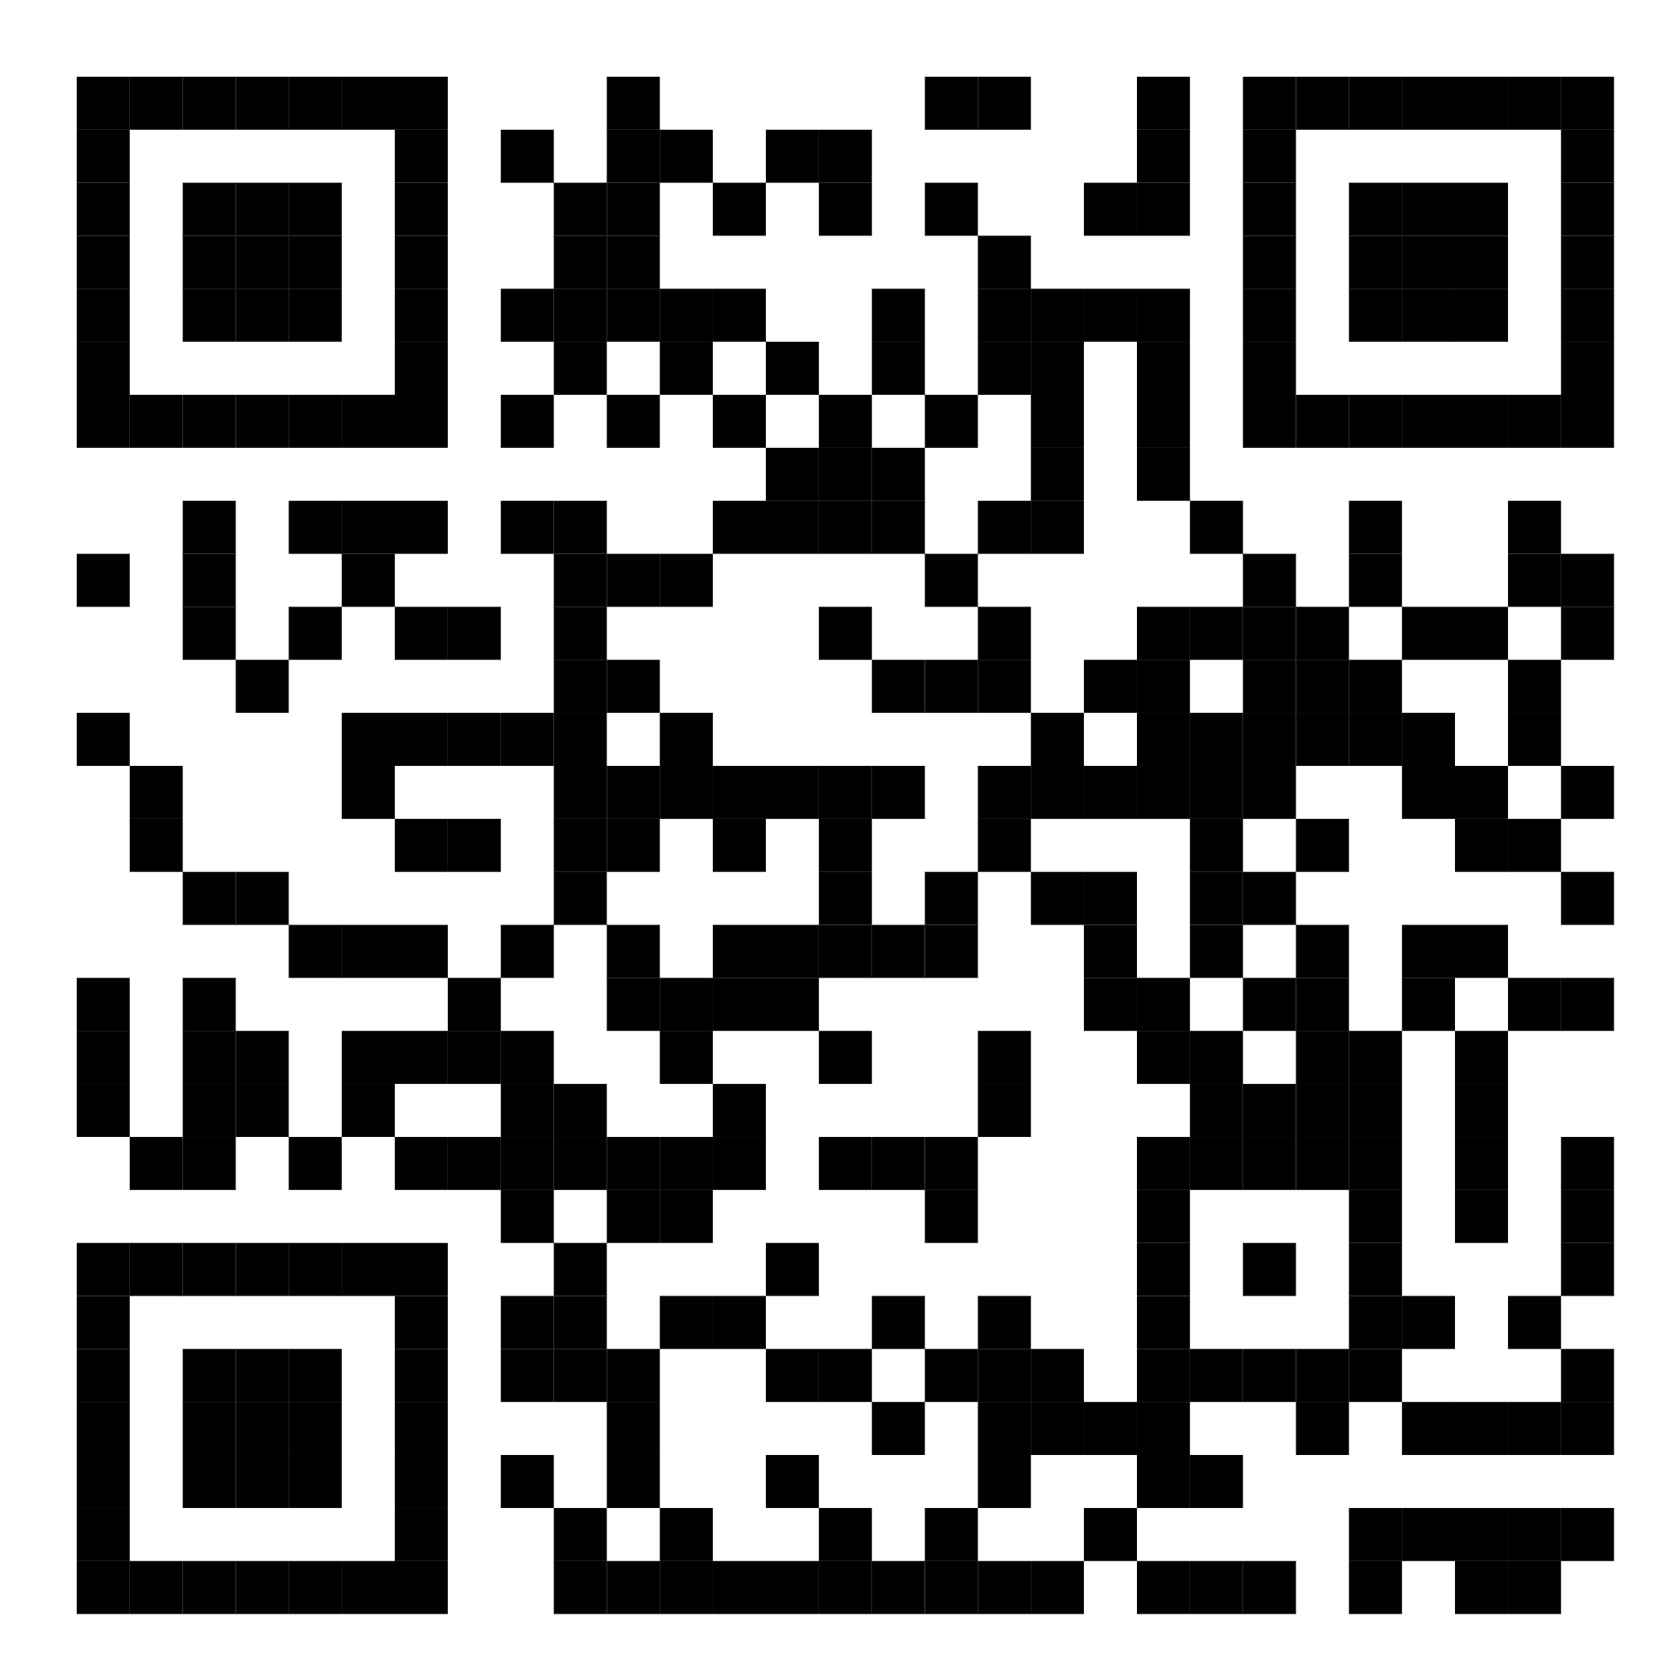
The 19th Hole
Dan Rescigno, Paul Jay Wiegand, Mickey Camarco, Drew Senour

Slide 2
Elevator PItch
Introducing The 19th Hole, the ultimate solution for all golf enthusiasts and liquor lovers! We are a one-of-a-kind company that helps you find the best golf courses and liquor stores in your area, based on your zip code.
Whether you're a seasoned golfer looking for your next challenge or a casual player who enjoys a relaxing round with friends, we have the perfect course for you. Before your game, we'll guide you to the nearest liquor store with an incredible selection of beverages to bring along for some fun!
Why waste time searching for the perfect golf course or where to get the booze for the day?!
Let The 19th Hole be your go-to source for all your recreational needs.
Notes:
Drew

Slide 3
Concept
Description
Find a golf course and liquor store by entering your zip code. Once you provide the parameter, you will be presented with the current weather for that location and the top 5 search results for golf courses and alcohol distributors.
Motivation for development?
As a golfer and drinker of alcohol distributors who frequently travels, I felt a need to quickly access courses and distributors while quickly jumping in an Uber.
User story
AS A Golfer
I WANT TO use an app that can provide me with the locations of nearby golf courses and the nearest beer distributors to said courses
SO THAT the user saves time and money
Notes:
Mickey

Slide 4
Process
Technologies used
Bulma Framework
Google Places API
VS Code
Visual Crossing API
Openweather API
GitHub
Breakdown of tasks and roles
CSS, Bulma Framework - Dan
HTML - Paul Jay
Google API & OpenWeather API - Mickey
JavaScript - Drew & Mickey
PM - Mickey
README, Repo - Dan
Challenges
APIs were not free
Google API does not provide general text searches and only provides limited options (ie. liquor_store)
Successes
Implementing Bulma Framework
Implementing Google API, Openweather API, and Visual Crossing API
Team Collaboration
Notes:
Dan

Slide 5
Demo
Notes:
Paul Jay

Slide 6
Directions for Future Development
The ability to select a radius (5, 10, 25 miles etc) around your zip code for the results.
Specify Beer Distributors or Bars instead of what the google API provides of “liquor_store”
Map with markers showing the locations instead of cards across the screen
Notes:
Mickey

Slide 7
Links
Deployed App
GitHub Repo

Slide 8
Thank you !
Notes:
Paul Jay

