Slide 1

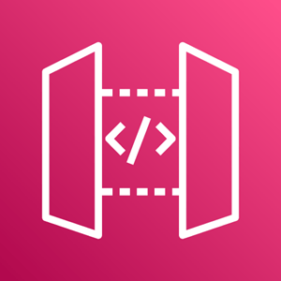












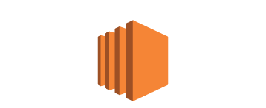
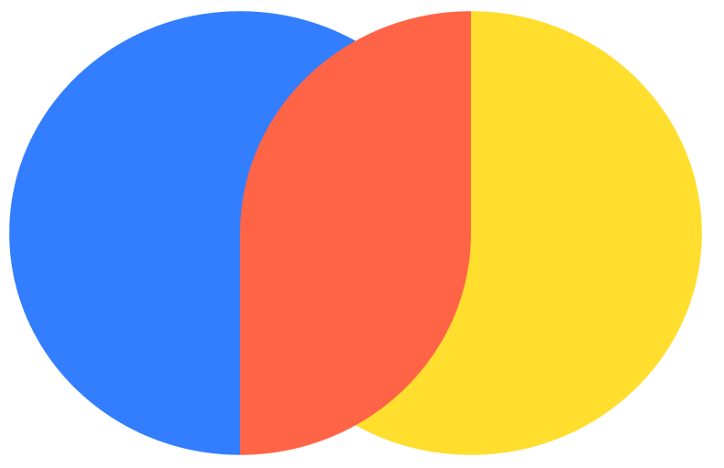

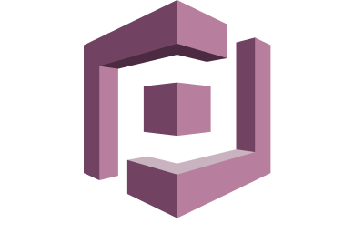

ALPACA-BOT ARCHITECTURE POC
User
RAG Lambda Function
SageMaker or Bedrock model
LangChain Embedding (or BedRock Embedding endpoint)
API
EC2 Instance with Frontend
Query
Vector DB Chroma (or AWS DB)
Documentation upgrade
AWS Cognito
SageMaker Ingestion
LangChain Embedding (or BedRock Embedding endpoint)
Doc Update Lambda Function
API
S3 Bucket

