Slide 1

Java Exception Handling

Slide 2
Topics:
1. Exception Hierarchy
2. Checked vs Unchecked
3. Custom Exceptions
4. Try-Catch-Finally
5. Resource Management
6. Multiple Exceptions

Slide 3
What is Exception
In Java, an exception is an event that disrupts the normal flow of a program while it is running.
→Java provides a way to handle exceptions,Prevent program crashes, Helps manage errors gracefully using:
try-catch
try-catch with multiple catches
try-catch-finally
throws keyword
throw keyword

Slide 4
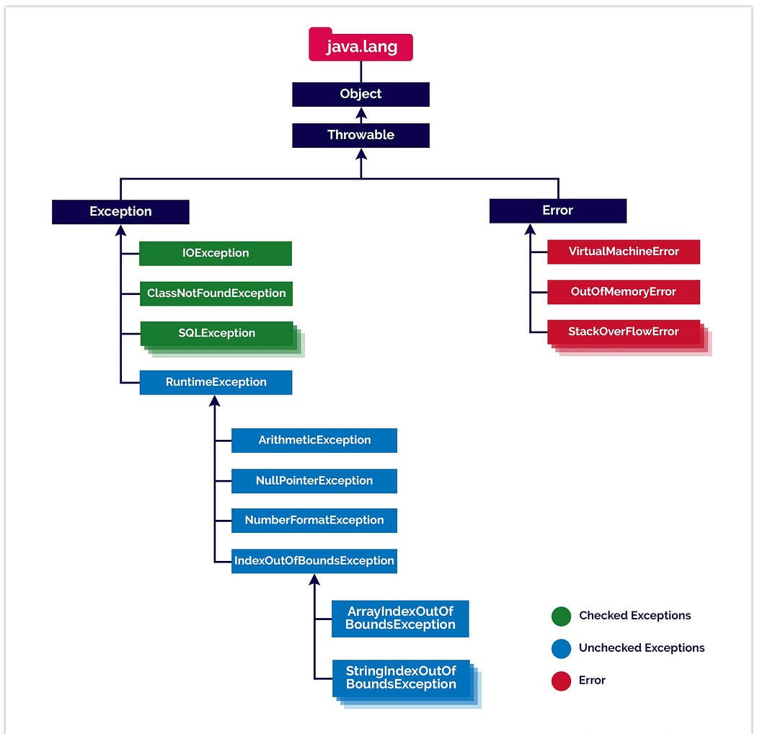

Slide 5
Checked vs Unchecked
Checked exceptions are exceptions that the compiler forces you to handle.
If a method can throw a checked exception, it must either:
Catch it using try-catch, or
Declare it using throws in the method signature.
Unchecked exceptions are exceptions that the compiler does not require you to handle.
They are subclasses of RuntimeException (and Error is also unchecked but usually represents fatal conditions).

Slide 6
Checked Exception Example
import java.io.*;
class Test {
public static void main(String[] args) {
try {
FileReader fr = new FileReader("file.txt");
} catch(IOException e) {
System.out.println(e.getMessage());
}
}
}

Slide 7
Unchecked Exception Example
class Test {
public static void main(String[] args) {
int a = 10/0; // ArithmeticException
}
}

Slide 8
When to Use Each
Checked: Checked exceptions represent recoverable conditions, meaning the caller can take an alternative action or gracefully degrade instead of crashing. catch handles the recovery, finally ensures resources like files, DB connections, or sockets are always released, preventing leaks.

Slide 9
UnChecked: Unchecked exceptions represent programming errors or logic bugs that are typically unrecoverable at runtime. You may catch them to log or take optional fallback actions, but they are generally meant to signal bugs.

Slide 10
Custom Exceptions
Create your own exception by extending Exception or RuntimeException
Extend Exception -> checked
Extend RuntimeException -> unchecked

Slide 11
Custom Checked Exception
class MyException extends Exception {
public MyException(String msg) {
super(msg);
}
}

Slide 12
Custom Unchecked Exception
class MyRuntimeException extends RuntimeException {
public MyRuntimeException(String msg) {
super(msg);
}
}

Slide 13
Best Practices (Custom)
Use meaningful names
Add constructors
Don't overuse custom exceptions
Hundreds of tiny exception classes make it hard to maintain.
Other developers may not know which exception to catch.
When an error is specific to your application or business logic.

Slide 14
Try-Catch-Finally
try: risky code
catch: handle exception
finally: always executes

Slide 15
Try-Catch-Finally Example
try {
int a = 10/0;
} catch(ArithmeticException e) {
System.out.println("Error");
} finally {
System.out.println("Cleanup");
}

Slide 16
Best Practices
Aspect | Checked Custom Exceptions | Unchecked Custom Exceptions
Base Class | Extends Exception (not RuntimeException) | Extends RuntimeException
Declaration | Must be declared with throws or caught | No need to declare or catch
When to Use | Recoverable conditions where caller can take corrective action | Programming errors or illegal usage where caller cannot reasonably recover
Typical Scenarios | External resources (DB, files, network), business operations that can fail | Invalid arguments, illegal state, logic errors, validation failures
Example 1 | PaymentFailedException, OrderPersistenceException | NegativeAmountException, InvalidOrderStateException
Example 2 | FileMissingException, ConfigurationNotFoundException | IllegalCustomerIdException, InvalidOperationException
Handling Expectation | Caller is expected to handle or propagate | Caller usually does not handle, often global logging or runtime failure
Recovery Possibility | High — program can continue gracefully | Low — indicates a bug or misuse
Stack Trace Use | Provides context for recoverable errors | Signals programmer or logic mistake
Best Practice | Wrap lower-level exceptions, provide meaningful messages | Use for domain logic errors or validation, avoid forcing unnecessary catching

Slide 17
Resource Management
Closeable vs AutoCloseable In Java, AutoCloseable and Closeable are interfaces used to manage resources (like files, streams, database connections) so they can be closed properly.
Try-With-Resources introduced in Java 7

Slide 18
Try-With-Resources Example
try (BufferedReader br = new BufferedReader(new FileReader("file.txt"))) {
System.out.println(br.readLine());
} catch(IOException e) {
e.printStackTrace();
}

Slide 19
Closeable vs AutoCloseable
Closeable: is a subinterface of AutoCloseable in java.io, mainly used for I/O streams.
close() throws IOException
AutoCloseable:AutoCloseable is an interface in Java (java.lang) that allows a resource to be closed automatically using try-with-resources.

Slide 20
Custom Resource
Custom Resource → You create a class that needs cleanup
ARM → Java automatically calls close() for that class
Implement AutoCloseable for automatic cleanup

Slide 21
Custom Resource Example
class MyResource implements AutoCloseable {
public void close() {
System.out.println("Closed");
}
}

Slide 22
Multiple Exceptions
Java 7 introduced multi-catch
A multi-catch exception allows you to handle multiple exception types in a single catch block.
Reduces code duplication
Cleaner and more readable

Slide 23
Multi-Catch Example
public class MultiCatchExample { public static void main(String[] args) { try { int[] arr = {1, 2, 3}; int result = arr[5] / 0; // causes exceptions } catch (ArithmeticException | ArrayIndexOutOfBoundsException e) { System.out.println("Exception occurred: " + e); }

Slide 24
What is Exception Propagation?
When an exception is not handled in a method, it is passed (propagated) to the calling method until it is caught.
→When it happens?
Propagation happens only when exception is not caught
It moves up the call stack
If no method handles it → program terminates

Slide 25
Important Methods of Throwable Class
Here are the most commonly used methods
Method | Purpose
printStackTrace() | Full error details
toString() | Exception + message
getMessage() | Only message
getCause() | Root cause
getStackTrace() | Stack trace array
fillInStackTrace() | Reset stack trace
getLocalizedMessage() | Localized message

Slide 26
Rules & Limitations
Exceptions must not be related
No duplicate exceptions
Use parent if needed

Slide 27
Conclusion
Use proper exception types
Write clean handling
Use try-with-resources

