Slide 1
Advanced Dependency Resolution

Slide 2
Advanced Dependency Resolution
Topics:
Combining @Primary and @Qualifier
Using @Resource and @Named
Injection of collections (List, Set, Map of beans)
Conditional bean loading

Slide 3
Combining @Primary and @Qualifier
In Spring Boot, the @Primary and @Qualifier annotations are used to resolve ambiguity when multiple beans of the same type are present in the application context.
If you use @Primary, it acts as the default unless you specify a bean with @Qualifier.
@Qualifier overrides @Primary and allows you to select a specific bean.

Slide 4
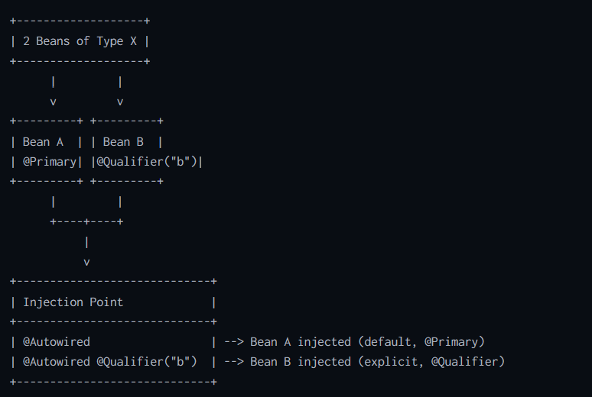
Bean Selection Flow FOR @Qualifier and @Primary:

Slide 5
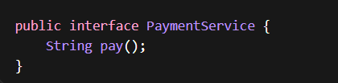
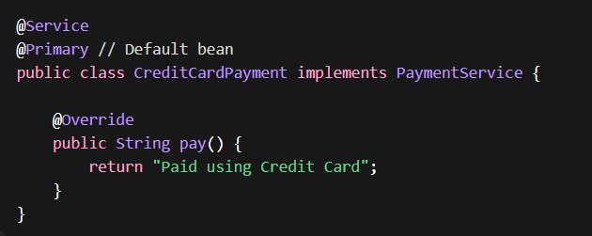
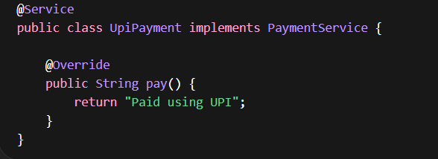
Using @Primary
The @Primary annotation marks one bean as the default choice when multiple candidates exist.

Slide 6
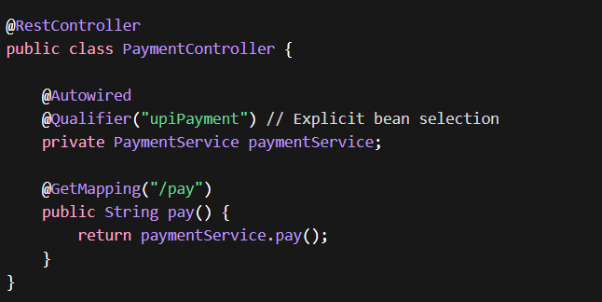
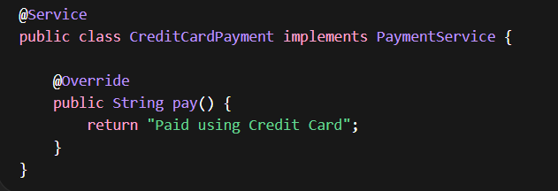
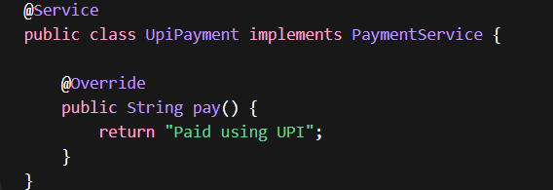
Using @Qualifier
The @Qualifier annotation allows you to specify exactly which bean to inject by its name.

Slide 7
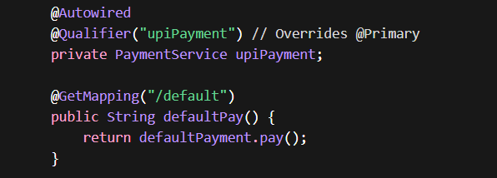
Combining @Primary and @Qualifier
You can use both together to provide a default option while allowing explicit overrides.

Slide 8
When to use what?
Scenario | What to Use | Why
One bean is used in most cases (default behavior) | @Primary | Avoids writing @Qualifier everywhere
You want a default fallback bean | @Primary | Spring automatically injects it when no qualifier is specified
You need different implementations in different places | @Qualifier | Gives precise control over which bean to inject
Multiple beans are equally important and frequently used | @Qualifier | Explicit selection improves clarity
You want to override default behavior in specific cases | @Qualifier | Overrides @Primary
Large project with many services | Both (@Primary + @Qualifier) | Use @Primary as default + @Qualifier where needed

Slide 9
Important interview questions
What happens if no @Primary and no @Qualifier?
Exception: NoUniqueBeanDefinitionException
What happens if @Qualifier name doesn’t match the Bean Name?
Exception: NoSuchBeanDefinitionException
Does @Qualifier name matching done by an implementing Class name?
No. It is done by a Bean Name. (Bean name will be upiPayment for UpiPayment class)
Can we use multiple @Primary?
No
Which has higher priority?
@Qualifier

Slide 10
@Resource annotation
@Resource is part of Jakarta EE (earlier Java EE).
It is used for dependency injection by NAME (default).
Injection Strategy:
First → by name
If name not found → fallback to by type
Add the following dependency.
<dependency>
<groupId>jakarta.annotation</groupId>
<artifactId>jakarta.annotation-api</artifactId>
</dependency>

Slide 11
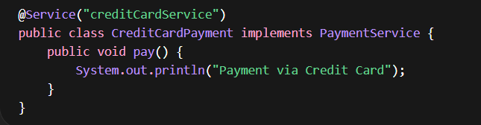
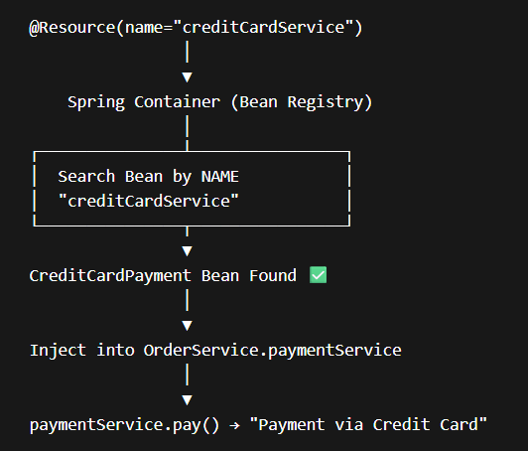
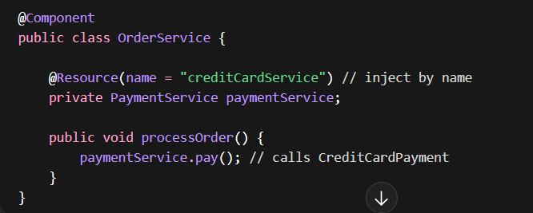
@Resource with name

Slide 12
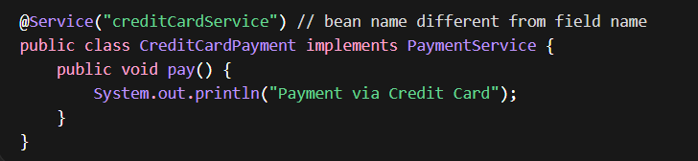
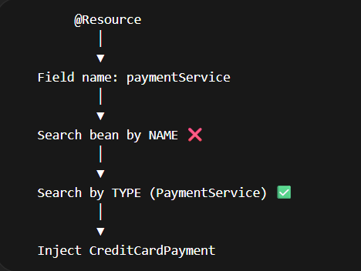
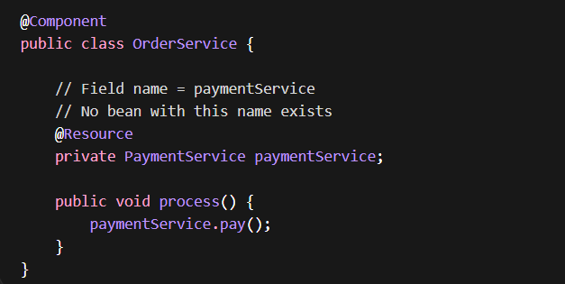
@Resource without name

Slide 13
Points to remember:
@Resource default = by name
If no name → uses field name
If not found → fallback to type
Multiple beans → exception
Always use name when multiple implementations exist

Slide 14
@Resource continued…
Benefits:
Works across:
-Spring
-Jakarta EE servers (like WildFly, GlassFish) like EJB applications, Legacy enterprise systems
No ambiguity when multiple beans exist
No need for separate qualifier annotation. Everything handled in one annotation
Simpler than Spring combo: @Autowired + @Qualifier
Limitations:
Less flexible than Spring
Weak support for advanced DI features

Slide 15
CDI annotations @Named and @Inject
Spring offers support for JSR-330 standard Dependency Injection annotations which are available in the jakarta.inject package. These annotations may optionally be used as alternatives to Spring annotations.
In Spring 3.0 the support for the CDI annotations @Named and @Inject are provided.
1) @Inject instead of Spring’s @Autowired to inject a bean.
2) @Named instead of Spring’s @Component to declare a bean.
Add the following dependency.
<dependency>
<groupId>jakarta.inject</groupId>
<artifactId>jakarta.inject-api</artifactId>
<version>2.0.0</version>
</dependency>

Slide 16
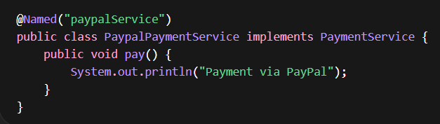
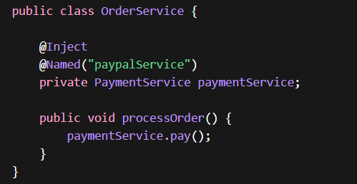
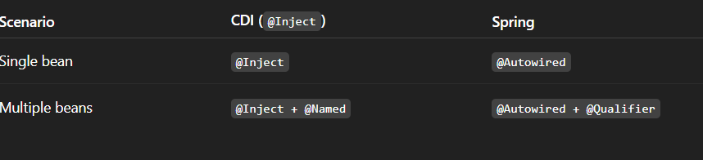
Implementation using @Named and @Inject

Slide 17
@NAMED continued…
Benefits:
Works in:
-Spring
-CDI containers
-Microservices frameworks
Industry standard for dependency injection
Cleaner Alternative to @Component and not tied to Spring
Standard DI pattern (used in enterprise apps)
No dependency on Spring annotations
Easier migration between frameworks
Limitation
Requires @Inject → two annotations needed
Slightly more verbose than @Resource

Slide 18
@Resource vs @Named vs Spring
Feature | @Resource | @Named | @Autowired
Standard | Yes | Yes | No
Default Injection | By Name | By Type (@Inject) | By Type
Needs Extra Annotation | No | Yes (@Inject) | Sometimes (@Qualifier)
Framework Dependency | None | None | Spring
Readability | High (explicit) | Medium | Medium
Flexibility | Medium | High | Very High

Slide 19
Injection of collections (List, Set, Map of beans)
Injection of collections in Spring is a very important concept when you have multiple beans of the same type and want to use them together.
Spring allows you to inject multiple beans into a collection like:
List<T>
Set<T>
Map<String, T>
Instead of injecting a single bean, Spring automatically collects all matching beans and injects them.
Use collection injection when you have multiple implementations of an interface and want to process all implementations dynamically with flexible/extensible design (no hardcoding).

Slide 20
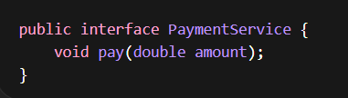
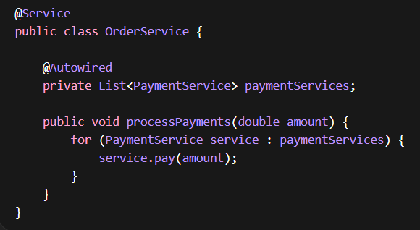
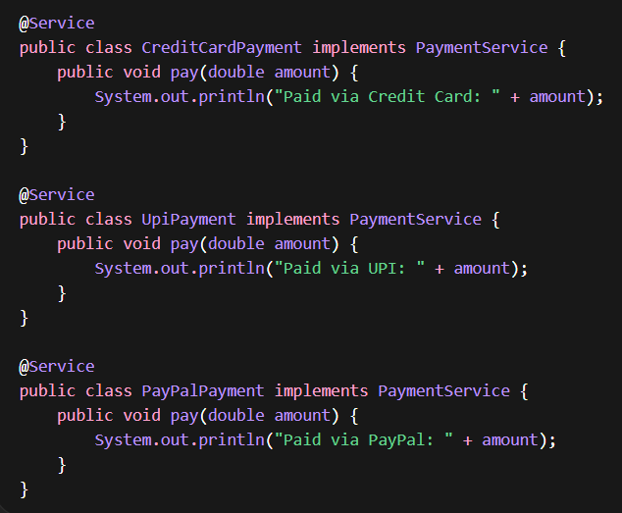
Injecting List of Beans
              How It Works?
Spring finds all beans of type PaymentService
Adds them to a List
Injects into OrderService

Slide 21
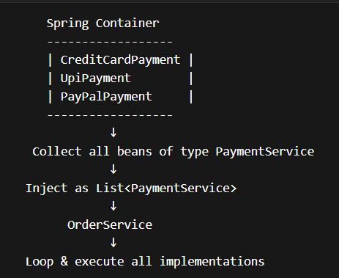
Flow Diagram (List Injection)

Slide 22

Injecting Set of Beans
Same as List, but no duplicates and no guaranteed order.
Use when:
Order doesn’t matter
Avoid duplicates

Slide 23
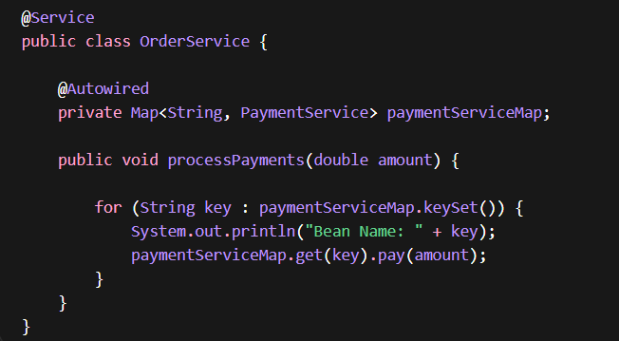
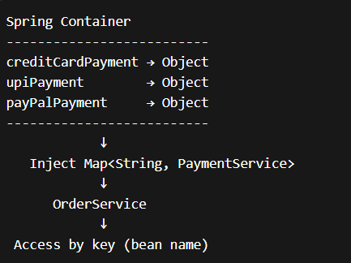
Injecting Map of Beans
How Map Injection Works?
-Key = Bean name
-Value = Bean instance
This pattern is used in:
-Payment gateway selection
-Notification systems
-Strategy pattern implementations
-Rule engines

Slide 24
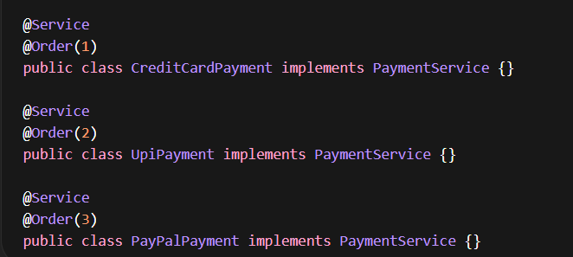
Controlling Order of List
Spring does NOT guarantee order unless you specify it.
By default, beans are added to the list in random order. Use @Order to control the sequence.

Slide 25
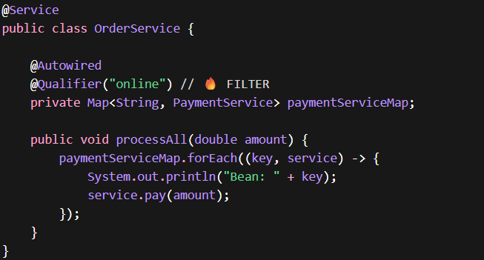
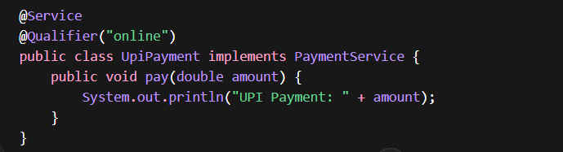
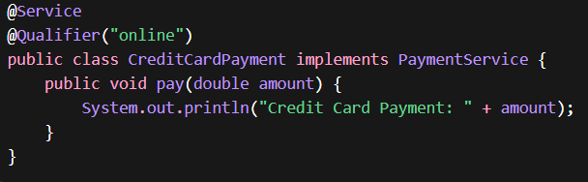
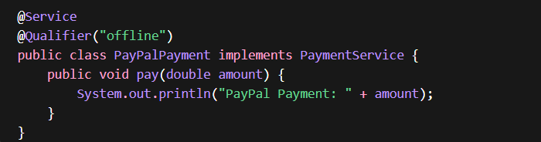
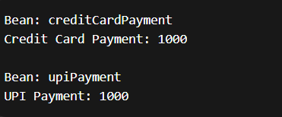
Using @Qualifier with Collections
We can filter beans with @Qualifier.

Slide 26
Conditional Bean Loading
Conditional bean loading allows you to create beans only when certain conditions are met.
This is crucial for:
-Environment-specific beans (dev, staging, prod)
-Feature toggles
-Loading beans only when certain libraries are present
-Configuration-based bean creation
Spring provides this via:
@Conditional
Spring Boot specialized annotations like:
@ConditionalOnProperty
@ConditionalOnClass
@ConditionalOnMissingBean
@ConditionalOnBean

Slide 27
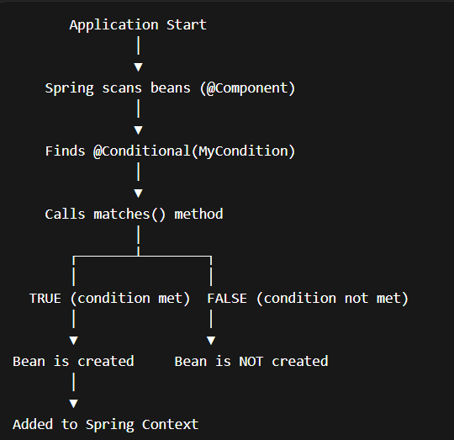
Flow Diagram

Slide 28

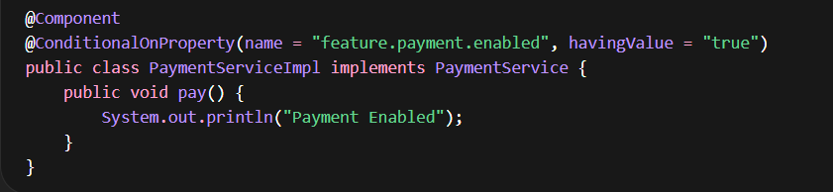
@ConditionalOnProperty
Loads bean if property is present or has a specific value in application.properties or application.yml.

Slide 29
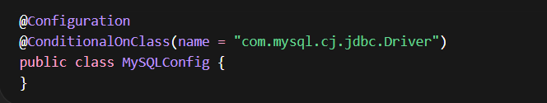
@ConditionalOnClass
Loads bean only if a class exists in classpath. It is used for auto-configuration.

Slide 30
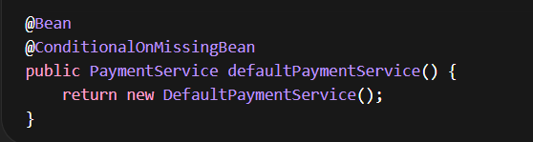
@ConditionalOnMissingBean
Creates bean only if no other bean exists.

Slide 31
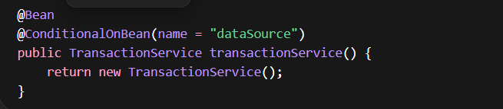
@ConditionalOnBean
Loads bean only if another bean exists.

Slide 32
@Conditional vs @Profile
Feature | @Conditional | @Profile
Flexibility | Very High | Limited
Logic | Custom logic | Env-based only
Use Case | Advanced control | Environment switching

