Slide 1
Java 21 LTS Features
Notes:
---

Slide 2
Java 21 LTS Context and Upgrade Motivation
Notes:
Why Java 21 LTS Matters for Modern Engineering Teams

Slide 3
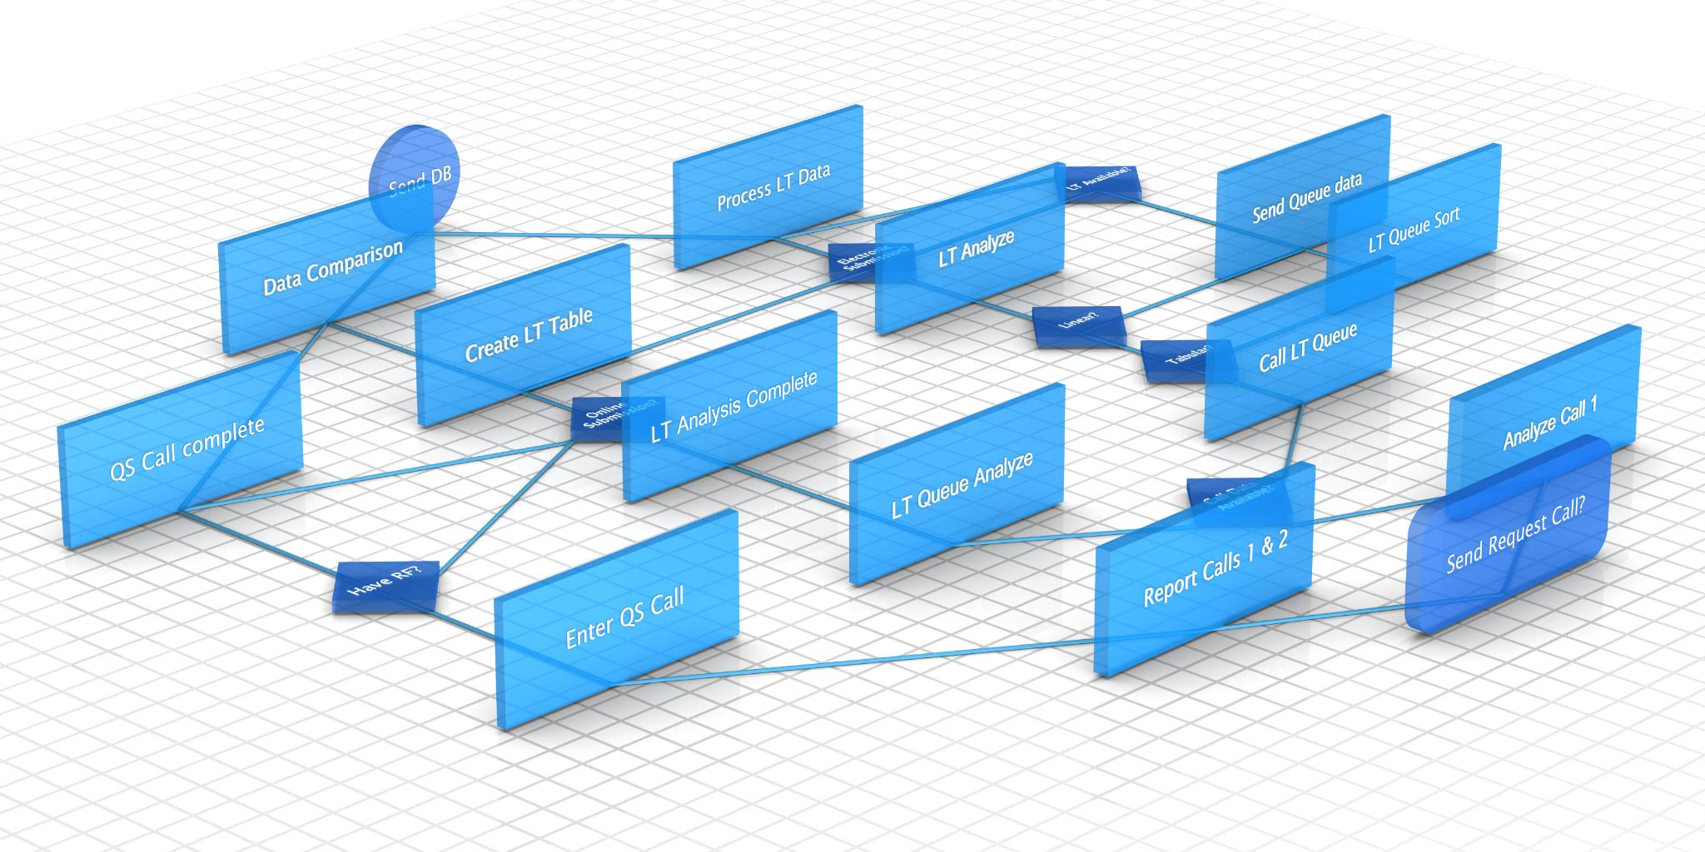
Why Java 21 LTS Matters for Modern Engineering Teams
Long-Term Support and Stability
  Java 21 LTS offers extended updates and security patches, ensuring stability for large-scale production systems.
Virtual Threads for Concurrency
  Virtual threads remove OS resource bottlenecks, enabling simpler code and massive concurrency in backend services.
Enhanced Developer Productivity
  Pattern matching and record patterns reduce boilerplate, making code safer and easier to understand.
Improved Runtime Performance
  Generational ZGC enhances garbage collection, reducing latency and operational tuning effort for large applications.
Notes:
Java 21, released in September 2023, is a Long-Term Support (LTS) release, making it a strategic upgrade target for enterprise and platform teams focused on stability, performance, and long-term maintainability. Unlike short-term feature releases, Java 21 will receive extended updates and security patches, which is especially important for organizations running large-scale production systems. This presentation intentionally focuses only on finalized, non-preview features to ensure everything discussed is production-ready and safe for adoption. One of the most significant motivations to move to Java 21 is the fundamental shift in how Java handles concurrency and scalability. With the introduction of virtual threads as a finalized feature, Java removes one of its long-standing bottlenecks: the tight coupling between threads and operating system resources. This change directly impacts how backend services, APIs, and integration layers are designed, allowing teams to write simpler, blocking-style code while achieving massive concurrency. From a developer productivity perspective, Java 21 continues to reduce boilerplate through language enhancements like pattern matching for switch and record patterns, making code more expressive, safer, and easier to reason about. These features are particularly valuable in domain-driven design, event processing, and data-centric services where conditional logic and data decomposition are common. On the infrastructure side, Java 21 strengthens its runtime capabilities with Generational ZGC, improving garbage collection behavior for applications with large heaps and high allocation rates. This reduces latency variability and operational tuning effort, which is a major win for SRE and platform teams. For internal upskilling, Java 21 serves as an excellent learning milestone because it connects language evolution, concurrency models, and JVM internals into a cohesive story. Teams can learn not only new APIs, but also how the JVM itself is evolving to meet modern cloud-native and high-throughput demands. Overall, Java 21 is not just an incremental update; it represents a practical modernization of the Java platform that benefits both application developers and infrastructure engineers without forcing risky architectural rewrites.

Slide 4
Modern Concurrency with Virtual Threads
Notes:
Virtual Threads: Scalable Concurrency Without Reactive Complexity, ForkJoinPool Mechanics and Their Role in Virtual Thread Scheduling

Slide 5

Virtual Threads:
Virtual Threads Overview
  Virtual threads allow JVM to manage millions of lightweight threads, improving scalability and efficiency.
Simplified Concurrency Model
  Developers can write simple blocking-style code while achieving massive concurrency without reactive complexity.
Improved CPU Utilization
  Virtual threads free carrier threads during I/O blocking, leading to better CPU usage and throughput.
Adoption
  Best for I/O-heavy workloads such as REST APIs, DB calls, file/network operations, and integrations.
  Use Executors.newVirtualThreadPerTaskExecutor() to run many blocking tasks with simpler thread-per-request style.
Notes:
Virtual threads, finalized in Java 21 under JEP 444, represent one of the most impactful changes to Java’s concurrency model since its inception. Traditional Java threads are mapped one-to-one with operating system threads, which makes them expensive in terms of memory and scheduling overhead. As a result, high-concurrency systems often relied on complex asynchronous or reactive programming models to avoid thread exhaustion. Virtual threads fundamentally change this trade-off by allowing the JVM to manage millions of lightweight threads efficiently. From a developer’s point of view, virtual threads enable a return to simple, readable, blocking-style code while still achieving massive scalability. For example, a typical request-per-thread server model becomes viable again, even under very high load, because virtual threads are cheap to create and park when blocked on I/O. Existing APIs such as JDBC, REST clients, and file I/O can be used without modification, which dramatically lowers adoption friction compared to reactive frameworks. Internally, virtual threads are scheduled by the JVM rather than the operating system. When a virtual thread blocks on I/O, it is unmounted from its carrier thread, freeing that carrier to run other virtual threads. This leads to much better CPU utilization and throughput for I/O-bound workloads such as microservices, gateways, and integration services. However, teams must also understand the limitations. Certain blocking operations, such as holding a synchronized monitor or executing native code, can pin a virtual thread to its carrier, reducing scalability. This makes it important to review legacy synchronization patterns during adoption. Overall, virtual threads allow Java teams to scale concurrency in a way that is both performant and maintainable, making them a cornerstone feature for modern backend development in Java 21.

Slide 6
Virtual Threads:
How to create virtual threads?
All the APIs that work with current platform threads, will work with virtual threads as is. However, the APIs to create java virtual threads are slightly different. Below is a sample program that creates Java virtual thread:
  Runnable task = () -> {
  System.out.println("Hello Virtual Thread!");
  };
  Thread.startVirtualThread(task);
You can also create java virtual threads using the following APIs:
  1. Thread.ofVirtual().start(Runnable);
  2. Thread.ofVirtual().unstarted(Runnable);
  3. Executors.newVirtualThreadPerTaskExecutor();
  4. Executors.newThreadPerTaskExecutor(ThreadFactory);
Notes:
Virtual threads, finalized in Java 21 under JEP 444, represent one of the most impactful changes to Java’s concurrency model since its inception. Traditional Java threads are mapped one-to-one with operating system threads, which makes them expensive in terms of memory and scheduling overhead. As a result, high-concurrency systems often relied on complex asynchronous or reactive programming models to avoid thread exhaustion. Virtual threads fundamentally change this trade-off by allowing the JVM to manage millions of lightweight threads efficiently. From a developer’s point of view, virtual threads enable a return to simple, readable, blocking-style code while still achieving massive scalability. For example, a typical request-per-thread server model becomes viable again, even under very high load, because virtual threads are cheap to create and park when blocked on I/O. Existing APIs such as JDBC, REST clients, and file I/O can be used without modification, which dramatically lowers adoption friction compared to reactive frameworks. Internally, virtual threads are scheduled by the JVM rather than the operating system. When a virtual thread blocks on I/O, it is unmounted from its carrier thread, freeing that carrier to run other virtual threads. This leads to much better CPU utilization and throughput for I/O-bound workloads such as microservices, gateways, and integration services. However, teams must also understand the limitations. Certain blocking operations, such as holding a synchronized monitor or executing native code, can pin a virtual thread to its carrier, reducing scalability. This makes it important to review legacy synchronization patterns during adoption. Overall, virtual threads allow Java teams to scale concurrency in a way that is both performant and maintainable, making them a cornerstone feature for modern backend development in Java 21.

Slide 7
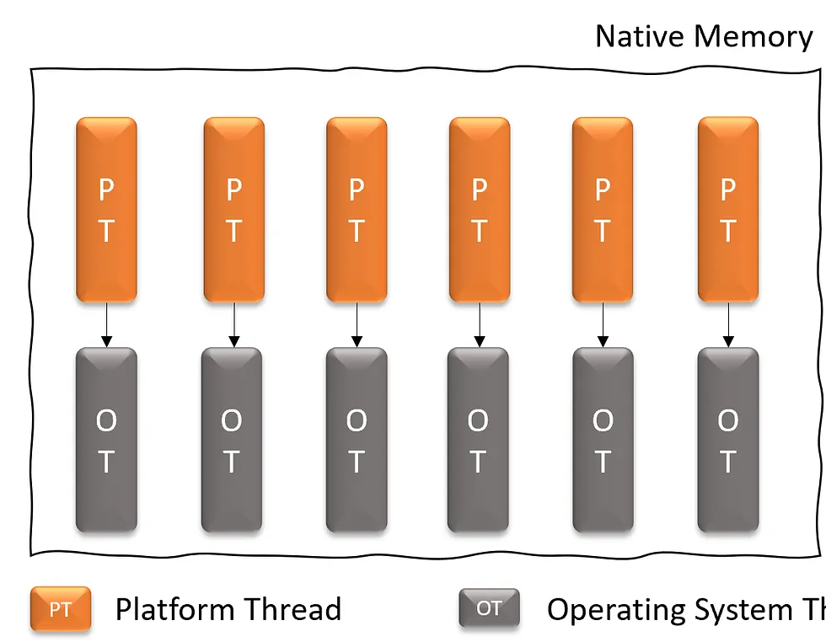
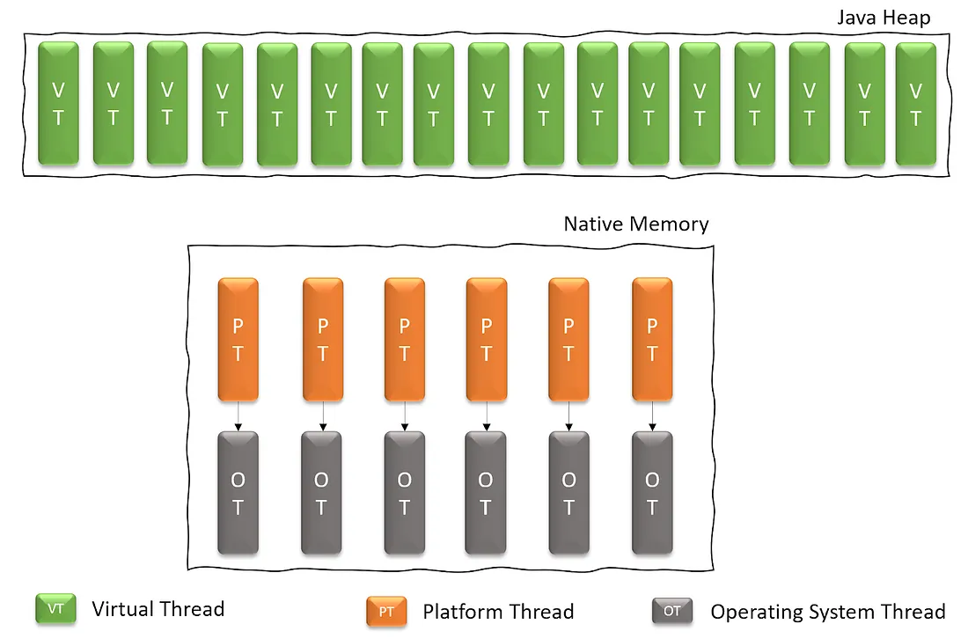
Platform threads architecture vs
Virtual threads architecture
Notes:
https://medium.com/@RamLakshmanan/java-virtual-threads-easy-introduction-44d96b8270f8

Slide 8

ForkJoinPool Mechanics and Their Role in Virtual Thread Scheduling
ForkJoinPool and Carrier Threads
  ForkJoinPool manages carrier threads that run virtual threads, optimizing task scheduling through work-stealing.
Virtual Thread Mounting and Unmounting
  Virtual threads unmount from carrier threads during blocking I/O, allowing carriers to execute other tasks efficiently.
Observability and Performance Tuning
  Monitoring carrier thread utilization, blocking rates, and task queues is essential for tuning ForkJoinPool performance.
Notes:
To fully understand virtual threads, it is important to look beneath the surface at the ForkJoinPool, which plays a central role in their execution. In Java 21, virtual threads are typically mounted onto carrier threads that are managed by a ForkJoinPool. This pool is optimized for work-stealing, allowing idle threads to take tasks from busy ones, which improves overall throughput and fairness. The key concept is that a virtual thread is not permanently bound to a carrier thread. When a virtual thread performs a blocking operation that the JVM understands, such as network or file I/O, it is unmounted from the carrier. The carrier thread is then free to execute other virtual threads, while the blocked virtual thread is parked until it can resume. This design is what allows Java to scale to hundreds of thousands or even millions of concurrent tasks without overwhelming the operating system. Understanding thread pinning is critical at both developer and infrastructure levels. If a virtual thread enters a synchronized block or calls certain native methods, it may remain pinned to its carrier thread, negating some of the scalability benefits. This does not mean synchronized code is forbidden, but it does mean teams should be intentional about its use in high-concurrency paths. From an operational perspective, ForkJoinPool behavior also affects observability and tuning. Metrics such as carrier thread utilization, blocking rates, and task queues become important when diagnosing performance issues. For internal upskilling, this topic bridges application-level concurrency concepts with JVM internals, helping teams reason about performance not just in terms of code, but in terms of scheduling, resource utilization, and runtime behavior. Mastery of these mechanics enables teams to use virtual threads confidently and effectively in production.

Slide 9
Language Enhancements for Developer Productivity
Notes:
Sequenced Collections: Consistent and Expressive Ordered APIs, Pattern Matching for Switch and Record Patterns in Real Codebases

Slide 10
Sequenced Collections: Consistent and Expressive Ordered APIs
Collection | Accessing the first element | Accessing the last element
List | list.get(0) | list.get(list.size() – 1)
Deque | deque.getFirst() | deque.getLast()
SortedSet | sortedSet.first() | sortedSet.last()
Notes:
Java 21 introduces Sequenced Collections as a finalized feature that brings long-overdue consistency to how ordered collections are accessed and manipulated. Prior to this change, developers had to rely on different method names and patterns depending on whether they were working with lists, deques, or maps. SequencedCollection, SequencedSet, and SequencedMap unify these concepts by explicitly modeling collections that have a well-defined encounter order. From a developer standpoint, this results in clearer, more expressive code. Methods such as getFirst(), getLast(), addFirst(), and addLast() eliminate the need for index-based access or specialized deque APIs when working with ordered data. This is particularly useful in domains such as event processing, caching, task scheduling, and streaming pipelines, where the notion of first and last elements is semantically meaningful. SequencedMap extends these benefits to key-value structures, making it easier to work with ordered maps without leaking implementation details like LinkedHashMap. Importantly, this feature is largely additive and backward-compatible. Existing collection implementations such as ArrayList, LinkedHashSet, and LinkedHashMap now implement the new interfaces where appropriate, meaning teams can adopt these APIs incrementally without refactoring existing code. From a learning and upskilling perspective, Sequenced Collections are a good example of Java evolving to improve API design clarity rather than just adding new abstractions. They encourage developers to write intention-revealing code and reduce subtle bugs caused by incorrect assumptions about ordering. When combined with other Java 21 features, they contribute to a cleaner, more maintainable codebase that is easier for teams to understand and evolve over time.

Slide 11
New interfaces
SequencedCollection :
A sequenced collection is a Collection whose elements have a defined encounter order. The new SequencedCollection interface provides methods to add, retrieve, or remove elements at both ends of the collection, along with a method to get a reverse-ordered view of the collection.
SequencedSet:
A sequenced set can be defined as a specialized Set which functions as a SequencedCollection, ensuring the absence of duplicate elements. The SequencedSet interface extends SequencedCollection and overrides its reversed() method. The only difference is that the return type of SequencedSet.reversed() is SequencedSet.
SequencedMap:
A sequenced map is a Map whose entries have a defined encounter order. The SequencedMap does not extend SequencedCollection and provides its own methods to manipulate elements at either end of the collection.
https://www.baeldung.com/java-21-sequenced-collections
Notes:
Java 21 introduces Sequenced Collections as a finalized feature that brings long-overdue consistency to how ordered collections are accessed and manipulated. Prior to this change, developers had to rely on different method names and patterns depending on whether they were working with lists, deques, or maps. SequencedCollection, SequencedSet, and SequencedMap unify these concepts by explicitly modeling collections that have a well-defined encounter order. From a developer standpoint, this results in clearer, more expressive code. Methods such as getFirst(), getLast(), addFirst(), and addLast() eliminate the need for index-based access or specialized deque APIs when working with ordered data. This is particularly useful in domains such as event processing, caching, task scheduling, and streaming pipelines, where the notion of first and last elements is semantically meaningful. SequencedMap extends these benefits to key-value structures, making it easier to work with ordered maps without leaking implementation details like LinkedHashMap. Importantly, this feature is largely additive and backward-compatible. Existing collection implementations such as ArrayList, LinkedHashSet, and LinkedHashMap now implement the new interfaces where appropriate, meaning teams can adopt these APIs incrementally without refactoring existing code. From a learning and upskilling perspective, Sequenced Collections are a good example of Java evolving to improve API design clarity rather than just adding new abstractions. They encourage developers to write intention-revealing code and reduce subtle bugs caused by incorrect assumptions about ordering. When combined with other Java 21 features, they contribute to a cleaner, more maintainable codebase that is easier for teams to understand and evolve over time.

Slide 12
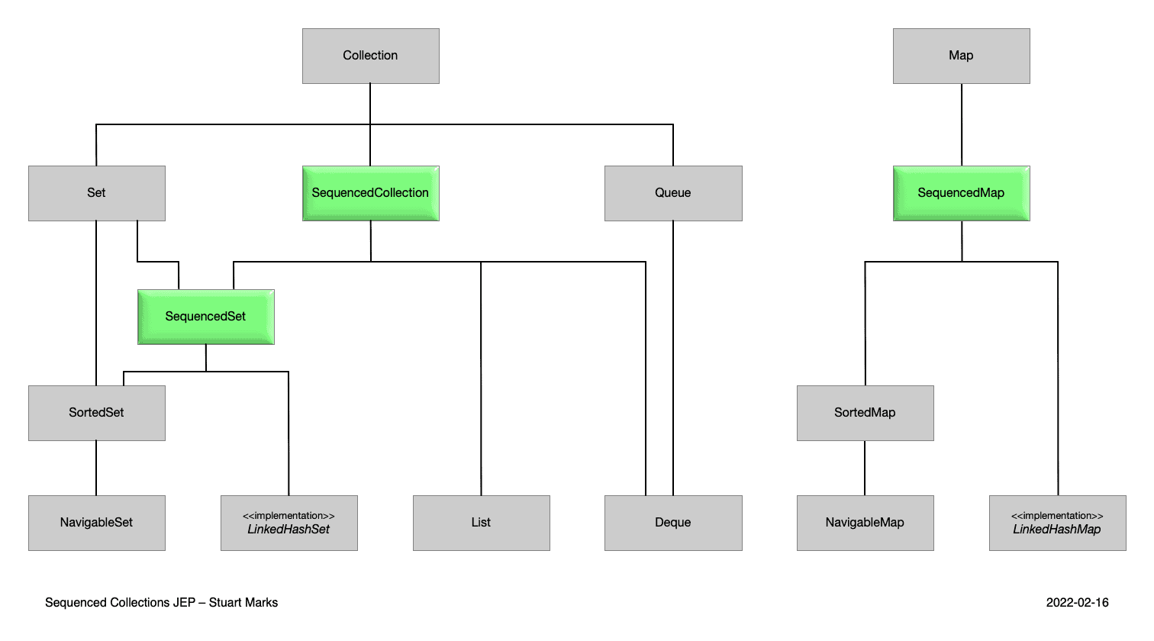
The New Java Collection Hierarchy

Slide 13

Pattern Matching for Switch and Record Patterns in Real Codebases
Pattern Matching for Switch
  Simplifies conditional logic by replacing verbose instanceof checks with concise, exhaustive switch expressions.
Record Patterns Decomposition
  Allows direct decomposition of record components to express data shape and content in one construct.
Improved Code Readability
  Enhancements reduce boilerplate and improve clarity, making business logic easier to follow and maintain.
Java 21 Finalized Features
  Features fully finalized in Java 21 with no preview risk, promoting safer and expressive coding styles.
Notes:
Java 21 finalizes two closely related language enhancements: pattern matching for switch and record patterns. Together, these features significantly reduce boilerplate and improve correctness in code that performs conditional logic based on types or data structure shapes. Pattern matching for switch allows developers to replace verbose chains of instanceof checks and casts with a single, exhaustive switch expression. This not only makes the code more readable, but also enables the compiler to verify that all possible cases are handled, reducing runtime errors. Record patterns extend this idea by allowing direct decomposition of record components within patterns. Instead of manually extracting fields after a type check, developers can express both the shape and content of the data in a single construct. This is especially powerful in applications that rely heavily on immutable data carriers, such as event-driven systems, APIs, and domain models. From a productivity perspective, these features make business logic easier to follow and maintain. They encourage a more declarative style, where the structure of the code mirrors the structure of the data. For internal teams, this is an important learning area because it influences how new code should be written going forward. While existing code does not need to be rewritten, new features and services can immediately benefit from these constructs. Importantly, these enhancements are fully finalized in Java 21, meaning there is no preview risk. They represent Java’s continued evolution toward safer and more expressive language features, helping teams write code that is both concise and robust while remaining familiar to experienced Java developers.

Slide 14
Thank you
Notes:
Generational ZGC: Low-Latency Garbage Collection at Scale

