Slide 1
Microservices Design Principles

Slide 2
Design Principles Overview
Microservices design principles are a set of guidelines for building systems as a collection of small, independent services, each focused on a specific business capability.
They emphasize loose coupling, high cohesion, and clear ownership of data and functionality.
These principles ensure services can be developed, deployed, and scaled independently.
They also promote resilience, fault isolation, and efficient communication between services.
Overall, they help manage the complexity of distributed systems while maintaining flexibility and reliability.

Slide 3
Single Responsibility Principle
The Single Responsibility Principle (SRP) states that a service should have only one reason to change, meaning it should focus on a single business capability.
This principle ensures that each microservice is focused on a specific functionality, making it easier to understand, develop, and maintain.

Slide 4
Following SRP in Practice
Define service boundaries by business capability
Start from domain, not code.
    ✅ Order Service → create/update/cancel orders
    ✅ Payment Service → handle payments
    ❌ One service doing orders + payments + notifications
2. Give each service a single reason to change
Ask a simple test:
“Why would I modify this service?”
      If answers are multiple → it violates SRP
      Example:
      Order logic change ❌
      Payment gateway change ❌
      → Split them

Slide 5
3. Keep data ownership aligned
SRP breaks instantly if data is shared.
    Each service owns its database/schema
    No cross-service table access
      Communicate via APIs/events
4. Avoid “utility” or “god” services
    These are silent SRP killers.
      ❌ Common Service doing email + logging + validation
      ❌ User Service handling auth + profile + analytics
Instead:
        Auth Service
        Profile Service
        Notification Service

Slide 6
5. Keep APIs focused and minimal
If your service exposes unrelated endpoints, it’s already drifting.
    ❌ /createOrder, /processPayment, /sendEmail
    ✅ Only endpoints relevant to that service’s role
6. Watch for growth signals (when to split)
Even a clean service can drift over time.
Split when you see:
    Too many APIs
    Frequent unrelated changes
    Multiple teams modifying same service
    Complex conditional logic (“if payment type… if email type…”)

Slide 7
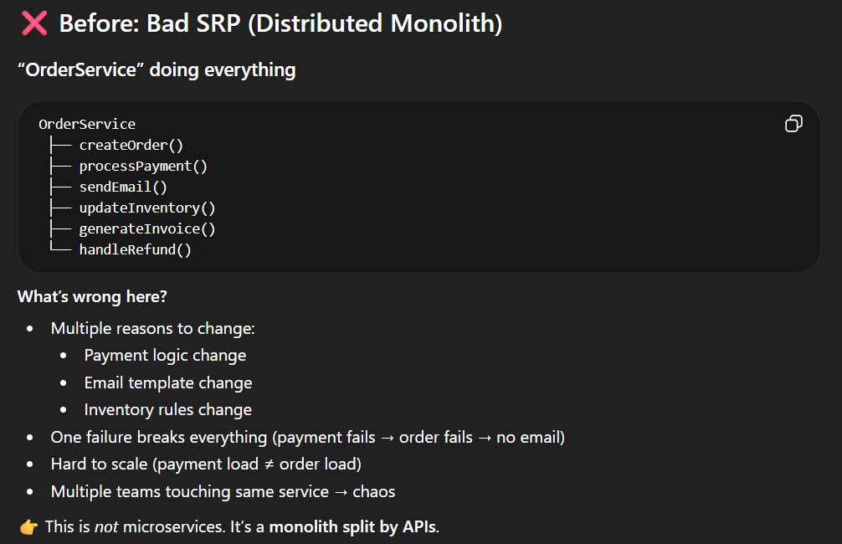

Slide 8
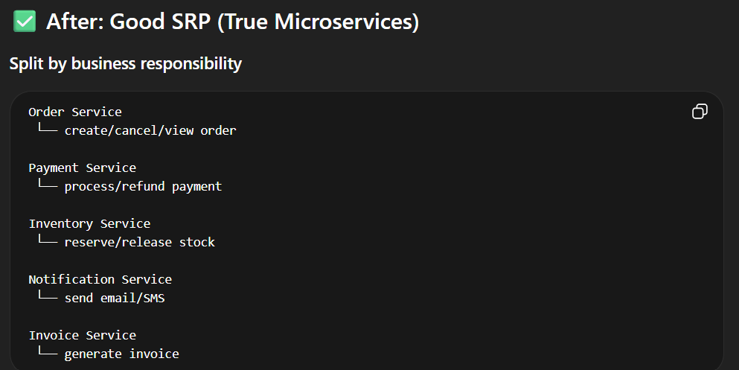

Slide 9
Advantages and Challenges
Advantages:
  Clarity and Simplicity: Services with a single responsibility are easier to understand and manage.
  Improved Maintainability: Changes in one service do not impact others, reducing the risk of unintended side effects.
  Enhanced Testability: Focused services allow for more targeted and effective testing.
Challenges:
  Granularity Balance: Determining the right level of granularity can be challenging. Too fine-grained services may lead to increased complexity and communication overhead.
  Domain Understanding: Requires a deep understanding of the business domain to identify appropriate service boundaries.

Slide 10
Loose Coupling
Loose coupling in microservices means designing services so they have minimal dependencies on each other’s internal logic, data, or implementation.
Each service communicates through well-defined APIs or events rather than direct access to another service’s database or code.
This ensures that changes in one service have little to no impact on others.
It improves flexibility, allowing services to be developed, deployed, and scaled independently.
Overall, it enhances system resilience by preventing failures from spreading across services.

Slide 11
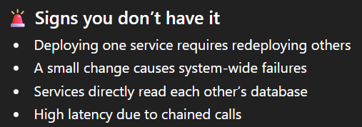
Following Loose Coupling in Practice
1. API-first contracts
    Stable, versioned APIs (/v1/payments)
    Don’t expose internal models
2. Event-driven communication
    Publish events like OrderCreated, PaymentCompleted
    Consumers react independently via tools like Apache Kafka
3. Database per service
    No cross-service queries
    Share data via APIs/events, not joins

Slide 12
Benefits of Loose Coupling
Independent deployment and scaling
Reduced risk of cascading failures
Faster feature delivery

Slide 13
High Cohesion
Cohesion is a measure of the number of relationships that parts of a component have with each other.
High cohesion means that all of the parts that are needed to deliver the component’s functionality are included in the component.
SRP and High Cohesion sound alike, but they operate at different levels. One sets the boundary, the other measures the quality inside that boundary.

Slide 14
SRP Vs High Cohesion
🔹 Single Responsibility Principle (SRP)
Focus: Why the service changes
Helps in defining external boundary
A service should have one reason to change (one business capability)
Defines what belongs together
Example:
Payment Service → only payment-related logic
🔹 High Cohesion
Focus: How well things inside a service fit together
Helps in defining Internal structure
All components in a service should be closely related and work toward one purpose
Ensures the service is internally clean and focused
Example:
Inside Payment Service:
  payment processing
  refund handling
  transaction validation
  (all tightly related)

Slide 15
Benefits of High Cohesion
Improves readability and maintainability
  Simplifies testing and debugging
  Clear responsibility of the service

Slide 16
