Slide 1
Creational Design Patterns
Abstract Factory, Builder, Object Pool& Lazy Initialization

Slide 2
Agenda
Introduction to Creational Design Patterns
Abstract Factory Pattern
Builder Pattern
Object Pool Pattern
Lazy Initialization Pattern
Comparison & Best Practices

Slide 3
What are Creational DesignPatterns?
Creational Design Patterns deal with object creation mechanisms.
Improve flexibility and reuse
Hide complex object creation logic
Promote loose coupling and maintainability

Slide 4
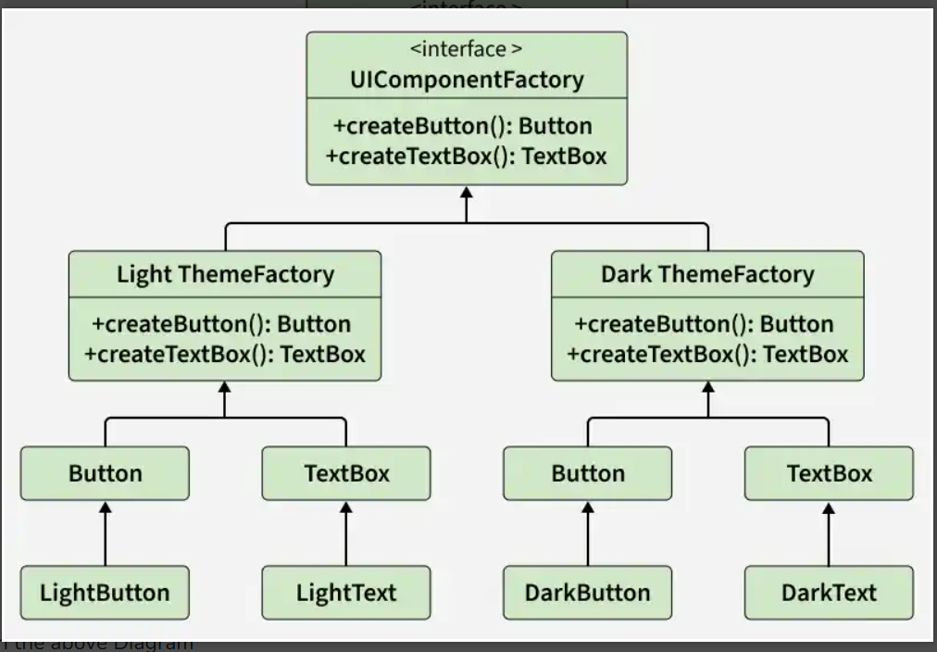
Abstract Factory Pattern
Definition: This creational design pattern thatprovides an interface for creating families ofrelated or dependent objects without specifyingtheir concrete classes. It acts as a "factory offactories," where a super-factory creates otherfactories that in turn produce specific objects.
Use Cases:
Cross-platform UI libraries
Theme-based object creation
Database driver families
Advantages:
Promotes consistency
Loose coupling
Easy scalability

Slide 5
Components:
Abstract Factory: It provides a way such that concrete factories follow acommon interface, providing consistent way to produce related set of objects.
Concrete Factories: Concrete Factories implement the rules specified by the abstract factory. It contain the logic for creating specific instances of objects within a family.
Abstract Products: It acts as an abstract or interface type that all concrete products within a family must follow to and provides a unified way for concrete products to be used interchangeably.
Concrete Products: They implement the methods declared in the abstract products, ensuring consistency within a family and belong to a specific category or family of related objects.
Client: Client utilizes the abstract factory to create families of objects without specifying their concrete types and interacts with objects through abstract interfaces provided by abstract products.

Slide 6
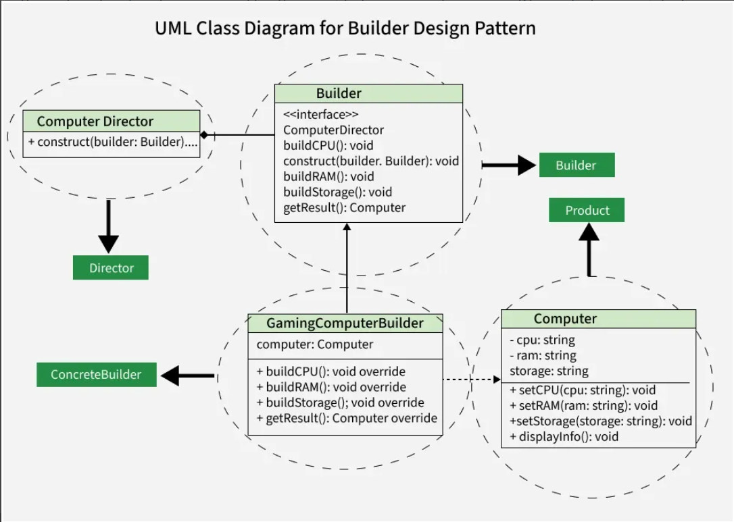
Builder Pattern
Definition: This pattern provides a step-by-step approach to constructing complex objects. It separates the construction process from the object’s representation, enabling the same method to create different variations of an object.
Use Cases:
• Creating immutable objects
• Complex object configuration
• Step-by-step object creation
Advantages:
• Readable object creation
• Flexible construction
• Avoids telescoping constructors

Slide 7
Components:
Product: The complex object being constructed, typically a class with attributes representing different parts built by the Builder.
Builder: An interface or abstract class that defines construction steps, including methods to build individual parts of the product.
Concrete Builder: Implements the Builder interface, providing specific logic to construct each part and create a particular variation of the product.
Client: Initiates the construction by creating a Builder and passing it to the Director to build the final product.

Slide 8
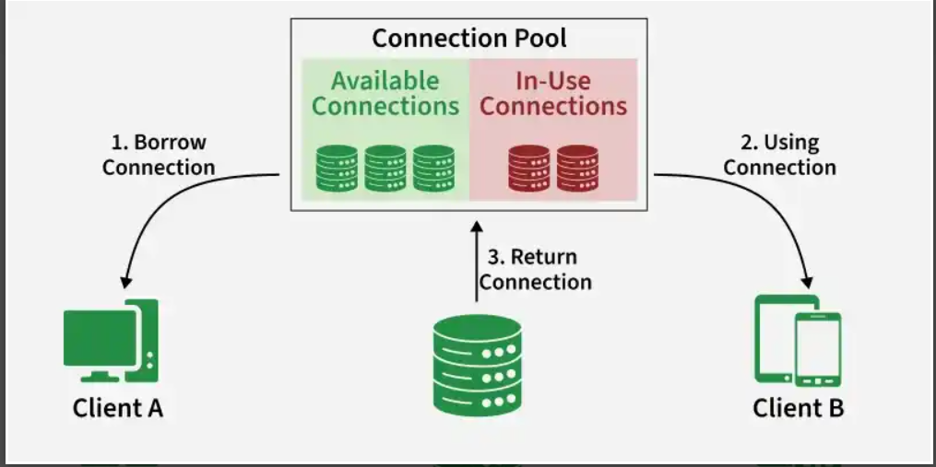
Object Pool Pattern
Definition: This pattern manages a set of reusable objects to reduce the cost of repeatedly creating and destroying them. Instead of instantiating new objects, clients borrow objects from a pool and return them after use. This improves performance and resource utilization, especially when object creation is expensive.
Use Cases:
• Database connections
• Thread pools
• Game object management
Advantages:
• Improves performance
• Reduces memory overhead
• Efficient resource usage

Slide 9
Components:
Client : This is the class that uses an object of the Pooled Object type
ReusablePool: The Pooled Object class is the type that is expensive or slow to instantiate, or that has limited availability, so is to be held in the object pool.
ObjectPool : The Pool class is the most important class in the object pool design pattern. Object Pool maintains a list of available objects and a collection of objects that have already been requested from the pool.

Slide 10
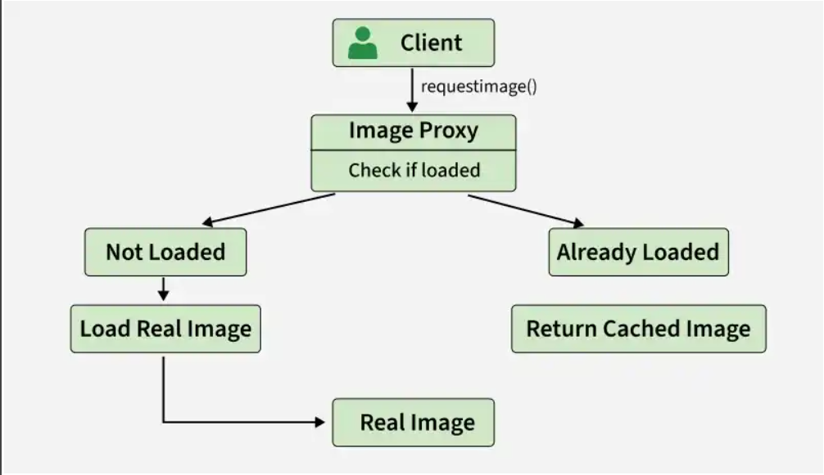
Lazy Initialization Pattern
Definition: Lazy Loading is a Creational design pattern where an object or resource is initialized only when it is actually needed, rather than at the time of application startup. This approach delays object creation to reduce memory usage and improve performance.
Use Cases:
• Singleton objects
• Expensive resource loading
• Caching systems
Advantages:
• Saves memory
• Improves startup time
• Avoids unnecessary creation

Slide 11
Components:
Subject: The main class that defines the interface for accessing the resource. It represents the object that will be lazily loaded.
Real Subject: The actual heavy or expensive object that performs the real work. It is created only when required.
Lazy Loader / Proxy: Acts as a placeholder for the real object. It controls access and initializes the real object when it is first requested.
Client: The class that interacts with the subject. It is unaware whether the object is already created or loaded lazily.
Initialization Check Mechanism: Logic (often inside a getter method) that checks whether the object is already created; if not, it creates it before returning.

Slide 12
Pattern Comparison
Abstract Factory → Creates families of related objects
Builder → Constructs complex objects step-by-step
Object Pool → Reuses expensive objects efficiently
Lazy Initialization → Creates objects only when required

Slide 13
Interview questions
Abstract Factory Pattern — Interview Questions
What is the purpose of the Abstract Factory Pattern?
It provides an interface to create families of related objects without specifying their concrete classes.
How is Abstract Factory different from Factory Method?
Factory Method creates one product at a time, whereas Abstract Factory creates families of related products.
Where is the Abstract Factory Pattern commonly used?
Cross-platform UI frameworks, database drivers, theme-based applications.
What are the advantages and disadvantages of Abstract Factory?
Advantages: Loose coupling, consistency, scalability.
Disadvantages: Adding new product types becomes difficult.
Can you explain a real-time example of Abstract Factory?
GUI toolkit where WindowsFactory creates WindowsButton and WindowsCheckbox, while MacFactory creates MacButton and MacCheckbox.

Slide 14
Builder Pattern — Interview Questions
Why do we use the Builder Pattern?
To construct complex objects step-by-step and avoid telescoping constructors.
What problem does Builder Pattern solve?
It handles objects with many optional parameters in a clean and readable way.
What is the difference between Builder Pattern and Factory Pattern?
Factory focuses on object creation logic; Builder focuses on step-by-step object construction.
Where is Builder Pattern used in Java?
StringBuilder, Lombok @Builder, HttpClient builders.
What are the advantages of Builder Pattern?
Improves readability, supports immutability, flexible object creation.

Slide 15
Object Pool Pattern — Interview Questions
What is the Object Pool Pattern?
It manages and reuses expensive objects instead of creating them repeatedly.
When should we use Object Pool Pattern?
When object creation is costly, such as database connections or thread pools.
What are the benefits of Object Pool Pattern?
Better performance, reduced memory allocation, efficient resource management.
What are the drawbacks of Object Pool Pattern?
Pool management complexity and risk of resource leaks.
Can you give real-world examples of Object Pool Pattern?
JDBC connection pools, thread pools, game engine object reuse.

Slide 16
Lazy Initialization Pattern — Interview Questions
What is Lazy Initialization?
Delaying object creation until it is actually needed.
Why is Lazy Initialization important?
It improves startup performance and reduces unnecessary memory usage.
How is Lazy Initialization used in Singleton Pattern?
Singleton instance is created only when getInstance() is called for the first time.
What are the challenges with Lazy Initialization in multithreading?
Multiple threads may create multiple instances unless synchronization is used.
What are common techniques for thread-safe lazy initialization?
Synchronized methods, Double-Checked Locking, Bill Pugh Singleton approach.

Slide 17
Thank You
Questions & Discussion

