Slide 1
JPA
JPA Basics, Entity Lifecycle, Relations, JPQL, and Inheritance Strategies

Slide 2
Agenda
JPA Basics and Architecture
EntityManager and Persistence Context
Entity Lifecycle States
Relationships and mappedBy
JPQL
JPA Inheritance Strategies
Code Demos and FAQs

Slide 3
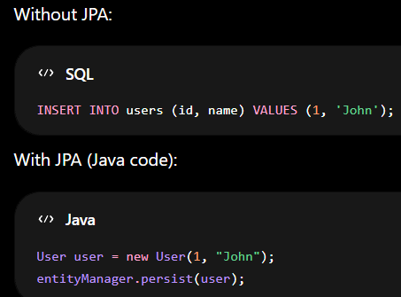
What is JPA?
JPA = Java Persistence API
Specification for ORM in Java
Hibernate is the most popular implementation
Maps Java Objects to Database Tables
Reduces boilerplate JDBC code

Slide 4
Key Features
ORM (Object-Relational Mapping): Maps Java classes to database tables
Entity Management: Uses @Entity to mark classes as database tables
Database Independence: Works with different databases (MySQL, PostgreSQL, etc.)
CRUD Operations: Create, Read, Update, Delete made simple
Query Support: JPQL (Java Persistence Query Language)

Slide 5
Important JPA Annotations
@Entity -> Marks a class as JPA Entity
@Table -> Maps entity to DB table
@Id -> Primary key
@GeneratedValue -> Auto generation strategy
@Column -> Column mapping
@Transient -> Ignore field from persistence
@OneToMany, @ManyToOne, @OneToOne, @ManyToMany

Slide 6
JPA Entity Lifecycle
Transient
(new object)
Persistent
(managed by EM)
Detached
(not managed)
Removed
(scheduled)
Entity Lifecycle States
Transient: Object not associated with Persistence Context.
Managed: Persisted in the context; changes are tracked.
Detached: Exists in DB but no longer managed.
Removed: Scheduled for deletion.

Slide 7
EntityManager
Core JPA interface
Handles persist, merge, remove, find operations
Maintains Persistence Context
Tracks entity changes automatically (Dirty Checking)
Key point: A bridge between Java objects and the database.

Slide 8
Persistence Context
A cache/storage area where EntityManager keeps managed entity objects.
Inside it:
JPA tracks entity state
Tracks modifications
Avoids duplicate objects
Synchronizes with DB
Persistence Context is also called “First-Level Cache”

Slide 9
Relationship Mapping
Traveler
Passport
Student
Course
One to One
Student
Course
Employee
Student
Course
Department
Employee
Many to Many
Employee
One to Many / Many to One

Slide 10
Relations
One to One
One to Many
Many to One
Many to Many

Slide 11
Key Attributes
JoinColumn: Create foreign key column person_id exists in Passport table
MappedBy: I am NOT the owner of the relationship
Cascade: Parent operation affects child entities.
Fetch Types: Lazy and Eager
Owning Side : The side having @JoinColumn
Inverse Side: The side having mappedBy

Slide 12
Cascade Types
Cascade Type | Meaning
PERSIST | Save child automatically
MERGE | Merge child
REMOVE | Delete child
REFRESH | Refresh child
DETACH | Detach child
ALL | All above

Slide 13
Fetch Types
EAGER Fetch
Loads relationship immediately.
LAZY Fetch
Loads only when needed.

Slide 14
JPQL
Object-oriented query language
Queries entities instead of tables
Uses entity names and field names
Supports joins, aggregates, subqueries

Slide 15
JPQL Examples
SELECT e FROM Employee e
SELECT e FROM Employee e WHERE e.salary > 50000
SELECT d.name, COUNT(e) FROM Department d JOIN d.employees e GROUP BY d.name

Slide 16
Inheritance Strategies
SINGLE_TABLE -> One table for entire hierarchy
JOINED -> Separate tables with joins
TABLE_PER_CLASS -> Separate table for each class

Slide 17
Inheritance Strategy Comparison
SINGLE_TABLE
Fast Reads
Many NULL columns
JOINED
Normalized
Uses JOINs
TABLE_PER_CLASS
Independent Tables
Union Queries

Slide 18
Frequently Asked Questions
Difference between save() and persist()?
What is Persistence Context?
Difference between eager and lazy loading?
Why mappedBy is required?
When to use JOINED vs SINGLE_TABLE?

