Slide 1
GC After java 8
1, After Java 8, Java GC evolved massively:
CMS got removed
G1 became default
ZGC and Shenandoah introduced ultra-low latency
Generational ZGC arrived in Java 21
2. I’ll explain:
JVM memory model
Basic GC algorithms
Every important GC after Java 8
Internal working algorithms
STW pauses
Tradeoffs
When to use which GC
Real production recommendations
Diagrams
JVM flags

Slide 2
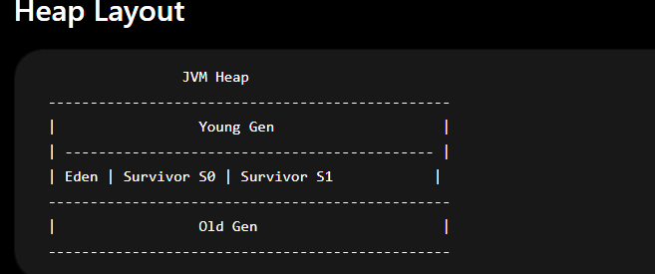

Slide 3
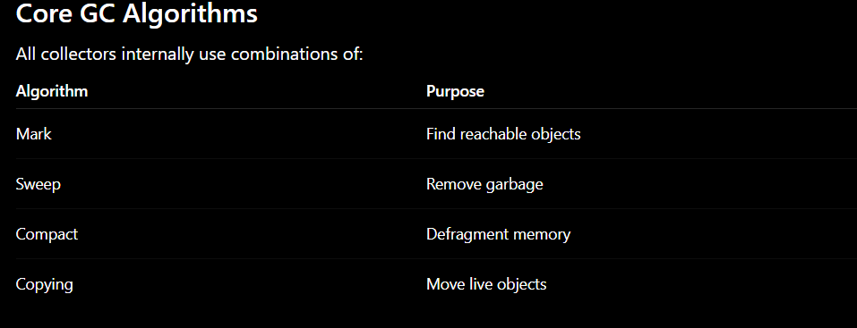

Slide 4
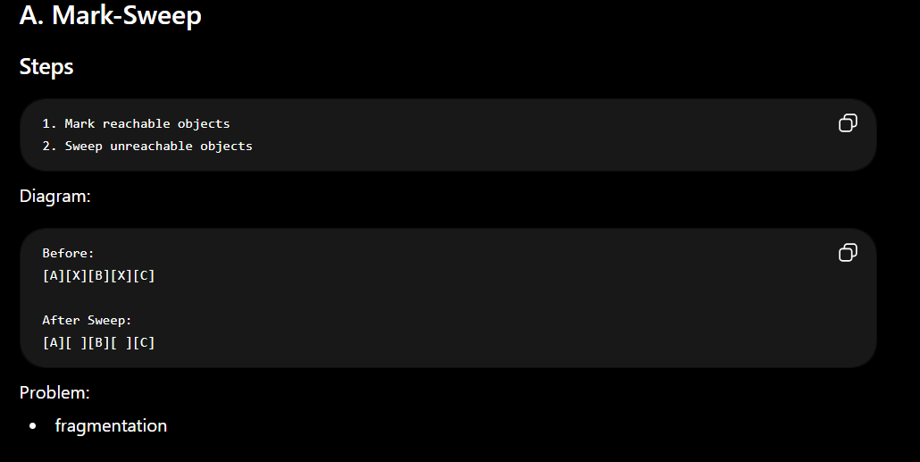

Slide 5
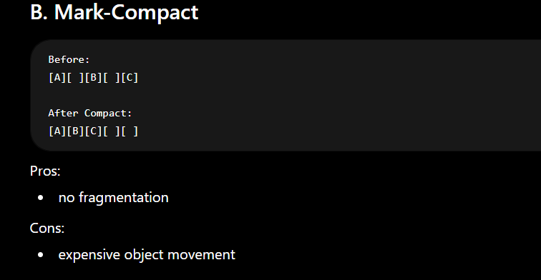

Slide 6
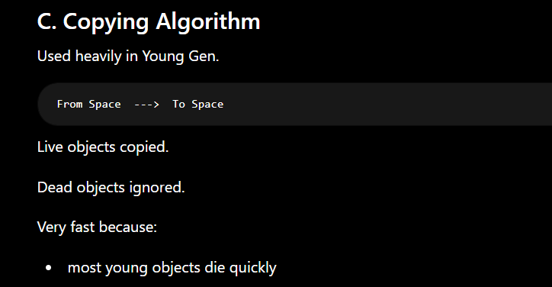

Slide 7
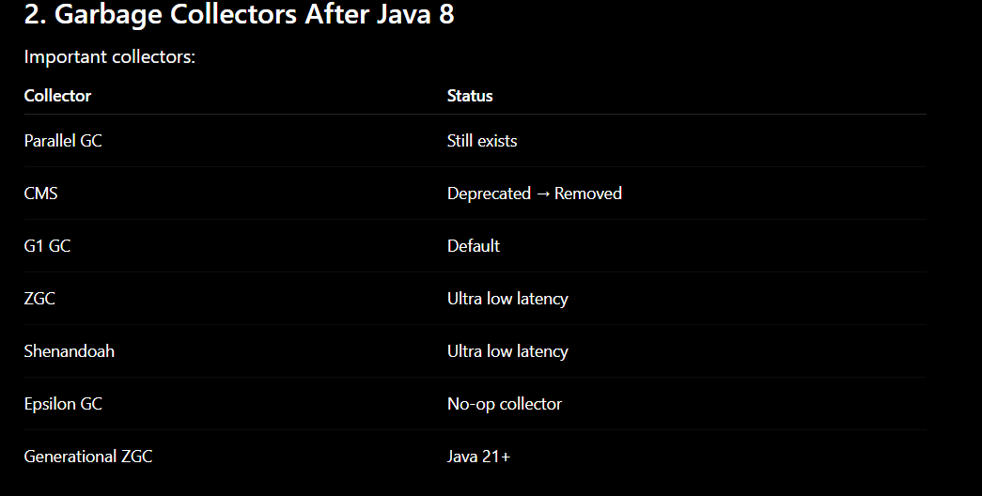

Slide 8
Application Running
│
Initial Mark (pause)
│
Concurrent Mark
│
Remark (pause)
│
Concurrent Sweep
https://www.logicbrace.com/2025/10/evolution-of-garbage-collection-in-java.html?utm_source=chatgpt.com

Slide 9
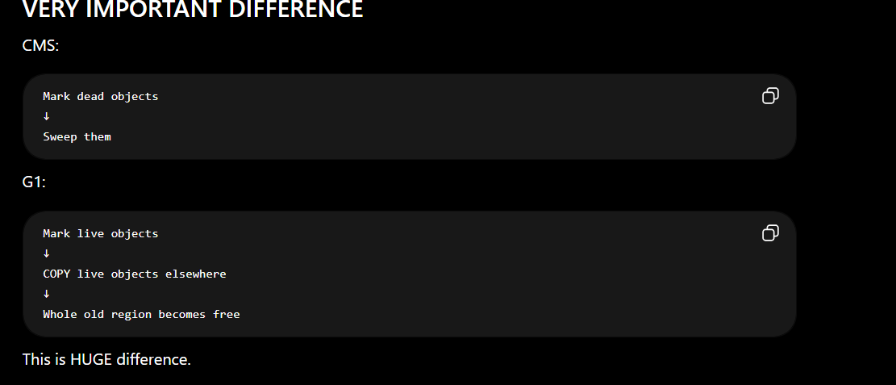
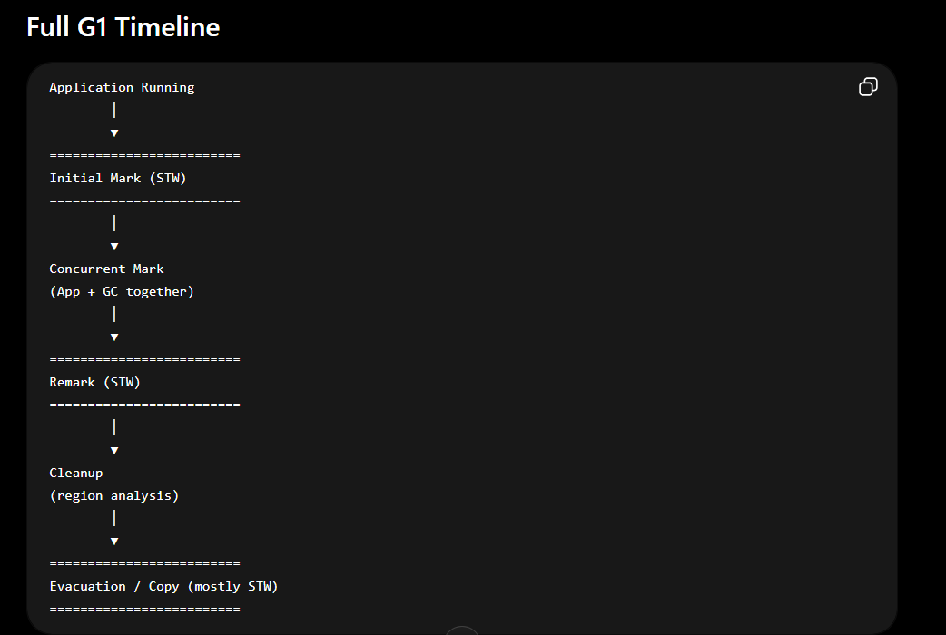
G1 GC
1. Initial Mark (STW)
2. Concurrent Mark
3. Remark (STW)
4. Cleanup
5. Evacuation/Copy

Slide 10
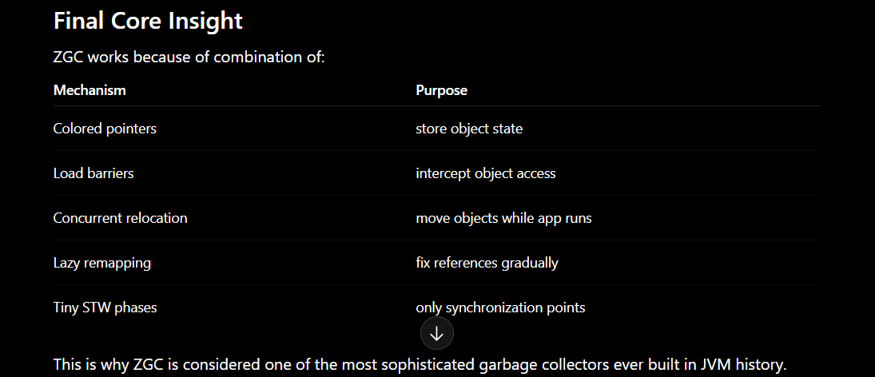

Slide 11
G1 GC (Garbage First)
Default since Java 9
Most important collector today.

Slide 12
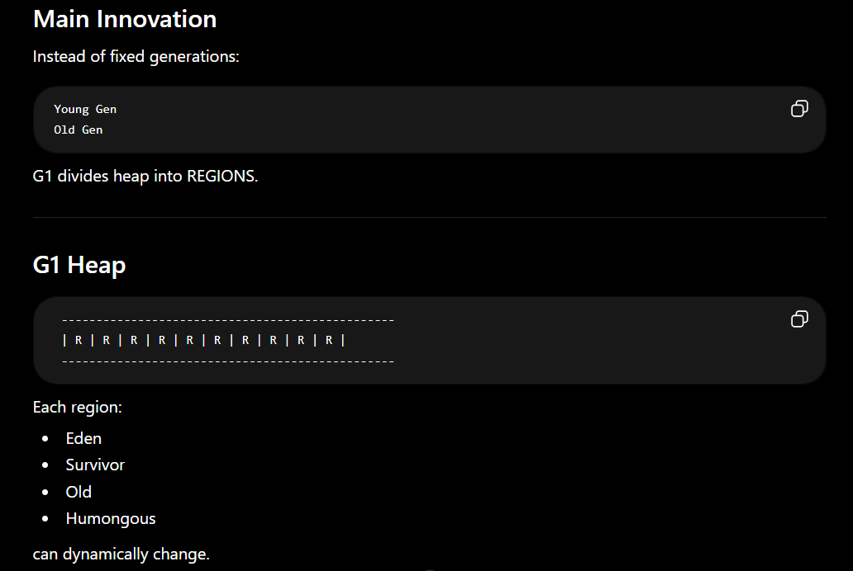

Slide 13
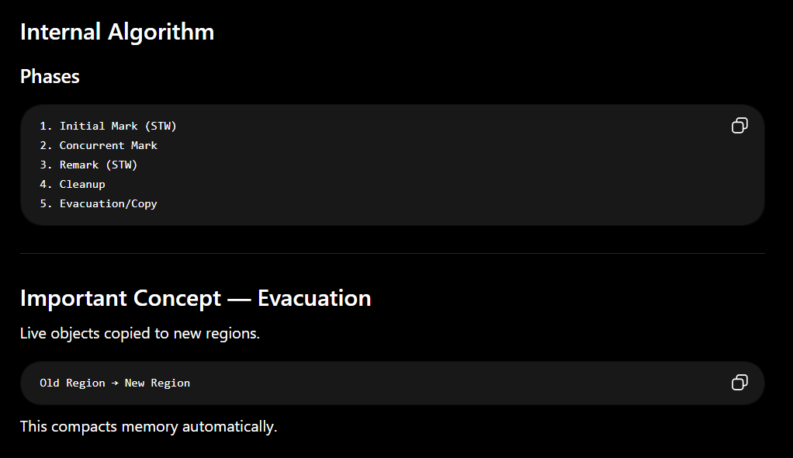

Slide 14
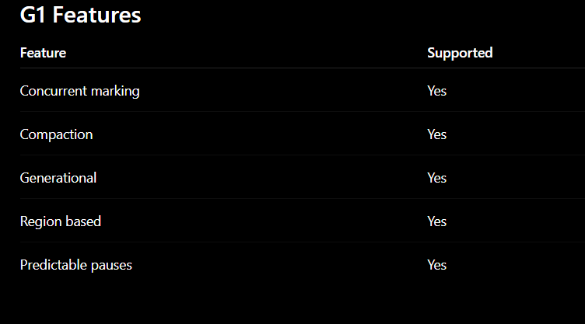
-XX:MaxGCPauseMillis=200
-XX:+UseG1GC

Slide 15


Slide 16

Explanation of the – marking Phase Initial mark-root element marking not deeping it done avoid long pause concurrent Mark - now deep marking start Remark – now STW final remarking.
GC Cycle 1:
Root → A → B → C
Application changes:
A → X
B,C become floating garbage
=============================================
GC Cycle 2:
Root → A → X
B,C reclaimed
==================================Final Steps =======================================
1. Marking starts
2. Heap snapshot logically established STAB
3. Live/dead finalized
4. Sweep reclaims only old dead objects
5. New allocations belong to future cycles

Slide 17
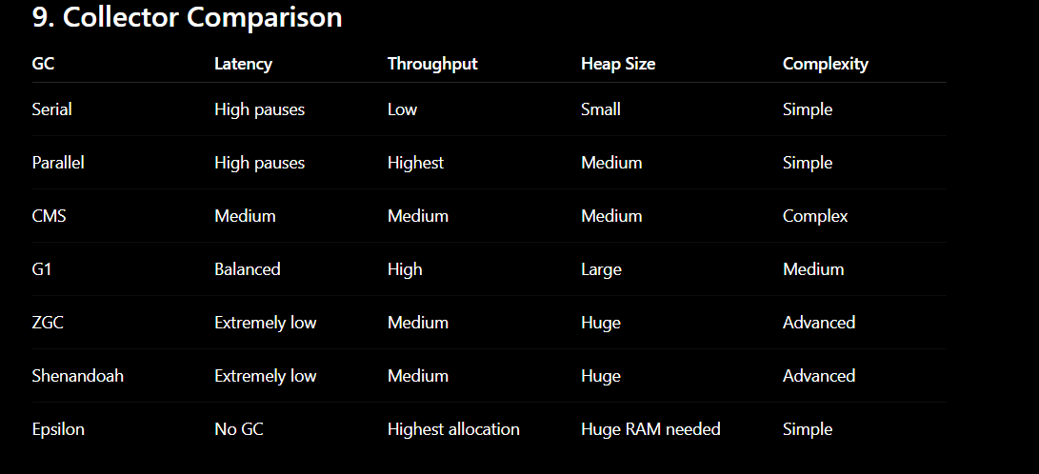

Slide 18


