Slide 1
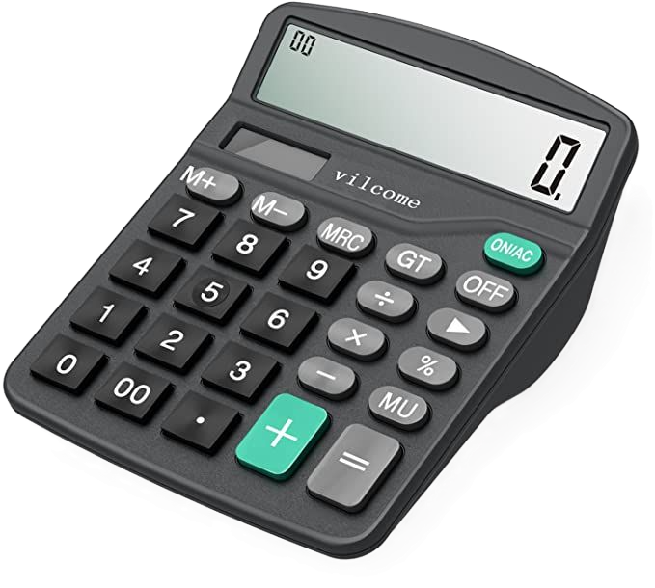
SMART CALCULATOR
CALCULATE • CONVERT • VISUALISE
NEXTHIKES IT SOLUTIONS
Presented by :Nirmala Bisht
SMART CALCULATOR • PYTHON + TKINTER

Slide 2
02 / 08
Six tabs, one smart workspace
A compact Tkinter app combining everyday arithmetic with practical tools.
01
02
03
Basic
Scientific
Convert
Everyday arithmetic
Advanced maths
Measurement units
04
05
06
Graph
BMI
GST
CSV charts
Body mass index
Tax calculation
INTERFACE HIGHLIGHTS
Dark charcoal background • Orange action keys • Oval keypad buttons • Input validation
SMART CALCULATOR • PYTHON + TKINTER
PROJECT PRESENTATION

Slide 3
03 / 08
Basic calculator
A familiar keypad for fast, everyday arithmetic.
CORE FUNCTIONS
BASIC MODE
125 × 8
Addition, subtraction, multiplication and division.
= 1000
Percentage, decimal point and positive / negative toggle.
AC
⌫
%
÷
7
8
9
×
AC clears the expression; backspace removes one character.
4
5
6
−
Equals evaluates the expression and displays the answer.
1
2
3
+
±
0
.
=
USE CASE • Daily calculations and quick checks
SMART CALCULATOR • PYTHON + TKINTER
PROJECT PRESENTATION

Slide 4
04 / 08
Scientific calculator
Advanced mathematical operations extend the standard calculator.
SCIENTIFIC TOOLS
SCIENTIFIC MODE
sin(30)
Trigonometry: sin, cos and tan.
= 0.5
sin
cos
tan
log
ln
Logarithms: base-10 log and natural log (ln).
sqrt
x²
1/x
pi
e
Square root, square, reciprocal, factorial and powers.
(
)
^
%
÷
7
8
9
×
−
π and e constants, parentheses and percentage input.
4
5
6
+
=
1
2
3
AC
⌫
DEG / RAD toggle changes the angle mode for trig functions.
±
0
.
!
DEG
For scientific and advanced maths calculations
SMART CALCULATOR • PYTHON + TKINTER
PROJECT PRESENTATION

Slide 5
05 / 08
Unit converter
Convert values between commonly used measurement units.
CONVERSION PANEL
SUPPORTED UNIT GROUPS
Length: meters, kilometers, miles and feet.
LENGTH
WEIGHT
TEMP
Weight: grams, kilograms, pounds and ounces.
VALUE
1
Temperature: Celsius, Fahrenheit and Kelvin.
Meters ▾
Kilometers ▾
Choose a category, enter a value, then select source and target units.
CONVERT
Result updates when the input or unit selection changes.
1 METER = 0.001 KILOMETERS
SMART CALCULATOR • PYTHON + TKINTER
PROJECT PRESENTATION

Slide 6
06 / 08
Graph plotting
Upload a CSV file and turn a numeric column into a visual chart.
GRAPH INPUT
AVAILABLE CHART TYPES
Line: connects values to show a trend.
sales_data.csv
Bar: compares the size of each value.
UPLOAD CSV
Select numeric column ▾
Scatter: displays values as separate points.
LINE
BAR
SCATTER
PIE
Pie: represents positive values as parts of a whole.
Select a numeric CSV column and plot the chosen chart type.
SMART CALCULATOR • PYTHON + TKINTER
PROJECT PRESENTATION

Slide 7
07 / 08
BMI calculator
Calculates body mass index from the height and weight entered by the user.
BMI INPUTS
HOW THE TAB WORKS
Takes weight in kilograms and height in centimetres.
WEIGHT (KG)
Enter weight
Converts height from centimetres to metres.
HEIGHT (CM)
Calculates BMI using weight divided by height squared.
Enter height
Displays the BMI value and a category label.
CALCULATE BMI
Checks that entered values are valid and positive.
BMI = weight ÷ height²
BMI is a screening measure, not a complete health assessment.
SMART CALCULATOR • PYTHON + TKINTER
PROJECT PRESENTATION

Slide 8
08 / 08
GST calculator
Calculate the GST amount and final total from a pre-tax amount.
GST INPUT PANEL
FEATURES & PROJECT WRAP-UP
Enter the amount before tax.
AMOUNT BEFORE GST
Enter amount
Choose a GST rate: 0%, 5%, 12%, 18% or 28%.
GST RATE
Calculates the GST value and adds it to the original amount.
0%
5%
12%
18%
28%
Displays both the tax amount and the final total.
CALCULATE GST
Six tabs combine arithmetic, scientific maths, conversions, charts, BMI and GST.
GST = Amount × Rate ÷ 100
TOTAL = AMOUNT BEFORE GST + GST
SMART CALCULATOR • PYTHON + TKINTER
PROJECT PRESENTATION

Slide 9
08 / 08
Thank You
SMART CALCULATOR • PYTHON + TKINTER
PROJECT PRESENTATION

