Slide 1
Two-Phase Commit
CS 240: Computing Systems and Concurrency
Lecture 8
Marco Canini
Credits: Michael Freedman and Kyle Jamieson developed much of the original material.

Slide 2
Plan
Fault tolerance in a nutshell
Safety and liveness
Two-phase commit
Notes:
Floods, fires, top-of-rack switch failure & c.

Slide 3
Fault tolerance in a nutshell
Notes:
QUESTION: how is it different from parallelism?

Slide 4
What is fault tolerance?
Building reliable systems from unreliable components
Three basic steps
Detecting errors: discovering the presence of an error in a data value or control signal
Containing errors: limiting how far errors propagate
Masking errors: designing mechanisms to ensure a system operates correctly despite error (and possible correct error)

Slide 5
Why is fault tolerance hard?
Failures
Propagate
Say one bit in a DRAM fails…
…it flips a bit in a memory address the kernel is writing to...
...causes big memory error elsewhere, or a kernel panic...
...program is running one of many distributed file system storage servers...
...a client can’t read from FS, so it hangs.

Slide 6
So what to do?
Do nothing: silently return the failure
Fail fast: detect the failure and report at interface
Ethernet station jams medium on detecting collision
Fail safe: transform incorrect behavior or values into acceptable ones
Failed traffic light controller switches to blinking-red
Mask the failure: operate despite failure
Retry op for transient errors, use error-correcting code for bit flips, replicate data in multiple places

Slide 7
Masking failures
We mask failures on one server via
Atomic operations
Logging and recovery
In a distributed system with multiple servers, we might replicate some or all servers
Requires a mechanism to keep replica servers consistent in a fault tolerant way

Slide 8
Safety and liveness
Notes:
QUESTION: how is it different from parallelism?

Slide 9
Reasoning about fault tolerance
This is hard!
How do we design fault-tolerant systems?
How do we know if we’re successful?
Often use “properties” that hold true for every possible execution
We focus on safety and liveness properties

Slide 10
Safety
“Bad things” don’t happen, ever
No stopped or deadlocked states
No error states
Examples
Mutual exclusion: two processes can’t be in a critical section at the same time
Bounded overtaking: if process 1 wants to enter a critical section, process 2 can enter at most once before process 1
Notes:
NOTE: can be violated in finite execution

Slide 11
Liveness
“Good things” happen
…eventually
Examples
Starvation freedom: process 1 can eventually enter a critical section as long as process 2 terminates
Eventual consistency: if a value in an application doesn’t change, two servers will eventually agree on its value
Notes:
NOTE: might not be violated in finite execution

Slide 12
Often a trade-off
“Good” and “bad” are application-specific
Safety is very important in banking transactions
May take some time to confirm a transaction
Liveness is very important in social networking sites
See updates right away (what about the “breakup problem”?)

Slide 13
Two-phase commit

Slide 14
Motivation: sending money
send_money(A, B, amount) {
Begin_Transaction();
if (A.balance - amount >= 0) {
A.balance = A.balance - amount;
B.balance = B.balance + amount;
Commit_Transaction();
} else {
Abort_Transaction();
}
}

Slide 15
Single-server: ACID
Atomicity: all parts of the transaction execute or none (A’s decreases and B’s balance increases)
Consistency: the transaction only commits if it preserves invariants (A’s balance never goes below 0)
Isolation: the transaction executes as if it executed by itself (even if C is accessing A’s account, that will not interfere with this transaction)
Durability: the transaction’s effects are not lost after it executes (updates to the balances will remain forever)

Slide 16
Distributed transactions?
Partition databases across multiple machines for scalability (A and B might not share a server)
A transaction might touch more than one partition
How do we guarantee that all of the partitions commit the transactions or none commit the transactions?

Slide 17
Two-Phase Commit (2PC)
Goal: General purpose, distributed agreement on some action, with failures
Different entities play different roles in the action
Running example: Transfer money from A to B
Debit at A, credit at B, tell the client “okay”
Require both banks to do it, or neither
Require that one bank never act alone
This is an all-or-nothing atomic commit protocol
Later will discuss how to make it before-or-after atomic

Slide 18


Straw Man protocol
C → TC: “go!”
Client C
go!
Transaction Coordinator TC
Bank
A
B
Notes:
Invent a transaction coordinator as a single authoritative entity

Slide 19
Straw Man protocol
C → TC: “go!”
TC → A: “debit $20!”
TC → B: “credit $20!”
TC → C: “okay”
A, B perform actions on receipt of messages
Client C
go!
okay
Transaction Coordinator TC
debit $20!
credit $20!
Bank
A
B
Notes:
Invent a transaction coordinator as a single authoritative entity

Slide 20
Reasoning about the Straw Man protocol
What could possibly go wrong?
Not enough money in A’s bank account?
B’s bank account no longer exists?
A or B crashes before receiving message?
The best-effort network to B fails?
TC crashes after it sends debit to A but before sending to B?

Slide 21
Safety versus liveness
Note that TC, A, and B each have a notion of committing
We want two properties:
Safety
If one commits, no one aborts
If one aborts, no one commits
Liveness
If no failures and A and B can commit, action commits
If failures, reach a conclusion ASAP
Notes:
Segue: Let’s start with correctness

Slide 22
A correct atomic commit protocol
C → TC: “go!”
Client C
go!
Transaction Coordinator TC
Bank
A
B

Slide 23
A correct atomic commit protocol
C → TC: “go!”
TC → A, B: “prepare!”
Client C
Transaction Coordinator TC
prepare!
prepare!
Bank
A
B

Slide 24
A correct atomic commit protocol
C → TC: “go!”
TC → A, B: “prepare!”
A, B → P: “yes” or “no”
Client C
Transaction Coordinator TC
yes
yes
Bank
A
B

Slide 25
A correct atomic commit protocol
C → TC: “go!”
TC → A, B: “prepare!”
A, B → P: “yes” or “no”
TC → A, B: “commit!” or “abort!”
TC sends commit if both say yes
TC sends abort if either say no
Client C
Transaction Coordinator TC
commit!
commit!
Bank
A
B

Slide 26
A correct atomic commit protocol
C → TC: “go!”
TC → A, B: “prepare!”
A, B → P: “yes” or “no”
TC → A, B: “commit!” or “abort!”
TC sends commit if both say yes
TC sends abort if either say no
TC → C: “okay” or “failed”
A, B commit on receipt of commit message
Client C
okay
Transaction Coordinator TC
Bank
A
B

Slide 27
Reasoning about atomic commit
Why is this correct?
Neither can commit unless both agreed to commit
What about performance?
Timeout: I’m up, but didn’t receive a message I expected
Maybe other node crashed, maybe network broken
Reboot: Node crashed, is rebooting, must clean up
Notes:
Segue: Let’s deal with timeout first

Slide 28
Timeouts in atomic commit
Where do hosts wait for messages?
TC waits for “yes” or “no” from A and B
TC hasn’t yet sent any commit messages, so can safely abort after a timeout
But this is conservative: might be network problem
We’ve preserved correctness, sacrificed performance
A and B wait for “commit” or “abort” from TC
If it sent a no, it can safely abort (why?)
If it sent a yes, can it unilaterally abort?
Can it unilaterally commit?
A, B could wait forever, but there is an alternative…
Notes:
…
2. If A/B voted no, it can safely abort (since the TC will abort from receiving the no, or conservatively abort)
If sent yes, can it unilaterally abort? (NO, since the TC may go ahead, or may have crashed before sending commit to B but will come back up)
Can it unilaterally commit? (NO, never, needs consensus)

Slide 29
Server termination protocol
Consider Server B (Server A case is symmetric) waiting for commit or abort from TC
Assume B voted yes (else, unilateral abort possible)
B → A: “status?” A then replies back to B. Four cases:
(No reply from A): no decision, B waits for TC
Server A received commit or abort from TC: Agree with the TC’s decision
Server A hasn’t voted yet or voted no: both abort
TC can’t have decided to commit
Server A voted yes: both must wait for the TC
TC decided to commit if both replies received
TC decided to abort if it timed out
Notes:
Segue: Let’s deal with timeout first

Slide 30
Reasoning about the server termination protocol
What are the liveness and safety properties?
Safety: if servers don’t crash and network between A and B is reliable, all processes reach the same decision (in a finite number of steps)
Liveness: if failures are eventually repaired, then every participant will eventually reach a decision
Can resolve some timeout situations with guaranteed correctness
Sometimes however A and B must block
Due to failure of the TC or network to the TC
But what will happen if TC, A, or B crash and reboot?
Notes:
SEGUE: Crash and reboot? Let's see (next slide).

Slide 31
How to handle crash and reboot?
Can’t back out of commit if already decided
TC crashes just after sending “commit!”
A or B crash just after sending “yes”
If all nodes knew their state before crash, we could use the termination protocol…
Use write-ahead log to record “commit!” and “yes” to disk
Notes:
Big Trouble: We’re back to debiting one bank and not crediting another
Why write to log first? (If we write to log second we might send commit then crash!)

Slide 32
Recovery protocol with non-volatile state
If everyone rebooted and is reachable, TC can just check for commit record on disk and resend action
TC: If no commit record on disk, abort
You didn’t send any “commit!” messages
A, B: If no yes record on disk, abort
You didn’t vote “yes” so TC couldn’t have committed
A, B: If yes record on disk, execute termination protocol
This might block

Slide 33
Two-Phase Commit
This recovery protocol with non-volatile logging is called Two-Phase Commit (2PC)
Safety: All hosts that decide reach the same decision
No commit unless everyone says “yes”
Liveness: If no failures and all say “yes” then commit
But if failures then 2PC might block
TC must be up to decide
Doesn’t tolerate faults well: must wait for repair
Notes:
SEGUE: So, let’s investigate replicating the data.

Slide 34
Wednesday topic Consensus I: FLP Impossibility and Paxos

Slide 35
Two-phase commit failure scenarios

Slide 36
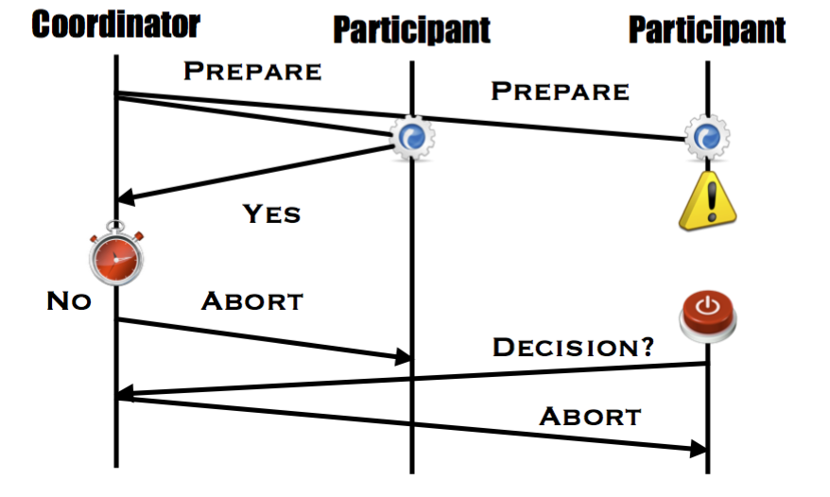
What if participant fails before sending response?
Notes:
SEGUE: So, let’s investigate replicating the data.

Slide 37
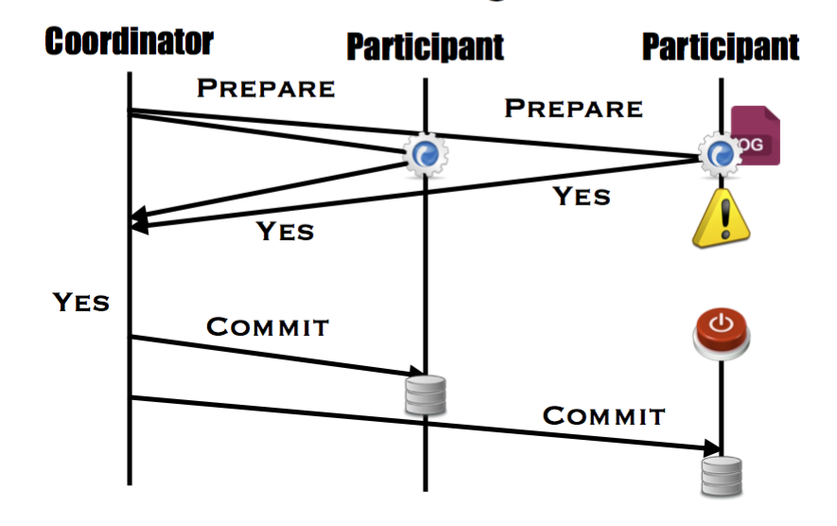
What if participant fails after sending vote
Notes:
SEGUE: So, let’s investigate replicating the data.

Slide 38
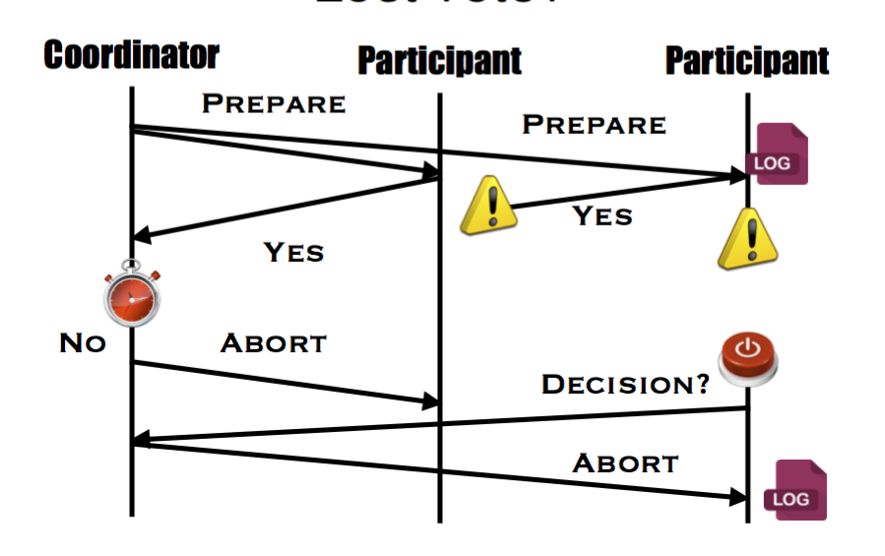
What if participant lost a vote?
Notes:
SEGUE: So, let’s investigate replicating the data.

Slide 39
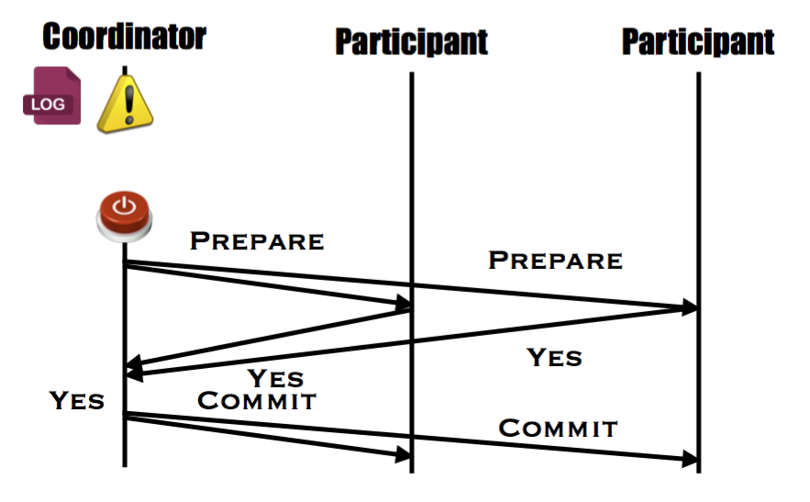
What if coordinator fails before sending prepare?
Notes:
SEGUE: So, let’s investigate replicating the data.

Slide 40
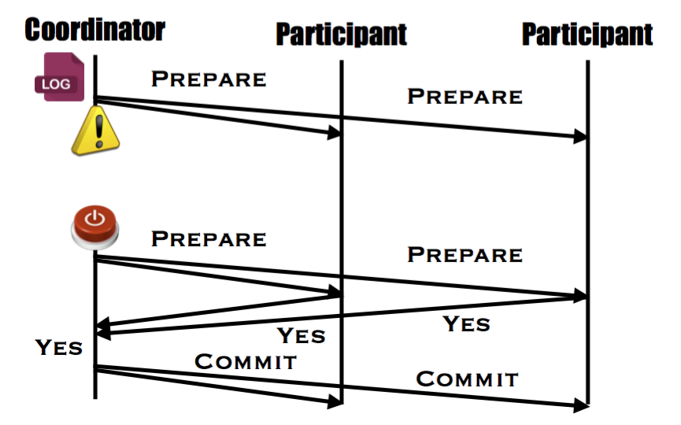
What if coordinator fails after sending prepare?
Notes:
SEGUE: So, let’s investigate replicating the data.

Slide 41
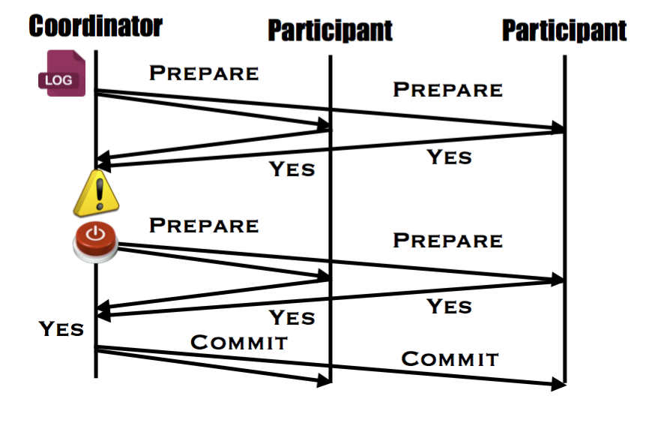
What if coordinator fails after receiving votes
Notes:
SEGUE: So, let’s investigate replicating the data.

Slide 42
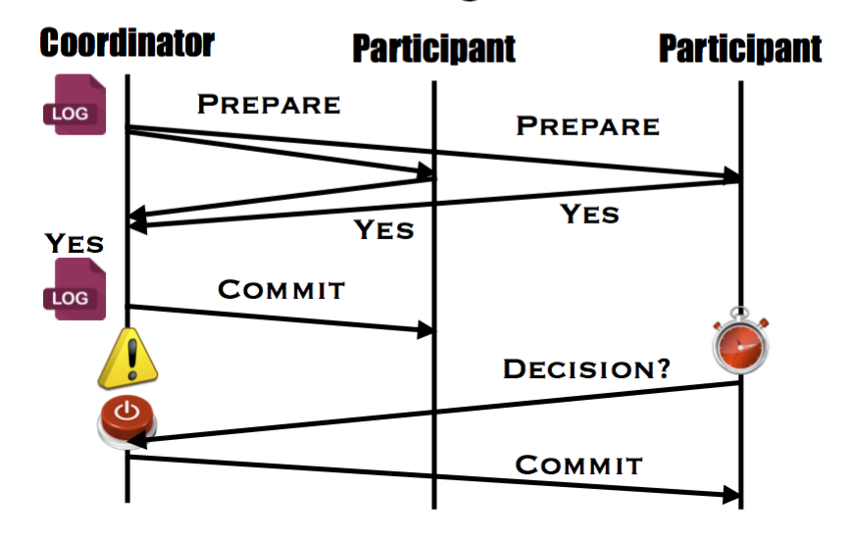
What if coordinator fails after sending decision?
Notes:
SEGUE: So, let’s investigate replicating the data.

Slide 43
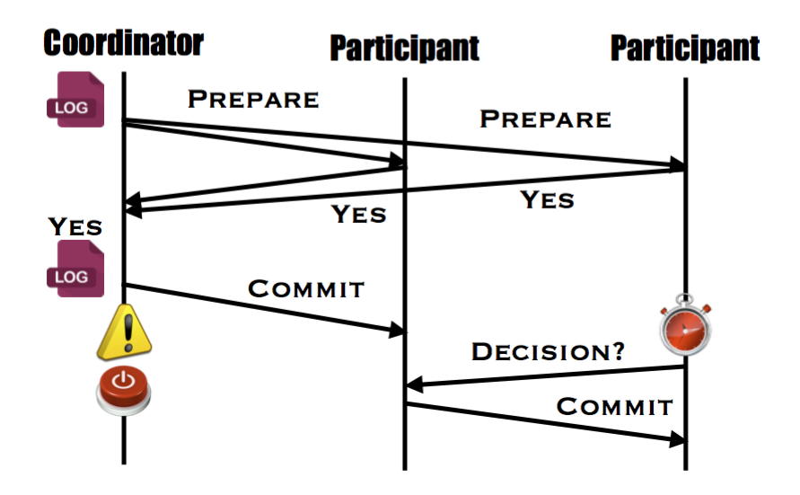
Do we need the coordinator?
Notes:
SEGUE: So, let’s investigate replicating the data.

Slide 44
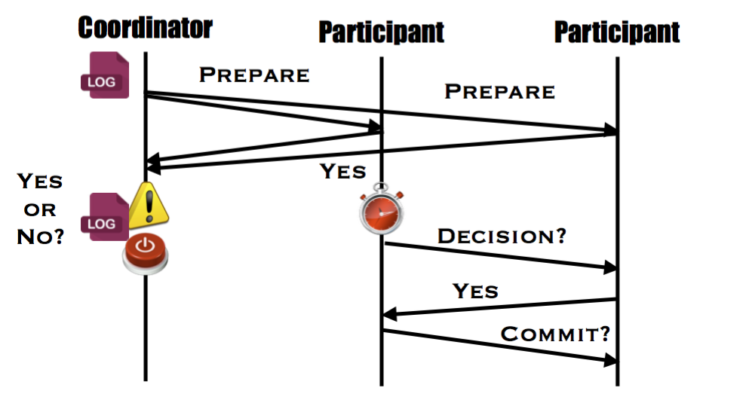
What happens if we don’t have a decision?
Notes:
SEGUE: So, let’s investigate replicating the data.

