Slide 1
Consensus I FLP Impossibility, Paxos
CS 240: Computing Systems and Concurrency
Lecture 8
Marco Canini
Credits: Michael Freedman and Kyle Jamieson developed much of the original material.

Slide 2


Recall our 2PC commit problem
Client C
C → TC: “go!”
TC → A, B: “prepare!”
A, B → P: “yes” or “no”
TC → A, B: “commit!” or “abort!”
Transaction Coordinator TC
Bank
A
B

Slide 3
Recall our 2PC commit problem
Client C
Who acts as TC?
Which server(s) own the account of A? B?
Who takes over if TC fails? What about if A or B fail?
Transaction Coordinator TC
Bank
A
B

Slide 4
Doing failover “correctly” isn’t easy
Which node takes
over as backup?
Transaction Coordinator TC

Slide 5
Doing failover “correctly” isn’t easy
Okay, so specify some ordering
(manually, using some identifier)
Transaction Coordinator TC
1
2
3

Slide 6
Doing failover “correctly” isn’t easy
But who determines
if 1 failed?
Transaction Coordinator TC
1
2
3

Slide 7
Doing failover “correctly” isn’t easy
Easy, right?
Just ping and timeout!
Transaction Coordinator TC
1
2
3

Slide 8
Doing failover “correctly” isn’t easy
Is the server or the network actually dead/slow?
Transaction Coordinator TC
✘
1
1
2

Slide 9
What can go wrong?
Two nodes think they are TC:
“Split brain” scenario
Transaction Coordinator TC
1
1

Slide 10
What can go wrong?
Two nodes think they are TC:
“Split brain” scenario
Transaction Coordinator TC
1
1

Slide 11
What can go wrong?
Safety invariant:
Only 1 node is TC at any single time
Transaction Coordinator TC
1
Another problem:
A and B need to know (and agree upon) who the TC is…

Slide 12
Consensus
Definition:
A general agreement about something
An idea or opinion that is shared by all the people in a group
Origin: Latin, from consentire

Slide 13
Consensus
Given a set of processors, each with an initial value:
Termination: All non-faulty processes eventually decide on a value
Agreement: All processes that decide do so on the same value
Validity: The value that has been decided must have proposed by some process

Slide 14
Consensus used in systems
Group of servers attempting:
Make sure all servers in group receive the same updates in the same order as each other
Maintain own lists (views) on who is a current member of the group, and update lists when somebody leaves/fails
Elect a leader in group, and inform everybody
Ensure mutually exclusive (one process at a time only) access to a critical resource like a file

Slide 15
Step one: Define your system model
Network model:
Synchronous (time-bounded delay) or asynchronous (arbitrary delay)
Reliable or unreliable communication
Unicast or multicast communication
Node failures:
Fail-stop (correct/dead) or Byzantine (arbitrary)

Slide 16
Step one: Define your system model
Network model:
Synchronous (time-bounded delay) or asynchronous (arbitrary delay)
Reliable or unreliable communication
Unicast or multicast communication
Node failures:
Fail-stop (correct/dead) or Byzantine (arbitrary)

Slide 17
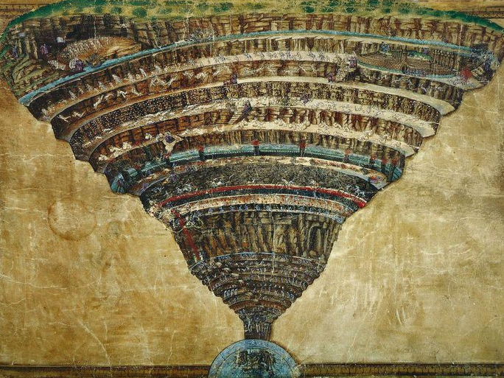
Consensus is impossible
… abandon hope, all ye who enter here …

Slide 18
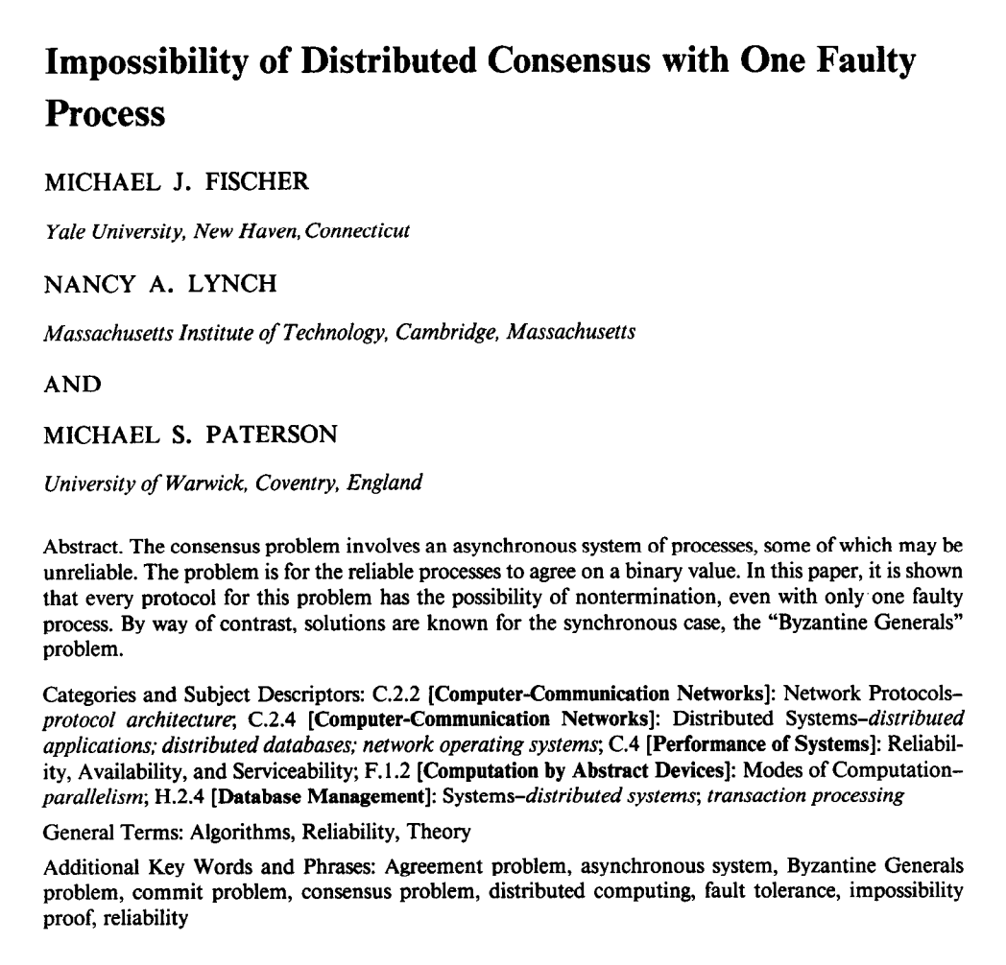
“FLP” result
1985
No deterministic 1-crash-robust consensus algorithm exists for asynchronous model
Holds even for “weak” consensus (i.e., only some process needs to decide, not all)
Holds even for only two states: 0 and 1

Slide 19
Main technical approach
Initial state of system can end in decision “0” or “1”
Consider 5 processes, each in some initial state
[ 1,1,0,1,1 ] → 1
[ 1,1,0,1,0 ] → ?
[ 1,1,0,0,0 ] → ?
[ 1,1,1,0,0 ] → ?
[ 1,0,1,0,0 ] → 0
Must exist two configurations here which differ in decision

Slide 20
Main technical approach
Initial state of system can end in decision “0” or “1”
Consider 5 processes, each in some initial state
[ 1,1,0,1,1 ] → 1
[ 1,1,0,1,0 ] → 1
[ 1,1,0,0,0 ] → 1
[ 1,1,1,0,0 ] → 0
[ 1,0,1,0,0 ] → 0
Assume decision differs between these two processes

Slide 21
Main technical approach
Goal: Consensus holds in face of 1 failure
[ 1,1,0,0,0 ] →
[ 1,1,1,0,0 ] →
One of these configs must be “bi-valent”:
Both futures possible
1 | 0
0

Slide 22
Main technical approach
Goal: Consensus holds in face of 1 failure
[ 1,1,0,0,0 ] →
[ 1,1,1,0,0 ] →
Key result: All bi-valent states can remain in bi-valent states after performing some work
One of these configs must be “bi-valent”:
Both futures possible
1
0 | 1

Slide 23
You won’t believe this one trick!
System thinks process p crashes, adapts to it…
But then p recovers and q crashes…
Needs to wait for p to rejoin, because can only handle 1 failure, which takes time for system to adapt …
… repeat ad infinitum …

Slide 24
All is not lost…
But remember
“Impossible” in the formal sense, i.e., “there does not exist”
Even though such situations are extremely unlikely …
Circumventing FLP Impossibility
Probabilistically
Randomization
Partial Synchrony (e.g., “failure detectors”)

Slide 25
Why should you care?
Werner Vogels, Amazon CTO
Job openings in my group
What kind of things am I looking for in you?
“You know your distributed systems theory: You know about logical time, snapshots, stability, message ordering, but also acid and multi-level transactions. You have heard about the FLP impossibility argument. You know why failure detectors can solve it (but you do not have to remember which one diamond-w was). You have at least once tried to understand Paxos by reading the original paper.”

Slide 26
Paxos
Safety
Only a single value is chosen
Only a proposed value can be chosen
Only chosen values are learned by processes
Liveness ***
Some proposed value eventually chosen if fewer than half of processes fail
If value is chosen, a process eventually learns it

Slide 27
Roles of a Process
Three conceptual roles
Proposers propose values
Acceptors accept values, where chosen if majority accept
Learners learn the outcome (chosen value)
In reality, a process can play any/all roles

Slide 28
Strawman
3 proposers, 1 acceptor
Acceptor accepts first value received
No liveness on failure
3 proposals, 3 acceptors
Accept first value received, acceptors choose common value known by majority
But no such majority is guaranteed

Slide 29
Paxos
Each acceptor accepts multiple proposals
Hopefully one of multiple accepted proposals will have a majority vote (and we determine that)
If not, rinse and repeat (more on this)
How do we select among multiple proposals?
Ordering: proposal is tuple (proposal #, value) = (n, v)
Proposal # strictly increasing, globally unique
Globally unique? Trick: set low-order bits to proposer’s ID

Slide 30
Paxos Protocol Overview
Proposers:
Choose a proposal number n
Ask acceptors if any accepted proposals with n_{a} < n
If existing proposal v_{a} returned, propose same value (n, v_{a})
Otherwise, propose own value (n, v)
Note altruism: goal is to reach consensus, not “win”
Accepters try to accept value with highest proposal n
Learners are passive and wait for the outcome

Slide 31
Paxos Phase 1
Proposer:
Choose proposal number n, send <prepare, n> to acceptors
Acceptors:
If n > n_{h}
n_{h} = n ← promise not to accept any new proposals n’ < n
If no prior proposal accepted
Reply < promise, n, Ø >
Else
Reply < promise, n, (n_{a ,} v_{a}) >
Else
Reply < prepare-failed >

Slide 32
Paxos Phase 2
Proposer:
If receive promise from majority of acceptors,
Determine v_{a} returned with highest n_{a}, if exists
Send <accept, (n, v_{a} || v)> to acceptors
Acceptors:
Upon receiving (n, v), if n ≥ n_{h},
Accept proposal and notify learner(s)
n_{a} = n_{h} = n
v_{a} = v

Slide 33
Paxos Phase 3
Learners need to know which value chosen
Approach #1
Each acceptor notifies all learners
More expensive
Approach #2
Elect a “distinguished learner”
Acceptors notify elected learner, which informs others
Failure-prone

Slide 34
Paxos: Well-behaved Run
1
1
1
1
1
2
2
2
.
.
.
<accept,
(1,v₁)>
.
.
.
.
.
.
decide
v₁
<prepare, 1>
<promise, 1>
n
n
n
<accepted, (1 ,v₁)>

Slide 35
Paxos is safe
Intuition: if proposal with value v decided, then every higher-numbered proposal issued by any proposer has value v.
Majority of acceptors accept (n, v):
v is decided
Next prepare request with proposal n+1

Slide 36
Race condition leads to liveness problem
Process 0
Process 1
Completes phase 1 with proposal n0
Starts and completes phase 1 with proposal n1 > n0
Performs phase 2, acceptors reject
Restarts and completes phase 1 with proposal n2 > n1
Performs phase 2, acceptors reject
… can go on indefinitely …

Slide 37
Paxos with leader election
Simplify model with each process playing all three roles
If elected proposer can communicate with a majority, protocol guarantees liveness
Paxos can tolerate failures f < N / 2

Slide 38
Using Paxos in system
Leader election to decide transaction coordinator
1
2
3
L

Slide 39
Using Paxos in system
New leader election protocol
2
3
L
L _{new}
Still have split-brain scenario!

Slide 40
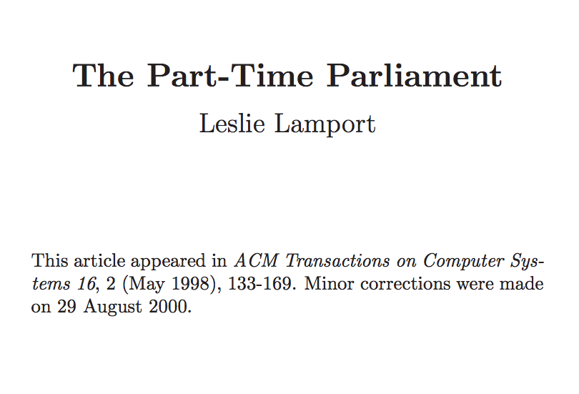
Tells mythical story of Greek island of Paxos with “legislators” and “current law” passed through parliamentary voting protocol
Misunderstood paper: submitted 1990, published 1998
Lamport won the Turing Award in 2013

Slide 41
The Paxos story…
As Paxos prospered, legislators became very busy.
Parliament could no longer handle all details of government, so a bureaucracy was established.
Instead of passing a decree to declare whether each lot of cheese was fit for sale, Parliament passed a decree appointing a cheese inspector to make those decisions.
Cheese inspector ≈ leader
using quorum-based voting protocol

Slide 42
The Paxos story…
Parliament passed a decree making ∆̆ικστρα the first cheese inspector. After some months, merchants complained that ∆̆ικστρα was too strict and was rejecting perfectly good cheese.
Parliament then replaced him by passing the decree
1375: Γωυδα is the new cheese inspector
But ∆̆ικστρα did not pay close attention to what Parliament did, so he did not learn of this decree right away.
There was a period of confusion in the cheese market when both ∆ῐκστρα and Γωυδα were inspecting cheese and making conflicting decisions.
Split-brain!

Slide 43
The Paxos story…
To prevent such confusion, the Paxons had to guarantee that a position could be held by at most one bureaucrat at any time.
To do this, a president included as part of each decree the time and date when it was proposed.
A decree making ∆ῐκστρα the cheese inspector might read
2716: 8:30 15 Jan 72 – ∆ῐκστρα is cheese inspector for 3 months.
Leader gets a lease!

Slide 44
The Paxos story…
A bureaucrat needed to tell time to determine if he currently held a post. Mechanical clocks were unknown on Paxos, but Paxons could tell time accurately to within 15 minutes by the position of the sun or the stars.
If ∆̆ικστρα’s term began at 8:30, he would not start inspecting cheese until his celestial observations indicated that it was 8:45.
Handle clock skew:
Lease doesn’t end until expiry + max skew

Slide 45
Solving Split Brain
New leader election protocol
2
3
L
L _{new}
Solution
If L isn’t part of majority electing L _{new}
L _{new} waits until L’s lease expires before accepting new ops

Slide 46
Next lecture: Sunday
Other consensus protocols with group membership + leader election at core
Viewstamped Replication
RAFT (assignment 3)

