Slide 1
Network File Systems
CS 240: Computing Systems and Concurrency
Lecture 4
Marco Canini
Credits: Michael Freedman and Kyle Jamieson developed much of the original material.

Slide 2
Abstraction, abstraction, abstraction!
Local file systems
Disks are terrible abstractions: low-level blocks, etc.
Directories, files, links much better
Distributed file systems
Make a remote file system look local
Today: NFS (Network File System)
Developed by Sun in 1980s, still used today!

Slide 3
3 Goals: Make operations appear: Local Consistent Fast

Slide 4
NFS Architecture
“Mount” remote FS (host:path) as local directories
Notes:
Coulouris, Dollimore, Kindberg and Blair, Distributed Systems: Concepts and Design Edn. 5 © Pearson Education 2012

Slide 5
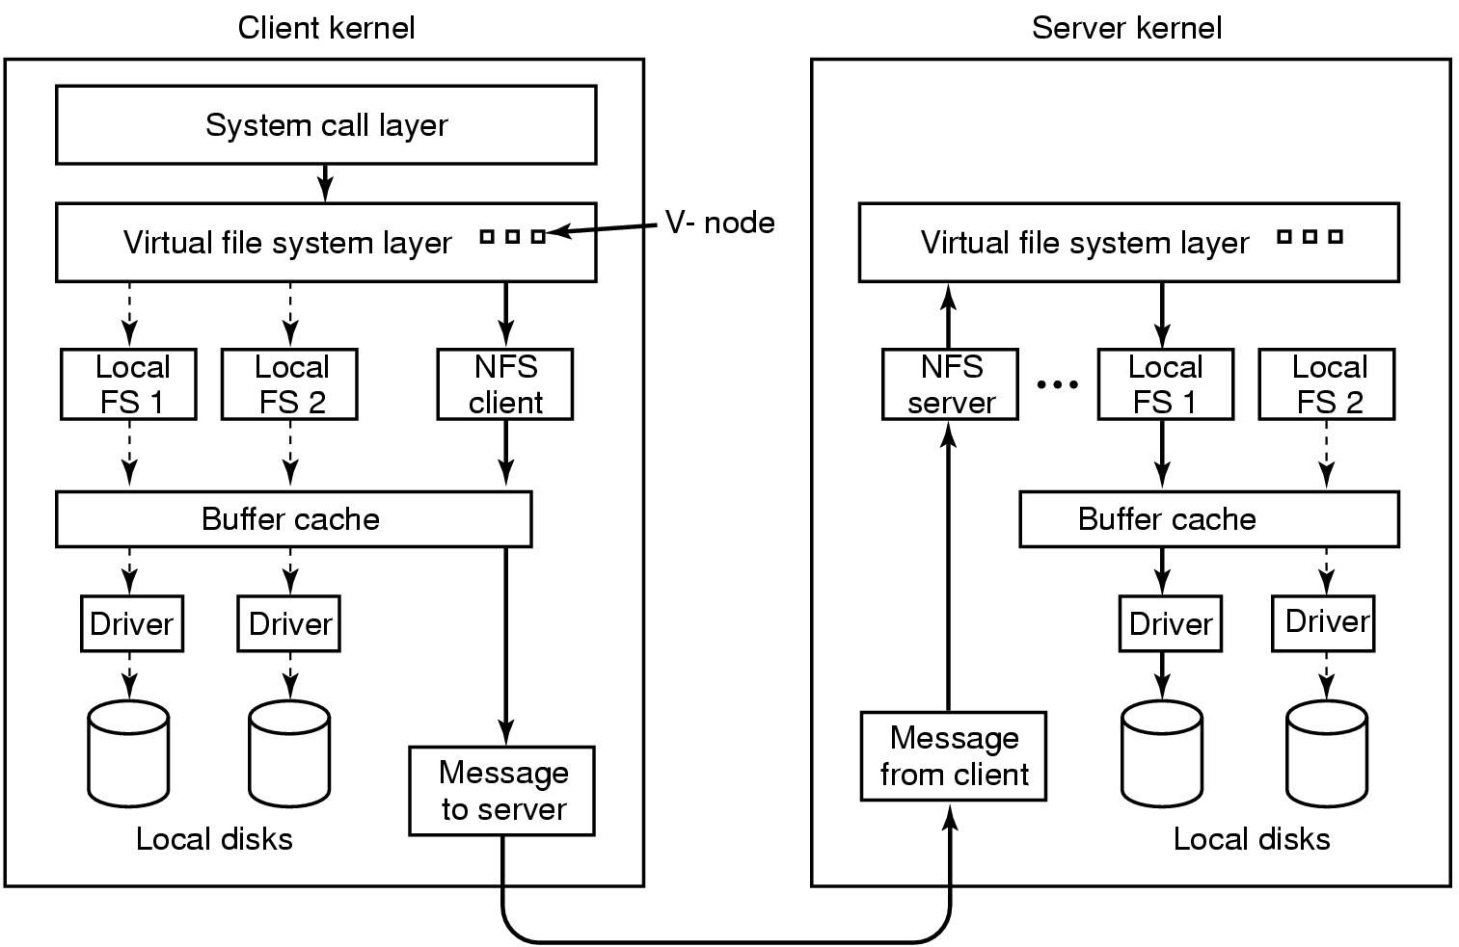
Virtual File System enables transparency

Slide 6
Interfaces matter

Slide 7
VFS / Local FS
fd = open(“path”, flags)
read(fd, buf, n)
write(fd, buf, n)
close(fd)
Server maintains state that maps fd to inode, offset

Slide 8
Stateless NFS: Strawman 1
fd = open(“path”, flags)
read(“path”, buf, n)
write(“path”, buf, n)
close(fd)

Slide 9
Stateless NFS: Strawman 2
fd = open(“path”, flags)
read(“path”, offset, buf, n)
write(“path”, offset, buf, n)
close(fd)

Slide 10
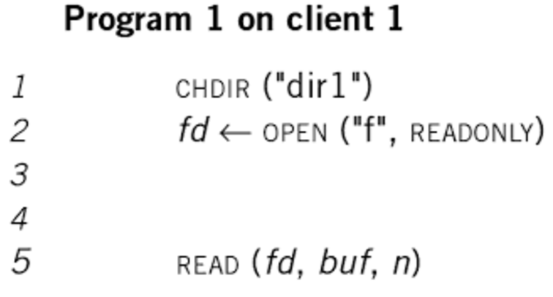
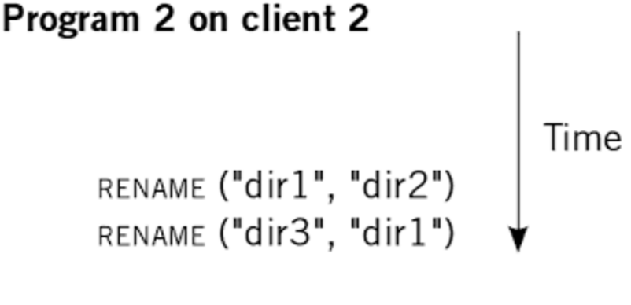
Embed pathnames in syscalls?
Should read refer to current dir1/f or dir2/f ?
In UNIX, it’s dir2/f. How do we preserve in NFS?

Slide 11
Stateless NFS (for real)
fh = lookup(“path”, flags)
read(fh, offset, buf, n)
write(fh, offset, buf, n)
getattr(fh)
Implemented as Remote Procedure Calls (RPCs)

Slide 12
NFS File Handles (fh)
Opaque identifier provider to client from server
Includes all info needed to identify file/object on server
volume ID | inode # | generation #
It’s a trick: “store” server state at the client!

Slide 13
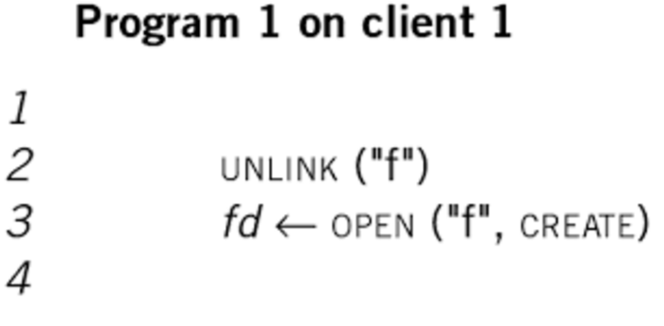
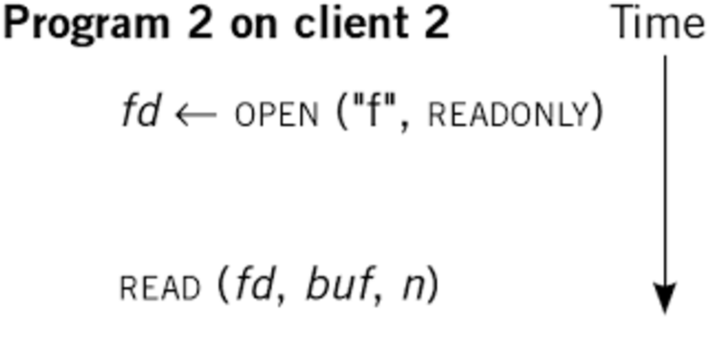
NFS File Handles (and versioning)
With generation #’s, client 2 continues to interact with “correct” file, even while client 1 has changed “ f ”
This versioning appears in many contexts, e.g., MVCC (multiversion concurrency control) in DBs

Slide 14
NFS example
fd = open(”/foo”, ...);
Send LOOKUP (rootdir FH, ”foo”)
Receive LOOKUP request
look for ”foo” in root dir
return foo’s FH + attributes
Receive LOOKUP reply allocate file desc in open file table
store foo’s FH in table store current file position (0)
return file descriptor to application
Notes:
Credits: Operating Systems: Three Easy Pieces, Remzi H. Arpaci-Dusseau and Andrea C. Arpaci-Dusseau

Slide 15
NFS example
read(fd, buffer, MAX);
Index into open file table with fd
get NFS file handle (FH) use current file position as offset
Send READ (FH, offset=0, count=MAX)
Receive READ request use FH to get volume/inode num
read inode from disk (or cache)
compute block location (using offset)
read data from disk (or cache) return data to client
Receive READ reply update file position (+bytes read)
set current file position = MAX
return data/error code to app
Notes:
Credits: Operating Systems: Three Easy Pieces, Remzi H. Arpaci-Dusseau and Andrea C. Arpaci-Dusseau

Slide 16
NFS example
read(fd, buffer, MAX);
Same except offset=MAX and
set current file position = 2*MAX
read(fd, buffer, MAX);
Same except offset=2*MAX and
set current file position = 3*MAX
close(fd);
Just need to clean up local structures
Free descriptor ”fd” in open file table
(No need to talk to server)
Notes:
Credits: Operating Systems: Three Easy Pieces, Remzi H. Arpaci-Dusseau and Andrea C. Arpaci-Dusseau

Slide 17
Handling server failures
What to do when server is not responding?
Retry again!
set a timer; a reply before cancels the retry; else retry
Is it safe to retry operations?
NFS operations are idempotent
the effect of multiple invocations is same as single one
LOOKUP, READ, WRITE: message contains all that is necessary to re-execute
What is not idempotent?
E.g., if we had INCREMENT
Real example: MKDIR is not

Slide 18
Are remote == local?

Slide 19
TANSTANFL (There ain’t no such thing as a free lunch)
With local FS, read sees data from “most recent” write, even if performed by different process
“Read/write coherence”, linearizability
Achieve the same with NFS?
Perform all reads & writes synchronously to server
Huge cost: high latency, low scalability
And what if the server doesn’t return?
Options: hang indefinitely, return ERROR
All operations appear to have executed atomically in an order that is consistent with the global real-time ordering of operations. (Herlihy & Wing, 1991)

Slide 20
Caching GOOD Lower latency, better scalability Consistency HARDER No longer one single copy of data, to which all operations are serialized

Slide 21
Caching options
Centralized control: Record status of clients (which files open for reading/writing, what cached, …)
Read-ahead: Pre-fetch blocks before needed
Write-through: All writes sent to server
Write-behind: Writes locally buffered, send as batch
Notes:
Paul Krzyzanowski, CS 417 Distributed Systems, Rutgers, Fall 2013.
http://www.cs.rutgers.edu/~pxk/417/notes/content/08-nas-slides-6pp.pdf

Slide 22
Cache consistency problem
Consistency challenges:
When client writes, how do others caching data get updated? (Callbacks, …)
Two clients concurrently write? (Locking, overwrite, …)
C1
cache: F[v1]
C2
cache: F[v2]
C3
cache: empty
Server S
disk: F[v1] at first
F[v2] eventually

Slide 23
Should server maintain per-client state?
Stateful
Stateless
Pros
Smaller requests
Simpler req processing
Better cache coherence, file locking, etc.
Cons
Per-client state limits scalability
Fault-tolerance on state required for correctness
Pros
Easy server crash recovery
No open/close needed
Better scalability
Cons
Each request must be fully self-describing
Consistency is harder, e.g., no simple file locking
Notes:
Paul Krzyzanowski, CS 417 Distributed Systems, Rutgers, Fall 2013.
http://www.cs.rutgers.edu/~pxk/417/notes/content/08-nas-slides-6pp.pdf

Slide 24
It’s all about the state, ’bout the state, …
Hard state: Don’t lose data
Durability: State not lost
Write to disk, or cold remote backup
Exact replica or recoverable (DB: checkpoint + op log)
Availability (liveness): Maintain online replicas
Soft state: Performance optimization
Then: Lose at will
Now: Yes for correctness (safety), but how does recovery impact availability (liveness)?

Slide 25
NFS
Stateless protocol
Recovery easy: crashed == slow server
Messages over UDP (unencrypted)
Read from server, caching in NFS client
NFSv2 was write-through (i.e., synchronous)
NFSv3 added write-behind
Delay writes until close or fsync from application

Slide 26
Exploring the consistency tradeoffs
Write-to-read semantics too expensive
Give up caching, require server-side state, or …
Close-to-open “session” semantics
Ensure an ordering, but only between application close and open, not all writes and reads.
If B opens after A closes, will see A’s writes
But if two clients open at same time? No guarantees
And what gets written? “Last writer wins”

Slide 27
NFS Cache Consistency
Recall challenge: Potential concurrent writers
Cache validation:
Get file’s last modification time from server: getattr(fh)
Both when first open file, then poll every 3-60 seconds
If server’s last modification time has changed, flush dirty blocks and invalidate cache
When reading a block
Validate: (current time – last validation time < threshold)
If valid, serve from cache. Otherwise, refresh from server

Slide 28
Some problems…
“Mixed reads” across version
A reads block 1-10 from file, B replaces blocks 1-20, A then keeps reading blocks 11-20.
Assumes synchronized clocks. Not really correct.
We’ll learn about the notion of logical clocks later
Writes specified by offset
Concurrent writes can change offset

Slide 29
Server-side write buffering
xxxxxxxxxxxxxxxxxxxxxxxxxxxxxxxxxxxxxxxxxxxxxxxxxxxxxxxxxxxx
yyyyyyyyyyyyyyyyyyyyyyyyyyyyyyyyyyyyyyyyyyyyyyyyyyyyyyyyyyyy
zzzzzzzzzzzzzzzzzzzzzzzzzzzzzzzzzzzzzzzzzzzzzzzzzzzzzzzzzzzz
write(fd, a_buffer, size); // fill first block with a’s
write(fd, b_buffer, size); // fill second block with b’s
write(fd, c_buffer, size); // fill third block with c’s
Expected:
aaaaaaaaaaaaaaaaaaaaaaaaaaaaaaaaaaaaaaaaaaaaaaaaaaaaaaaaaaaa
bbbbbbbbbbbbbbbbbbbbbbbbbbbbbbbbbbbbbbbbbbbbbbbbbbbbbbbbbbbb
cccccccccccccccccccccccccccccccccccccccccccccccccccccccccccc
But assume server buffers 2nd write, reports OK but then crashes:
aaaaaaaaaaaaaaaaaaaaaaaaaaaaaaaaaaaaaaaaaaaaaaaaaaaaaaaaaaaa
yyyyyyyyyyyyyyyyyyyyyyyyyyyyyyyyyyyyyyyyyyyyyyyyyyyyyyyyyyyy
cccccccccccccccccccccccccccccccccccccccccccccccccccccccccccc
Server must commit each write to stable (persistent) storage before informing the client of success

Slide 30
When statefulness helps
Callbacks
Locks + Leases

Slide 31
NFS Cache Consistency
Recall challenge: Potential concurrent writers
Timestamp invalidation: NFS
Callback invalidation: AFS, Sprite, Spritely NFS
Server tracks all clients that have opened file
On write, sends notification to clients if file changes; client invalidates cache
Leases: Gray & Cheriton ’89, NFSv4

Slide 32
Locks
A client can request a lock over a file / byte range
Advisory: Well-behaved clients comply
Mandatory: Server-enforced
Client performs writes, then unlocks
Problem: What if the client crashes?
Solution: Keep-alive timer: Recover lock on timeout
Problem: what if client alive but network route failed?
Client thinks it has lock, server gives lock to other: “Split brain”

Slide 33
Leases
Client obtains lease on file for read or write
“A lease is a ticket permitting an activity; the lease is valid until some expiration time.”
Read lease allows client to cache clean data
Guarantee: no other client is modifying file
Write lease allows safe delayed writes
Client can locally modify then batch writes to server
Guarantee: no other client has file cached

Slide 34
Using leases
Client requests a lease
May be implicit, distinct from file locking
Issued lease has file version number for cache coherence
Server determines if lease can be granted
Read leases may be granted concurrently
Write leases are granted exclusively
If conflict exists, server may send eviction notices
Evicted write lease must write back
Evicted read leases must flush/disable caching
Client acknowledges when completed

Slide 35
Bounded lease term simplifies recovery
Before lease expires, client must renew lease
Client fails while holding a lease?
Server waits until the lease expires, then unilaterally reclaims
If client fails during eviction, server waits then reclaims
Server fails while leases outstanding? On recovery,
Wait lease period + clock skew before issuing new leases
Absorb renewal requests and/or writes for evicted leases

Slide 36
Requirements dictate design
Case Study: AFS

Slide 37
Andrew File System (CMU 1980s-)
Scalability was key design goal
Many servers, 10,000s of users
Observations about workload
Reads much more common than writes
Concurrent writes are rare / writes between users disjoint
Interfaces in terms of files, not blocks
Whole-file serving: entire file and directories
Whole-file caching: clients cache files to local disk
Large cache and permanent, so persists across reboots

Slide 38
AFS: Consistency
Consistency: Close-to-open consistency
No mixed writes, as whole-file caching / whole-file overwrites
Update visibility: Callbacks to invalidate caches
What about crashes or partitions?
Client invalidates cache iff
Recovering from failure
Regular liveness check to server (heartbeat) fails.
Server assumes cache invalidated if callbacks fail + heartbeat period exceeded

Slide 39
Homework / Lab
3-part exercise
Virt. basics: AWS, Vagrant, Docker
Simple socket programming
Simple RPC client-server
Do you prefer a lab format with TAs or DIY?

Slide 40
Next lecture topic:
Google File System (GFS)

