Slide 1
Strong Consistency & CAP Theorem
CS 240: Computing Systems and Concurrency
Lecture 15
Marco Canini
Credits: Michael Freedman and Kyle Jamieson developed much of the original material.

Slide 2
Consistency models
2PC / Consensus
Paxos / Raft
Eventual consistency
Dynamo

Slide 3

Consistency in Paxos/Raft
shl
Consensus Module
State Machine
Consensus Module
State Machine
Consensus Module
State Machine
Log
Log
Log
add
jmp
mov
shl
add
jmp
mov
shl
add
jmp
mov
shl
Fault-tolerance / durability: Don’t lose operations
Consistency: Ordering between (visible) operations
Notes:
Processes may be running on different machines

Slide 4
Correct consistency model?
A
B
Let’s say A and B send an op.
All readers see A → B ?
All readers see B → A ?
Some see A → B and others B → A ?
Notes:
Processes may be running on different machines

Slide 5
Paxos/RAFT has strong consistency
Provide behavior of a single copy of object:
Read should return the most recent write
Subsequent reads should return same value, until next write
Telephone intuition:
Alice updates Facebook post
Alice calls Bob on phone: “Check my Facebook post!”
Bob read’s Alice’s wall, sees her post

Slide 6

Strong Consistency?
write(A,1)
success
1
read(A)
Phone call: Ensures happens-before relationship, even through “out-of-band” communication

Slide 7
Strong Consistency?
write(A,1)
success
1
read(A)
One cool trick: Delay responding to writes/ops until properly committed

Slide 8
Strong Consistency? This is buggy!
write(A,1)
success
1
committed
read(A)
Isn’t sufficient to return value of third node: It doesn’t know precisely when op is “globally” committed
Instead: Need to actually order read operation

Slide 9
Strong Consistency!
write(A,1)
success
1
read(A)
Order all operations via (1) leader, (2) consensus

Slide 10
Strong consistency = linearizability
Linearizability (Herlihy and Wang 1991)
All servers execute all ops in some identical sequential order
Global ordering preserves each client’s own local ordering
Global ordering preserves real-time guarantee
All ops receive global time-stamp using a sync’d clock
If ts_{op1}(x) < ts_{op2}(y), OP1(x) precedes OP2(y) in sequence
Once write completes, all later reads (by wall-clock start time) should return value of that write or value of later write.
Once read returns particular value, all later reads should return that value or value of later write.
Notes:
If ts(a) < ts (b), are either linearizable? Does ts(a) have to be before ts(b)? If concurrent, both just need to agree (tie break via some other thing (processor ID)?)

Slide 11
Intuition: Real-time ordering
write(A,1)
success
1
committed
read(A)
Once write completes, all later reads (by wall-clock start time) should return value of that write or value of later write.
Once read returns particular value, all later reads should return that value or value of later write.

Slide 12
Weaker: Sequential consistency
Sequential = Linearizability – real-time ordering
All servers execute all ops in some identical sequential order
Global ordering preserves each client’s own local ordering
With concurrent ops, “reordering” of ops (w.r.t. real-time ordering) acceptable, but all servers must see same order
e.g., linearizability cares about time sequential consistency cares about program order
Notes:
If ts(a) < ts (b), are either linearizable? Does ts(a) have to be before ts(b)? If concurrent, both just need to agree (tie break via some other thing (processor ID)?)

Slide 13
Sequential Consistency
write(A,1)
success
0
read(A)
In example, system orders read(A) before write(A,1)

Slide 14
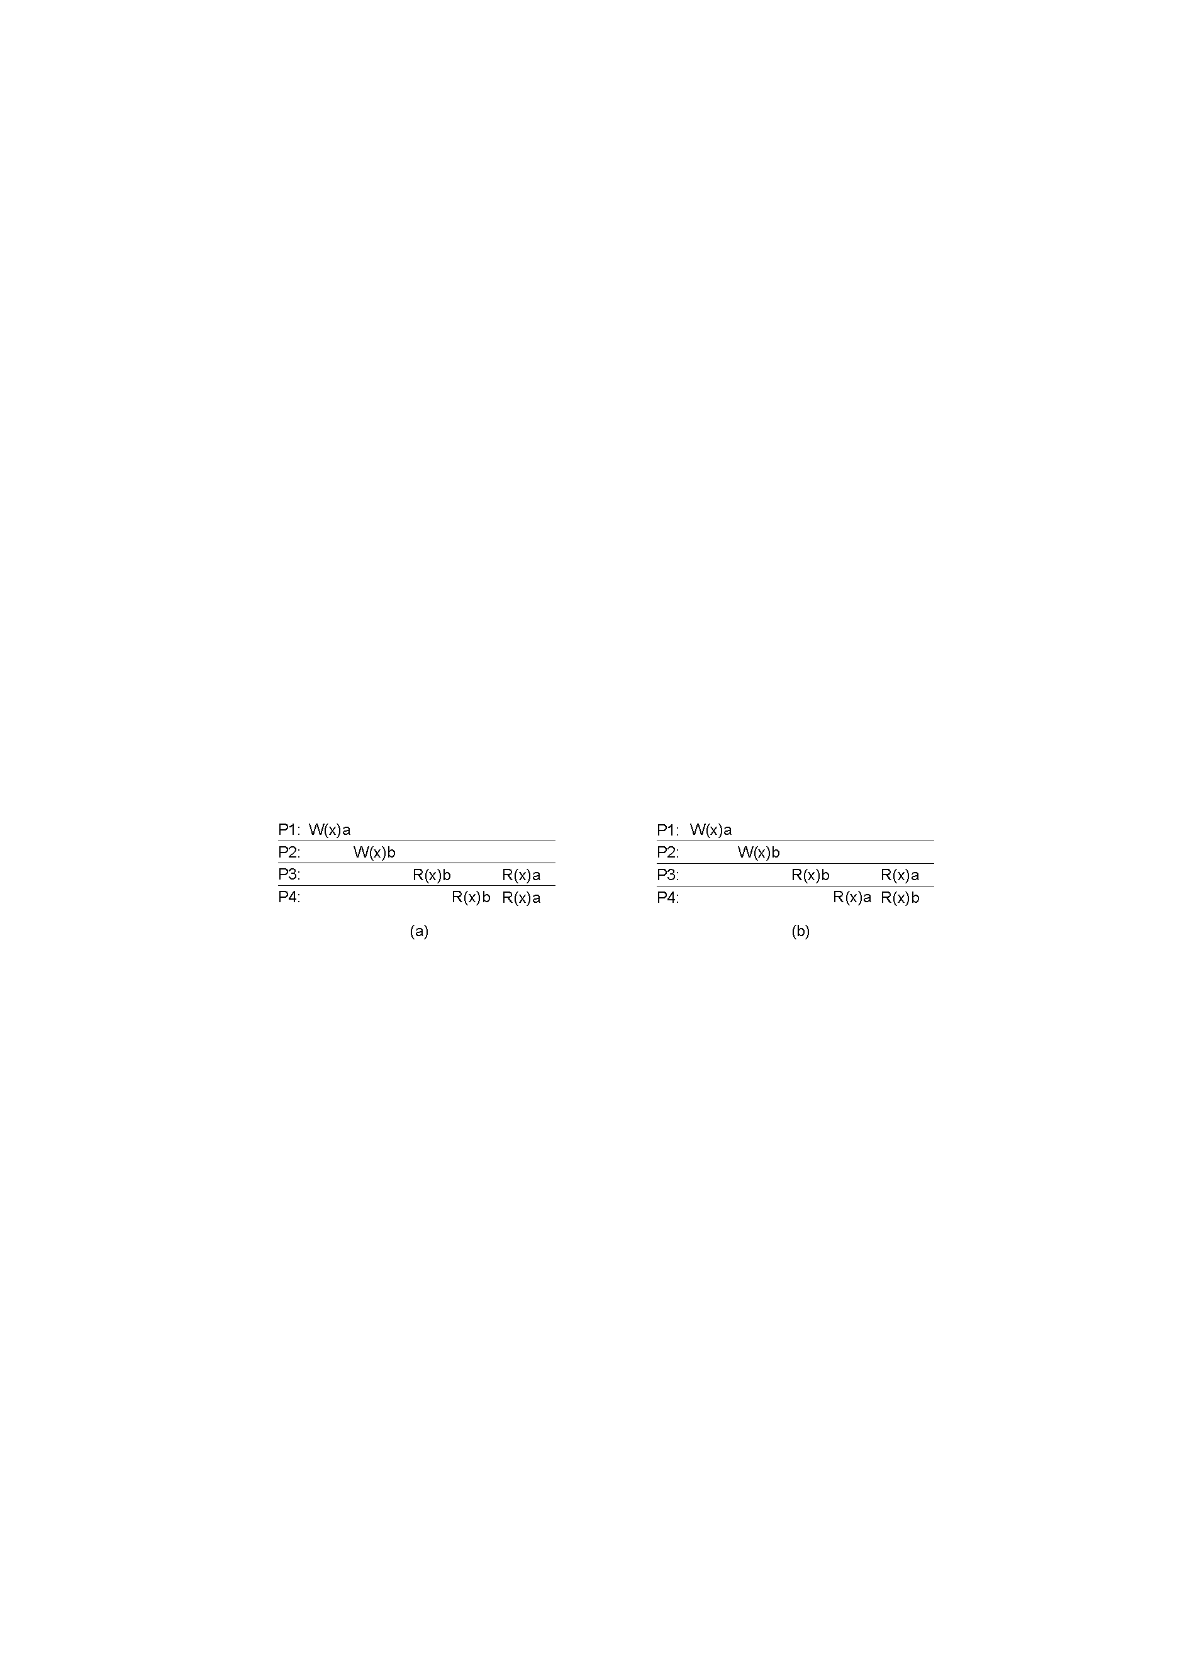
Valid Sequential Consistency?
x
✓
Why? Because P3 and P4 don’t agree on order of ops. Doesn’t matter when events took place on diff machine, as long as proc’s AGREE on order.
What if P1 did both W(x)a and W(x)b?
Neither valid, as (a) doesn’t preserve local ordering

Slide 15
Tradeoffs are fundamental?
2PC / Consensus
Paxos / Raft
Eventual consistency
Dynamo

Slide 16
“CAP” Conjection for Distributed Systems
From keynote lecture by Eric Brewer (2000)
History: Eric started Inktomi, early Internet search site based around “commodity” clusters of computers
Using CAP to justify “BASE” model: Basically Available, Soft-state services with Eventual consistency
Popular interpretation: 2-out-of-3
Consistency (Linearizability)
Availability
Partition Tolerance: Arbitrary crash/network failures

Slide 17
CAP Theorem: Proof
Not
consistent
Gilbert, Seth, and Nancy Lynch. "Brewer's conjecture and the feasibility of consistent, available, partition-tolerant web services." ACM SIGACT News 33.2 (2002): 51-59.

Slide 18
CAP Theorem: Proof
Not
available
Gilbert, Seth, and Nancy Lynch. "Brewer's conjecture and the feasibility of consistent, available, partition-tolerant web services." ACM SIGACT News 33.2 (2002): 51-59.

Slide 19
CAP Theorem: Proof
Not
partition
tolerant
Gilbert, Seth, and Nancy Lynch. "Brewer's conjecture and the feasibility of consistent, available, partition-tolerant web services." ACM SIGACT News 33.2 (2002): 51-59.

Slide 20
CAP Theorem: AP or CP
Not
partition
tolerant
Criticism: It’s not 2-out-of-3
Can’t “choose” no partitions
So: AP or CP

Slide 21
More tradeoffs L vs. C
Low-latency: Speak to fewer than quorum of nodes?
2PC: write N, read 1
RAFT: write ⌊N/2⌋ + 1, read ⌊N/2⌋ + 1
General: |W| + |R| > N
L and C are fundamentally at odds
“C” = linearizability, sequential, serializability (more later)

Slide 22
PACELC
If there is a partition (P):
How does system tradeoff A and C?
Else (no partition)
How does system tradeoff L and C?
Is there a useful system that switches?
Dynamo: PA/EL
“ACID” dbs: PC/EC
http://dbmsmusings.blogspot.com/2010/04/problems-with-cap-and-yahoos-little.html

Slide 23
More linearizable replication algorithms

Slide 24
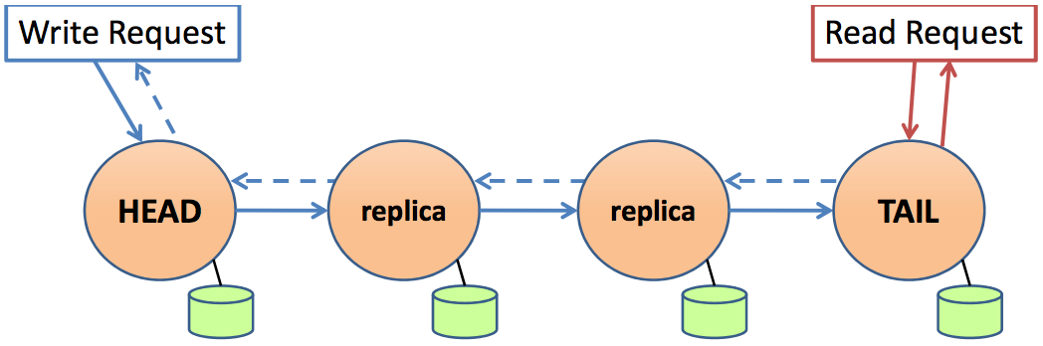
Chain replication
Writes to head, which orders all writes
When write reaches tail, implicitly committed rest of chain
Reads to tail, which orders reads w.r.t. committed writes
Notes:
Processes may be running on different machines

Slide 25
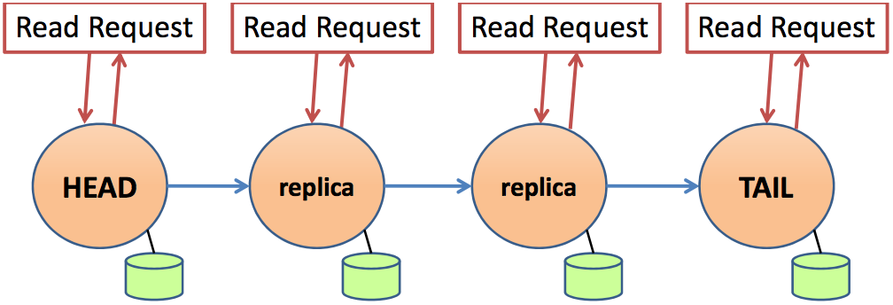
Chain replication for read-heavy (CRAQ)
Goal: If all replicas have same version, read from any one
Challenge: They need to know they have correct version
Notes:
Processes may be running on different machines

Slide 26
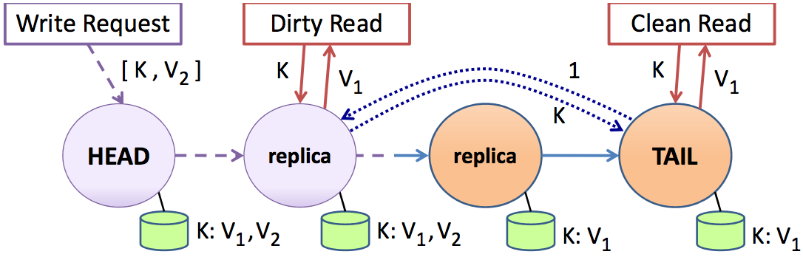
Chain replication for read-heavy (CRAQ)
Replicas maintain multiple versions of objects while “dirty”, i.e., contain uncommitted writes
Commitment sent “up” chain after reaches tail
Notes:
Processes may be running on different machines

Slide 27
Chain replication for read-heavy (CRAQ)
Read to dirty object must check with tail for proper version
This orders read with respect to global order, regardless of replica that handles
Notes:
Processes may be running on different machines

Slide 28
Performance: CR vs. CRAQ
7x-
3x-
1x-
R. van Renesse and F. B. Schneider. Chain replication for supporting high throughput and availability. OSDI 2004.
J. Terrace and M. Freedman. Object Storage on CRAQ: High-throughput chain replication for read-mostly workloads. USENIX ATC 2009.

Slide 29
Wednesday lecture
Causal Consistency

