Slide 1
Causal Consistency
CS 240: Computing Systems and Concurrency
Lecture 16
Marco Canini
Credits: Michael Freedman and Kyle Jamieson developed much of the original material.

Slide 2
Consistency models
Linearizability
Causal
Eventual
Sequential

Slide 3
Recall use of logical clocks (lec 5)
Lamport clocks: C(a) < C(z) Conclusion: None
Vector clocks: V(a) < V(z) Conclusion: a → … → z
Distributed bulletin board application
Each post gets sent to all other users
Consistency goal: No user to see reply before the corresponding original message post
Conclusion: Deliver message only after all messages that causally precede it have been delivered
Notes:
Users post messages, reply to each others’ messages.

Slide 4
Causal Consistency
Writes that are potentially causally related must be seen by all machines in same order.
Concurrent writes may be seen in a different order on different machines.
Concurrent: Ops not causally related

Slide 5
Causal Consistency
Writes that are potentially causally related must be seen by all machines in same order.
Concurrent writes may be seen in a different order on different machines.
Concurrent: Ops not causally related
P1
P2
P3
a
f
b
c
d
e
g
Physical time ↓

Slide 6
Causal Consistency
Operations
a, b
b, f
c, f
e, f
e, g
a, c
a, e
Concurrent?
N
Y
Y
Y
N
Y
N
P1
P2
P3
a
f
b
c
d
e
g
Physical time ↓

Slide 7
Causal Consistency
Operations
a, b
b, f
c, f
e, f
e, g
a, c
a, e
Concurrent?
N
Y
Y
Y
N
Y
N
P1
P2
P3
a
f
b
c
d
e
g
Physical time ↓

Slide 8
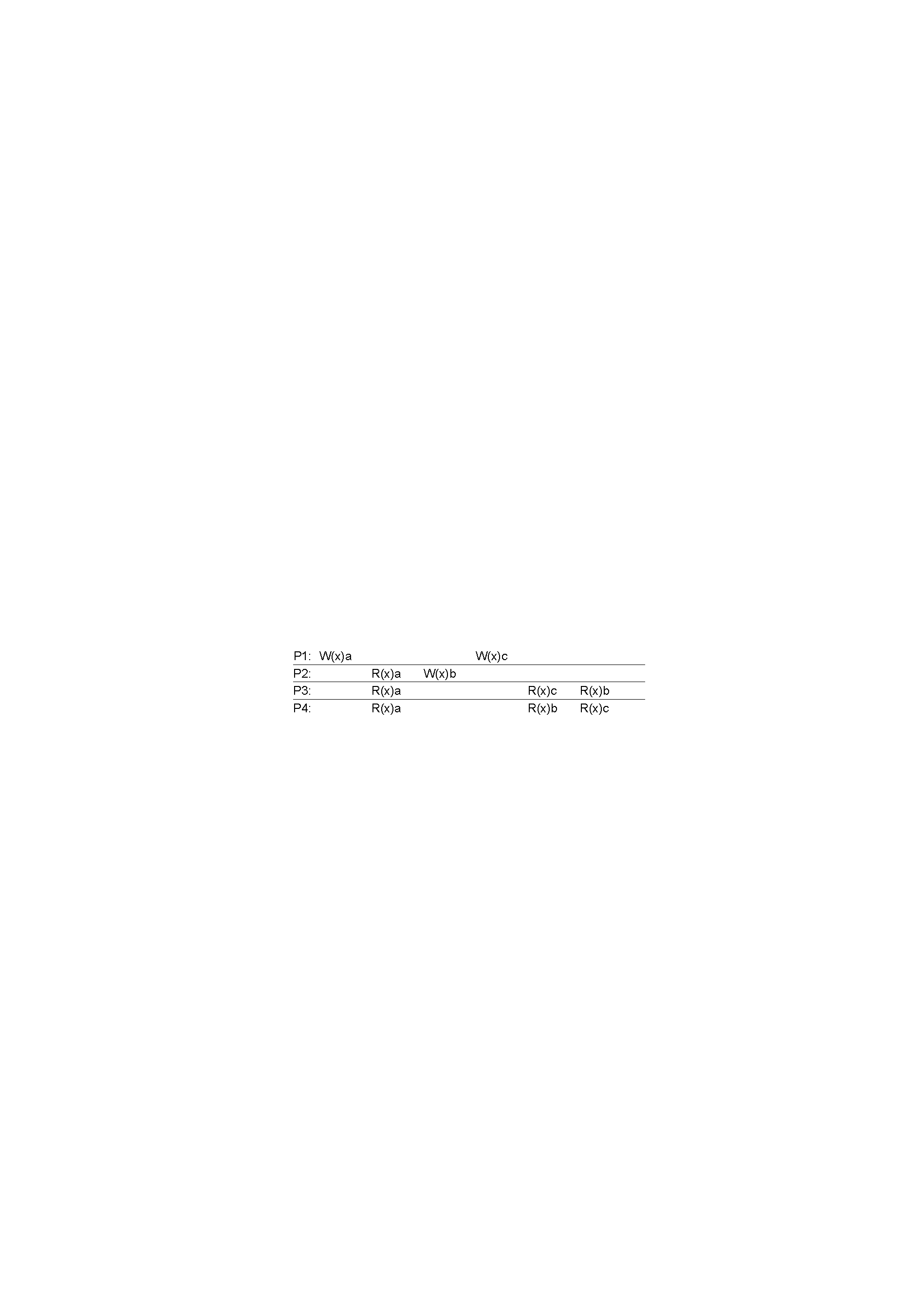
Causal Consistency: Quiz
Valid under causal consistency
Why? W(x)b and W(x)c are concurrent
So all processes don’t (need to) see them in same order
P3 and P4 read the values ‘a’ and ‘b’ in order as potentially causally related. No ‘causality’ for ‘c’.

Slide 9
Sequential Consistency: Quiz
Invalid under sequential consistency
Why? P3 and P4 see b and c in different order
But fine for causal consistency
B and C are not causually dependent
Write after write has no dep’s, write after read does

Slide 10
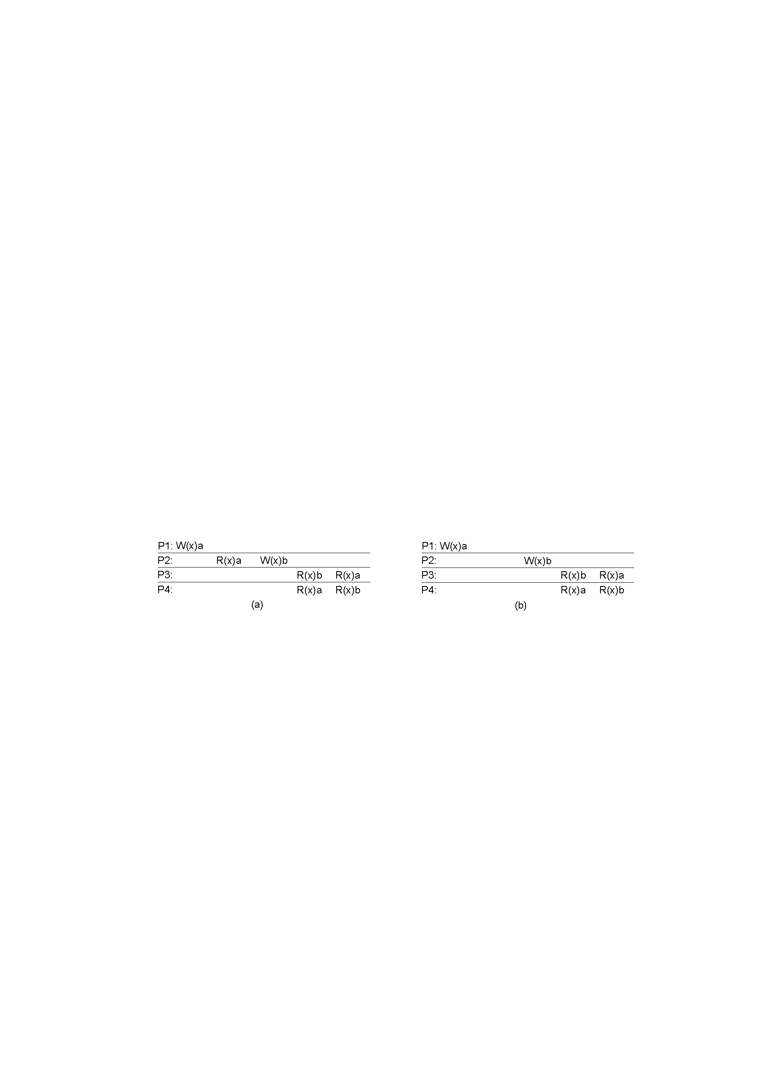
Causal Consistency
x
✓
A: Violation: W(x)b is potentially dep on W(x)a
B: Correct. P2 doesn’t read value of a before W

Slide 11
Causal consistency within replication systems

Slide 12

Implications of laziness on consistency
shl
Consensus Module
State Machine
Consensus Module
State Machine
Consensus Module
State Machine
Log
Log
Log
add
jmp
mov
shl
add
jmp
mov
shl
add
jmp
mov
shl
Linearizability / sequential: Eager replication
Trades off low-latency for consistency

Slide 13
Implications of laziness on consistency
shl
State Machine
State Machine
State Machine
Log
Log
Log
add
jmp
mov
shl
add
jmp
mov
shl
add
jmp
mov
shl
Causal consistency: Lazy replication
Trades off consistency for low-latency
Maintain local ordering when replicating
Operations may be lost if failure before replication

Slide 14
Don't Settle for Eventual: Scalable Causal Consistency for Wide-Area Storage with COPS
W. Lloyd, M. Freedman, M. Kaminsky, D. Andersen
SOSP 2011

Slide 15
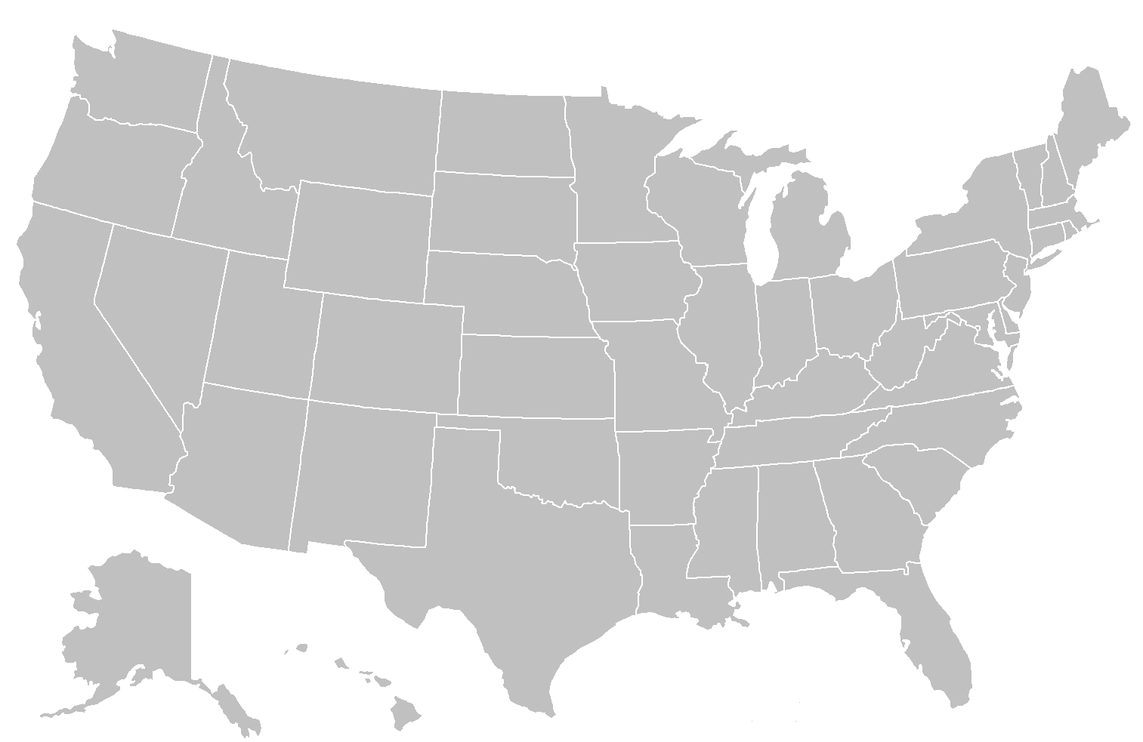
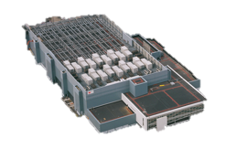
Wide-Area Storage: Serve reqs quickly

Slide 16

Inside the Datacenter
Web Tier
Storage Tier
A-F
Replication
Remote DC
G-L
Web Tier
Storage Tier
A-F
M-R
G-L
M-R
S-Z
S-Z

Slide 17
Trade-offs
Consistency (Stronger)
Partition Tolerance
vs.
Availability
Low Latency
Partition Tolerance
Scalability

Slide 18
Scalability through partitioning
A-C
A-Z
A-Z
A-F
A-F
A-L
A-L
A-C
D-F
G-L
G-L
M-Z
M-Z
D-F
G-J
M-R
M-R
G-J
K-L
S-Z
S-Z
K-L
M-O
M-O
P-S
P-S
T-V
T-V
W-Z
W-Z

Slide 19



Causality By Example
Causality ( )
Thread-of-Execution
Gets-From
Transitivity
Remove boss from friends group
Post to friends: “Time for a new job!”
Friend reads post
Friends
Boss
New Job!
Notes:
There are three rules that define causality:
1) Thread-of-Execution: all operations occurring in the same thread are ordered by causality
2) Gets-From: operations that read a value are after operations that wrote that value
3) Transitivity: For operations a, b, and c, if a ~> b and b ~> c, then a ~> c. Where ~> denotes causality

Slide 20
Previous Causal Systems
Bayou ‘94, TACT ‘00, PRACTI ‘06
Log-exchange based
Log is single serialization point
Implicitly captures and enforces causal order
Limits scalability OR no cross-server causality

Slide 21
Scalability Key Idea
Dependency metadata explicitly captures causality
Distributed verifications replace single serialization
Delay exposing replicated puts until all dependencies are satisfied in the datacenter

Slide 22
COPS architecture
All
Data
Local Datacenter
Causal
Replication
Client Library
All
Data
All
Data

Slide 23
Reads
Local Datacenter
Client Library
get
get

Slide 24
Writes
put
+
ordering
metadata
put
after
=
?
Local Datacenter
?
Client Library
put
put_after
K:V
Replication Q
put
after

Slide 25
Dependencies
Dependencies are explicit metadata on values
Library tracks and attaches them to put_afters

Slide 26
Dependencies
Dependencies are explicit metadata on values
Library tracks and attaches them to put_afters
Client 1
put_after(key,val,deps)
put(key, val)
deps
. . .
K_{version}
version
(Thread-Of-Execution Rule)

Slide 27
Dependencies
Dependencies are explicit metadata on values
Library tracks and attaches them to put_afters
Client 2
get(K)
get(K)
value, version, deps'
value
deps
. . .
K_{version}
L₃₃₇
M₁₉₅
(Gets-From Rule)
deps'
L₃₃₇
M₁₉₅
(Transitivity Rule)

Slide 28
Causal Replication
put_after(K,V,deps)
K:V,deps
Replication Q
put
after

Slide 29
Causal Replication (at remote DC)
put_after(K,V,deps)
dep_check(L₃₃₇)
K:V,deps
deps
L₃₃₇
M₁₉₅
dep_check(M₁₉₅)
dep_check blocks until satisfied
Once all checks return, all dependencies visible locally
Thus, causal consistency satisfied

Slide 30
System So Far
ALPS + Causal
Serve operations locally, replicate in background
Partition keyspace onto many nodes
Control replication with dependencies
Proliferation of dependencies reduces efficiency
Results in lots of metadata
Requires lots of verification
We need to reduce metadata and dep_checks
Nearest dependencies
Dependency garbage collection

Slide 31
Many Dependencies
Dependencies grow with client lifetimes
Put
Put
Get
Put
Get
Put

Slide 32
Nearest Dependencies
Transitively capture all ordering constraints

Slide 33
The Nearest Are Few
Transitively capture all ordering constraints

Slide 34
The Nearest Are Few
Only check nearest when replicating
COPS only tracks nearest
COPS-GT tracks non-nearest for read transactions
Dependency garbage collection tames metadata in COPS-GT
Notes:
COPS-GT also provides Get Transactions that give clients a consistent view of multiple keys

Slide 35
Experimental Setup
Local Datacenter
Clients
COPS Servers
Replication
Remote DC
COPS
N
N
N

Slide 36
Performance
All Put Workload – 4 Servers / Datacenter
High per-client write rates result in 1000s of dependencies
Low per-client
write rates expected
People tweeting 1000 times/sec
People tweeting 1 time/sec

Slide 37
COPS Scaling

Slide 38
COPS summary
ALPS: Handle all reads/writes locally
Causality
Explicit dependency tracking and verification with decentralized replication
Optimizations to reduce metadata and checks
What about fault-tolerance?
Each partition uses linearizable replication within DC

Slide 39
Sunday lecture
Concurrency Control

