Slide 1
Introduction to GO
CS240
20/8/2017

Slide 2
Course overview
Course website: http://web.kaust.edu.sa/Faculty/MarcoCanini/classes/CS240/F17/
Piazza: https://piazza.com/kaust.edu.sa/fall2017/cs240/home
Grades are based on lab assignments and exams
We will use Go as the programming language for the assignments
Prof. Canini is away this week; he will expand more on the class overview next week
Today we will re-introduce version control and go over the basics of Go (golang)

Slide 3
Version control
It is a way to manage different versions or revisions of the files.
Examples:
Undo/redo buffers
Google docs
Overleaf (online Latex)
Multiple versions
sibyani@kaust:~$ ls
assignment1-1.go
assignment1-2.go
assignment1-3_work_in_progress.go

Slide 4


Example:
finished 1-1
finished 1-2
working 1-3
sibyani
assignment1.go
assignment1.go
assignment1.go
Local Versioning

Slide 5

finished 1-1
sibyani
assignment1.go
github/sibyani
Remote Versioning

Slide 6
finished 1-1
sibyani
assignment1.go
finished 1-1
github/hsibyani
assignment1.go
Remote Versioning

Slide 7
finished 1-1
finished 1-2
working 1-3
sibyani
assignment1.go
assignment1.go
assignment1.go
finished 1-1
finished 1-2
github/hsibyani
assignment1.go
assignment1.go
Remote Versioning

Slide 8
finished 1-1
finished 1-2
working 1-3
sibyani
assignment1.go
assignment1.go
assignment1.go
finished 1-1
finished 1-2
working 1-3
github/hsibyani
assignment1.go
assignment1.go
assignment1.go
Remote Versioning

Slide 9
finished 1-1
sibyani
assignment1.go
mcanini
finished 1-1
github/team
assignment1.go
Collaborative Remote Versioning

Slide 10
finished 1-1
finished 1-2
sibyani
assignment1.go
mcanini
assignment1.go
finished 1-1
finished 1-2
github/team
assignment1.go
assignment1.go
Collaborative Remote Versioning

Slide 11

Git
Git is a version control system (not the only one)
Most common commands
git init: create git repository
git add: add a file to be tracked in the repository
git commit: commit the current tracked files
git push: push the local files to the cloud
git pull: pull the cloud files locally
Start with git at: https://try.github.io
https://education.github.com/pack

Slide 12
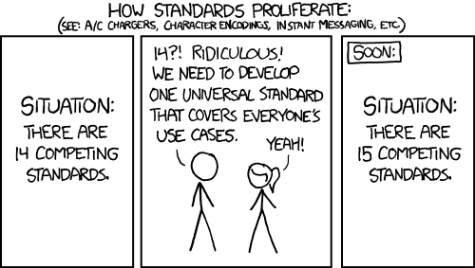
Why Go?
Simpler, cleaner, and faster programming
Fast compilation
Easier interface abstractions
Garbage collection
Concurrency as a goal
Read more in: https://golang.org/doc/faq#Origins
source: xkcd

Slide 13





Who uses Go?
and many more ...

Slide 14
Installation
Usually straightforward (package manager or source)
apt (Ubuntu)
yum/dnf (RedHat)
brew (macOS)
Pay special attention to environment variables
You may need to make sure you configure some of them (GOPATH and GOROOT)

Slide 15
Demo: Basics and declarations

Slide 16
Demo: Packages

Slide 17
Demo: Control flow

Slide 18
Demo: Extras

Slide 19
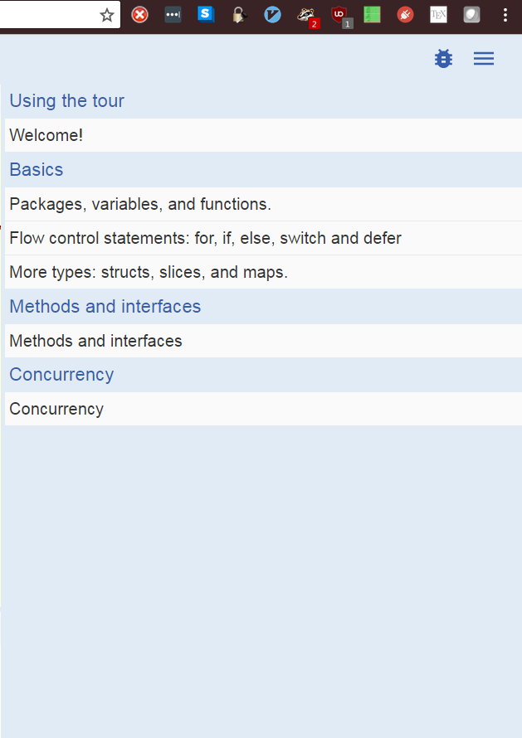
To do before next class
Join Piazza
Install Go
Go tour – up to the concurrency: https://tour.golang.org
Do some exercises
And if you have time:
How to write Go code: https://golang.org/doc/code.html
Effective Go: https://golang.org/doc/effective_go.html

