Slide 1
Global State and Gossip
CS 240: Computing Systems and Concurrency
Lecture 6
Marco Canini
Credits: Indranil Gupta developed much of the original material.

Slide 2
Today
Global snapshot of a distributed system
Chandy-Lamport’s algorithm
Gossip

Slide 3
Distributed snapshot
Let’s think of this as a picture of all servers and their states comprising a distributed system
How do you calculate a “global snapshot” in a distributed system?
What does a “global snapshot” even mean?
Why is the ability to obtain a “global snapshot” important?

Slide 4
Some uses of global system snapshot
Checkpointing
can restart distributed system on failure
Gargabe collection of objects
objects at servers that don’t have any other objects (at any servers) with references to them
Deadlock detection
useful in database transaction systems
Termination of computation
useful in batch computing systems
Debugging
useful to inspect the global state of the system

Slide 5
What’s a global snapshot?
Global Snapshot = Global State =
Individual state of each process in the distributed system
+
Individual state of each communication channel in the distributed system
Capture the instantaneous state of each process
And the instantaneous state of each communication channel, i.e., messages in transit on the channels

Slide 6
A strawman solution
Synchronize clocks of all processes
Ask all processes to record their states at known time t
Problems?
Time synchronization always has error
Your bank might inform you, “We lost the state of our distributed cluster due to a 1 ms clock skew in our snapshot algorithm.”
Also, does not record the state of messages in the channels
Again: synchronization not required – causality is enough!

Slide 7
Example
Pi
Cij
Cji
Pj

Slide 8
Pi
[$1000,
100 iPhones]
Cij
[empty]
[empty]
Cji
Pj
[$600,
50 Androids]
[Global Snapshot 0]

Slide 9
Pi
[$701,
100 iPhones]
Cij
[empty]
[$299, Order Android ]
Cji
Pj
[$600,
50 Androids]
[Global Snapshot 1]

Slide 10
Pi
[$701,
100 iPhones]
Cij
[$499, Order iPhone]
[$299, Order Android ]
Cji
Pj
[$101,
50 Androids]
[Global Snapshot 2]

Slide 11
Pi
[$1200, 1 iPhone order from Pj,
100 iPhones]
Cij
[empty]
[$299, Order Android ]
Cji
Pj
[$101,
50 Androids]
[Global Snapshot 3]

Slide 12
Pi
[$1200,
99 iPhones]
Cij
[empty]
[
($299, Order Android),
(1 iPhone)
]
Cji
Pj
[$101,
50 Androids]
[Global Snapshot 4]

Slide 13
Pi
[$1200,
99 iPhones]
Cij
[empty]
[
(1 iPhone)
]
Cji
Pj
[$400, 1 Android order from Pi,
50 Androids]
[Global Snapshot 5]

Slide 14
Pi
[$1200,
99 iPhones]
Cij
[empty]
[empty]
… and so on …
Cji
Pj
[$400, 1 Android order from Pi,
50 Androids, 1 iPhone]
[Global Snapshot 6]

Slide 15
Moving from State to State
Whenever an event happens anywhere in the system, the global state changes
Process receives message
Process sends message
Process takes a step
State to state movement obeys causality
Next: Causal algorithm for Global Snapshot calculation

Slide 16
Today
Global snapshot of a distributed system
Chandy-Lamport’s algorithm
Gossip

Slide 17
System Model
Problem: Record a global snapshot (state for each process, and state for each channel)
System Model:
N processes in the system
There are two uni-directional communication channels between each ordered process pair Pj → Pi and Pi → Pj
Communication channels are FIFO-ordered
First in First out
No failure
All messages arrive intact, and are not duplicated
Other papers later relaxed some of these assumptions

Slide 18
Requirements
Snapshot should not interfere with normal application actions, and it should not require application to stop sending messages
Each process is able to record its own state
Process state: Application-defined state or, in the worst case:
its heap, registers, program counter, code, etc. (essentially the coredump)
Global state is collected in a distributed manner
Any process may initiate the snapshot
We’ll assume just one snapshot run for now

Slide 19
Chandy-Lamport Global Snapshot Algorithm
First: Initiator Pi records its own state
Initiator process creates special messages called “Marker” messages
Not an application message, does not interfere with application messages
for j=1 to N except i
Pi sends out a Marker message on outgoing channel C_{ij}
(N-1) channels
Starts recording the incoming messages on each of the incoming channels at Pi: C_{ji} (for j=1 to N except i)

Slide 20
Chandy-Lamport Global Snapshot Algorithm (2)
Whenever a process Pi receives a Marker message on an incoming channel C_{ki}
if (this is the first Marker Pi is seeing)
Pi records its own state first
Marks the state of channel C_{ki} as “empty”
for j=1 to N except i
Pi sends out a Marker message on outgoing channel C_{ij}
Starts recording the incoming messages on each of the incoming channels at Pi: C_{ji} (for j=1 to N except i and k)
else // already seen a Marker message
Mark the state of channel C_{ki} as all the messages that have arrived on it since recording was turned on for C_{ki}

Slide 21
Chandy-Lamport Global Snapshot Algorithm (3)
The algorithm terminates when
All processes have received a Marker
To record their own state
All processes have received a Marker on all the (N-1) incoming channels at each
To record the state of all channels
Then, (if needed), a central server collects all these partial state pieces to obtain the full global snapshot

Slide 22
Example
A B C D E
P1
Time
E F G
P2
H I J
P3
Instruction or Step
Message

Slide 23
P1 is Initiator:
Record local state S1,
Send out markers
Turn on recording on channels C₂₁, C₃₁
A B C D E
P1
Time
E F G
P2
H I J
P3

Slide 24
S1, Record C₂₁, C₃₁
A B C D E
P1
Time
E F G
P2
H I J
P3
First Marker!
Record own state as S3
Mark C₁₃ state as empty
Turn on recording on other incoming C₂₃
Send out Markers

Slide 25
S1, Record C₂₁, C₃₁
A B C D E
P1
Time
E F G
P2
H I J
P3
S3
C₁₃ = < >
Record C₂₃

Slide 26
Duplicate Marker!
State of channel C₃₁ = < >
S1, Record C₂₁, C₃₁
A B C D E
P1
Time
E F G
P2
H I J
P3
S3
C₁₃ = < >
Record C₂₃

Slide 27
S1, Record C₂₁, C₃₁
C₃₁ = < >
A B C D E
P1
Time
E F G
P2
H I J
P3
First Marker!
Record own state as S2
Mark C₃₂ state as empty
Turn on recording on C₁₂
Send out Markers
S3
C₁₃ = < >
Record C₂₃

Slide 28
S1, Record C₂₁, C₃₁
C₃₁ = < >
A B C D E
P1
Time
E F G
P2
H I J
P3
S3
C₁₃ = < >
Record C₂₃
S2
C₃₂ = < >
Record C₁₂

Slide 29
S1, Record C₂₁, C₃₁
C₃₁ = < >
A B C D E
P1
Time
E F G
P2
H I J
P3
S3
C₁₃ = < >
Record C₂₃
S2
C₃₂ = < >
Record C₁₂
Duplicate!
C₁₂ = < >

Slide 30
Duplicate!
C₂₁ = <message G→D >
S1, Record C₂₁, C₃₁
C₃₁ = < >
A B C D E
P1
Time
E F G
P2
H I J
P3
S3
C₁₃ = < >
Record C₂₃
S2
C₃₂ = < >
Record C₁₂
C₁₂ = < >

Slide 31
C₂₁ = <message G→D >
S1, Record C₂₁, C₃₁
C₃₁ = < >
A B C D E
P1
Time
E F G
P2
H I J
P3
S3
C₁₃ = < >
Record C₂₃
S2
C₃₂ = < >
Record C₁₂
C₁₂ = < >
Duplicate!
C₂₃ = < >

Slide 32
Algorithm has terminated
C₂₁ = <message G→D >
S1
C₃₁ = < >
A B C D E
P1
Time
E F G
P2
H I J
P3
S3
C₁₃ = < >
S2
C₃₂ = < >
C₁₂ = < >
C₂₃ = < >

Slide 33
Collect the global snapshot pieces
C₂₁ = <message G→D >
S1
C₃₁ = < >
A B C D E
P1
Time
E F G
P2
H I J
P3
S2 C₃₂ = < >
C₁₂ = < >
S3 C₁₃ = < >
C₂₃ = < >

Slide 34
Next
Global Snapshot calculated by Chandy-Lamport algorithm is causally correct
What?

Slide 35
Cuts
Cut = time frontier at each process and at each channel
Events at the process/channel that happen before the cut are “in the cut”
And happening after the cut are “out of the cut”

Slide 36
Consistent Cuts
Consistent Cut: a cut that obeys causality
Cut C is a consistent cut if and only if:
for (each pair of events e, f in the system)
Such that event e is in the cut C, and if f → e (f happens-before e)
Then: Event f is also in the cut C

Slide 37
Example
A B C D E
P1
Time
E F G
P2
H I J
P3
Consistent Cut
Inconsistent Cut
G → D, but only D is in cut

Slide 38
Our Global Snapshot Example …
C₂₁ = <message G→D >
S1
C₃₁ = < >
A B C D E
P1
Time
E F G
P2
H I J
P3
S3
C₁₃ = < >
S2
C₃₂ = < >
C₁₂ = < >
C₂₃ = < >

Slide 39
… is causally correct
C₂₁ = <message G→D >
S1
C₃₁ = < >
A B C D E
P1
Time
E F G
P2
H I J
P3
S3
C₁₃ = < >
S2
C₃₂ = < >
C₁₂ = < >
Consistent Cut captured by our Global Snapshot Example
C₂₃ = < >

Slide 40
In fact…
Any run of the Chandy-Lamport Global Snapshot algorithm creates a consistent cut

Slide 41
Chandy-Lamport Global Snapshot algorithm creates a consistent cut
Let’s quickly look at the proof
Let e_{i} and e_{j} be events occurring at Pi and Pj, respectively such that
e_{i} → e_{j} (e_{i} happens before e_{j})
The snapshot algorithm ensures that
if e_{j} is in the cut then e_{i} is also in the cut
That is: if e_{j} → <Pj records its state>, then
it must be true that e_{i} → <Pi records its state>

Slide 42
Chandy-Lamport Global Snapshot algorithm creates a consistent cut
if e_{j} → <Pj records its state>, then it must be true that e_{i} → <Pi records its state>
By contradiction, suppose e_{j} → <Pj records its state> and <Pi records its state> → e_{i}
Consider the path of app messages (through other processes) that go from e_{i} → e_{j}
Due to FIFO ordering, markers on each link in above path will precede regular app messages
Thus, since <Pi records its state> → e_{i} , it must be true that Pj received a marker before e_{j}
Thus e_{j} is not in the cut => contradiction

Slide 43
Summary
The ability to calculate global snapshots in a distributed system is very important
But don’t want to interrupt running distributed application
Chandy-Lamport algorithm calculates global snapshot
Obeys causality (creates a consistent cut)

Slide 44
Distributed snapshot algorithm summary
Chandy & Lamport,1985
algorithm to select a consistent cut
any process may initiate a snapshot at any time
processes can continue normal execution
send and receive messages
assumes:
no failures of processes & channels
strong connectivity
at least one path between each process pair
unidirectional, FIFO channels
reliable delivery of messages
Notes:
Credit: Thomas W. Doeppner, Rodrigo Fonseca

Slide 45
Today
Global snapshot of a distributed system
Chandy-Lamport’s algorithm
Gossip

Slide 46
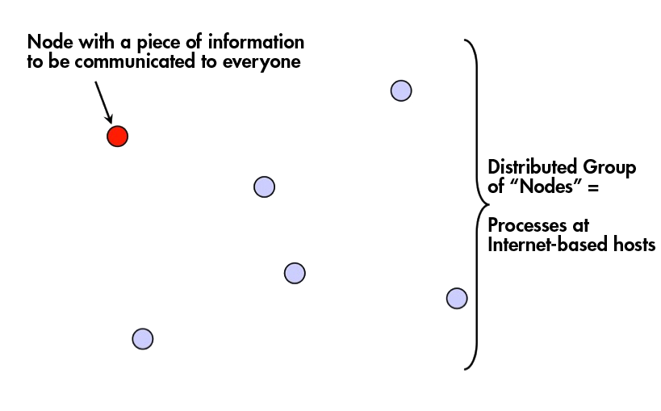
Multicast problem

Slide 47
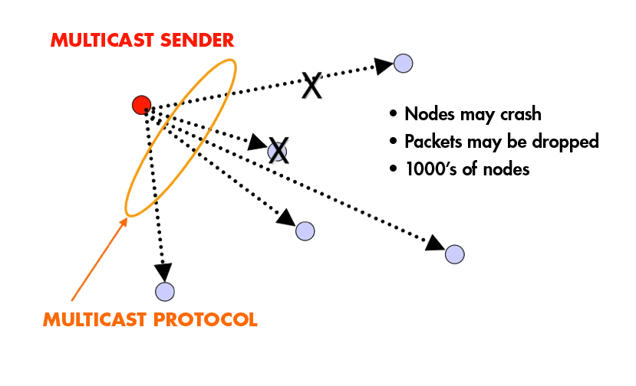
Fault-tolerance and Scalability
Needs:
Reliability (Atomicity)
100% receipt
Speed

Slide 48
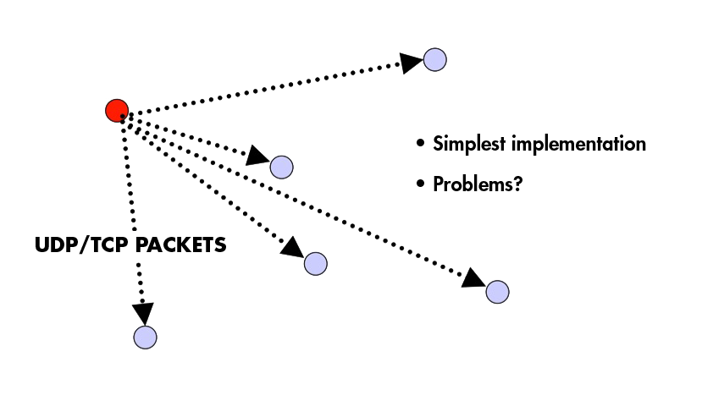
Centralized

Slide 49
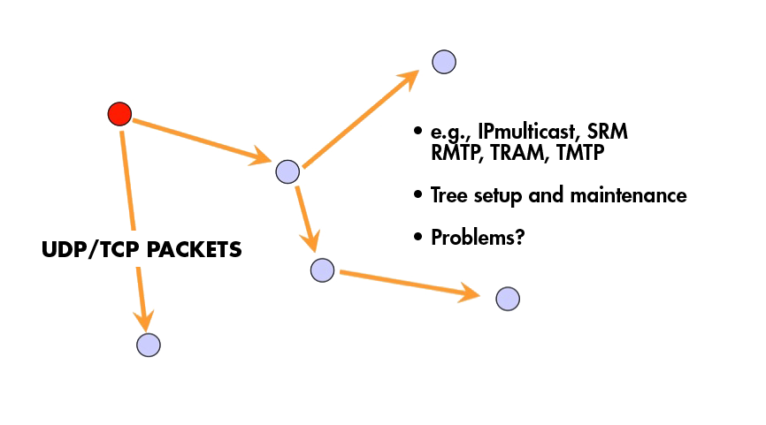
Tree-Based

Slide 50
Tree-based Multicast Protocols
Build a spanning tree among the processes of the multicast group
Use spanning tree to disseminate multicasts
Use either acknowledgments (ACKs) or negative acknowledgements (NAKs) to repair multicasts not received
SRM (Scalable Reliable Multicast)
Uses NAKs
But adds random delays, and uses exponential backoff to avoid NAK storms
RMTP (Reliable Multicast Transport Protocol)
Uses ACKs
But ACKs only sent to designated receivers, which then re-transmit missing multicasts
These protocols still cause an O(N) ACK/NAK overhead [Birman99]

Slide 51
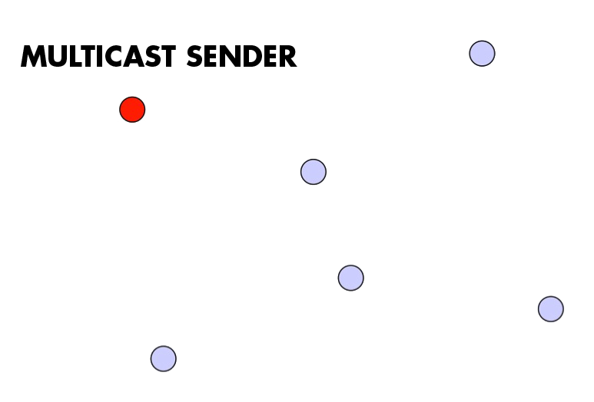
A Third Approach

Slide 52
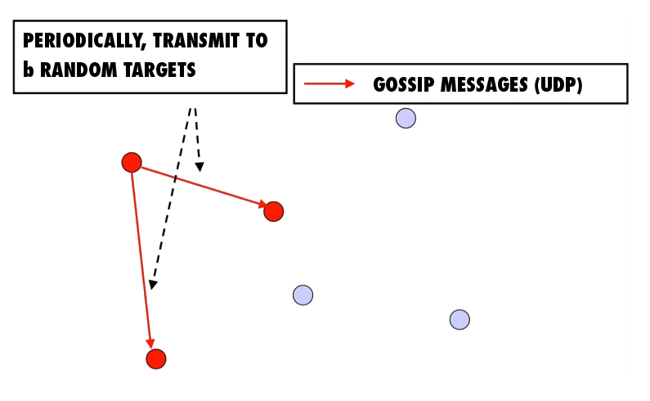
A Third Approach

Slide 53
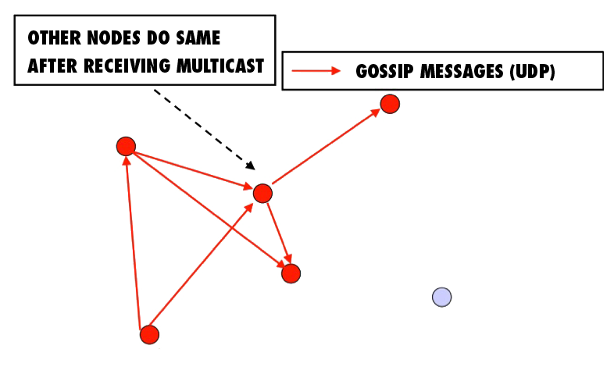
A Third Approach

Slide 54
A Third Approach

Slide 55
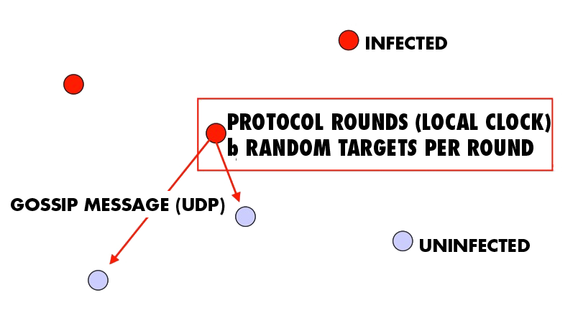
“Epidemic” Multicast (or “Gossip”)

Slide 56
Push vs. Pull
So that was “Push” gossip
Once you have a multicast message, you start gossiping about it
Multiple messages? Gossip a random subset of them, or recently-received ones, or higher priority ones
There’s also “Pull” gossip
Periodically poll a few randomly selected processes for new multicast messages that you haven’t received
Get those messages
Hybrid variant: Push-Pull
As the name suggests

Slide 57
Properties
Claim that the simple Push protocol
Is lightweight in large groups
Spreads a multicast quickly
Is highly fault-tolerant

Slide 58
Analysis
From old mathematical branch of Epidemiology [Bailey75]
Population of (n+1) individuals mixing homogeneously
Contact rate between any individual pair is
At any time, each individual is either uninfected (numbering x) or infected (numbering y)
Then,
and at all times
Infected–uninfected contact turns latter infected, and it stays infected

Slide 59
Analysis (contd.)
Continuous time process
Then
(why?)
with solution:
(can you derive it?)

Slide 60
Epidemic Multicast

Slide 61
Epidemic Multicast Analysis
(why?)
Substituting, at time t=clog(n), the number of infected is
(correct? can you derive it?)

Slide 62
Analysis (contd.)
Set c, b to be small numbers independent of n
Within clog(n) rounds, [low latency]
all but number of nodes receive the multicast
[reliability]
each node has transmitted no more than cblog(n) gossip messages [lightweight]

Slide 63
Why is log(N) low?
log(N) is not constant in theory
But pragmatically, it is a very slowly growing number
Base 2
log(1000) ~ 10
log(1M) ~ 20
log (1B) ~ 30
log(all IPv4 address) = 32

Slide 64
Fault-tolerance
Packet loss
50% packet loss: analyze with b replaced with b/2
To achieve same reliability as 0% packet loss, takes twice as many rounds
Node failure
50% of nodes fail: analyze with n replaced with n/2 and b replaced with b/2
Same as above

Slide 65
Fault-tolerance
With failures, is it possible that the epidemic might die out quickly?
Possible, but improbable:
Once a few nodes are infected, with high probability, the epidemic will not die out
So the analysis we saw in the previous slides is actually behavior with high probability
[Galey and Dani 98]
Think: why do rumors spread so fast? why do infectious diseases cascade quickly into epidemics? why does a virus or worm spread rapidly?

Slide 66
Pull Gossip: Analysis
In all forms of gossip, it takes O(log(N)) rounds before about N/2 processes get the gossip
Why? Because that’s the fastest you can spread a message – a spanning tree with fanout (degree) of constant degree has O(log(N)) total nodes
Thereafter, pull gossip is faster than push gossip
After the ith, round let p_{i} be the fraction of non-infected processes. Let each round have k pulls. Then
This is super-exponential
Second half of pull gossip finishes in time O(log(log(N))

Slide 67
Summary
Multicast is an important problem
Tree-based multicast protocols
When concerned about scale and fault-tolerance, gossip is an attractive solution
Also known as epidemics
Fast, reliable, fault-tolerant, scalable, topology-aware

Slide 68
Next Topic:
Primary-backup replication
(pre-reading: VM replication)

