Slide 1


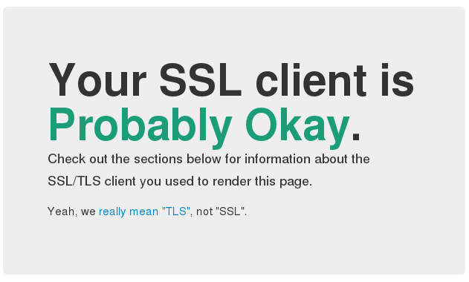

WAP | SSL/TLS
INGI2347: COMPUTER SYSTEM SECURITY (Spring 2014)
Marco Canini
Lecture slides adapted from UCL INGI2347 by Gildas Avoine Reproduced with permission
Notes:
Image source: http://2.bp.blogspot.com/-M8oKe2_nLFQ/TyqaGyrOVcI/AAAAAAAAA1U/MJUJDGRGewo/s1600/wpa+secure.jpg | https://blog.dbrgn.ch/images/2014/1/ssl_ok.png

Slide 2
Plan for today
Lecture 10
WiFi Protection Access (WPA)
Protocol phases
WPA attacks
SSL / TLS
Protocol details
NEXT

Slide 3
Recall: Weaknesses of WEP
IV is too short and not protected from reuse
The way keys are constructed from the IV makes it susceptible to weak key attacks (FMS attack)
There is no effective detection of message tampering (message integrity)
It directly uses the master key and has no built-in provision to update the keys
There is no protection against message replay

Slide 4
WiFi Protected Access (WPA)
Goal: replace WEP
WPA was developed as a urgent patch before the publication of the 802.11i standard (WPA2)
WPA was designed to be deployed on old WiFi-compliant through a firmware update
WiFi-compliant devices now must implement WPA2 since 2006

Slide 5
WPA Features
A seq. number is used to prevent replay attacks
Initialization Vector (IV) is 48-bit long
User authentication vs. device-only authentication in WEP
Keys are dynamically refreshed
WPA2 uses AES instead of RC4 as in WEP and WPA

Slide 6
WPA Data Encryption
Two major suites of algorithms:
Temporal Key Integrity Protocol (TKIP)
RC4 + Message Integrity Check (MIC)
Counter Mode CBC-MAC Protocol (CCMP)
AES in Counter Mode (WPA2 only)

Slide 7
Changes from WEP to TKIP
Purpose | Change | Weakness addressed
Message Integrity | Add a message integrity protocol to prevent tampering (implementable in software on a low-power microprocessor) | (3)
IV selection and use | Change the rules for how IV values are selected and reuse the IV as a replay counter | (1)(5)
Per-Packet Key Mixing | Change the encryption key for every frame | (1)(2)(4)
IV Size | Increase the size of the IV to avoid ever reusing the same IV | (1)(4)
Key Management | Add a mechanism to distribute and change the broadcast keys | (4)

Slide 8
Modes: Personal vs. Enterprise
Personal WPA utilizes pre-shared keys (PSK): all devices use same passphrase
User need a 256-bit passphrase (64 hex digits or 8 to 63 ASCII characters)
Authentication between client and Access Point (based on EAP-MD5)
Suited for home or small office infrastructure
Enterprise WPA uses an IEEE 802.1X Authentication Server that distributes different keys to users
User authentication
Requires an authentication server (e.g. Radius)
Centralizes management of user credentials

Slide 9
IEEE 802.11i Operational Phases
Supplicant
Authenticator
Authentication server
Party being authenticated
Access Point
Radius
1. Security Policy Agreement
2. 802.1X Authentication
3. Key derivation and distribution
Master Key (MK) by Radius
4. Data confidentiality and integrity

Slide 10
Phase 2
802.1X Authentication

Slide 11

IEEE 802.1X Authentication
Extensible Authentication Protocol (EAP) over LAN: EAPoL
Authenticator
LAN
Supplicant
EAPoL
EAPoL
Authentication server

Slide 12
Extensible Authentication Protocol (EAP)
A framework for transporting authentication protocols
Not really an authentication protocol itself
Four types of packet:
request, response, success and failure
Request packets are issued by the authenticator and solicit a response from the supplicant
Any number of request-response exchanges may be used to complete the authentication
A success (resp. failure) packet is sent to the supplicant if the authentication succeeded (resp. failed)

Slide 13
EAP variants
Legacy based methods
EAP-MD5
Certificate based methods
EAP-TLS, EAP-TTLS, PEAP
Password based methods
LEAP, SPEKE
And many others …

Slide 14
EAP-MD5 (not secure!) [RFC2284]
Authentication of the client only
MD5 message hashing algorithm
Very simple EAP method
Supplicant
Authentication server
1. challenge
2. MD5(password, challenge)

Slide 15
EAP-TLS [RFC5216]
Mutual authentication and key exchange
Public key certificates, also at the client
Strong authentication but requires PKI
Supplicant
Authentication server
TLS mutual authentication

Slide 16
EAP-TTLS (Tunneled TLS) [RFC5281]
Mutual authentication and key exchange
Public key certificates, only at the AS
Allows less secure authentication methods through a secure channel
Supplicant
Authentication server
TLS mutual authentication

Slide 17
Phase 3
Key derivation and distribution

Slide 18
Key derivation and distribution
Supplicant
802.1X
Authenticator
Radius
Authentication server
1. Master Key (MK) transmission
2. 4-way handshake for key derivation and distribution: Pairwise Transient Key (PTK), used for unicast Group Transient Key (GTK), used for multicast
3. Group Key handshake for GTK renewal

Slide 19
Pairwise Key Hierarchy
key
PSK or MK
PBKDF2(SSID, key)
PBKDF2 = Password-Based Key Derivation Function 2 [RFC2898]
Pairwise Master Key (PMK) – 256 bits
key expansion using HMAC-SHA1
PTK 512 bits for TKIP 384 bits for CCMP
TKIP only
EAPoL Confirmation Key – 128 bits
EAPoL Encryption Key 128 bits
Temporal Encryption Key 128 bits
Temporal AP Tx MIC Key 64 bits
Temporal AP Rx MIC Key 64 bits
KCK
KEK
TEK = TK
TMK1
TMK2

Slide 20
Pairwise Key Hierarchy
KCK (Key Confirmation Key)
Key for authenticating messages during the 4-way handshake and Group Key handshake
KEK (Key Encryption Key)
Key for ensuring data confidentiality during the 4-way handshake and Group Key Handshake

Slide 21
Pairwise Key Hierarchy
TK (Temporary Key)
Key for data encryption (used by TKIP or CMMP)
TMK (Temporary MIC Key)
Key for data authentication (used only by Michael with TKIP)
A dedicated key is used for each side of the communication

Slide 22
Further Reading
Details of 4-way handshake and Group Key handshake:
http://bit.ly/OQooma

Slide 23
Phase 4
Data confidentiality and integrity

Slide 24
TKIP Key-Mixing
RC4 stream cipher used with a 128-bit per-packet key
48-bit IV Upper IV (32) | Lower IV (16)
RC4 Encryption Key
IV || dummy || IV byte
Per-Packet Key 104 bits
Phase 1 Key Mixing
Phase 2 Key Mixing
MAC Address
Session key

Slide 25
TKIP MAC
Message Integrity Code (MIC)
Michael algorithm instead of CRC32
Michael is keyed
Strongest MIC that was available with most older network cards
Due to weaknesses of Michael, the network is shut down during one minute if two frames fail to pass Michael’s check
Generation of new keys and re-authentication are required

Slide 26
Further Reading
Details of AES-CCMP:
http://bit.ly/NIXhZk

Slide 27
Attacks on WPA

Slide 28
Attack on Weak Password
All the keys derive from PSK
PMK = PBKDF2(SSID, PSK) then 4-way handshake to derive the other keys
Handshake is eavesdropped and used to check a candidate passphrase:
For every candidate passphrase, compute the associated PMK
Compute the PTK (4 HMAC-SHA1 computed on PMK and random values)
Compute the MIC (1 HMAC-SHA1 or MD5) and compare with the eavesdropped one
To mitigate the problem, the network’s SSID should not match any entry in the top 1000 SSIDs [https://wigle.net/gps/gps/main/ssidstats]

Slide 29
Attack on TKIP
Packet injection
E.Tews and M.Beck (2008)
T.Ohigashi and M.Morii (2009)
F.Halvorsen, O.Haugen, M.Eian, S. Mjølsnes (2009)
596 bytes within 18 min 25
Decryption of packets from AP to client
M.Beck (2010)

Slide 30
Recap WPA
 | WPA | WPA2
Enterprise Mode | Authentication IEEE 802.1X/EAP Encryption TKIP/MIC | Authentication IEEE 802.1X/EAP Encryption AES-CCMP
Personal Mode | Authentication PSK Encryption TKIP/MIC | Authentication PSK Encryption AES-CCMP

Slide 31
SSL / TLS

Slide 32

SSL Primer
Authentication of server based on public key
Trusted third party: certification authority (CA)
tampering
eavesdropping
client
server
fake client
fake server

Slide 33
Secure Sockets Layer (SSL)
Most widely deployed security protocol in the world
SSL was developed by Netscape to offer secure access to web servers (HTTPS)
History
SSL v1.0 never publicly released
SSL v2.0 released in 1994 (flawed)
SSL v3.0 released in 1996, leads to TLS 1.0 in 1999

Slide 34
Transport Layer Security (TLS)
TLS is an IETF standard based on SSL v3.0
Slight modifications compared to SSL v3.0
TLS v1.0 and SSL v3.0 do not interoperate
TLS v1.0 sometimes called SSL v3.1
TLS v1.0 defined in RFC 2246
TLS v1.2 updated in RFC 5246 (August 2008)
Current version (March 2011)
TLS v1.2 (prohibits SSL v2.0)
RFC 6176

Slide 35
SSL in the layered model
process-to-process
Application
Application
secure communication
SSL
SSL
Transport
Transport
Internet
Internet
Link
Link
Ethernet

Slide 36
Approaches
Create a new protocol from an existing protocol
Examples: HTTP (80) / HTTPS (443), FTP (21) / FTPS (990), SMTP (25) / SMTPS (995), POP3 (110) / POP3S (995), IMAP (143) / IMAPS (993)
Disadvantage: only clients supporting TLS can connect
Advantage: we are sure that communications are secure
Extend a protocol to negotiate SSL/TLS
Examples: (E)SMTP, POP3, IMAP, with the help of the STARTTLS command the client can ask to use TLS
Advantage: the client is not required to support TLS to use the service

Slide 37
OpenSSL
bash$ openssl s_client -connect www.uclouvain.be:443
CONNECTED(00000003)
[...]
Certificate chain
0 s:/C=BE/L=Louvain-la-Neuve/O=Universit\xC3\xA9 Catholique de Louvain/OU=Portail UCL/CN=www.uclouvain.be
i:/C=NL/O=TERENA/CN=TERENA SSL CA
[...]
Server certificate
-----BEGIN CERTIFICATE-----
MIIErDCCA5SgAwIBAgIRAOjy08jirG7k+6k8Ln7bZxQwDQYJKoZIhvcNAQEFBQAw
[...]
-----END CERTIFICATE-----
[...]
SSL handshake has read 5258 bytes and written 328 bytes
---
New, TLSv1/SSLv3, Cipher is DHE-RSA-AES256-SHA
Server public key is 2048 bit
[...]
SSL-Session:
Protocol : TLSv1
Cipher : DHE-RSA-AES256-SHA
Session-ID: C0FE449DC7345355B4119A095C27DA72691326880FE52271FB2CB3B0DCF29FE0
Master-Key: 7A8DE9425505930A2F11AFC241F9236ABA61DAC7BFC0A9709C6F887D819BAA42C5F1B7A9E01CC26945A[...]

Slide 38
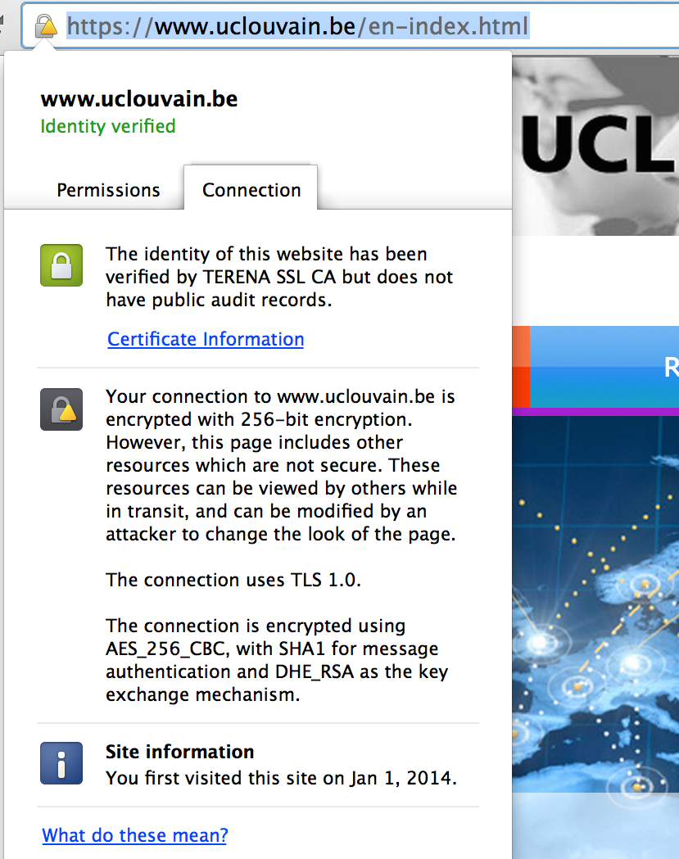
Example: HTTPS
TLS guarantees data confidentiality and authenticity (server, possibly client)
The server must have a certificate
The client can have one
e.g. e-banking

Slide 39
Example: Mail
ESMTP (sending mail), POP3 (mailbox access), IMAP (better mailbox access)
TLS is implemented as a protocol extension
The use of TLS is optional (needs to be configured)
By default these protocols send cleartext passwords
TLS protects passwords and email contents

Slide 40
TLS Protocol

Slide 41
TLS Layers
For passing data from an application to the record layer in a transparent manner
For initializing a session
For managing warnings and fatal errors
Processing data
For setting-up cryptographic algorithms

Slide 42
TLS Record Layer
Processing of data
Fragmentation
Compression (optional)
Authentication
Encryption
It delivers processed fragments to the transport layer (TCP)
At the receiving end, the inverse operations are carried out

Slide 43
Record Layer Summary
Data
Data
MAC
Data
MAC
HEADER
Encrypted Data and MAC
HEADER
Encrypted

Slide 44
MAC Computation
MAC = Hash ( MAC_key || Pad2 ||
Hash (MAC_key || Pad1 || Seq || Length || Content))
MAC_key: secret shared by client and server
Pad1, Pad2: pre-defined constants
Seq: sequence number of this message
Hash: Either HMAC-MD5 or HMAC-SHA1
Length: Length in bytes of the compressed record
Content: Compressed record

Slide 45
Encryption
Encryption is performed on compressed and authenticated records
Block ciphers:
DES (40 bits or 56 bits), 3DES, IDEA, RC2 (40 bits)
AES (128 bits or 256 bits) in TLS v1.1
Stream ciphers:
NULL, RC4 (40 bits or 128 bits)
The client should refuse 40-bit keys if such a cipher is suggested by the server (warning enforced in TLS 1.1)

Slide 46
Handshake in Brief
Negotiation of:
Protocol version (SSL 3.0, TLS 1.0, TLS 1.1)
Algorithms:
Key exchange (RSA, Diffie-Hellman)
Encryption (DES, 3DES, IDEA, RC4, RC2, AES)
MAC (HMAC-MD5, HMAC-SHA)
The client proposes the desired algorithms in order of preference, the server chooses
Optional authentication of the partner using a certificate
Messages are not encrypted
Last messages authenticate the exchange

Slide 47
Handshake Exchanges
Client_Hello (crypto, random)
Server_Hello (crypto, random)
Server Certificate
Server_Hello_Done
Client_Key_Exchange
Change_Cipher_Spec
Handshake_Finished
Change_Cipher_Spec
Handshake_Finished

Slide 48
Client_Hello Content
Goal
Used by the client to initiate SSL session
Sent in clear without signature
Content
Protocol Version
32 bytes long random number
Composed of two parts:
4 bytes Unix timestamp (number of seconds since 01/01/1970)
28 bytes random number
Optional Session Identifier
Each SSL session has an identifier which can be used later to restart a session
List of supported Ciphers
List of supported Compression Methods

Slide 49
Client_Hello Crypto
List of supported cryptographic algorithms
Authentication + key exchange + cipher + hash
Authentication
RSA or DSS
Key Exchange
RSA, Diffie Hellman
Encryption
Hash

Slide 50
Cipher Suite Examples
CipherSuite TLS_DH_DSS_WITH_DES_CBC_SHA = { 0x00,0x0C };
CipherSuite TLS_DH_DSS_WITH_3DES_EDE_CBC_SHA = { 0x00,0x0D };
CipherSuite TLS_DH_RSA_WITH_DES_CBC_SHA = { 0x00,0x0F };
CipherSuite TLS_DH_RSA_WITH_3DES_EDE_CBC_SHA = { 0x00,0x10};
CipherSuite TLS_DHE_DSS_WITH_DES_CBC_SHA = { 0x00,0x12 };
CipherSuite TLS_DHE_DSS_WITH_3DES_EDE_CBC_SHA = { 0x00,0x13};
CipherSuite TLS_DHE_RSA_WITH_DES_CBC_SHA = { 0x00,0x15 };
CipherSuite TLS_DHE_RSA_WITH_3DES_EDE_CBC_SHA = { 0x00,0x16};
Source: RFC4346.
DH: Diffie-Hellman
DSS: Digital Signature Standard
DES: Data Encryption Standard
CBC: Cipher Block Chaining
SHA: Secure Hash Algorithm
EDE: Encrypt-Decrypt-Encrypt

Slide 51
Server_Hello Content
Goal
Used by the server to reply to Client_Hello
Sent in the clear without signature
Content
Protocol version: highest version of the protocol supported by both client and server
Random number
Optional Session Identifier, if it allows sessions to be resumed
Cipher Suite: One of the cipher suites proposed by client
Compression Method

Slide 52
Server Certificate
Goal
Sent by the server to authenticate itself
A server may have several certificates from different certification authorities
Content
A list of X.509 certificates:
Server certificate
Certificates of certification authorities
Certificate can also be sent by the client
when client authentication is requested by
the server with Certificate_Request

Slide 53
Server_Hello_Done
Goal
Indicates that server has finished its handshake first phase
Sent unencrypted

Slide 54
Client_Key_Exchange
Goal
Used by the client to send the PreMasterSecret, which is used to derive session keys
Encrypted with the server’s public key
Content
Encrypted PreMasterSecret with the public key of the server

Slide 55
Change_Cipher_Spec
Goal
Used by client and server to indicate that they start using a (new) key
During handshake, indicates that next message will be encrypted with the appropriate key

Slide 56
Handshake_Finished
Goal
Sent by both client and server to confirm the establishment of the secure SSL session
Session is established only if client received expected Finished message from server and vice-versa
Allows to detect man in the middle attacks on Client_Hello and Server_Hello messages
Example: Attacker changes cipher list to propose weaker ciphers
First encrypted message on each direction
Contents
Keyed hash (MD5 or SHA-1) of all the
handshake messages and the MasterSecret

Slide 57
Any questions?

Slide 58

Passwords | Time-memory trade-offs
Stay tuned
Next time you will learn about
Notes:
Source: http://1.bp.blogspot.com/-5ggMWTO_KvU/T3ABUC0YktI/AAAAAAAAAog/oH-YhOz4LXY/s1600/spy_password_hacker-5223066.jpg

