Slide 1

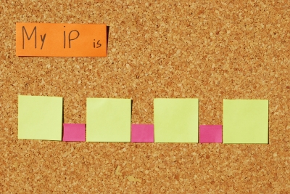

Firewalls | NAT
INGI2347: COMPUTER SYSTEM SECURITY (Spring 2014)
Marco Canini
Lecture slides adapted from UCL INGI2347 by Gildas Avoine and Upenn CSE331 by Steve Zdancewic Reproduced with permission
Notes:
Image source: http://info.netcenter.net/Portals/192612/images/firewall2.jpg; http://www.remoteutilities.com/images/blog/nat.jpg

Slide 2
Announcements
First challenge deadline 24 Feb 23:59h
From 18 Feb, Tuesdays lectures start at 8:30h
Inform the instructor if you wish to take the exam in French by end of Feb

Slide 3
Firewalls and NAT
Problem:
Protecting or isolating one part of the network from other parts
Prevent propagation of an attack while allowing legitimate traffic
Need to filter or otherwise limit network traffic
How to configure this information?
Questions:
What information do you use to filter?
Where do you do the filtering?

Slide 4
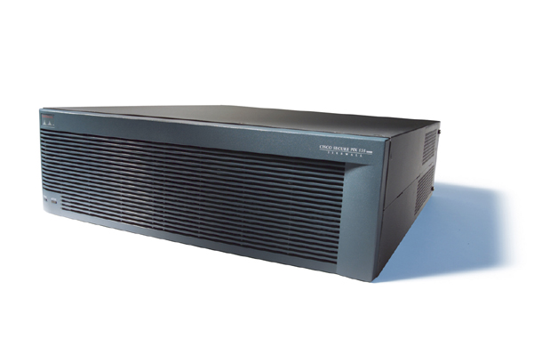
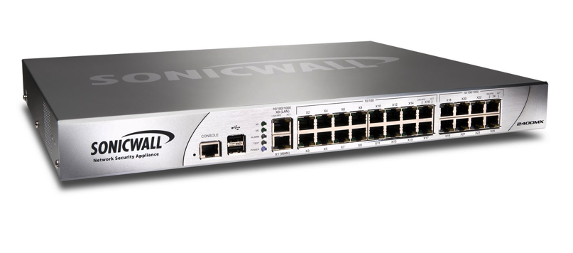
Types of Firewalls
Software
Standard firewall software:
Iptables, IPFILTER, IPFW, Ipcop
Hardware
Specialized middlebox (also runs software as firmware):
Cisco PIX, Juniper, WatchGuard, SonicWall, Barracuda

Slide 5
Software Firewalls
Software firewalls inherit all vulnerabilities of the OS on which they run
Software firewall architectures are well known, it’s easier to exploit their vulnerabilities
Example: buffer overflows
Software firewalls often have good performance
They benefit from rapid advances in PC hardware

Slide 6
Plan for today
Lecture 3
Basic principles
NAT
Firewall features
Firewall architectures
Filtering rules
NEXT

Slide 7
Basic Principles

Slide 8
Principles: The Seven Principles
Least privileges
Defense in depth
Choke point
Weakest link
Deny by default
User participation
Simplicity

Slide 9
Principle: Least Privilege
Every part of the system must only have the minimal rights necessary to carry out its job
Examples:
Regular users must not be administrators
Administrators must also use regular user accounts
A Web server runs under a non-privileged account
Unix: nobody
Windows: IUSR_machine_name
Military’s slogan: “Need to know”

Slide 10
Principle: Defense in Depth
Layers of security are harder to break than a single defense
Examples:
Anti-viruses on mail servers and on desktops
Patch machines even if they are protected by a firewall
Even if FTP connections are blocked by the firewall, workstations should not run FTP servers

Slide 11
Principle: Choke Point
It is easier to control security if all data has to go through one given point
Users should not be allowed to bypass the network policy
Example: use alternate Internet connection
Interconnections with other companies must go through the firewall

Slide 12
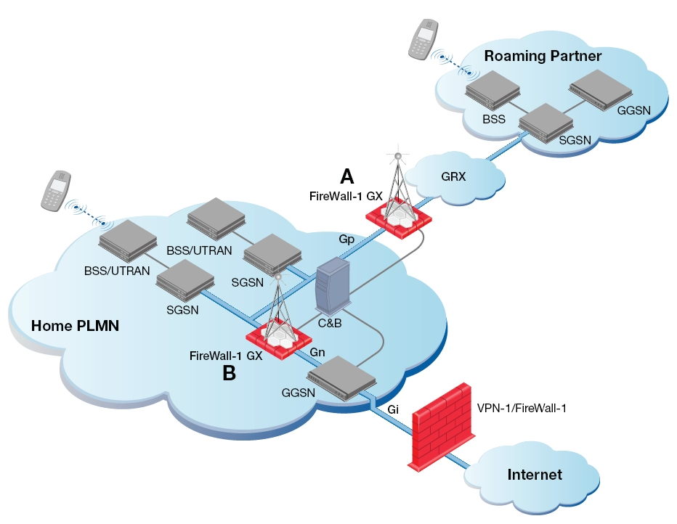

Slide 13
Principle: Weakest Link
Attackers go after the easiest part of the system to attack
So improving that part will improve security the most
Example:
Useless to install expensive anti-virus software for HTTP traffic if you do not also install one for SMTP traffic
How do you identify it?
Weakest link may not be a software problem
Social engineering
Physical security

Slide 14
Principle: Deny by Default
It is better to prohibit all that is not explicitly authorized than to authorize all that is not explicitly prohibited
We can never know in advance all the threats to which we will be exposed
If we make an error, it is better to prohibit something useful than to allow an attack!

Slide 15
Principle: User Participation
A protection system is efficient only if all users support it
The goal of a firewall is to authorize all that is useful and at the same time avoid dangers
A system that is too restrictive pushes users to be creative
Example: saving confidential email on personal’s Gmail to read remotely
We must understand the user’s needs and make sure that reasons for restrictions are well understood by them

Slide 16
Principle: Simplicity
Most security problems originate from human error
Complexity leads to bugs and bugs lead to vulnerabilities
Failsafe defaults
The default configuration should be secure
In a simple system:
The risk of error is smaller
It is easier to verify its correct functioning
Especially in evolving networks and with several administrators

Slide 17
Network Address Translation
NAT

Slide 18
Network Address Translation (NAT)
Idea: Break the invariant that IP addresses are globally unique
10.0.0.1
130.25.1.246
Internet
10.0.0.2
NAT
178.11.0.127
NAT port
NAT
10.0.0.3
10.0.0.1
10.0.0.4

Slide 19
Dynamic NAT
Basic principle: Maintain a table of the form:
<client IP> <client port> ⇄ <NAT ID>
Outgoing packets (on non-NAT port):
Lookup client (source) IP address, client port in the mapping table
If not found, allocate a new unique NAT ID and replace client port with chosen NAT ID (same size as port = 2¹⁶)
If found, replace client port with previously allocated NAT ID
Replace client address with NAT address

Slide 20
Dynamic NAT
Incoming packets (on NAT port)
Look up destination port number as NAT ID in port mapping table
If found, replace destination address and port with client entries from the mapping table
If not found, the packet is not for us and should be rejected
Unused table entries expire periodically
Example: after 2-3 minutes
Dynamic NAT doesn’t allow establishing incoming connections
Good protection by default

Slide 21
Mapping Table Example
Protocol | Local IP | Local port | NAT IP | NAT ID | Peer IP | Peer port
TCP | 192.168.0.1 | 1912 | 81.242.186.64 | 1912 | 192.178.100.4 | 80
TCP | 192.168.0.1 | 1913 | 81.242.186.64 | 23745 | 192.178.100.4 | 80
TCP | 192.168.0.2 | 1912 | 81.242.186.64 | 55468 | 212.27.63.3 | 80
UDP | 192.168.0.3 | 18551 | 81.242.186.64 | 1912 | 83.170.84.81 | 26000

Slide 22
Mapping Table Example
NAT ID must be unique
Protocol | Local IP | Local port | NAT IP | NAT ID | Peer IP | Peer port
TCP | 192.168.0.1 | 1912 | 81.242.186.64 | 1912 | 192.178.100.4 | 80
TCP | 192.168.0.1 | 1913 | 81.242.186.64 | 23745 | 192.178.100.4 | 80
TCP | 192.168.0.2 | 1912 | 81.242.186.64 | 55468 | 212.27.63.3 | 80
UDP | 192.168.0.3 | 18551 | 81.242.186.64 | 1912 | 83.170.84.81 | 26000

Slide 23
Mapping Table Example
Mapping can hide auto-increasing port numbers
Protocol | Local IP | Local port | NAT IP | NAT ID | Peer IP | Peer port
TCP | 192.168.0.1 | 1912 | 81.242.186.64 | 1912 | 192.178.100.4 | 80
TCP | 192.168.0.1 | 1913 | 81.242.186.64 | 23745 | 192.178.100.4 | 80
TCP | 192.168.0.2 | 1912 | 81.242.186.64 | 55468 | 212.27.63.3 | 80
UDP | 192.168.0.3 | 18551 | 81.242.186.64 | 1912 | 83.170.84.81 | 26000

Slide 24
Mapping Table Example
Protocol info. further demultiplexes mapping entries
Protocol | Local IP | Local port | NAT IP | NAT ID | Peer IP | Peer port
TCP | 192.168.0.1 | 1912 | 81.242.186.64 | 1912 | 192.178.100.4 | 80
TCP | 192.168.0.1 | 1913 | 81.242.186.64 | 23745 | 192.178.100.4 | 80
TCP | 192.168.0.2 | 1912 | 81.242.186.64 | 55468 | 212.27.63.3 | 80
UDP | 192.168.0.3 | 18551 | 81.242.186.64 | 1912 | 83.170.84.81 | 26000

Slide 25
Static NAT
To allow incoming connections, we have to define certain static entries in the mapping table
Typically we create one entry per protocol
Example: SSH (22), HTTP (80), SMTP (25), …
Example:
Protocol | Local IP | Local port | NAT port | Peer IP & port
TCP | 192.168.0.1 | 22 | 22 | *
TCP | 192.168.0.1 | 8080 | 80 | *
UDP | 192.168.0.3 | 26000 | 26000 | *

Slide 26
Benefits of NAT
Dynamic NAT only allows outbound connections established from internal network
External hosts can only contact internal hosts that appear in the mapping table, which are only added once they establish a connection
Hides the internal network’s structure
Can simplify network administration
Divide network into small chunks
Reuse IP address space
Original motivation behind NAT
IETF-allocated private addresses:
10.0.0.0 - 10.255.255.255
172.16.0.0 - 172.31.255.255
192.168.0.0 - 192.168.255.255

Slide 27
Drawbacks of NAT
Rewriting IP addresses (and ports) isn’t so easy:
Must validate/recalculate checksums
Certain protocols such as IPSec do not support packet modifications
Has to be aware of protocols that exchange IP addresses (e.g., FTP)
Must also look for IP addresses beyond packet headers and rewrite them
Hinder throughput
Breaks end-to-end principle
Prevents host-to-host connection establishment for hosts behind NAT
Slow the adoption of IPv6?
Limited filtering of packets

Slide 28
Firewall Features

Slide 29
Firewall Features
Stateless vs Stateful
Packet Analysis
Filtering
Network Address Translation
Authentication
Remote network access
Encryption
Logging

Slide 30
Stateless vs Stateful
Stateless: without memory
Does not maintain state associated with observed packets
Stateful: with memory
Maintain state associated with observed packets
Reconstructs each connection’s state, or even certain protocols

Slide 31
Stateful Firewall: Example TCP
For each connection it knows what the next packet should look like
TCP flags, sequence numbers
It can eliminate packets that do not fit in
It can replace sequence numbers
Example: to randomize initial sequence numbers
It can prevent SYN flooding

Slide 32
Protection Against SYN Flooding
Simple:
FW keeps track of all attempts to open a connection
If it judges that a connection stays half-open for too long, it sends a RST to the server
Advanced:
FW delays SYN packets and generates a SYN + ACK in place of the server
Only when it receives an ACK does it send the original SYN to the server

Slide 33
Protection Against SYN Flooding
client
FW
server
flags=(SYN) seq=x
flags=(SYN,ACK) seq=z ack=x+1
flags=(ACK) seq=x+1 ack=z+1
flags=(SYN) seq=x
flags=(SYN,ACK) seq=y ack=x+1
flags=(ACK) seq=x+1 ack=y+1
FW must adapt all sequence numbers

Slide 34
Packet Analysis (Deep Packet Inspection)
Analyze an application protocol
Example: Block Skype
Analyze packets to verify their format and content
Eliminate unwanted packets
DoS, exploits, viruses
Eliminate packets that do not correspond to the current protocol’s state

Slide 35
Filtering
Filtering helps limiting traffic to useful services
Can be based on multiple criteria:
SRC or DST IP address
Protocols (TCP, UDP, ICMP, …) and port numbers
Flags and options (SYN, ACK, ICMP message type, …)
Filtering of source addresses prevents IP spoofing
Filtering of flags allows defining the direction in which connections can be established
Cons of filtering?

Slide 36
Cons of Filtering
Add-on security hampers network evolvability
Hard to deploy new protocols across the Internet
IPv6
Stream Control Transmission Protocol (SCTP)
Multipath TCP (MPTCP) designed to be compatible with existing middleboxes
Still not easy to deploy because certain middleboxes remove unknown TCP options

Slide 37
Authentication
The FW can require authentication before letting a connection through
Outbound: allows limiting Internet access only to privileged users
Inbound: allows authorizing access to internal resources for offsite employees
Authentication can be done based on a local database or by interaction with a central database

Slide 38
Remote Network Access
A FW may realize a Virtual Private Network (VPN) service to allow remote users to access the LAN
More on VPNs in the IPSec lecture
The remote user establishes an encrypted connection (a tunnel) with the FW
The user finds himself just as if he were in the LAN

Slide 39
Encryption
A FW can encrypt or decrypt traffic that traverses a less secure zone
Examples:
Interconnection between remote sites via the Internet
Remote network access

Slide 40
Logging
It is important to be protected but we must also know when we are attacked and react accordingly
Logs keep a trace of attack attempts
They also allow verifying that the ports or destinations that we authorize are really needed
(least privilege)

Slide 41
Firewall Architectures

Slide 42
Firewall Architectures
Personal Firewall
NAT + Filtering
FW with demilitarized zone
Sandwiched demilitarized zone

Slide 43
Personal Firewall
Internet
Client
FW

Slide 44
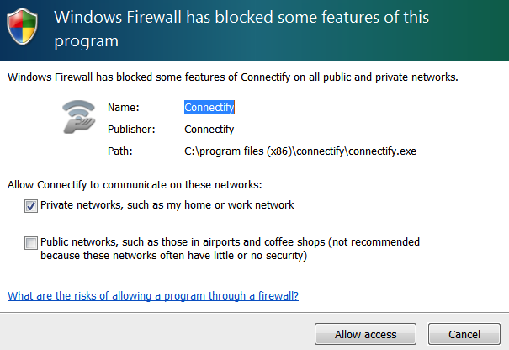
Personal Firewall
The personal firewall initially prohibits all connections
At each alarm, the user can authorize the application to connect
Allows blocking backdoors, spywares, …
An ideal complement to an anti-virus for safe surfing

Slide 45
NAT + Filtering
Client
Internet
Client
Switch
FW
Mail server
Web server

Slide 46
NAT + Filtering
Configuration
Dynamic NAT for all internal machines
Static NAT for all accessible servers
Outbound and Inbound filtering
Limitations
No analysis of contents (virus) from Internet
Direct connections to internal servers (exploits, DoS)
Applicability
Low security needs
Not for large public Web servers

Slide 47
Demilitarized Zone (DMZ) simple case
Client
Internet
Client
Switch
FW
Proxy
Mail server
Web server

Slide 48
Demilitarized Zone (DMZ) simple case
The DMZ is connected neither to the Internet, nor to the internal network
Configuration
Internal machines can only connect to the proxy
Only the proxy can connect to the Internet
Outbound dynamic NAT
Inbound static NAT toward the proxy
Outbound and Inbound filtering

Slide 49
Demilitarized Zone (DMZ) simple case
Limitations (of the example, not DMZ)
The firewall is a critical point
All services pass through the same proxy, a vulnerability on a single service can give access to all traffic
Applicability
Medium security needs

Slide 50
Sandwiched DMZ
Client
HTTP Proxy
Internet
Client
Switch
FW2
SMTP Proxy
FW1
DNS
Web server
Mail server

Slide 51
Sandwiched DMZ
Configuration
Internal machines can only connect to the proxies
(one proxy per protocol)
Only proxies can connect to the Internet
No routing in proxies
Outbound dynamic NAT, inbound static NAT
Outbound and Inbound filtering
Applicability
High security needs

Slide 52
Filtering Rules

Slide 53
Filtering Rules (Organization)
Filtering rules are specified in a list
The firewall runs through the list until it finds a rule that applies
The firewall executes the action specified by the matching rule and moves on to the next packet
We create a last rule that prohibits all that has not been authorized

Slide 54
Filtering: A Simple Example
Internet
FW
Mail server
(TCP port 25)
Remote mail server
(TCP port 25)

Slide 55
Filtering: A Simple Example
 | Src | Port | Dst | Port | Proto | Action
1 | Any | Any | 128.3.3.1 | 25 | tcp | allow
2 | 128.3.3.1 | 25 | Any | Any | tcp | allow
3 | 128.3.3.1 | Any | Any | 25 | tcp | allow
4 | Any | 25 | 128.3.3.1 | Any | tcp | allow
5 | Any | Any | Any | Any | tcp | deny

Slide 56
Filtering: A Simple Example
Problem:
All ports of the server are accessible as long as the attacker chooses port 25 as source port!

Slide 57
Filtering: Corrected Example
 | Src | Port | Dst | Port | Proto | ACK | Action
1 | Any | Any | 128.3.3.1 | 25 | tcp | ACK = * | Allow
2 | 128.3.3.1 | 25 | Any | Any | tcp | ACK = 1 | allow
3 | 128.3.3.1 | Any | Any | 25 | tcp | ACK = * | allow
4 | Any | 25 | 128.3.3.1 | Any | tcp | ACK = 1 | allow
5 | Any | Any | Any | Any | Any | ACK = * | deny
Specifying the ACK flag prevents sending of SYN packets and hence the establishment of connections

Slide 58
Filtering: Corrected Example
Problem:
The attacker can still send unsolicited ACK packets (scanning, DoS)

Slide 59
Filtering: Stateful
 | Src | Port | Dst | Port | Proto | Action
1 | Any | Any | 128.3.3.1 | 25 | tcp | allow
3 | 128.3.3.1 | Any | Any | 25 | tcp | allow
5 | Any | Any | Any | Any | Any | deny
Stateful FW knows about established connections and can automatically authorize returning traffic
Safer:
No unsolicited packets
Simpler to configure, hence less errors

Slide 60
Organization of Filtering Rules
The order in which the rules are specified matters!
When there are many rules, it is important to organize them systematically

Slide 61
Organizing Rules: Example
FW should allow inbound connections to the DMZ Web server
FW should allow outbound connections to the Internet only through the DMZ Proxy
Client
Web server
Internet
Client
Switch
FW
Proxy
Client

Slide 62
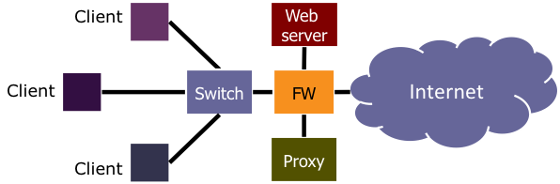
Organizing Rules: Example
 | Src | Port | Dst | Port | Proto | Action
1 | Any | Any | dmz-web | 80 | tcp | allow
2 | Internal | Any | dmz-proxy | 8080 | tcp | allow
3 | Internal | Any | Any | Any | tcp | deny
4 | Any | Any | Any | Any | Any | deny

Slide 63
Organizing Rules: Example
 | Src | Port | Dst | Port | Proto | Action
1 | Any | Any | dmz-web | 80 | tcp | allow
2 | Internal | Any | dmz-proxy | 8080 | tcp | allow
3 | Internal | Any | Any | Any | tcp | deny
4 | Any | Any | Any | Any | Any | deny
Rule 1 allows internal machines to access dmz-web, while rule 3 should have prohibited it

Slide 64
Organizing Rules: Example
 | Src | Port | Dst | Port | Proto | Action
1 | Internal | Any | dmz-proxy | 8080 | tcp | allow
2 | Internal | Any | Any | Any | tcp | deny
3 | Any | Any | dmz-web | 80 | tcp | allow
4 | Any | Any | Any | Any | Any | deny
Rule 3 does not influence the internal traffic anymore

Slide 65
Organizing Rules: Method
We define a security level for each zone
We group rules by zones in descending order of security level
Each groups consists of four parts:
Explicit authorizations for inbound traffic
General prohibition for inbound traffic
Explicit authorizations for outbound traffic
General prohibition for outbound traffic

Slide 66
Organizing Rules: 4-zone Example
Zone | Rule | Src | Port | Dst | Port | Prot | Action
 | 1 | bob | any | alice | 23 | tcp | allow
 | 2 | any | any | zone_1 | Any | any | deny
 | 3 | alice | any | bob | 22 | tcp | allow
 | 4 | zone_1 | any | any | any | any | deny
 | 5 | authorized traffic entering zone 2 |  |  |  |  | allow
 | 6 | other traffic entering zone 2 |  |  |  |  | deny
 | 7 | authorized traffic leaving zone 2 |  |  |  |  | allow
 | 8 | other traffic leaving zone 2 |  |  |  |  | deny
 | 9 | authorized traffic entering zone 3 |  |  |  |  | allow
 | 10 | other traffic entering zone 3 |  |  |  |  | deny
 | 11 | authorized traffic leaving zone 3 |  |  |  |  | allow
 | 12 | other traffic leaving zone 3 |  |  |  |  | deny
 | 13 | any | any | any | any | any | deny
Zone 1
Zone 2
Zone 3

Slide 67
Organizing Rules: Properties
For each zone, it is sufficient to declare the flow towards less secure zones
The flow towards more secure zones cannot be influenced anymore (operation goal): “any” refers to lower levels
A rule that implies 2 zones appears in the block related to the more secure zone
The block related to the last zone is empty
The last rule (any-any) must not be required
By activating logging on that rule we may detect possible errors

Slide 68
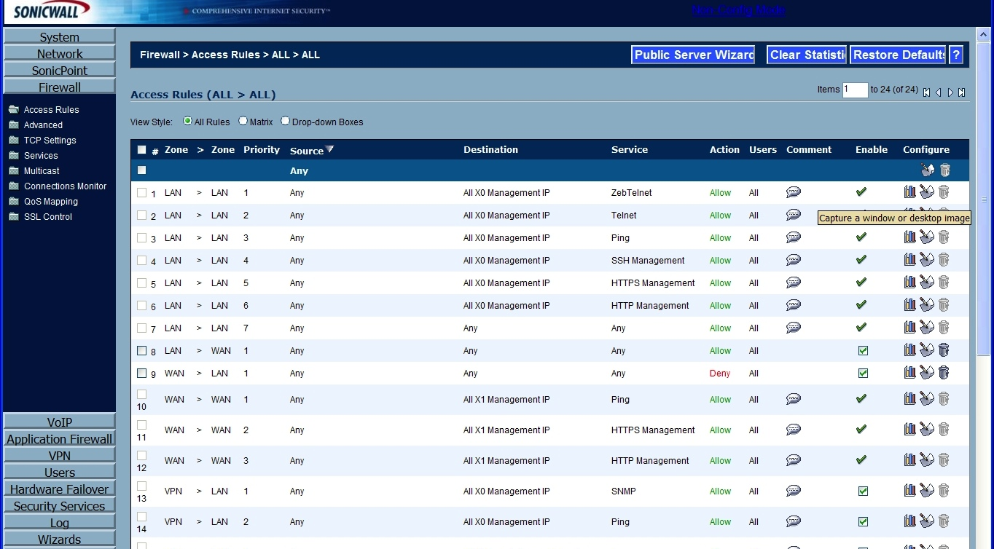
Example: SonicWall https://sonicwall.com

Slide 69
Summary
7 basic principles of secure system design
Firewalls + NAT
Protect networks, allow useful services
Stateful is safer
But more advanced protection requires looking into packet contents
How to deal with encrypted traffic?
Rule ordering matters!
Manual configuration leads to potential for errors

Slide 70
Any questions?

Slide 71

Proxies
Stay tuned
Next time you will learn about
Notes:
Source: http://info.netcenter.net/Portals/192612/images/firewall2.jpg

