Slide 1



Proxies | IDS
INGI2347: COMPUTER SYSTEM SECURITY (Spring 2014)
Marco Canini
Lecture slides adapted from UCL INGI2347 by Gildas Avoine and Upenn CSE331 by Steve Zdancewic Reproduced with permission
Notes:
Image source: http://www.marcofolio.net/images/stories/useful/tools/proxy/proxy_websites.png; http://coreitx.com/images/firewallmanagement.jpg

Slide 2
Plan for today
Lecture 5
Proxies
Proxies features and benefits
Types of proxies
Reverse proxies
Intrusion Detection Systems
NEXT

Slide 3
Proxies are application relays
Client
Proxy
Server
Transport
Transport
Transport
Internet
Internet
Internet
Link
Link
Link
Ethernet
Ethernet

Slide 4
Proxy
Internal connection
External connection
Internal Client
Proxy
External Server
Proxy acts like both a client and a server
Can provide other services too
Examples: caching, load balancing, mobile page transformation, content transcoding/compression/translation
A typical example of the defense in depth and choke point principles

Slide 5
Proxy Benefits
Prevent direct connections from the internal network towards the Internet
Choke point
Possibly authentication
Able to filter application-level info
URL or DNS blacklists, URL filtering
Content type (MIME) filtering, keyword filtering
Virus, exploit, …

Slide 6
Cache Feature
The proxy can keep a copy of all the contents it has served in a cache
When another client asks for the same content, it can provide the cached copy
Ensure content is up-to-date (Example: in HTTP, use header info)
The transfer is much faster (increase in QoE)
We can save on bandwidth (limit cost)

Slide 7
HTTP Without Proxy
$ telnet www.example.com 80
GET /index.html HTTP/1.0
HTTP/1.1 200 OK
Date: Mon, 10 Feb 2014 15:21:38 GMT
Server: Apache/2.2.3 (CentOS)
Expires: Mon, 10 Feb 2014 15:21:38 GMT
Cache-Control: no-cache
Pragma: no-cache
Connection: close
Content-Type: text/html;charset=UTF-8
<html>
<head><title>Example</title></head>
<body>…

Slide 8
HTTP With Proxy
$ telnet www.example.com 80
GET http://www.example.com/index.html HTTP/1.0
HTTP/1.1 200 OK
Date: Mon, 10 Feb 2014 15:21:38 GMT
Server: Apache/2.2.3 (CentOS)
Expires: Mon, 10 Feb 2014 15:21:38 GMT
Cache-Control: no-cache
Pragma: no-cache
Connection: close
Content-Type: text/html;charset=UTF-8
<html>
<head><title>Example</title></head>
<body>…
Requires browser configuration!

Slide 9
Anonymity?
Surf anonymously?
IP address of proxy is visible
HTTP request headers are visible
Traffic can be analyzed by the proxy operator

Slide 10
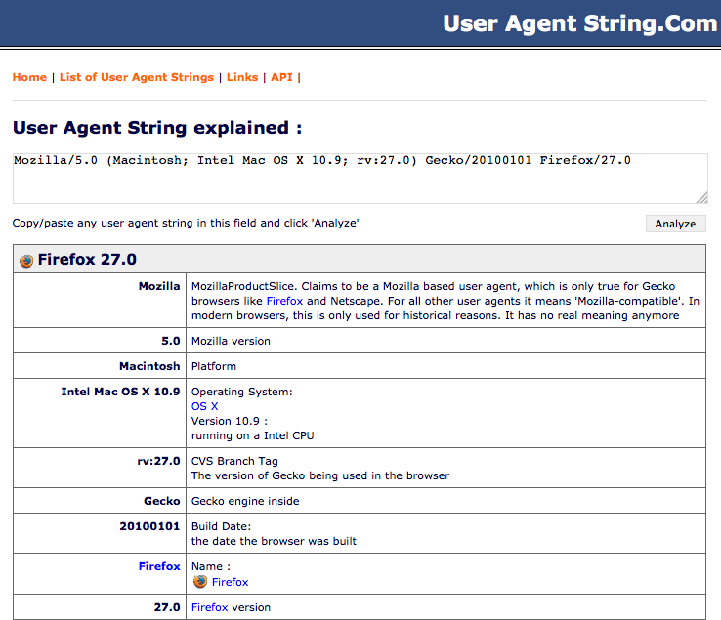

Slide 11
Types of Proxies

Slide 12
Transparent Proxy (intercepting proxy)
Traffic targeted at a certain port is automatically redirected towards the proxy by the firewall
Pros
Avoid having to configure browsers
Enforce usage of the proxy
Enable load balancing
Cons
Doesn’t work for servers that are not on the configured port

Slide 13
Transparent Proxy (intercepting proxy)
“A 'transparent proxy' is a proxy that does not modify the request or response beyond what is required for proxy authentication and identification.” [RFC2616]
Detection of the use of a proxy:
Compare IP address of client with that observed by the server
(if client is not NATed)
Examine HTTP request headers at the server
Make a connection to an IP address at which there is no server

Slide 14
FTP Proxy
FTP summary
FTP uses a command connection and a data connection
The data connection can be directed towards the client (active mode, default setting) or towards the server (passive mode)
The FTP protocol has not been designed to be used through a proxy

Slide 15
FTP Proxy using HTTP
Browsers allow specifying URLs in the form ftp://example.com/filename
If the browser is configured to use an HTTP proxy, it will ask the proxy for that URL
The HTTP proxy carries out the FTP transfer and provides the document as part of the HTTP reply
HTTP connection
FTP connection
Client
HTTP Proxy
Server
GET ftp://…

Slide 16
User@ FTP Proxy
User@ proxy behaves like a standard FTP server
Access server through the proxy by connecting with USER user@server as username to the proxy
The latter connects to the server and relays the password, commands and the data
The two connections can use active or passive mode independently
FTP connection
FTP connection
Client
User@ FTP Proxy
Server
USER x@srv
USER x

Slide 17
SMTP Proxy
SMTP was conceived for relaying mail hop by hop
Hence, any SMTP server can work as a proxy
Outbound (forward path):
Use specified as SMTP server for outgoing mail in the mail client
Inbound (reverse path):
Proxy registered in the DNS as the official server for that domain
Proxy has to be configured to forward all mail to the internal server

Slide 18
DNS Proxy
DNS protocol is designed to retransmit requests from one server to another
DNS servers can work as proxies
DNS servers have a cache to limit traffic and reduce response times
It is a good idea to configure a DNS proxy to direct all its request towards a bigger server (e.g., that of an ISP) to take advantage of a bigger cache

Slide 19
SOCKS Proxy
SOCKS (Socket Server) proxy is a general proxy for TCP (and UDP) connections
Accept a client connection, then open another one towards the server
Then relay data between the two connections
SOCKS allows any protocol to pass via a proxy
Both an advantage and limitation

Slide 20
HTTPS Proxy
HTTPS is the secure version of HTTP
(encryption, authentication)
HTTPS proxies are NOT a secure version of HTTP proxies!
HTTPS encrypts and authenticates end-to-end
HTTPS proxy just transparently relays data between client and server
Much like SOCKS

Slide 21
HTTPS Proxy: Implementation
HTTPS proxy uses the HTTP command CONNECT that indicates the server address
Replies with a status and becomes transparent
CONNECT www… HTTP/1.0
Client
HTTPS Proxy
Server
GET http://…
GET http://…

Slide 22
HTTPS Proxy: Security Issues
The HTTPS proxy allows relaying any type of protocol (it is transparent, just like SOCKS)
To limit abuses, the available ports are often limited to 443 (HTTPS) and 563 (SNEWS)
To allow any protocol to cross a firewall, it is sufficient to run the server on port 443 and pass through an HTTPS proxy

Slide 23
Reverse Proxies

Slide 24
Reverse Proxy
Appears to clients to be an ordinary server
Requests are forwarded to one or more origin servers which handle the requests
Client has no knowledge of the origin servers
External connection
Internal connection
Server
Server
Client
Reverse Proxy
Server
Internet

Slide 25


Reverse HTTP Proxy
Filter requests (blocking exploits)
Authenticate clients even before they communicate with the server
Cannot attack the server unless authenticated
Accelerate servers
Encryption acceleration
Caching static content
Load balancing
Accelerate clients via content compression

Slide 26
Reverse HTTPS Proxy
HTTPS proxies are used as encryption accelerators
Can reduce the server load by taking care of encryption
Can have a hardware accelerator for encrypting data
The connection between the proxy and the server is HTTP and not HTTPS

Slide 27
Protocol Translation Proxy
A proxy can use different protocols each side
Examples:
A Web mail proxy can accept HTTPS requests from the Internet and generate IMAP requests towards the mail server
An MPTCP proxy can enable MPTCP-compatible hosts to connect to TCP-only hosts
Protocol diversity strongly limits the chances of exploiting a vulnerability across a proxy

Slide 28

Intrusion Detection System
Notes:
Source: http://blog.simplilearn.com/wp-content/uploads/2013/08/IDS_BLOG.jpg

Slide 29
Intrusion Detection System (IDS)
Idea: don’t wait for the symptoms of an attack before reacting
An Intrusion Detection System (IDS) monitors
Network traffic (Network IDS, NIDS), typically in front of the firewall
Events on servers (Host IDS, HIDS)
When malicious activities are detected, launch an alarm (SMS, mail, etc.)
Can attempt prevent attacks from succeeding
Example: reconfigure firewalls or servers
Analysis can be done in real-time or by analyzing logs

Slide 30
IDS: Approaches
Network IDS (NIDS)
Off-line Analysis | Analysis of logs and configuration of firewall, routers | Network sniffer | Real-time Analysis
 | Examination of system logs | Log/Registry/Sys-call watcher
Host IDS (HIDS)

Slide 31
IDS with Traffic Characterization
IDS performs statistical analysis on traffic
If a value goes beyond its usual limits then assume there is an attack
Can recognize new attacks
May also not recognize them… (false negatives)
Or see attacks where there aren’t (false positives)
High false positives makes this IDS type unpopular
Example: Port Scanning (slow mode to avoid detection)

Slide 32
Signature-based IDS
Use a database of known attacks
Example: Web request with URL of 2000 characters == buffer overflow
Doesn’t recognize new attacks
Must be constantly updated
Honeypots: traps to detect attack
False negatives
Manual attacks can have variations that are not detected
Signatures are not always precise
False positives
Doesn’t know if an attempted attack was successful
Doesn’t know if the target is vulnerable (e.g. Linux attack on Windows server)
Notes:
Honeypot: computer with some weak services.
Production honeypots, research honeypots.
Low interactivity, High interactivity.

Slide 33

Snort: Signature-based
Lightweight IDS for Linux and Windows
“Signature, protocol and anomaly based inspection methods”
Analyze traffic, for example in front of the firewall, to detect possible attacks
Send mails and/or update filtering rules
Huge signature database updated by users

Slide 34
Snort: Example of Signatures
log tcp any 80 -> any any
Means “Log TCP packets coming from any host, port 80, going to any host, any port”
alert tcp any any -> 192.168.1.0/24 143 (content: "|90C8 C0FF FFFF|/bin/sh"; msg: "IMAP buffer overflow!";)
Means “Alert when receiving a packet from any host, any port to port 143 of a computer with IP address in 192.168.1.0/24, when the packet contains the string “|90C8 C0FF FFFF|/bin/sh”

Slide 35
Integrity-based Host IDS: Tripwire
Typical example of a HIDS with a differed analysis
Create a digital signature of all files and directories that should not be modified
Signatures cannot be modified by an attacker
Regularly compare files and signatures to detect any modification
Generate an alarm when a modification is detected and can automatically restore the original version of the file

Slide 36
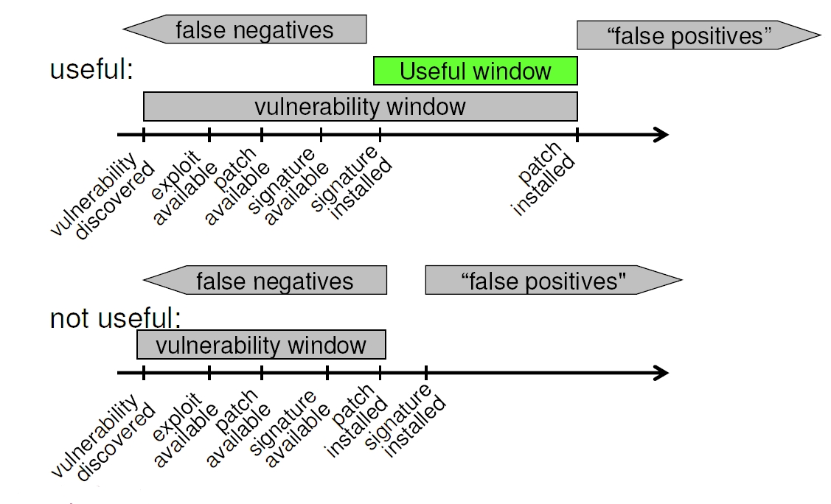
IDS: Efficiency

Slide 37
Intrusion Prevention Systems: IPS
An IDS that reacts to an attack
IP level: Filters the source IP address in the firewall (for a while)
TCP level: Sends a spoofed TCP reset packet to the destination to kill the connection
Application level: “Corrects” a Web request by removing special characters
Beware of denial of service through false positives!

Slide 38
IDS: Discussion
Traffic-characterization IDSes are not yet very efficient
IDS with signatures work well but:
Majority of the attacks for which we have the signature can be blocked by a FW or proxies
We should first prevent before trying to detect
Not sufficient to install an IDS: must also know how to react to attacks and deal with many false positives
Automatic reactions are usually not advisable (DoS)

Slide 39
IDS: Discussion
If both traffic characterization and signature-based are possible, it provides a good defense in depth
IDS deployed in internal networks create less frequent and more critical alarms

Slide 40
Summary
Proxies
Prevent direct connections
Application-level filtering
Defense in depth and choke point principles
Other useful features (e.g., load balancing, caching)
IDS
Monitor network and system activities
Raise alarms
IPS: react to alarms automatically
Challenge: deal with false positives (self DoS)

Slide 41
Any questions?

Slide 42

Cryptography
Stay tuned
Next time you will learn about
Notes:
Source: http://spectrum.ieee.org/image/62374

