Slide 1
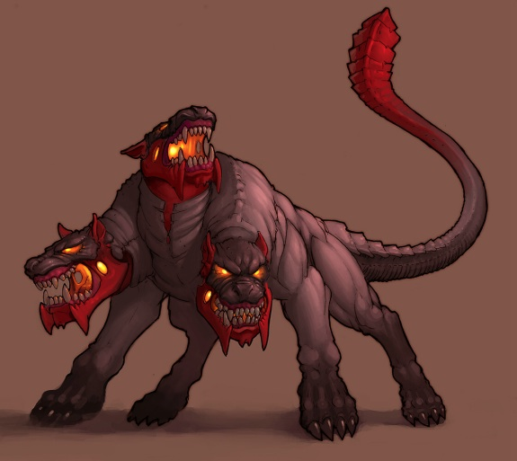


Kerberos | PGP
INGI2347: COMPUTER SYSTEM SECURITY (Spring 2014)
Marco Canini
Lecture slides adapted from UCL INGI2347 by Gildas Avoine Reproduced with permission
Notes:
Image source: http://24-timepass.com/postimg/three-headed-dog.jpg | http://shutdownhls.files.wordpress.com/2012/08/xl_gnupg_logo_200.png?w=500

Slide 2
Announcements
Final exam on 11 Jun at 8:30 in BARB91
Lecture 12 (Cloud computing security) will not be part of the exam

Slide 3
Plan for today
Lecture 13
Kerberos
Pretty Good Privacy (PGP)
NEXT

Slide 4







Many-to-many authentication
users
services
How do users prove their identities when requesting services from servers on the network?
Solution: every server knows every user’s password
Insecure: break into one server may compromise all users
Inefficient: passwords must be changed on every servers
Inconvenient: passwords must be typed for each request

Slide 5
Server-aided authentication
Credential is supplied to get the expected service
3
users
services
Trusted third party provides a credential to the user
2
The credential (aka ticket) is an identity proof but does not necessarily give the ability to use a given service
User proves his identity and requests a credential
1
TTP

Slide 6
Server-aided authentication
Hypotheses:
There is an online trusted authentication server (AS)
AS shares K_{C} with client C
AS shared K_{S} with server S
Goal:
To help C and S share a session key K

Slide 7
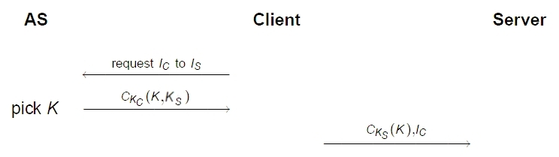
Very Weak Example
Identity of the Client
Identity of the Server
The client can give the server’s key to other clients

Slide 8
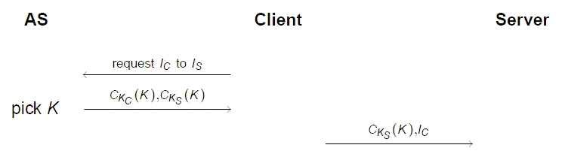
Weak Example
A solution consists in not revealing the server’s key: AS encrypts itself the session key K with the server’s key. “sealed envelop”
AS uses K_{A} instead of K_{C}
An attacker can replace I_{C} by I_{A}
Notes:
The attack is possible because the two values sent to the server are not linked.

Slide 9
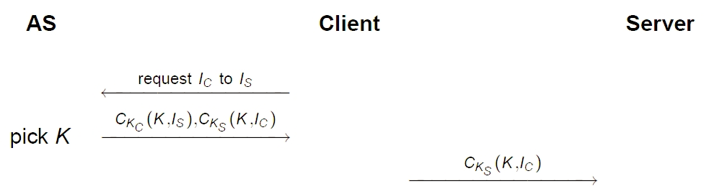
Still Weak Example
Replay attack by impersonating AS if K is compromised, due to careless users: no means to be sure that K is fresh

Slide 10
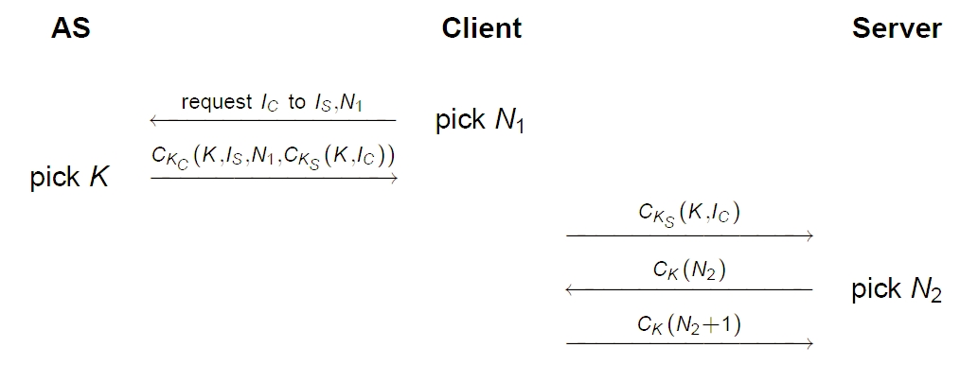
Needham Schroeder (1978)
Replay attack by impersonating C if K is compromised, due to careless users: no means to be sure that K is fresh
N1 is a nonce, a random value used only once
Notes:
S cannot be sure that K is a fresh key.

Slide 11
Kerberos

Slide 12
Kerberos V
The name Kerberos comes from Greek mythology
It is the three-headed dog that guarded Hades’ entrance
Created at the MIT, free of charge
Kerberos 4 (1988), obsolete
Kerberos 5 (1993), RFC 1510, then RFC 4120 (2005)
Deployed:
Initially on Unix systems
Used in many commercial products, e.g., Windows since 2K
Based on symmetric-key cryptography

Slide 13
Kerberos V
Once logged into a system, you can access remote resources without inputing username and password anymore
Kerberos software on the workstation will finish the authentication automatically on your behalf

Slide 14
Kerberos Elements
C = Client | S = Server
AS = Authentication server
a.k.a. KDC = Key Distribution Center
TGS = Ticket Granting Server
1- Request a Ticket Granting Ticket
TGS
2- Provide a Ticket Granting Ticket
3
4
3- Request a Ticket for a given service
4- Provide a Ticket for a given service
1
5
AS
C
S
5- Forward the Ticket
2
6
6- Provide a service

Slide 15
Tickets and Authenticator
To access a service, the client must have a ticket for that service
Client can get this ticket from the TGS
To access the TGS, the client must have a Ticket Granting Ticket
Client can get this ticket from the Authentication Server
The client shows a ticket + an authenticator

Slide 16
Tickets, Authenticator
The ticket contains:
I_{C}: the client’s identity
v: validity period
K_{C,S}: symmetric session key to be used between client and server
Others: Flags, IP address, times, etc.
It is encrypted with the key of the server K_{S}
The authenticator is just the client’s identity and a timestamp encrypted with the session key

Slide 17
Between C and AS
Firstly, C must be authenticated by AS to have access to TGS
C sends his identity and the identity of the TGS he wants to access to
AS replies with a Ticket Granting Ticket (TGT) encrypted with TGS’s key and a session key encrypted with C’s key
(1) I_{C} , I_{TGS} , N
(2) {I_{TGS} , N, K_{C,TGS}}_{KC} , {I_{C} , v , K_{C,TGS}}_{KTGS}
TGS
1
AS
C
S
2

Slide 18
User & Service Authentication
The user types his username and password on his machine
The client applies a one-way function (in practice a hash function) on the password in order to get the cryptographic key K_{c}
Server’s keys are random bit-strings

Slide 19
Between C and TGS
Client sends the TGT as well as an authenticator to the TGS
Recall that the ticket contains the session key K_{C,TGS}
TGS uses the session key to verify the authenticator
TGS knows whether C is authorized to access the server S
TGS delivers a ticket to access the service
(3) I_{S} , N’ , {I_{C}, v, K_{C,TGS}}_{KTGS} {I_{C} , t}_{KC,TGS}
(4) {I_{S} , N’ , K_{C,S}}_{KC,TGS} , {I_{C} , v, K_{C,S}}_{KS}
TGS
3
4
AS
C
S

Slide 20
Between C and S
Service ticket again contains the client’s identity, a validity period and the session key to be used between client and server
Client has also received a copy of the session key, encrypted with the previous session key
It sends an authenticator and the ticket to the server
TGS
(5) {I_{C}, v , K_{C,S}}_{KS} , {I_{C} , t}_{KC,S}
(6) {t}_{KC,S}
5
AS
C
S
6

Slide 21
Discussion
It is the client’s responsibility to store its credential (the tickets); the servers are stateless
The authentication server is accessed only once during the ticket validity (typically 8 hours)
Clients can access services with their tickets even if the authentication server is down
Once a client is authenticated, its ticket cannot be revoked

Slide 22
Ski Pass Analogy
You get a three-day ski pass (TGT) from your travel agency against a proof of identity (and money…)
The three-day ski pass (TGT) can be used at four different resorts
You show the pass at whichever resort you decide to go (until it expires), and you receive a lift ticket (ST) for that resort
Once you have the lift ticket (ST), you can ski all you want at that resort (until it expires)
If you go to another resort later, you once again show the three-day ski pass (TGT), and you get another lift ticket (ST) for the new resort

Slide 23
Pretty Good Privacy (PGP)

Slide 24
PGP History
PGP = Pretty Good Privacy
Several flavors: PGP, PGPi, GPG
PGP
Published by Philip Zimmermann in 1991
Portable software initially containing classical algorithms MD5, IDEA, RSA
First software allowing anybody to completely protect their documents and messages
3 years of enquiry and harassment by the American government
Patented algorithms (RSA patented in the US until 2000)
Suspicion of violating export regulations

Slide 25
PGP History
1996-97:
Selling of PGP Inc. to McAffee (Network Associates)
Code no longer public
During the 39th IETF meeting at Munich, Zimmermann and Callas requested the IETF to setup a working group on the standardization of PGP (OpenPGP [RFC1991, Aug 96], [RFC2440, Nov 98], [RFC4880, Nov 07])
Richard Stallman at the Individual-Network Betriebstagung at Aachen requested the European hackers to implement public key software (US citizens were not allowed to do so outside us)
2001:
Zimmermann leaves Network Associates
Network Associates abandons PGP

Slide 26
PGP History
2002:
PGP Corporation is created, buys back PGP rights www.pgp.com
Code is again public
Free trial version
Basic functionalities remain available after 30 days, but not the additional functionalities, e.g., disk encryption
Complete system compliant with OpenPGP
2010:
Symantec acquired PGP

Slide 27
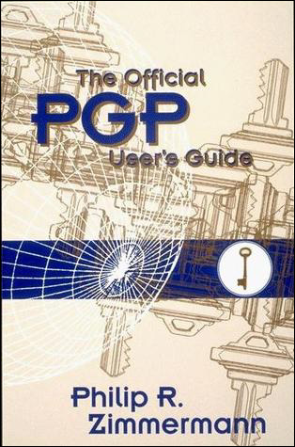
PGP History
PGPi
Developed by Ståle S. Ytteborg (Norway) to counter the US export regulations
Maintained from 1997 to 2000
Obtained from the printed source code of PGP
MIT Press thus published a book with the PGP source code
www.pgpi.org

Slide 28
PGP History
GPG = GnuPG = GNU Privacy Guard
GnuPG is the GNU GPL version of PGP www.gnupg.org
Initially, used ElGamal and Blowfish instead of RSA and IDEA
Follow the Open PGP Standard
Version 0.0.0 released in December 1997
GUI Frontends:
http://www.gnupg.org/related_software/frontends.en.html

Slide 29
Basics

Slide 30
PGP Features
Signature
Encryption
Hybrid crypto: combine symmetric and public-key crypto
Session key is symmetric; encrypt session key with public-key of recipient
Key management
What is called a PGP key is actually a PGP certificate
Web of trust

Slide 31
Example
This is an example of signed message
-----BEGIN PGP SIGNATURE-----
iQIcBAEBCgAGBQJTcWJaAAoJEChyd2euJIo/aYYP/0Vl/+u5zNkFw9lgvCd4UYdu
88aTImx+KmP8loFnu0Q6EC8UCuYCd8q/CHNPVq9k+pBE3Szolt6L3EIO6hDwRjJn
lnODZVoAWBgy5S5+BEgTA6OI3ixsmySacjkfYKbSprgLCKRklgesVl9Lo+5/ZTXJ
gQRhqePkYEmsfMKnTmLi9jiS/TqfXBcKOiuZ2Y/ihhNULIP4mnIDKw7k2AI8d27/
rAV2uMEi2XKDwxn9ziJ31yAM6IUhKvEKFwAjHf63rETZM3QrlgHaG/U128S5pqzS
JCkXFMhXnyCVRXmVDaoq9drzWXJ7EU8YHYDZnw6cuuYXPkGQC83T8XM+ZDIXFeQz
o0uFXcKUPyO+Ns6D2HrPKv+yxi8PbmBTOZs8nKIj843BzWFr3etnR19N1f/+zV+X
VMaNRW/i67Of8uD4dJlkA8PYDgBmglBn8oRiU0L5bqOWoXJFJKXQiYz62lZvtPwS
PBDAfM2NfGkdBV4ypOoqydTzwhd8ZO26PICKAKFhW+AfEeQu7a7tOD0+m/3L74Mf
ljbTTalyctgTY/slDiP/bHS8NCgIIhvjsJYdfrMCuc+t29bh5FwMnyemU07Ynqa2
vo4L/Jq1qJ3Cy2h+kyW4MZlh6ADauacbHH1pVLKvHOnH5mT4FsP0rsI/F73oZSN2
RQZwQdrjHsIihP02ERCX
=FyhH
-----END PGP SIGNATURE-----

Slide 32
Symmetric Encryption [RFC4880]
TDES [Mandatory]
Slow. Considered to be secure
IDEA
Patented until 2010. Seem to be secure, resisted to all cryptanalysis for 17 years…
CAST5 (128 bit-key) [should impl. CAST5]
Less studied than the other algorithms
Blowfish (128 bit-key)
Less studied than the other algorithms
Twofish (256 bit-key) (AES contest top-5 finalists)
Rather new
AES (128/192/256 bit-key) [should impl. AES128]
The standard since 2000
All of them seem to be secure.

Slide 33
Public-Key Encryption [RFC4880]
RSA
ElGamal [Mandatory]
Notes:
Y1^(-a). y2

Slide 34
(Public-Key) Signature [RFC4880]
RSA
DSA [Mandatory]
ElGamal no longer recommended for signature
Attack by Phong Nguyen (2003) when ElGamal keys used for both encryption and signature.
“[…] We show that as soon as one (GPG-generated) ElGamal signature of an arbitrary message is released, one can recover the signer’s private key in less than a second on a PC. As a consequence, ElGamal signatures and the so-called ElGamal sign+encrypt keys have recently been removed from GPG” (Nguyen, 2003)
The flaw was exploitable during 4 years…

Slide 35
Hash Functions [RFC4880]
MD5
Deprecated
SHA-1 [Mandatory]
Should be avoided
SHA-224/256/384/512
Seem Ok
RIPEMD-160
Seem Ok
Tiger
Seem Ok

Slide 36
Protection of the Private Key
The private key cannot be memorized by the user
How can we protect the private key?
Stored on the hard drive
Encrypted with a password (no means to access it without the user’s collaboration)
Once decrypted, it is in the computer’s memory (dangerous)
Stored on a smart card
Access to the card is protected by a password
The key never leaves the card, it’s the data that transits through the card to get encrypted, decrypted or signed
The passphrase must be as strong as the key (i.e., same entropy at least)

Slide 37
Key Size [Lenstra,Verheul, 01]
sym. key (bits) | public key (bits)
71 | 1024
80 | 1536
87 | 2048
99 | 3072
Help choosing an appropriate key size:
http://www.keylength.com/en/1/

Slide 38
Public-key Validity

Slide 39
Getting the Recipient’s Key
How to be sure that the key we use to encrypt a message is the correct one?
Directory
Who put the key into the directory?
Fake identity associated to the key?
Is the directory a legitimate one?
Face to face, check the ID, check the hash of the key, sign the key
Certificates

Slide 40
Certificates
Peer-to-peer
Users trust some other users
One or several signatures on each certificate

Slide 41
Public-key Distribution

Slide 42
Validity and Trust in PGP
Two important notions in PGP
Validity: I know that this key belongs to Bob
Trust: I know that Bob does not sign keys arbitrarily
When we sign a key, we declare its validity

Slide 43
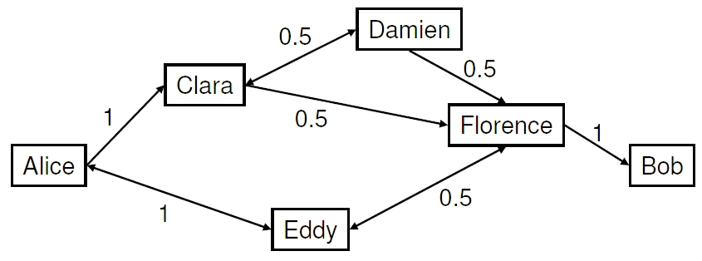
Validity and Trust in PGP
We can also declare a full or partial trust
A key is valid if the sum of the partial trusts of its valid signatures is at least 1

Slide 44
The Web of Trust
Clara and Eddy are valid since Alice has signed them
Alice has full trust in Clara and Eddy:
Damien, Florence, and Eddy are valid
Clara and Eddy each have a partial trust in Florence:
Alice trusts Florence and Bob is valid

Slide 45
Key Signing Party
Each participant’s public key is published in advance and downloaded by everybody
Each participant identifies himself (with passport) and reads aloud his key fingerprint
Everybody signs that key and uploads it on a key servers

Slide 46
Key Publication
Several PGP key servers exist across the world
http://pgp.mit.edu/
They contain keys of all PGP users that want to publish their key
If Alice is sure that the key associated to Clara belongs to Clara, she can sign Clara’s key and re-submit it to the servers
If Eddy trusts Alice, he can accept Clara’s key

Slide 47
Public-key Revocation

Slide 48
Key Revocation
How can we revoke a key published on a server?
Servers are replicated: withdrawing a key is useless because another server will duplicate it again
How can we prove that we are allowed to revoke a key if we lost it?
We generate a key revocation certificate when we generate the key
We put a validity deadline to the key when we generate it

Slide 49

Hope you enjoyed INGI2347!
Notes:
Source: http://wallpoper.com/images/00/23/97/54/cartoons-text_00239754.jpg

