Slide 1
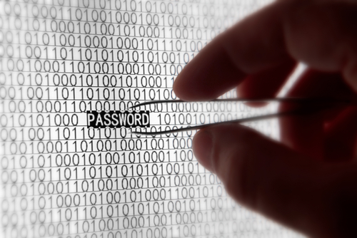

Passwords | Time-memory trade-offs
INGI2347: COMPUTER SYSTEM SECURITY (Spring 2015)
Marco Canini | Guest lecturer: Xavier Carpent
Lecture slides adapted from UCL INGI2347 by Gildas Avoine Reproduced with permission
Notes:
Image source: http://spectrum.ieee.org/image/62374

Slide 2
Plan for today
Lecture 12
Passwords
Vulnerabilities
Online Attacks
Offline Attacks
Weak Passwords
Unix/Windows Cases
Strong Passwords and Good Practices
Time-memory trade-offs
NEXT

Slide 3
Naïve Idea
User
Password file
123456
123456
abc123
qwerty
…
All passwords are revealed if the password file is stolen!

Slide 4
Password Storage
Passwords must never stored as plaintext!
Instead of passwords, store a hash
The hash must be irreversible
When logging in, the hashed password is compared with the stored hash

Slide 5
Implemented Idea
User
Hash file
123456
dLe47aP
1KeR45f
BV7Red4
...
hash

Slide 6
Vulnerabilities

Slide 7
Some Vulnerabilities
Written down passwords
Shoulder surfing
Social engineering
Key logger, Rootkit
Eavesdropping the network
Multi-website passwords
Audit trails
Guessing the password (low entropy)

Slide 8
Written Down Passwords
According to a 2002 security survey:
Probability of finding written passwords near a computer subjected to periodic password changes varied from 16% to 39%
Probability varied from 4% to 9% when the administrator did not enforce periodic password changes

Slide 9
Shoulder Surfing
Password keystroke observed
E.g. camera above an ATM
Graduate students at the University of Maryland Baltimore County shown that:
Non-dictionary passwords are more vulnerable to shoulder surfing than passwords belonging to a dictionary
Some keys are more easily observable

Slide 10
Social Engineering
Abuse the users
Survey at AArhus University:
336 students were asked by mail to send back their passwords to validate the password database
138 revealed their passwords
A few changed their passwords, but no one reported to the system administrator

Slide 11
Key Logger, Rootkit
Software or Hardware
Program that runs in the background, recording all the keystrokes.
Device between the keyboard and the computer
It has a microcontroller and a non-volatile memory
Microcontroller interprets the keystrokes as they are typed and stores them in the memory
Software example: ActualSpy

Slide 12
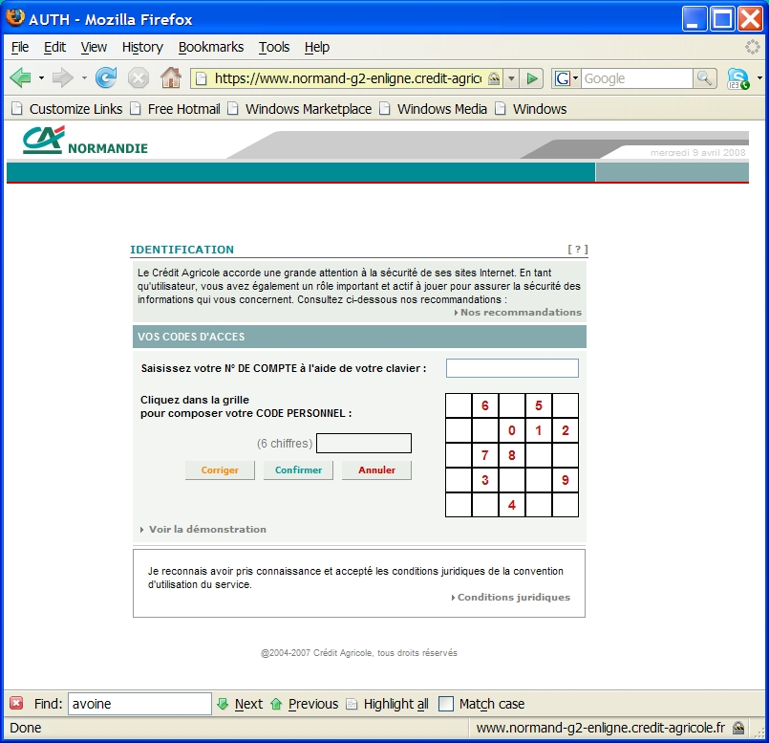
Key Logger, Rootkit
Solution: On-screen keyboard, password typed in different order using the mouse

Slide 13
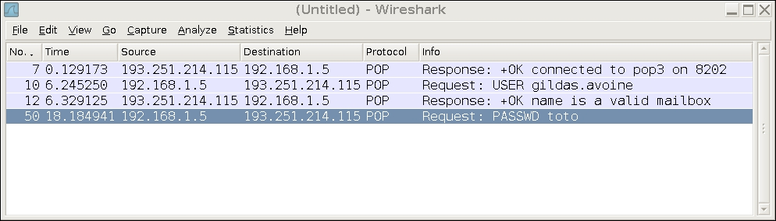
Eavesdropping the network
Passwords sent in the clear through the network: POP, FTP
A POP session sniffed with Wireshark
Notes:
Example with Wireshark

Slide 14
Multi-Website Passwords
Passwords should never be used for different purposes
Never use the same password for both Windows and Unix
Never use a password received by email for secure applications
A common practice is to use different security level passwords
Good different passwords for Windows accounts, Unix accounts, main mailbox
A few weaker passwords (easier to remember) for less secure applications, like online registration with pseudo

Slide 15
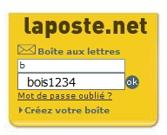
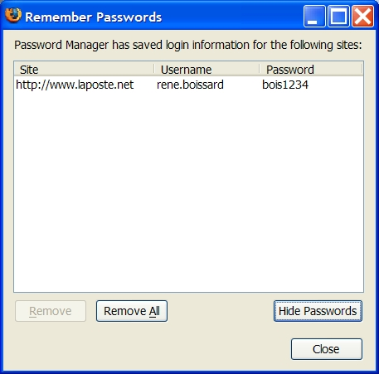
Audit Trails
Audit Trails can reveal the user name of the users
Password managers (be careful on public computers)
People enter passwords in the field of user name
Passwords in emails

Slide 16
Guessing some Password(s)
Targeted attack on one account
Attempt to penetrate any account on a system

Slide 17
Guessing a (the) Password(s)
Online Attack
The system is used as an oracle (black box)
Slow
Offline Attack
The attacker steals the hash file
The attacker recovers the passwords offline
The algorithm must be known
Target
A given account
Any account on the system

Slide 18
Online Attacks

Slide 19
Countermeasures
User
Computer
Username / pwd-1
Delayed
Answer
Wrong pwd
Username / pwd-2
Wrong pwd
…
Notification
to user
Username / pwd-5
Account
Locked
Wrong pwd

Slide 20
Locking Account
Denial of service attacks:
To lock a user, try to login into his account with random passwords
Customer service costs:
Users whose accounts are locked call a customer service center

Slide 21
Computing Cost for the User
Each login attempt must be accompanied by h(username,pwd,r) such that 20 least significant bits are 0
Negligible overhead for a single request
Attacks are slowed
Implementation Issues:
Clients must use a special software
Legitimate user with a slow machine

Slide 22


Captcha
Legitimate logins are done by humans while attacks are done by computers
Captcha: Completely Automated Public Turing Test to tell Computers and Humans Apart
Login attempts must be accompanied by a computation that is easy for humans and hard for programs
Notes:
Problem with captcha: there are today automatic tools to retrieve the word in the captcha. Hence captcha must be harder and harder, even for the legitimate user.

Slide 23
Offline Attacks

Slide 24
Offline Cracking
Hash algorithm must be known
Attacker must obtain a copy of passwords’ hashes
Since she cannot inverse hashes, she must guess the passwords (dictionary) or perform an exhaustive search
She generates the hashes of those words
She finally compares the generated hashes with the stolen hashes until finding a match
Notes:
Exhaustive search is also known as “brute force”.

Slide 25
Dictionary Attacks
Many people use dictionary words as passwords
Average dictionary contains only 150,000 to 200,000 words
People’s names, common pet names, and ordinary words
Hence files containing hashed passwords are susceptible to pre-compiled dictionary attack
A file of hashes of all possible dictionary words is generated
A PC can generate 200,000 to 10,000,000 password hashes per second depending on the type of hash

Slide 26
Heuristic Attack
Combine dictionary and brute force
Some rules are applied to the dictionary words according to the most used practices
Convert to lowercase, uppercase
Capitalize
Reverse: “Fred” -> “derF”
Duplicate: “Fred” -> “FredFred”
Reflect: “Fred” -> “FredderF”
Rotate the word left: “jsmith” -> “smithj”
Rotate the word right: “smithj” -> “jsmith”
Append or prefix character X to the word
Prefix the word with character X

Slide 27
Offline Attack Procedure
Progressive cracking:
Trivial and short passwords
Dictionary + Heuristics
Brute force
Cracking Tools:
Unix/Windows cracking: John the ripper, L0phtCrack
Windows password cracking: Cain, Ophcrack

Slide 28
Weak Passwords

Slide 29
Weak Passwords
Based on common dictionary words
Based on common names
Based on user/account identifier
Short (under 7 characters)
Based on keyboard patterns (e.g., “qwerty”)
Composed of single symbol type (e.g., characters)
…

Slide 30
Weak Passwords: Length
Length | Percent
1-4 | 0.82%
5 | 1.1%
6 | 15%
7 | 23%
8 | 25%
9 | 17%
10 | 13%
11 | 2.7%
12 | 0.93%
13-32 | 0.93%
Source: www.schneier.com

Slide 31
Weak Passwords: Content
numbers only | 1.3%
letters only | 9.6%
alphanumeric | 81%
non-alphanumeric | 8.3%
Source: www.schneier.com

Slide 32
Weak Passwords
Top-used passwords are (in order):
“We used to quip that ‘password’ is the most common password. Now it’s ‘password1’. Who said users haven't learned anything about security?” (Schneier, 2006)
Passwords are much better today than 15 years ago
password1, abc123, myspace1, password, blink182, qwerty1, fuckyou, 123abc, baseball1, football1, 123456, soccer, monkey1, liverpool1, princess1, jordan23, slipknot1, superman1, iloveyou1, monkey.
Source: www.schneier.com
Notes:
Quip= dire de manière sarcastique.

Slide 33
Unix/Windows Cases

Slide 34
Unix Passwords
The hash function can be based on:
DES
MD5 (Linux, BSD, Sun)
Blowfish (OpenBSD)
SHA256
SHA512

Slide 35
Unix Passwords (DES)
Random salt
(12 bits)
Key extracted
from password
plaintext
64-bit block of 0
25x DES
Ciphertext
64-bit hash
Notes:
account:coded password data:uid:gid:GCOS-field:homedir:shell
Salt: 12 bits encoded in 2 bytes
Ciphertext: 11 bytes
Characters beyond the eighth position are ignored.
Seven bits are extracted per character of the password to form a 56-bit key.
The hash is created by encrypting (25 times) with a variant of DES a chain of null characters with the password as key. Why 25 times?
A grain of salt (12 bits) is added s.t. the same password does not always generate the same hash.
Salt stored jointly with the hash.
Why are attacks harder?

Slide 36
Unix Passwords (MD5)
Key extracted
from password
Random salt
(48 bits)
MD5
128-bit hash

Slide 37
Storage Under Unix
Old method:
Name and hashes of passwords in the file /etc/passwd with free read access
Safer method:
The hashes are found in a separate file, /etc/shadow that can be read only by the administrator
Why is it safer since the function is one-way?
Two ways to gain access to the password file:
Reboot the machine with a USB key or a CD
Obtain administrator privileges using an exploit

Slide 38
/etc/shadow (DES, MD5)
Smith:3Yr83xxCi/Ki2:12801:0:99999:7:-1::
hash (11 char)
salt (2 char)
username
Smith:$1$gDT4Spf5$mr76vshidvcT1busoKrre1:11001:0:99999
hash (2 char)
salt (8 char)
hash algo (1=MD5)
username
Notes:
Characters encoded on 6 bits (Base64): [a-zA-Z0-9./]

Slide 39
Practice Yourself
DES:
openssl passwd –crypt –salt pH <PASSWORD>
MD5:
openssl passwd -1 –salt gDT4Spf5 <PASSWORD>

Slide 40
Win 9x Passwords (LM Hash)
Win98/ME uses the Lan Manager Hash (LM hash)
The password is cut in two blocks of 7 characters after completion to 14 characters with empty char
Lowercase letters are converted to uppercase
A separate hash is generated for each 7-char block
The 7 bytes block are used as DES keys to encrypt an 8-byte constant string:
0x4B, 0x47, 0x53, 0x21, 0x40, 0x23, 0x24, 0x25
The LM hash does not use any salt
http://lasecwww.epfl.ch/~oechslin/projects/ophcrack

Slide 41
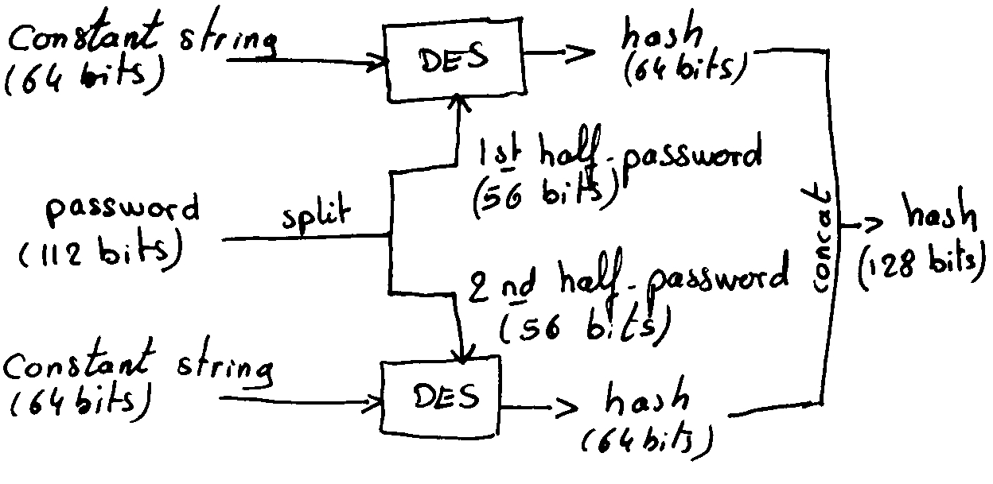
Win 9x Passwords (LM Hash)

Slide 42
Win NT/2000/XP/Vista/Seven (NT LM Hash)
Win NT/2000/XP/Vista/Seven uses the NT Lan Manager Hash (aka NT hash)
The password is no longer cut in two blocks
Passwords can be longer than 14 characters (but compatibility issues arise beyond 14 characters)
Lowercase letters are not converted to uppercase
The hash function is MD4
The NT hash still does not use any salt

Slide 43
Storage
Under W2k, XP, 2003, NTLM and LM hash of all users are stored in the Security Account Manager file or in the Active Directory (ntds.dit)
The file is encrypted, but by default the key can be extracted from the machine
If the machine is running we need administrator privileges plus a special exploit (pwdump) to extract the hashes
If we can boot another OS, we can steal and decrypt the hashes

Slide 44
Cracking Times – Benchmarks John (2011)
Traditional DES: 1134K c/s
FreeBSD MD5: 4400 c/s
OpenBSD Blowfish: 269 c/s
LM DES: 6547K c/s
NT MD4: 8260K c/s

Slide 45
LM Hash
All (LM Hash) alphanum passwords cracked within a few seconds (success 99.9%)
(Alphanum + 15 special char) LM Hash passwords cracked in a few minutes (success about 96%)
Storage: CD or DVD (fit the RAM)
See http://ophcrack.sourceforge.net/

Slide 46
Strong passwords and good practices

Slide 47
Strong Passwords
Contain at least one of each of the following
Digit (0…9)
Letter (a…Z)
Punctuation symbol (e.g., !)
Control character (e.g., ^s, Ctrl-s)
Special character in the first 7 characters
Based on a verse (e.g., passphrase)
Easily remembered but difficult for others to guess

Slide 48
Some good practices
Never recycle passwords
Never record a password anywhere
Exceptions include encrypted password “vaults”
Use a different password for each system/context
Change password regularly (?)
Change your password immediately if you suspect it has been “stolen”, or after using a public computer
Passwords should be protected in a manner that is consistent with the damage that could be caused by their compromise

Slide 49
