Slide 1
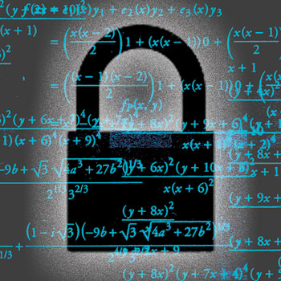

Cryptography 1
INGI2347: COMPUTER SYSTEM SECURITY (Spring 2016)
Marco Canini
Lecture slides adapted from UCL INGI2347 by Gildas Avoine, Upenn CSE331 by Steve Zdancewic, and Dan Boneh, Stanford Cryptography I@Coursera. Reproduced with permission
Notes:
Image source: http://spectrum.ieee.org/image/62374

Slide 2
Plan for today
Lecture 4
What’s crypto?
Symmetric key encryption
Trusted 3rd parties
Public key encryption
Crypto hash functions
NEXT

Slide 3
κρμπτο γραφη (Cryptography)
Greek for “secret writing”
Confidentiality
Obscure a message from eaves-droppers
Integrity
Assure recipient that the message was not altered
Authentication
Verify the identity of the source of a message
Non-repudation
Convince a 3rd party that what was said is accurate

Slide 4
Cryptography is everywhere
Secure communication:
web traffic: HTTPS
wireless traffic: 802.11i WPA2 (and WEP), GSM, Bluetooth
Encrypting files on disk: EFS, TrueCrypt
Content protection (e.g. DVD, Blu-ray): CSS, AACS
User authentication
… and much much more

Slide 5
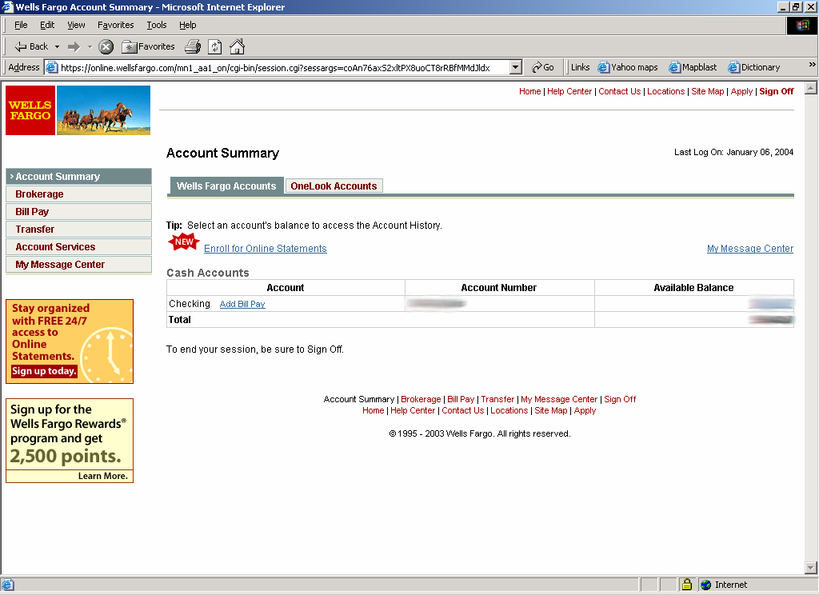
Secure communication
Bob
HTTPS
SSL / TLS
no eavesdropping
no tampering
Alice

Slide 6
Secure Sockets Layer / TLS
Two main parts
1. Handshake Protocol: Establish shared secret key using public-key cryptography
2. Record Layer: Transmit data using shared secret key
Ensure confidentiality and integrity

Slide 7
Protected files on disk
Disk
File 1
Alice
Alice
No eavesdropping
No tampering
File 2
Analogous to secure communication:
Alice today sends a message to Alice tomorrow

Slide 8
Terminology
Alice
Bob
plaintext
ciphertext
ciphertext
plaintext
Encryption
Decryption
Encryption algorithm
Transforms a plaintext into a ciphertext that is unintelligible for non-authorized parties
Usually parametrized with a cryptographic key
Asymmetric (Public) key cryptography
Crypto system: encryption + decryption algorithms + key generation
Symmetric (Shared) key cryptography
Cipher/decipher: symmetric-key encryption/decryption algorithms

Slide 9
Build block: sym.-key encryption
Alice
Bob
m
E(k,m)=c
c
D(k,c)=m
E
D
k
k
E, D: cipher k: secret key (e.g., 128 bits)
m, c: plaintext, cipher text
Same secret key for both encryption and decryption
Encryption algorithm is publicly known
Never use a proprietary algorithm
Fast in software or hardware implementations

Slide 10
Use Cases
Single use key: (one time key)
Key is only used to encrypt one message
encrypted email: new key generated for every email
Multi use key: (many time key)
Key used to encrypt multiple messages
encrypted files: same key used to encrypt many files
SSL: same key used to encrypt many packets
Need more machinery than for one-time key

Slide 11
Things To Remember
Cryptography is:
A tremendous tool
The basis for many security mechanisms
Cryptography is NOT:
The solution to all security problems
Reliable unless implemented and used properly
Something you should try to invent yourself
many many examples of broken ad-hoc designs
Privacy | Steganography | (Encoding|Decoding)

Slide 12
Cryptography is NOT
Privacy
Ability to control how personal information spreads in a community
Steganography
Science of information hiding
Encoding | Decoding
Code is a system of symbols which represent information
Encoding transforms information into a codeword
Decoding recovers information from a codeword

Slide 13
Cryptanalysis: a rigorous science
Proves or disproves the security of a cryptosystem
The three steps:
Precisely specify threat model
Propose a construction
Prove that breaking construction under threat mode will solve an underlying hard problem
Definition of break:
Decrypting (totally or partially) a given ciphertext
Recovering the key of the cryptosystem
Proving a cryptosystem is less secure than what is claimed

Slide 14
Symmetric-key cryptography
Assumes parties already share a secret key

Slide 15
Symmetric Ciphers: definition
Def: a cipher defined over ( K, M, C )
is a pair of “efficient” algs ( E, D ) where
E is often randomized | D is always deterministic

Slide 16
Stream vs. Block Ciphers
Stream ciphers
Act on the plaintext one symbol at a time
Examples: RC4, GSM A5-1, Bluetooth E0, CSS, …
High speed rate, hardware implementations very cheap
Security analysis is not well established
Block ciphers
Act on the plaintext in blocks of symbols
Examples: DES, 3DES, AES, IDEA, Blowfish, RC5, Kasumi, Safer, …
Suited to software implementations on various systems
(e.g., 8-bit, 32-bit, 64-bit processors)
Security analysis is well established

Slide 17
Stream Ciphers: The One Time Pad (Vernam 1917)
First example of a “secure” cipher
key = (random bit string as long the message)
msg: 0 1 1 0 1 1 1
key: 1 0 1 1 0 1 0
CT:
⊕
1 1 0 1 1 0 1
Indeed:

Slide 18
Stream ciphers (single key use)
Problem: OTP key is as long the message
Solution: Pseudo random key – stream ciphers
key
c ← PRG(k) ⊕ m
PRG
⊕
message
ciphertext

Slide 19
Dangers in using stream ciphers
One time key !! “Two time pad” is insecure:
C₁ ← m₁ ⊕ PRG(k)
C₂ ← m₂ ⊕ PRG(k)
Eavesdropper does:
C₁ ⊕ C₂ → m₁ ⊕ m₂
Enough redundancy in English and ASCII encoding that:
m₁ ⊕ m₂ → m₁ , m₂

Slide 20
What is a secure cipher?
Attacker’s abilities: obtains one ciphertext (for now)
Possible security requirements:
attempt #1: attacker cannot recover secret key
attempt #2: attacker cannot recover all of plaintext
Shannon’s information-theoretic perfect secrecy:
ciphertext should reveal no “info” about plaintext
Insecure: leaks m
Insecure: leaks m₀

Slide 21
Semantic Security (one-time key)
For b=0,1 define experiments EXP(0) and EXP(1) as:
for b=0,1: W_{b} := [ event that EXP(b)=1 ]
Adv_{SS}[A,E] := | Pr[ W₀ ] − Pr[ W₁ ] | ∈ [0,1]
b
Chal.
m₀ , m₁ ∈ M : |m₀| = |m₁|
Adv. A
k←K
c ← E(k, m_{b})
b’ ∈ {0,1}
Sematic Security Advantage of A against E
Notes:
The adversary behaves differently when give m0 than when given m1

Slide 22
Semantic Security (one-time key)
Def: E is semantically secure if for all efficient A Adv_{SS}[A,E] is negligible

Slide 23
Model of the attacker (also for PK)
Chosen-ciphertext attack (CCA)
The attacker has access to a decryption oracle: he can choose ciphertexts (other than the ciphertext he is challenged with) and get their corresponding plaintext
Chosen-plaintext attack (CPA)
The adversary has access to an encryption oracle: he can choose plaintexts and get their corresponding ciphertexts
More powerful than CCA

Slide 24
Block Ciphers
n bits
n bits
E, D
Plaintext Block
Ciphertext Block
Key
k bits
Canonical examples:
3DES: n= 64 bits, k = 168 bits
AES: n=128 bits, k = 128, 192, 256 bits

Slide 25
Block Ciphers Built by Iteration
key k
key expansion
⋯
k₁
k₂
k₃
k_{n}
m
R(k₁, ⋅)
R(k₂, ⋅)
R(k₃, ⋅)
R(k_{n}, ⋅)
c
R(k,m) is called a round function
for 3DES (n=48), for AES-128 (n=10)

Slide 26
Block Ciphers: DES (Feistel Network)
Given functions f₁, …, f_{d}: {0,1}^{n} ⟶ {0,1}^{n}
Goal: build invertible function F: {0,1}^{2n} ⟶ {0,1}^{2n}
R₀
R₁
R₂
R_{d-1}
R_{d}
n-bits
f₁
f₂
⋯
f_{d}
L₀
L₁
L₂
L_{d-1}
L_{d}
n-bits
⊕
⊕
⊕
input
output
In symbols:

Slide 27
Feistel Network
R₀
R₁
R₂
R_{d-1}
R_{d}
n-bits
f₁
f₂
⋯
f_{d}
L₀
L₁
L₂
L_{d-1}
L_{d}
n-bits
⊕
⊕
⊕
input
output
Feistel network F: {0,1}^{2n} ⟶ {0,1}^{2n} is invertible
Construct inverse:
R_{i-1}
R_{i}
f_{i}
L_{i-1}
L_{i}
⊕

Slide 28
Feistel Network inverse construction
R₀
R₁
R₂
R_{d-1}
R_{d}
n-bits
f₁
f₂
⋯
f_{d}
L₀
L₁
L₂
L_{d-1}
L_{d}
n-bits
⊕
⊕
⊕
input
output
Feistel network F: {0,1}^{2n} ⟶ {0,1}^{2n} is invertible
Construct inverse:
R_{i-1}
R_{i}
R_{i}
⊕
R_{i-1}
inverse
f_{i}
L_{i-1}
L_{i}
L_{i}
f_{i}
L_{i-1}
⊕

Slide 29
Feistel Network Decryption
R₀
R₁
R₂
R_{d-1}
R_{d}
n-bits
f₁
f₂
⋯
f_{d}
L₀
L₁
L₂
L_{d-1}
L_{d}
n-bits
⊕
⊕
⊕
input
output
Feistel network F: {0,1}^{2n} ⟶ {0,1}^{2n} is invertible
Construct inverse:
R_{i-1}
R_{i}
R_{i}
⊕
R_{i-1}
inverse
f_{i}
L_{i-1}
L_{i}
L_{i}
f_{i}
L_{i-1}
⊕

Slide 30
Feistel Network Decryption
R_{d}
⊕
R_{d-1}
⊕
R_{d-2}
R₁
⊕
R₀
n-bits
⋯
L_{d}
f_{d}
L_{d-1}
f_{d-1}
L_{d-2}
L₁
f₁
L_{i0}
n-bits
Inversion is basically the same circuit, with f₁, …, f_{d} applied in reverse order
General method for building invertible functions (block ciphers) from arbitrary functions
Used in many block ciphers … but not AES

Slide 31
DES: 16-round Feistel Network
f₁, …, f₁₆: {0,1}³² ⟶ {0,1}³² , f_{i}(x) = F( k_{i}, x )
k
derived from key k
key expansion
48 bits
⋯
k₁
k₂
k₁₆
16-round
Feistel network
64 bits
IP
IP⁻¹
64 bits
initial permutation (not for security)
final permutation (not for security)
input
To invert, use keys in reverse order
output

Slide 32
DES challenge
msg = “The unknown messages is: XXXX … “
CT = c₁ c₂ c₃ c₄ …
Goal: find k ∈ {0,1}⁵⁶ s.t. DES(k, m_{i}) = c_{i} for i=1,2,3
1997: Internet search -- 3 months
1998: EFF machine (deep crack) -- 3 days (250K $)
1999: combined search -- 22 hours
2006: COPACOBANA (120 FPGAs) -- 7 days (10K $)
⇒ 56-bit ciphers should not be used !! (128-bit key ⇒ 2⁷² days)

Slide 33
Triple-DES
Strengthening DES against exhaustive search
Let E : K × M ⟶ M be a block cipher
Define 3E: K³ × M ⟶ M as
For 3DES: key-size = 3×56 = 168 bits. 3×slower than DES.
3E( (k₁,k₂,k₃), m) = E(k₁, D(k₂, E(k₃, m)))
k₁ = k₂ = k₃
=> single DES

Slide 34
Advanced Encryption Standard (AES)
National Institute of Standards & Technology NIST
Computer Security Research Center (CSRC)
http://csrc.nist.gov/
Uses the Rijndael algorithm
Invented by Belgian researchers Dr. Joan Daemen & Dr. Vincent Rijmen
http://jda.noekeon.org/JDA_VRI_Rijndael_V2_1999.pdf
Adopted May 26, 2002
Key length: 128, 192, or 256 bits
Block size: 128 bits
If DES could be broken in 1 second, then AES would require 149 trillion years to be broken

Slide 35
Performance
Crypto++ 5.6.0 [ Wei Dai ]
AMD Opteron, 2.2 GHz ( Linux)
Cipher Block/key size Speed (MB/sec)
RC4 126
Salsa20/12 643
Sosemanuk 727
3DES 64/168 13
AES-128 128/128 109
stream
block

Slide 36
Problems with Shared Key Crypto
Compromised key means interceptors can decrypt any ciphertext they’ve acquired
Change keys frequently to limit damage
Distribution of keys is problematic
Keys must be transmitted securely
Use couriers?
Distribute in pieces over separate channels?

Slide 37
Trusted 3rd Parties
Basic key exchange

Slide 38
Key Management
Problem: n users
Storing mutual secret keys is difficult
Total: O(n) keys per user ; O(n²) keys in the system
k_{1,3}
u₁
u₃
k_{1,4}
k_{2,3}
k_{1,2}
k_{3,4}
u₂
u₄
k_{2,4}

Slide 39
A better solution
Onlined Trusted 3rd Party (TTP)
Every user only remembers one key
Alice
k_{A}
k₁
u₁
TTP
k_{AB}
Bob
u₂
k_{B}
k₂

Slide 40
Generating keys: a toy protocol
Alice wants a shared key with Bob
Eavesdropping security only
Bob (k_{B}) Alice (k_{A}) TTP
“Alice wants key with Bob”
choose random k_{AB}
E(k_{A}, “A,B” || K_{AB})
ticket
ticket⟵E(k_{B}, “A,B” || K_{AB})
k_{AB}
k_{AB}
(E,D) a CPA-secure cipher: attacker cannot distinguish between an encrypted value and a random one
Notes:
CPA=Chosen Plaintext Attack

Slide 41
Generating keys: a toy protocol
Alice wants a shared key with Bob
Eavesdropping security only
Eavesdropper sees: E(k_{A}, “A, B” || k_{AB} ) ; E(k_{B}, “A, B” || k_{AB} )
(E,D) is CPA-secure ⇒ eavesdropper learns nothing about k_{AB}
TTP needed for every key exchange, knows all session keys
In a corporate environment environment might make sense
Example: Kerberos system

Slide 42
Toy protocol: insecure against active attacks
Example: insecure against replay attacks
Attacker records session between Alice and Bob
For example a book order
Attacker replays session to Bob
Bob thinks Alice is ordering another copy of book

Slide 43
Key question
Can we generate shared keys without an online TTP?
Answer: yes!
Starting point of public-key cryptography:
Merkle (1974), Diffie-Hellman (1976), RSA (1977)
Further references:
More recently: ID-based enc. (BF 2001), Functional enc. (BSW 2011)

Slide 44
Public key cryptography

Slide 45
Asymmetric or Public Key Crypto
Sender encrypts using a public key
Receiver decrypts using a private key
Only the private key must be kept secret!
Public key can be distributed at will
Constructions generally rely on hard problems from number theory or algebra (e.g., FACT)
Can be used for digital signatures
Examples: RSA, El Gamal, DSA

Slide 46
Public Key Encryption
Alice
Bob
m
E(PK_{Bob},m)=c
c
D(SK_{Bob},c)=m
E
D
key pair
PK_{Bob}
SK_{Bob}
PK: public key , SK: secret key (e.g., 1024 bits)
Example: Bob generates (PK_{Bob}, SK_{Bob}) and gives PK_{Bob} to Alice
Sometimes E is the same algorithm as D
Fast in software or hardware implementations

Slide 47
Applications
Session setup (for now, only eavesdropping security)
Non-interactive applications: (e.g., Email)
Bob sends email to Alice encrypted using PK_{Alice}
Note: Bob needs PK_{Alice} (public key management)
Alice
PK_{Alice}
Bob
generate (PK, SK)
choose random x
(e.g. 48 bytes)
E(PK_{Alice}, x)
x

Slide 48
Public Key Encryption
Def: a public-key cryptosys. is a triple of algs. (G, E, D)
G(): randomized alg. outputs a key pair (PK, SK)
E(PK, m): randomized alg. that takes m∈M and outputs c∈C
D(SK, c): deterministic alg. that takes c∈C and outputs m∈M or ⊥
Consistency: ∀(PK, SK) output by G :
∀m∈M: D(SK, E(PK, m) ) = m

Slide 49
Semantic Security
For b=0,1 define experiments EXP(0) and EXP(1) as:
Def: E =(G,E,D) is sem. secure if for all efficient A: Adv_{SS}[A,E]=|Pr[EXP(0)=1] – Pr[EXP(1)=1] | < negligible
pk
b
Chal.
Adv. A
m₀ , m₁ ∈ M : |m₀| = |m₁|
(pk,sk)←G()
c ← E(pk, m_{b})
b’ ∈ {0,1}
EXP(b)

Slide 50
Establishing a shared secret
Alice
Bob
(pk, sk) ⟵ G()
“Alice”, pk
choose random
x ∈ {0,1}¹²⁸
“Bob”, c⟵E(pk,x)
D(sk,c) ⟶ x
x shared secret

Slide 51
Security (eavesdropping)
Adversary sees pk, E(pk, x) and wants x ∈M
Semantic security ⇒
adversary cannot distinguish
{ pk, E(pk, x), x } from { pk, E(pk, x), rand∈M }
⇒ can derive session key from x
Note: protocol is vulnerable to man-in-the-middle

Slide 52
Insecure against man in the middle
The protocol is insecure against active attacks
Alice
MiTM
Bob
(pk, sk) ⟵ G()
(pk’, sk’) ⟵ G()
“Alice”, pk
“Alice”, pk’
||
choose random
x ∈ {0,1}¹²⁸
“Bob”, E(pk’, x)
||
x ⟵ D(sk’, E(pk’, x))
“Bob”, E(pk, x)
||

Slide 53
Trade-offs for Public Key Crypto
More computationally expensive than symmetric (shared) key crypto
Algorithms are harder to implement
Require more complex machinery
More formal justification of difficulty
Hardness based on complexity-theoretic results
A principal needs 1 private key and 1 public key
Number of keys for pair-wise communication is O(n)

Slide 54
RSA Algorithm
Ron Rivest, Adi Shamir, Leonard Adleman
Proposed in 1979
They won the 2002 Turing award for this work
Has withstood years of cryptanalysis
Not a guarantee of security!
But a strong vote of confidence
Further reading: Twenty years of attacks on the RSA cryptosystem, D. Boneh, Notices of the AMS, 1999
Hardware implementations:
1000 x slower than DES

Slide 55
RSA at a High Level
Public and private key are derived from secret prime numbers
Today at least 1024 bits to ensure security (4096 bits is better)
Plaintext message (a sequence of bits)
Treated as a (large!) binary number
Encryption is modular exponentiation
To break the encryption, conjectured that one must be able to factor large numbers
Not known to be in P (polynomial time algorithms)

Slide 56
Crypto hash functions

Slide 57
Hash Algorithms
Take a variable length string
Produce a fixed length digest
(Non-cryptographic) Examples:
Parity (or byte-wise XOR)
CRC
Realistic Example:
The NIST Secure Hash Algorithm (SHA) takes a message of less than 2⁶⁴ bits and produces a digest of 160 bits
hash

Slide 58
Cryptographic Hashes
Create a hard-to-invert summary of input data
Like a check-sum or error detection code
Uses a cryptographic algorithm internally
More expensive to compute
Sometimes called a Message Digest
Examples:
Secure Hash Algorithm (SHA)
Message Digest (MD4, MD5)

Slide 59
Desired Properties
One way hash function
Given a hash value y, it should be infeasible to find m s.t. h(m)=y
Collision resistance
It should be infeasible to find two different messages m₁ and m₂ s.t. h(m₁)=h(m₂)
Random oracle property
h(m) is indistinguishable from a random n-bit value
Attacker must spend a lot of effort to be able to modify the message without altering the hash value

Slide 60
Any questions?

