Slide 1



Network Defenses
INGI2347: COMPUTER SYSTEM SECURITY (Spring 2016)
Marco Canini
Lecture slides adapted from Upenn CSE331 by Steve Zdancewic and UC Berkeley CS161 by Vern Paxson Reproduced with permission
Notes:
Image source: http://info.netcenter.net/Portals/192612/images/firewall2.jpg; http://www.remoteutilities.com/images/blog/nat.jpg

Slide 2
Controlling Networks … On The Cheap
How do you harden a set of systems against external attack?
Key Observation:
The more network services your machines run, the greater the risk
Due to larger attack surface
One way: on each system, turn off unnecessary network services
But you have to know all the services that are running
And sometimes some trusted remote users still require access
Plus key question of scaling
What happens when you have to secure 100s/1000s of systems?
Which may have different OSs, hardware & users …
Which may in fact not all even be identified …

Slide 3
Taming Management Complexity
Possibly more scalable defense: Reduce risk by blocking in the network outsiders from having unwanted access your network services
The traffic to/from the outside must traverse a firewall
Chokepoint can cover 1000s of hosts
Where in everyday experience do we see such chokepoints?
Internal network
Internet
FW

Slide 4
Selecting a Security Policy
Effectiveness of firewall relies on deciding what policy it should implement:
Who is allowed to talk to whom, accessing what service?
Distinguish between inbound & outbound connections
Inbound: attempts by external users to connect to internal services
Outbound: internal users to external services
Why? Because fits with a common threat model
Conceptually simple access control policy:
Permit inside users to connect to any service
External users restricted:
Permit connections to services meant to be externally visible
Deny connections to services not meant for external access

Slide 5
How To Treat Traffic Not Mentioned in Policy?
Default Allow: start off permitting external access to services
Shut them off as problems recognized

Slide 6
How To Treat Traffic Not Mentioned in Policy?
Default Allow: start off permitting external access to services
Shut them off as problems recognized
Default Deny: start off permitting just a few known, well-secured services
Add more when users complain (and mgmt. approves)

Slide 7
How To Treat Traffic Not Mentioned in Policy?
Default Allow: start off permitting external access to services
Shut them off as problems recognized
Default Deny: start off permitting just a few known, well-secured services
Add more when users complain (and mgt. approves)
Pros & Cons?
Flexibility vs. conservative design
Flaws in Default Deny get noticed more quickly / less painfully

In general, use Default Deny

Slide 8
Network Address Translation
NAT

Slide 9
Network Address Translation (NAT)
Idea: Break the invariant that IP addresses are globally unique
10.0.0.1
130.25.1.246
Internet
10.0.0.2
NAT
178.11.0.127
NAT port
NAT
10.0.0.3
10.0.0.1
10.0.0.4

Slide 10
Dynamic NAT
Basic principle: Maintain a table of the form:
<client IP> <client port> ⇄ <NAT ID>
Outgoing packets (on non-NAT port):
Lookup client (source) IP address, client port in the mapping table
If not found, allocate a new unique NAT ID and replace client port with chosen NAT ID (same size as port = 2¹⁶)
If found, replace client port with previously allocated NAT ID
Replace client address with NAT address

Slide 11
Dynamic NAT
Basic principle: Maintain a table of the form:
<client IP> <client port> ⇄ <NAT ID>
Incoming packets (on NAT port)
Look up destination port number as NAT ID in port mapping table
If found, replace destination address and port with client entries from the mapping table
If not found, the packet is not for us and should be rejected

Slide 12
Dynamic NAT
Unused table entries expire periodically
Example: after 2-3 minutes
Dynamic NAT doesn’t allow establishing incoming connections
Good protection by default

Slide 13
Mapping Table Example
Protocol | Local IP | Local port | NAT IP | NAT ID | Peer IP | Peer port
TCP | 192.168.0.1 | 1912 | 81.242.186.64 | 1912 | 192.178.100.4 | 80
TCP | 192.168.0.1 | 1913 | 81.242.186.64 | 23745 | 192.178.100.4 | 80
TCP | 192.168.0.2 | 1912 | 81.242.186.64 | 55468 | 212.27.63.3 | 80
UDP | 192.168.0.3 | 18551 | 81.242.186.64 | 1912 | 83.170.84.81 | 26000

Slide 14
Mapping Table Example
NAT ID must be unique
Protocol | Local IP | Local port | NAT IP | NAT ID | Peer IP | Peer port
TCP | 192.168.0.1 | 1912 | 81.242.186.64 | 1912 | 192.178.100.4 | 80
TCP | 192.168.0.1 | 1913 | 81.242.186.64 | 23745 | 192.178.100.4 | 80
TCP | 192.168.0.2 | 1912 | 81.242.186.64 | 55468 | 212.27.63.3 | 80
UDP | 192.168.0.3 | 18551 | 81.242.186.64 | 1912 | 83.170.84.81 | 26000

Slide 15
Mapping Table Example
Mapping can hide auto-increasing port numbers
Protocol | Local IP | Local port | NAT IP | NAT ID | Peer IP | Peer port
TCP | 192.168.0.1 | 1912 | 81.242.186.64 | 1912 | 192.178.100.4 | 80
TCP | 192.168.0.1 | 1913 | 81.242.186.64 | 23745 | 192.178.100.4 | 80
TCP | 192.168.0.2 | 1912 | 81.242.186.64 | 55468 | 212.27.63.3 | 80
UDP | 192.168.0.3 | 18551 | 81.242.186.64 | 1912 | 83.170.84.81 | 26000

Slide 16
Mapping Table Example
Protocol info. further demultiplexes mapping entries
Protocol | Local IP | Local port | NAT IP | NAT ID | Peer IP | Peer port
TCP | 192.168.0.1 | 1912 | 81.242.186.64 | 1912 | 192.178.100.4 | 80
TCP | 192.168.0.1 | 1913 | 81.242.186.64 | 23745 | 192.178.100.4 | 80
TCP | 192.168.0.2 | 1912 | 81.242.186.64 | 55468 | 212.27.63.3 | 80
UDP | 192.168.0.3 | 18551 | 81.242.186.64 | 1912 | 83.170.84.81 | 26000

Slide 17
Static NAT
To allow incoming connections, we have to define certain static entries in the mapping table
Typically we create one entry per protocol
Example: SSH (22), HTTP (80), SMTP (25), …
Example:
Protocol | Local IP | Local port | NAT port | Peer IP & port
TCP | 192.168.0.1 | 22 | 22 | *
TCP | 192.168.0.1 | 8080 | 80 | *
UDP | 192.168.0.3 | 26000 | 26000 | *

Slide 18
Benefits of NAT
Dynamic NAT only allows outbound connections established from internal network
External hosts can only contact internal hosts that appear in the mapping table, which are only added once they establish a connection
Hides the internal network structure
Can simplify network administration
Divide network into small chunks
Reuse IP address space
Original motivation behind NAT
IETF-allocated private addresses:
10.0.0.0 - 10.255.255.255
172.16.0.0 - 172.31.255.255
192.168.0.0 - 192.168.255.255

Slide 19
Drawbacks of NAT
Rewriting IP addresses (and ports) isn’t so easy:
Must validate/recalculate checksums
Certain protocols such as IPSec do not support packet modifications
Has to be aware of protocols that exchange IP addresses (e.g., FTP)
Must also look for IP addresses beyond packet headers and rewrite them
Hinders throughput
Breaks end-to-end principle
Prevents host-to-host connection establishment for hosts behind NAT
Slows the adoption of IPv6?
Limited filtering of packets

Slide 20
Firewall: packet filtering

Slide 21
Packet Filters
Most basic kind of firewall is a packet filter
Router with list of access control rules
Router checks each received packet against security rules to decide to forward or drop it
Each rule specifies which packets it applies to based on a packet’s header fields (stateless)
Specify source and destination IP addresses, port numbers, and protocol names, or wild cards

Slide 22
Version | Hlen | TOS | Length
Identification |  |  | Flags | Offset
Time to Live |  | Protocol | Checksum
Source Address
Destination Address
IP Header
Source Port |  |  | Destination Port
Sequence Number
Acknowledgment Number (if ACK set)
Data Offset | 0 | Flags | Window Size
Checksum |  |  | Urgent Pointer (if URG set)
Data
TCP Header

Slide 23
Packet Filters
Most basic kind of firewall is a packet filter
Router with list of access control rules
Router checks each received packet against security rules to decide to forward or drop it
Each rule specifies which packets it applies to based on a packet’s header fields (stateless)
Specify source and destination IP addresses, port numbers, and protocol names, or wild cards
Each rule specifies the action for matching packets: ALLOW or DROP (aka DENY)
<ACTION> <PROTO> <SRC:PORT> -> <DST:PORT>
First listed rule has precedence

Slide 24
Examples of Packet Filter Rules
allow tcp 4.5.5.4:1025 -> 3.1.1.2:80
States that the firewall should permit any TCP packet that is:
from Internet address 4.5.5.4 and
using a source port of 1025 and
destined to port 80 of Internet address 3.1.1.2
deny tcp 4.5.5.4:* -> 3.1.1.2:80
States that the firewall should drop any TCP packet like the above, regardless of source port

Slide 25
Examples of Packet Filter Rules
deny tcp 4.5.5.4:* -> 3.1.1.2:80
allow tcp 4.5.5.4:1025 -> 3.1.1.2:80
In this order, the rules won’t allow any TCP packets from 4.5.5.4 to port 80 of 3.1.1.2
allow tcp 4.5.5.4:1025 -> 3.1.1.2:80
deny tcp 4.5.5.4:* -> 3.1.1.2:80
In this order, the rules allow TCP packets from 4.5.5.4 to port 80 of 3.1.1.2 only if they come from source port 1025

Slide 26
Expressing Policy with Rulesets
Goal: prevent external access to Windows SMB (TCP port 445)
Except for one special external host, 8.4.4.1
Ruleset:
allow tcp 8.4.4.1:* -> *:445
drop tcp *:* -> *:445
allow * *:* -> *:*
Problems?
No notion of inbound vs outbound connections
Drops outbound SMB connections from inside users
(This is a default-allow policy!)

Slide 27
Expressing Policy with Rulesets
Want to allow:
Inbound mail connections to our mail server (1.2.3.4:25)
All outbound connections from our network, 1.2.3.0/24
Nothing else
Consider this ruleset:
allow tcp *:* -> 1.2.3.4:25
allow tcp 1.2.3.0/24:* -> *:*
drop * *:* -> *:*
This policy doesn’t work …
TCP connections are bidirectional
3-way handshake: client sends SYN, receives SYN+ACK, sends ACK
Followed by either/both sides sending DATA (w/ ACK bit set)

Slide 28
Problem: Outbound Connections Fail
allow tcp *:* -> 1.2.3.4:25
allow tcp 1.2.3.0/24:* -> *:*
drop * *:* -> *:*
Inside host opens TCP connection to port 80 on external machine:
Initial SYN packet passed through by rule 2
SYN+ACK packet coming back is dropped
Fails rule 1 (not destined for port 25)
Fails rule 2 (source not inside host)
Matches rule 3 ⇒ DROP

Slide 29
Problem: Outbound Connections Fail
allow tcp *:* -> 1.2.3.4:25
allow tcp 1.2.3.0/24:* -> *:*
drop * *:* -> *:*
Fix?
In general, we need to distinguish between 2 kinds of inbound packets
Allow inbound packets associated with an outbound connection
Restrict inbound packets associated with an inbound connection
How do we tell them apart?
Approach #1: remember previous outbound connections
Requires state: stateful firewall
Approach #2: leverage details of how TCP works …

Slide 30
Inbound vs. Outbound Connections
TCP feature: ACK bit set on all packets except first
Plus: TCP receiver disregards packets with ACK set if they don’t belong to an existing connection
Solution ruleset:
allow tcp *:* -> 1.2.3.4:25
allow tcp 1.2.3.0/24:* -> *:*
allow tcp *:* -> 1.2.3.0/24:* only if ACK bit set
drop * *:* -> *:*
Rules 1 and 2 allow traffic in either direction for inbound connections to port 25 on machine 1.2.3.4
Rules 2 and 3 allow outbound connections to any port

Slide 31
How This Ruleset Protects
allow tcp *:* -> 1.2.3.4:25
allow tcp 1.2.3.0/24:* -> *:*
allow tcp *:* -> 1.2.3.0/24:* only if ACK bit set
drop * *:* -> *:*
Suppose external attacker tries to exploit vulnerability in SMB (TCP port 445)
Attempts to open an inbound TCP connection to internal SMB server
Attempt #1: Sends SYN packet to server
Packet lacks ACK bit ⇒ no match to Rules 1-3, dropped by Rule 4
Attempt #2: Sends SYN+ACK packet to server
Firewall permits the packet due to Rule 3
But then dropped by server’s TCP stack (since ACK bit set, but isn’t part of existing connection)

Slide 32
Stateful Firewall
allow tcp *:* -> 1.2.3.4:25
allow tcp 1.2.3.0/24:* -> *:*
drop * *:* -> *:*
Stateful FW knows about established connections and can automatically authorize returning traffic
Safer:
No unsolicited packets
Simpler to configure, hence less errors

Slide 33
Stateful Firewall: Benefits
For each connection it knows what the next packet should look like
TCP flags, sequence numbers
It can eliminate packets that do not fit in
It can replace sequence numbers
Example: to randomize initial sequence numbers
It can prevent SYN flooding

Slide 34
Protection Against SYN Flooding
Simple:
FW keeps track of all attempts to open a connection
If it judges that a connection stays half-open for too long, it sends a RST to the server
Advanced:
FW delays SYN packets and generates a SYN + ACK in place of the server
Only when it receives an ACK does it send the original SYN to the server

Slide 35
Protection Against SYN Flooding
client
FW
server
flags=(SYN) seq=x
flags=(SYN,ACK) seq=z ack=x+1
flags=(ACK) seq=x+1 ack=z+1
flags=(SYN) seq=x
flags=(SYN,ACK) seq=y ack=x+1
flags=(ACK) seq=x+1 ack=y+1
FW must adapt all sequence numbers

Slide 36
Packet Analysis (Deep Packet Inspection)
Analyze an application protocol
Example: Block Bittorrent
Analyze packets to verify their format and content
Eliminate unwanted packets
DoS, exploits, viruses
Eliminate packets that do not correspond to the current protocol’s state

Slide 37
Proxies

Slide 38
Proxies are application relays
Client
Proxy
Server
Transport
Transport
Transport
Internet
Internet
Internet
Link
Link
Link
Ethernet
Ethernet

Slide 39
Proxy
Internal connection
External connection
Internal Client
Proxy
External Server
Proxy acts like both a client and a server
Can provide other services too
Examples: caching, load balancing, mobile page transformation, content transcoding/compression/translation
A typical example of the defense in depth and choke point principles

Slide 40
Proxy Benefits
Prevent direct connections from the internal network towards the Internet
Choke point
Possibly authentication
Able to filter application-level info
URL or DNS blacklists, URL filtering
Content type (MIME) filtering, keyword filtering
Virus, exploit, …

Slide 41
Cache Feature
The proxy can keep a copy of all the contents it has served in a cache
When another client asks for the same content, it can provide the cached copy
Ensure content is up-to-date (Example: in HTTP, use header info)
The transfer is much faster (increase in QoE)
We can save on bandwidth (limit cost)

Slide 42
HTTP Without Proxy
$ telnet www.example.com 80
GET /index.html HTTP/1.0
HTTP/1.1 200 OK
Date: Mon, 10 Feb 2014 15:21:38 GMT
Server: Apache/2.2.3 (CentOS)
Expires: Mon, 10 Feb 2014 15:21:38 GMT
Cache-Control: no-cache
Pragma: no-cache
Connection: close
Content-Type: text/html;charset=UTF-8
<html>
<head><title>Example</title></head>
<body>…

Slide 43
HTTP With Proxy
$ telnet www.example.com 80
GET http://www.example.com/index.html HTTP/1.0
HTTP/1.1 200 OK
Date: Mon, 10 Feb 2014 15:21:38 GMT
Server: Apache/2.2.3 (CentOS)
Expires: Mon, 10 Feb 2014 15:21:38 GMT
Cache-Control: no-cache
Pragma: no-cache
Connection: close
Content-Type: text/html;charset=UTF-8
<html>
<head><title>Example</title></head>
<body>…
Requires browser configuration!

Slide 44
Transparent Proxy (intercepting proxy)
Traffic targeted at a certain port is automatically redirected towards the proxy by the network
Proxy does not modify the request or response beyond what is required for proxy authentication and identification
Pros
Avoid having to configure browsers
Enforce usage of the proxy
Enable load balancing
Cons
Doesn’t work for servers that are not on the configured port

Slide 45
Reverse Proxy (or Load Balancer)
Appears to clients to be an ordinary server
Requests are forwarded to one or more origin servers which handle the requests
Client has no knowledge of the origin servers
External connection
Internal connection
Server
Server
Client
Reverse Proxy
Server
Internet

Slide 46


Reverse HTTP Proxy
Filter requests (blocking exploits)
Authenticate clients even before they communicate with the server
Cannot attack the server unless authenticated
Accelerate servers
Encryption acceleration
Caching static content
Load balancing
Accelerate clients via content compression

Slide 47
Firewall DMZ deployment

Slide 48
Demilitarized Zone (DMZ) simple case
Client
Internet
Client
Switch
FW
Proxy
Mail server
Web server

Slide 49
Demilitarized Zone (DMZ) simple case
The DMZ is connected neither to the Internet, nor to the internal network
Configuration
Internal machines can only connect to the proxy
Only the proxy can connect to the Internet
Outbound dynamic NAT
Inbound static NAT toward the proxy
Outbound and Inbound filtering

Slide 50
Demilitarized Zone (DMZ) simple case
Limitations (of the example, not DMZ)
The firewall is a critical point
All services pass through the same proxy, a vulnerability on a single service can give access to all traffic

Slide 51
Sandwiched DMZ
Client
HTTP Proxy
Internet
Client
Switch
FW2
SMTP Proxy
FW1
DNS
Web server
Mail server

Slide 52
Sandwiched DMZ
Configuration
Internal machines can only connect to the proxies
(one proxy per protocol)
Only proxies can connect to the Internet
No routing in proxies
Outbound dynamic NAT, inbound static NAT
Outbound and Inbound filtering

Slide 53
Why Have Firewalls Been Successful?
Central control – easy administration and update
Single point of control: update one config to change security policies
Potentially allows rapid response
Easy to deploy – transparent to end users
Easy incremental/total deployment to protect 1,000’s
Addresses an important problem
Security vulnerabilities in network services are rampant
Easier to use firewall than to directly secure code …

Slide 54
Firewall Disadvantages?
Functionality loss – less connectivity, less risk
May reduce network’s usefulness
Some applications don’t work with firewalls
Two peer-to-peer users behind different firewalls
The malicious insider problem
Assume insiders are trusted
Malicious insider (or anyone gaining control of internal machine) can wreak havoc
Firewalls establish a security perimeter
Threat from travelers with laptops, cell phones, …

Slide 55
Basic Principles

Slide 56
Principles: The Seven Principles
Least privileges
Defense in depth
Choke point
Weakest link
Deny by default
User participation
Simplicity

Slide 57
Principle: Least Privilege
Every part of the system must only have the minimal rights necessary to carry out its job
Examples:
Regular users must not be administrators
Administrators must also use regular user accounts
A Web server runs under a non-privileged account
Unix: nobody
Windows: IUSR_machine_name
Military’s slogan: “Need to know”

Slide 58
Principle: Defense in Depth
Layers of security are harder to break than a single defense
Examples:
Anti-viruses on mail servers and on desktops
Patch machines even if they are protected by a firewall
Even if FTP connections are blocked by the firewall, workstations should not run FTP servers

Slide 59
Principle: Choke Point
It is easier to control security if all data has to go through one given point
Users should not be allowed to bypass the network policy
Example: not allow using alternate Internet connection
Interconnections with other companies must go through the firewall

Slide 60
Principle: Weakest Link
Attackers go after the part of the system that is the easiest to attack
So improving that part will improve security the most
Example:
Useless to install expensive anti-virus software for HTTP traffic if you do not also install one for SMTP traffic
How do you identify it?
Weakest link may not be a software problem
Social engineering
Physical security

Slide 61
Principle: Deny by Default
It is better to prohibit all that is not explicitly authorized than to authorize all that is not explicitly prohibited
We can never know in advance all the threats to which we will be exposed
If we make an error, it is better to prohibit something useful than to allow an attack!

Slide 62
Principle: User Participation
A protection system is efficient only if all users support it
The goal of a firewall is to authorize all that is useful and at the same time avoid dangers
A system that is too restrictive pushes users to be creative
Example: saving confidential email on personal’s Gmail to read remotely
We must understand the user’s needs and make sure that reasons for restrictions are well understood by them

Slide 63
Principle: Simplicity
Most security problems originate from human error
Complexity leads to bugs and bugs lead to vulnerabilities
Failsafe defaults
The default configuration should be secure (https://bettercrypto.org/)
In a simple system:
The risk of error is smaller
It is easier to verify its correct functioning
Especially in evolving networks and with several administrators

Slide 64
VPN
Virtual Private Network

Slide 65
Virtual Private Network (VPN)
Goal: extend a private network across a public network
Scenarios:
Interconnection of remote sites through the Internet
Access to a company’s network from a laptop connected to Internet

Slide 66
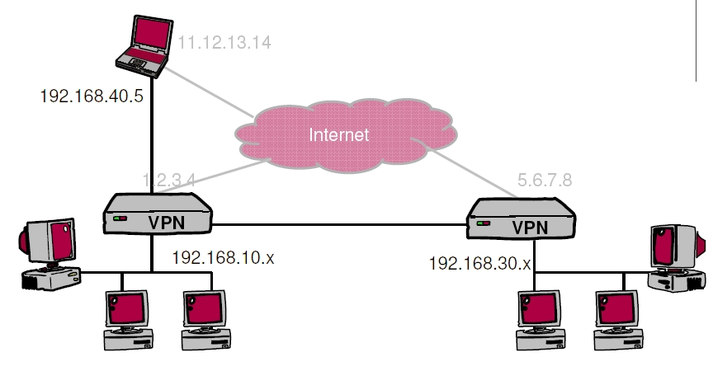
VPN Illustration

Slide 67
VPN basics
VPN software on routers or PCs (e.g. laptop)
Packet encapsulation across the Internet
Encryption of data to guarantee confidentiality

Slide 68
Existing VPN Protocols
Point to Point Tunneling Protocol (PPTP)
Microsoft
Layer 2 Tunneling Protocol (L2TP)
IETF
Result of merging Cisco’s Layer 2 Forwarding (L2F) protocol and Microsoft’s PPTP protocol
IP Security (IPsec)
IETF

Slide 69
IPsec
IP Security

Slide 70
IPsec Overview
Open standard developed by the IETF
Public algorithms for confidentiality, authentication, integrity
Authentication Headers (AH)
Provide connectionless integrity and origin authentication for IP packets
Encapsulating Security Payloads (ESP)
Provide confidentiality, data-origin authentication, connectionless integrity
Security Associations (SA)
Provide algorithms and parameters necessary to AH and/or ESP operations
Internet Key Exchange (IKE)
Key exchange protocol
Two operation modes: tunnel, transport

Slide 71
Authentication Header (AH)
The addition of an authentication header allows verifying the packet’s authenticity and integrity
authentication

Slide 72
Encapsulated Security Payload (ESP)
The ESP header allows packet encryption and authentication
Encryption is done only on the encapsulated data and the trailer
Encryption is done neither on the header’s fields, nor on the authentication data
Optional authentication is done on the ESP header and all that follow, but not on the IP header
encryption
authentication

Slide 73
IKE subprotocol from IPsec
m1
A, (gª mod p)
B, (g^{b} mod p)
, signB(m1,m2)
signA(m1,m2)
A
B
m2
Result: A and B share secret g^{ab} mod p

Slide 74
Transport & Tunnel Modes
Transport mode:
Only IP packet payload is encrypted and/or authenticated
Tunnel mode:
The entire packet is encapsulated in a new packet
Notes:
Draw the packets on the black board.

Slide 75
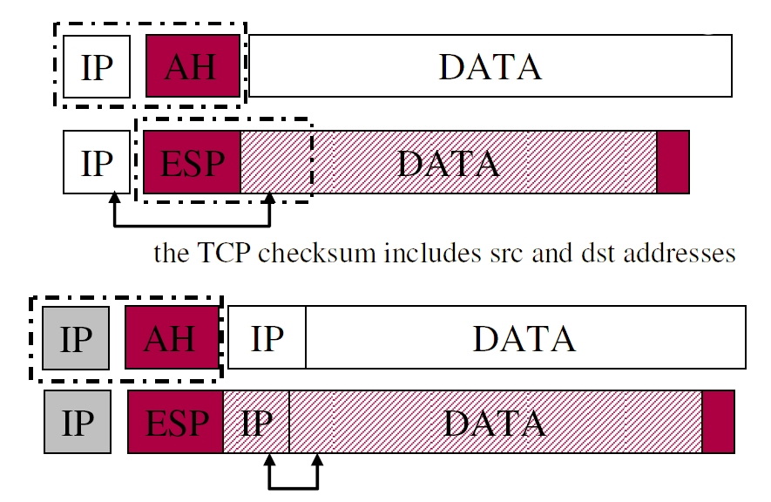
IPsec and NAT

Slide 76
IPsec and NAT
The TCP and UDP checksum calculation includes a pseudo header made of src and dst IP addresses and ports
When doing NAT, the checksum has to be readjusted every time the source IP address (and port) changes
This does not work if the payload is encrypted or authenticated
NAT-T mechanism: encapsulate IPsec in UDP to traverse NAT

Slide 77
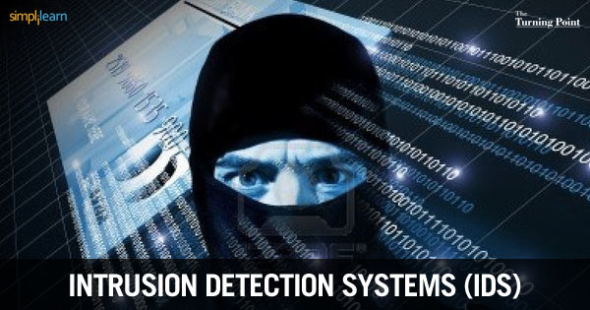
Intrusion Detection System
Notes:
Source: http://blog.simplilearn.com/wp-content/uploads/2013/08/IDS_BLOG.jpg

Slide 78
Intrusion Detection System (IDS)
Idea: don’t wait for the symptoms of an attack before reacting
An Intrusion Detection System (IDS) monitors
Network traffic (Network IDS, NIDS), typically in front of the firewall
Events on servers (Host IDS, HIDS)
When malicious activities are detected, launch an alarm (SMS, email, etc.)
Can attempt prevent attacks from succeeding
Example: reconfigure firewalls or servers
Analysis can be done in real-time or by analyzing logs

Slide 79
IDS: Approaches
Network IDS (NIDS)
Off-line Analysis | Analysis of logs and configuration of firewall, routers | Network sniffer | Real-time Analysis
 | Examination of system logs | Log/Registry/Sys-call watcher
Host IDS (HIDS)

Slide 80
IDS with Traffic Characterization
IDS performs statistical analysis on traffic
If a value goes beyond its usual limits then assume there is an attack
Can recognize new attacks
May also not recognize them… (false negatives)
Or see attacks where there aren’t (false positives)
High false positives makes this IDS type unpopular
Example: Port Scanning (slow mode to avoid detection)

Slide 81
Signature-based IDS
Use a database of known attacks
Example: Web request with URL of 2000 characters == buffer overflow
Doesn’t recognize new attacks
Must be constantly updated
Honeypots: traps to detect attack
False negatives
Manual attacks can have variations that are not detected
Signatures are not always precise
False positives
Doesn’t know if an attempted attack was successful
Doesn’t know if the target is vulnerable (e.g. Linux attack on Windows server)
Notes:
Honeypot: computer with some weak services.
Production honeypots, research honeypots.
Low interactivity, High interactivity.

Slide 82

Snort: Signature-based
Lightweight IDS for Linux and Windows
“Signature, protocol and anomaly based inspection methods”
Analyze traffic, for example in front of the firewall, to detect possible attacks
Send emails and/or update filtering rules
Huge signature database updated by users

Slide 83
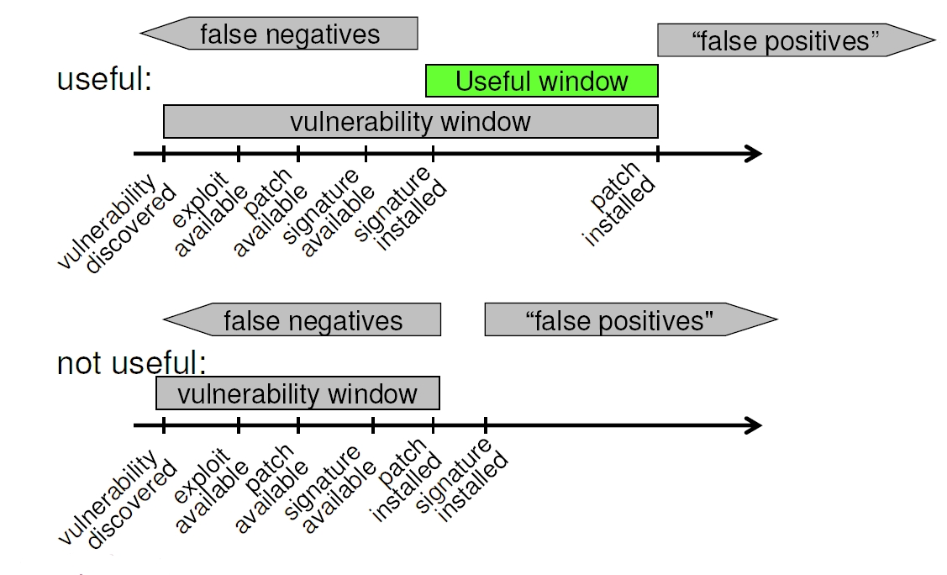
IDS: Efficiency

Slide 84
Intrusion Prevention Systems: IPS
An IDS that reacts to an attack
IP level: Filters the source IP address in the firewall (for a while)
TCP level: Sends a spoofed TCP reset packet to the destination to kill the connection
Application level: “Corrects” a Web request by removing suspicious contents
Beware of denial of service through false positives!

Slide 85
IDS: Discussion
Traffic-characterization IDSes are not yet very efficient
IDS with signatures work well but:
Majority of the attacks for which we have the signature can be blocked by a FW or proxies
We should first prevent before trying to detect
Not sufficient to install an IDS: must also know how to react to attacks and deal with many false positives
Automatic reactions are usually not advisable (DoS)

Slide 86
Any questions?

Slide 87
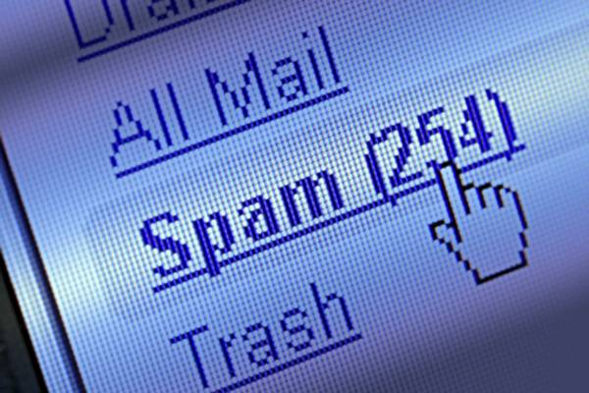
Cybercrime
Stay tuned
Next time you will learn about

