Slide 1

Association Rule Mining and Decision Making for
Closed-Ended Hierarchical Questionnaire Data
Mark Caple
Principle Supervisor:
Associate Professor Farookh Hussain
Co-Supervisor:
Associate Professor Fan Dong
mark.caple@student.uts.edu.au
farookh.hussain@uts.edu.au
fan.dongl@uts.edu.au
School of Computer Science
Faculty of Engineering and Information Technology
University of Technology Sydney
Notes:
<number>

Slide 2
Outline
1
2
3
4
Background
Literature Review
Research Gaps
Research Question
5
6
7
8
Research
Objectives
Research Methodology
Research Significance
Research Plan

Slide 3
Background
The Humble Questionnaire
The Questionnaire although commonly used today has a history of less than 200 years. It’s origins have been attributed to the Statistical Society of London in 1838 whose main goal was ”procuring, arranging and publishing facts to illustrate the condition and prospects of society”
The answers to such questionnaire’s can be summarised into two broad categories (Marshall, 2005)
1. Open-ended – where the question allows the participant to enter whatever they feel is appropriate with no restrictions being introduced.
What do you like to do on the weekend?
2. Closed-ended – where the question would have one correct answer or a limited number of options.
Select the things you do on the weekend? 1. Read, 2. Housework, 3. Eat out
So from this we could surmise that open-ended questions would promote long responses whereas closed-ended short responses.
Notes:
<number>

Slide 4
Background
The Humble Questionnaire
The answers to closed-ended questions maybe further split into five different types
1. category - represents a set of mutually exclusive categories (e.g male, female)
2. list - multiple category choice is possible as the answers are not exclusive,
eg ”what services have you used from your GP in the last year?”.
3. quantity/numeric - such as ”how many times have you broken your leg?”
4. ranking/scale - such as ”how would you rate your doctor [1-7]”
5. linguistic ranking/scale - such as ”would you describe yourself as: very tall,
tall,short,very short?”
Notes:
<number>

Slide 5
Background
The Humble Questionnaire
Our university industry partner has a core service that is pre-employment assessments. Currently they offer third party organisations an efficient means to bring candidates onboard which can involve interview(s), medical questionnaires and medical assessments. Through experience they have realised that sometimes a candidate that appears perfect for a role fails at the last hurdle of the selection process, being a medical assessment. It is this late assessment failure that brings rise to the core problem of this research. How can a potential candidate be assessed on some medical criteria without involving an actual medical assessment?
By focusing on the medical questionnaire it is hoped that a sufficient number of medical assessments will not be required leading to many positive outcomes.
The industry partner gleans medical information from a candidate through a wide variety of specific groups of questions dependent upon which particular role they are applying for.
Notes:
<number>

Slide 6
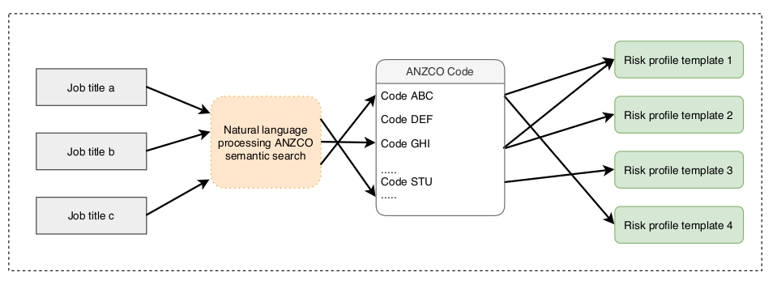
Background
ANZSCO Bridge
A potential candidate must first discover a role or job that they are interested in and this job maybe named differently by different people. For instance a bus driver could also be referred to as a bus operator or omnibus driver and so a standard convention is required. This convention within Australia and New Zealand is the Australian and New Zealand Standard Classification of Occupations (ANZSCO). This ANZSCO standard will form the ”bridge” between the description of a role given by a candidate and the definition of the role within the system.
The system then connects each ANZSCO code to one or more risk profile templates. A risk profile forms an association between particular job requirements such as ”lifting heavy weight from floor to waist” or ”sitting for extended periods” through to the body parts that are affected due to that requirement, such as back, arm, leg or shoulder.
Notes:
<number>

Slide 7
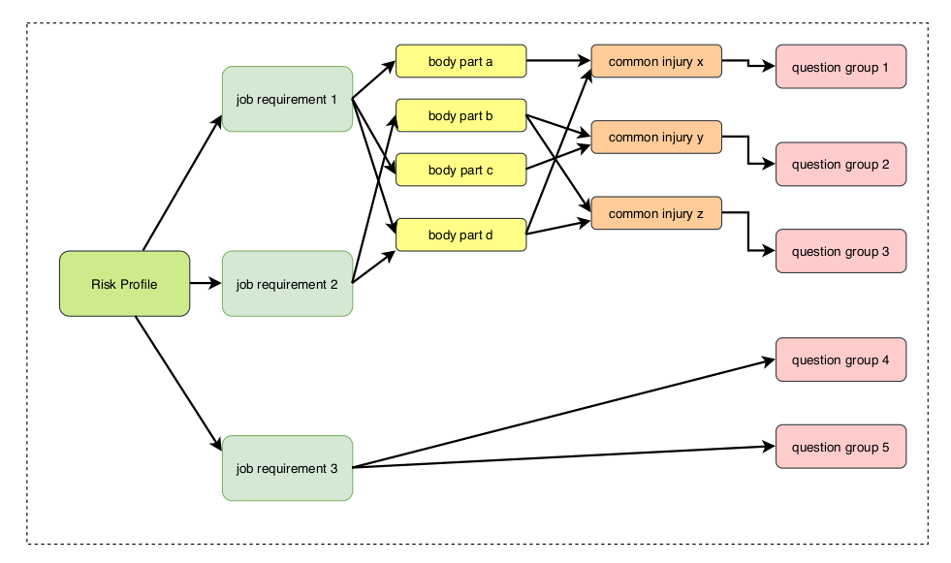
Background
Risk Profile
From these body parts a number of common injuries are linked and from those injuries ultimately a series of questions are added to the questionnaire for that role.
In this figure above we see two job requirements 1 & 2 that follow the classic association just described whereas job requirement 3 links directly to multiple question groups. An example of such a requirement would be a bus driver where a particular licence is a requirement which obviously has no reliance on a particular body part.
Notes:
<number>

Slide 8
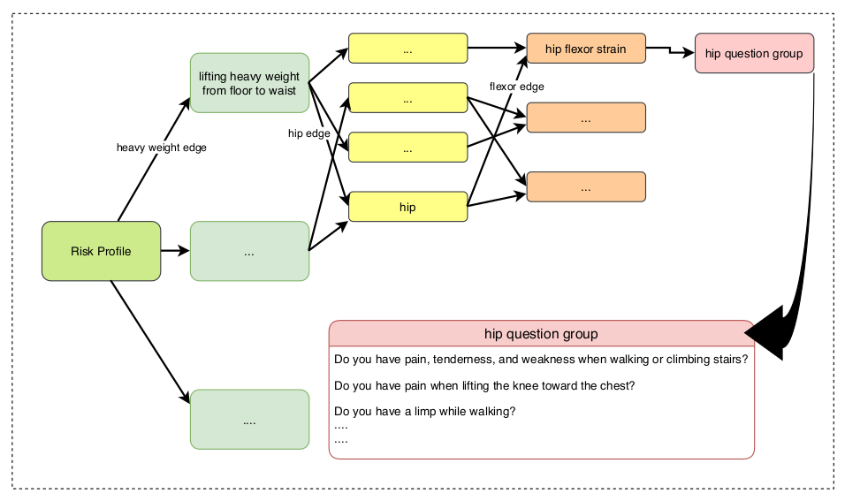
Background
Specific Job Requirement
The following shows a specific job requirement wherein a requirement of lifting heavy weight from floor to waist affects the hip which in turn is susceptible to hip flexor strain and this particular injury is connected to a hip question group which in turn asks the candidate a number of questions shown in the bottom right.
Notes:
<number>

Slide 9
Literature Review
Systematic Literature Review Approach
Stage 1
Papers found by searching electronic scientific databases
N = 2763
Stage 2
After using the inclusion and the exclusion criteria
N =211
Stage 3
After excluding studies based on keywords & titles
N =85
Stage 4
After excluding studies based on abstract
N= 29
Stage 5
Included studies after data synthesis
N =22
Notes:
<number>

Slide 10
Literature Review
Critical Analysis and Comparison between the Existing Blockchain Energy Trading Research
All of the existing studies
Private Blockchain Network
Energy Trading between Neighbours
None of the existing studies
Form a long term selling group
Assess and rank prosumers
Propose AI driven methods
Selling as a geographical Group
2017, Sabounchi and Wei [3]
2019, Alam, Islam, and Ferdous [4]
Notes:
<number>

Slide 11
Paper | Blockchain | Energy Trading | Matchmaking Method | Group Formation | Member Assessment and Ranking | Reputation System | Validation
[18] | Private | √ | Fixed | X | X | X | Ethereum
[19, 20] | Private | √ | - | X | X | X | Ethereum
[22] | Private | √ | - | X | X | X | Hyperledger Fabric0.1
[23] | Private | √ | Auction | X | X | X | Hyperledger Fabric0.1
[24] | Private | √ | Iteration Auction | √ | X | X | Ethereum0
[6] | Private | √ | Double Auction | X | X | X | Monax
[25] | Private | √ | Distributed Double Auction | X | X | X | PoW Blockchain in Python
[26] | Private | √ | - | X | X | X | Ethereum
[27] | Private | √ | Prosumer’s price | X | X | X | Ethereum
[28] | Private | √ | Energy Aggregator | X | X | X | Hyperledger Fabric0.1
[29] | Private | √ | - | X | X | X | X
[30] | Private | √ | The nearest neighbour | X | X | X | X
[31] | Private | √ | - | X | X | X | X
[14] | Private | √ | - | X | X | X | X
[32] | Private | √ | - | X | X | X | X
[33] | Private | √ | - | X | X | X | X
[34] | Private | √ | - | X | X | X | X
[35] | Private | √ | - | X | X | X | X
[36] | Private | √ | - | X | X | X | X
[37] | Private | √ | - | √ | X | X | X
[38] | Private | √ | - | X | X | X | X
Notes:
<number>

Slide 12
Research Gaps
Notes:
<number>

Slide 13
Research Questions
1. Is it possible, in a timely manner, to reduce the need for a physical medical assessment for a job role by introducing a suitability predictor using only responses given in a medical questionnaire?
2. Is it possible to improve upon the suitability predictor by allowing actual medical assessment results to be fed back into the live system?
3. Would removing rare or anomalous candidates from the pool of candidates create a better suitability predictor?
4. How to analyse and compare the results of repeat medical assessments from the same candidate for different job roles over time?
5. How to verify and validate the above aims?

Slide 14
Research Objectives
1. To classify a candidate into a small number of groups that give a sliding suitability score.
2. To define a mechanism whereby results of physical medical assessments are fed back into the system for a better predictor
3. To build an anomaly detection routine to predict a list of candidates of concern.
4. To build a model whereby assessments maybe compared along a timeline so that assessments taken multiple times maybe analysed.
5. To evaluate the developed artefacts from the previous objectives.

Slide 15
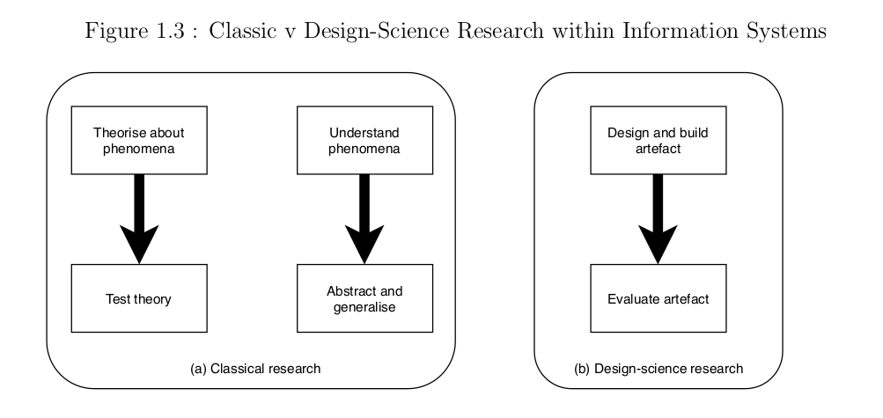
Methodology
Design Science Research Method
Babbie (2015) states that research is a ”systematic and orderly approach taken towards the collection and analysis of data so that information can be obtained from those data” A research methodology establishes the framework for research, amongst other things it defines strategy, approach and components for the research.
Over time certain methodologies have been put forward that suite the field of Information Systems which is the chosen field of this work. It is Design Study Research (DSR) which has been selected as the most suitable of these for this particular work. In DSR ”researchers focus on building some kind of artefact they believe will be useful to a particular stakeholder community. They then evaluate the merits of the artefact in various ways” (Williamson & Johanson (2017).
Figure 1.3 shows the differences between the classic approach, which creates artefacts to attempt to build or test a theory and the DSR approach which builds artefacts that are useful to certain stakeholders.
Notes:
<number>

Slide 16
Methodology
Overview solution for RQ1
Many research methodologies have been put forward within Design Science Research and each at some point has attracted there own share of praise and criticism and a number of practitioners advise to simply choose one that fits your research and then simply adhere
to it rigorously.
The specific methodology that this research will undertake is that proposed by Peffers et al. shown in the following 6 steps
1. Identify, define, and motivate the focal problem
As previously mentioned in the background of today our industry partner has learnt through experience that candidates may
fail at a very late stage of the recruitment process causing potential opportunity losses for both the client and candidate. It is this late failure that brings rise to the core problem of this research. How can a potential candidate be assessed on some medical criteria without involving an actual medical assessment?
2. Define objectives that a solution (possibly partial) to the focal problem must achieve
In order to address the focal problem any potential solution should garner useful information from the candidate’s answers to a preselection questionnaire that they are required to complete. The questions contained within any such questionnaire
should take into account the specific role for which the candidate is applying and any typical risks or needs that are associated with that role.
3. Design and develop the artefact
The developed artefact will initially encompass individual classification for each role from the associated question groups.
4. Demonstrate the artefact can be used to help solve the focal problem
5. Evaluate how well the artefact solves the focal problem
6. Communicate the outcomes of the research
Notes:
<number>

Slide 17

Significance
Scientific Significance
We will add to the very sparse representation of machine learning techniques that specifically target closed-data questionnaires.
The research will apply non static membership functions to the developed Association Rule Mining solution through real-time feedback of subject matter experts assessments back into the system.
3. We will develop a hybrid solution whereby any rule parameters that are mined will be further tuned through the use of gradient descent with the aim of thereby demonstrating a better solution.

Slide 18
Significance
Practical Significance
1. Medical assessments are a bottle-neck in a candidate’s selection process because of their late placement in any recruitment campaign. This lengthening represents a potential missed opportunity for the candidate of missing other company campaigns.
2. The added physical assessment time is also a potential missed opportunity for an employer as a final decision on a promising candidate may arrive too late as the candidate has already been picked up in an entirely different role. Indeed if this is the only chosen candidate the whole selection process may have to begin again.
3. The cost of physical medical assessments may also prove prohibitive to an employer.

Slide 19
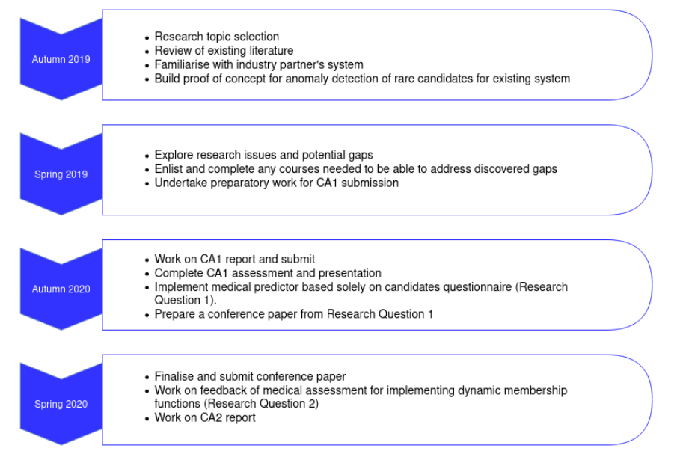
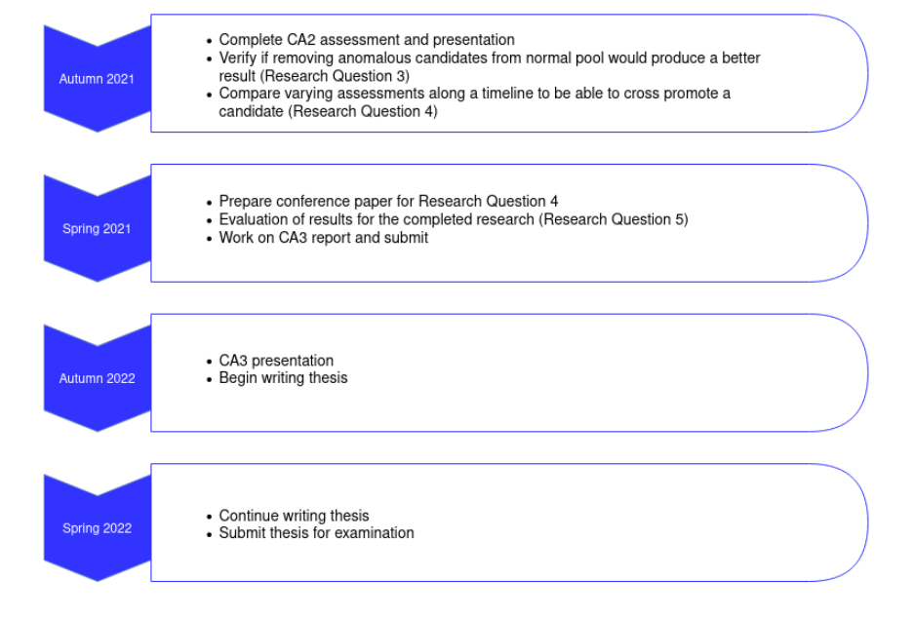
Research Plan
Timeline

Slide 20
References

Slide 21
THANK YOU

