Slide 1

Association Rule Mining and Decision Making for
Closed-Ended Hierarchical Questionnaire Data
Mark Caple
Principle Supervisor:
Associate Professor Farookh Hussain
Co-Supervisor:
Associate Professor Fan Dong
mark.caple@student.uts.edu.au
farookh.hussain@uts.edu.au
fan.dongl@uts.edu.au
School of Computer Science
Faculty of Engineering and Information Technology
University of Technology Sydney
Notes:
Hi everyone and good morning. Firstly let me thank everyone for making the time today for my CA1 presentation and before I begin I would like to introduce myself.
I am Mark Caple and after many years of working in industry I was lucky enough in 2019 to be accepted by the School of Computer Science at UTS to undertake a Masters by Research. The research is in collaboration with the industry partner Workforce Health Assessors. It is supervised by Associate Professor Farookh Hussain and co-supervised by Associate Professor Fan Dong.
So let’s jump in
36

Slide 2
Outline
1
2
3
4
Background
Literature Review
Research Gaps
Research Question
5
6
7
8
Research
Objectives
Research Methodology
Research Significance
Research Plan
Notes:
Firstly let me describe the scope of everything we will cover today: To start I will cover some background information on my topic
A literature review will describe how I discovered gaps in the current literature
We will then describe the gaps
Which will in turn lead us into our research questions
Our objectives will follow this
From here we will talk more deeply about how we will attempt to answer these questions in our research methodolgy
We will in the final part of the presentation talk about any research significance and
Finally we will discuss the research plan and at the end of the presentation a short demo will elaborate on our progress to date

Slide 3
Background
The Humble Questionnaire
The Questionnaire although commonly used today has a history of less than 200 years. It’s origins have been attributed to the Statistical Society of London in 1838 whose main goal was ”procuring, arranging and publishing facts to illustrate the condition and prospects of society”
The answers to such questionnaire’s can be summarised into two broad categories (Marshall, 2005 [38])
1. Open-ended – where the question allows the participant to enter whatever they feel is appropriate with no restrictions being introduced.
What do you like to do on the weekend?
2. Closed-ended – where the question would have one correct answer or a limited number of options.
Select the things you do on the weekend? 1. Read, 2. Housework, 3. Eat out
So from this we could surmise that open-ended questions would promote long responses whereas closed-ended short responses.
Notes:
The Questionnaire although commonly used today has a history of less than 200 years. It’s origins have been attributed to the Statistical Society of London in 1838 whose main goal was ”procuring, arranging and publishing facts to illustrate the condition and prospects of society”
The answers to such questionnaire’s can be summarised into two broad categories (Marshall, 2005 [38])
1. Open-ended – where the question allows the participant to enter whatever they feel is appropriate with no restrictions being introduced.
What do you like to do on the weekend?
2. Closed-ended – where the question would have one correct answer or a limited number of options.
Select the things you do on the weekend? 1. Read, 2. Housework, 3. Eat out
So from this we could surmise that open-ended questions would promote long responses whereas closed-ended short responses.
36

Slide 4
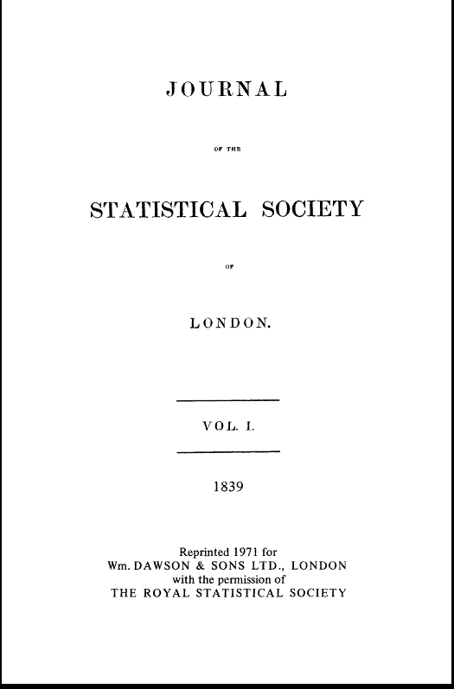
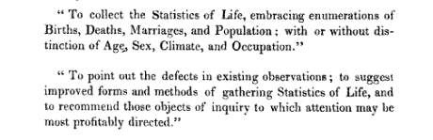
Background
The Humble Questionnaire
1. Open-ended – where the question allows the participant to enter whatever they feel is appropriate with no restrictions being introduced.
What do you like to do on the weekend?
2. Closed-ended – where the question would have one correct answer or a limited number of options.
Select the things you do on the weekend?
1. Read
2. Housework
3. Eat out
Notes:
The humble Questionnaire although commonly used today has a history of less than 200 years. It’s origins have been attributed to the Statistical Society of London in 1838 whose main goal was ”procuring, arranging and publishing facts to illustrate the condition and prospects of society”
The answers to such questionnaire’s can be summarised into two broad categories (Marshall, 2005 [38])
1. Open-ended – where the question allows the participant to enter whatever they feel is appropriate with no restrictions being introduced.
What do you like to do on the weekend?
2. Closed-ended – where the question would have one correct answer or a limited number of options.
Select the things you do on the weekend? 1. Read, 2. Housework, 3. Eat out
So from this we could surmise that open-ended questions would promote long responses whereas closed-ended short responses.
36

Slide 5
Background
The Humble Questionnaire
The answers to closed-ended questions maybe further split into five different types
1. category - represents a set of mutually exclusive categories (e.g male, female)
2. list - multiple category choice is possible as the answers are not exclusive,
eg ”what services have you used from your GP in the last year?”.
3. quantity/numeric - such as ”how many times have you broken your leg?”
4. ranking/scale - such as ”how would you rate your doctor [1-7]”
5. linguistic ranking/scale - such as ”would you describe yourself as: very tall,
tall,short,very short?”
Notes:
The answers to closed-ended questions maybe further split into five different types
1. category - represents a set of mutually exclusive categories (e.g male, female)
2. list - multiple category choice is possible as the answers are not exclusive,
eg ”what services have you used from your GP in the last year?”.
3. quantity/numeric - such as ”how many times have you broken your leg?”
4. ranking/scale - such as ”how would you rate your doctor [1-7]”
5. linguistic ranking/scale - such as ”would you describe yourself as: very tall,
tall,short,very short?”
36
”

Slide 6
Background
The Humble Questionnaire
Our university industry partner has a core service that is pre-employment assessments. Currently they offer third party organisations an efficient means to bring candidates onboard which can involve interview(s), medical questionnaires and medical assessments. Through experience they have realised that sometimes a candidate that appears perfect for a role fails at the last hurdle of the selection process, being a medical assessment. It is this late assessment failure that brings rise to the core problem of this research. How can a potential candidate be assessed on some medical criteria without involving an actual medical assessment?
By focusing on the medical questionnaire it is hoped that a sufficient number of medical assessments will not be required leading to many positive outcomes.
The industry partner gleans medical information from a candidate through a wide variety of specific groups of questions dependent upon which particular role they are applying for.
Notes:
36

Slide 7

Background
The Humble Questionnaire
Pre-employement assessments
1. Interview(s)
2. Medical questionnaires
3. Medical assessments
Through experience they have realised that sometimes a candidate that appears perfect for a role fails at the last hurdle of the selection process, being a medical assessment.
Notes:
Our university industry partner has a core service that is pre-employment assessments. Currently they offer third party organisations an efficient means to bring candidates onboard which can involve interview(s), medical questionnaires and medical assessments. Through experience they have realised that sometimes a candidate that appears perfect for a role fails at the last hurdle of the selection process, being a medical assessment. It is this late assessment failure that brings rise to the core problem of this research. How can a potential candidate be assessed on some medical criteria without involving an actual medical assessment?
By focusing on the medical questionnaire it is hoped that a sufficient number of medical assessments will not be required leading to many positive outcomes.
The industry partner gleans medical information from a candidate through a wide variety of specific groups of questions dependent upon which particular role they are applying for.
36

Slide 8
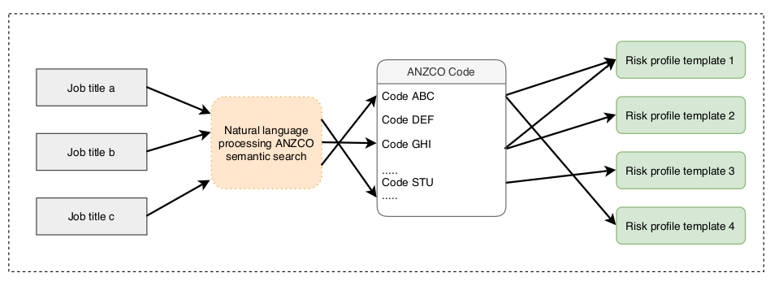
Background
ANZSCO Bridge
A potential candidate must first discover a role or job that they are interested in and this job maybe named differently by different people. For instance a bus driver could also be referred to as a bus operator or omnibus driver and so a standard convention is required. This convention within Australia and New Zealand is the Australian and New Zealand Standard Classification of Occupations (ANZSCO). This ANZSCO standard will form the ”bridge” between the description of a role given by a candidate and the definition of the role within the system.
The system then connects each ANZSCO code to one or more risk profile templates. A risk profile forms an association between particular job requirements such as ”lifting heavy weight from floor to waist” or ”sitting for extended periods” through to the body parts that are affected due to that requirement, such as back, arm, leg or shoulder.
Notes:
36

Slide 9
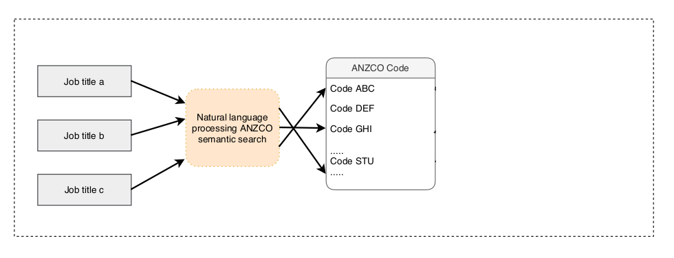
Background
ANZSCO Bridge
Job Title
Bus driver
Bus operator
Omnibus driver
The system then connects each ANZSCO code to one or more risk profile templates
Notes:
A potential candidate must first discover a role or job that they are interested in and this job maybe named differently by different people. For instance a bus driver could also be referred to as a bus operator or omnibus driver and so a standard convention is required. This convention within Australia and New Zealand is the Australian and New Zealand Standard Classification of Occupations (ANZSCO). This ANZSCO standard will form the ”bridge” between the description of a role given by a candidate and the definition of the role within the system.
<pause>
The system then connects each ANZSCO code to one or more risk profile templates.
<click>
A risk profile forms an association between particular job requirements such as ”lifting heavy weight from floor to waist” or ”sitting for extended periods” through to the body parts that are affected due to that requirement, such as back, arm, leg or shoulder.
36

Slide 10
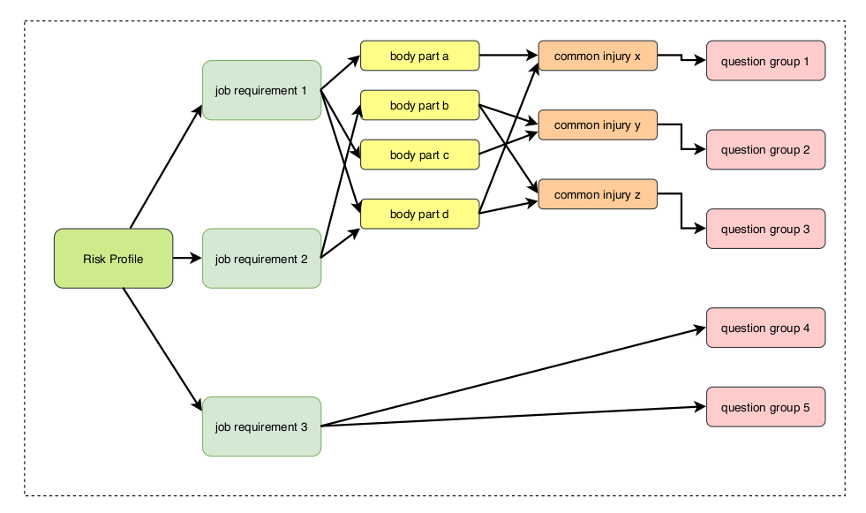
Background
Risk Profile
From these body parts a number of common injuries are linked and from those injuries ultimately a series of questions are added to the questionnaire for that role.
Notes:
From these body parts a number of common injuries are linked and from those injuries ultimately a series of questions are added to the questionnaire for that role.
In this figure shown we see two job requirements 1 & 2 that follow the classic association just described whereas job requirement 3 links directly to multiple question groups. An example of such a requirement would be a bus driver where a particular licence is a requirement which obviously has no reliance on a body part.
36

Slide 11
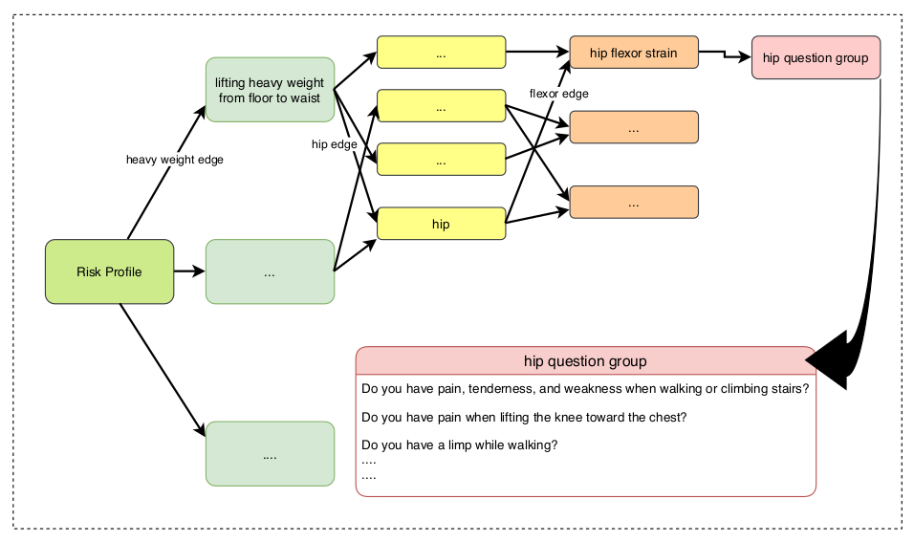
Background
Specific Job Requirement
Notes:
The following shows a specific job requirement wherein a requirement of lifting heavy weight from floor to waist affects the hip which in turn is susceptible to hip flexor strain and this particular injury is connected to a hip question group which in turn asks the candidate a number of questions shown in the bottom right.
36

Slide 12
Literature Review
Systematic Literature Review Approach
Databases
1. Scopus (https://www.scopus.com/home.uri)
2. Science & Technology (https://www.proquest.com/libraries/government/science-technology/)
3. ACM Digital Library (https://dl.acm.org/)
4. Google Scholar (https://scholar.google.com/)
5. IEEE Explore (https://ieeexplore.ieee.org/Xplore/home.jsp)
Inclusions
1. Available online
2. Article is peer reviewed
3. Full text is available in English
4. Article on or after 2005
5. Can be an academic or commercial project
Exclusions
1. Non English papers
2. Duplicate studies
3. Magazines, newspapers, websites, podcasts, blogs

Slide 13
Literature Review
Systematic Literature Review Approach
Filter 1
Papers found applying search with inclusion and exclusions
N = 529
Filter 2
After excluding studies based on title reviews
N =216
Filter 3
After excluding studies based on abstract
N =95
Filter 4
After more through review of paper
N =52
Notes:
36

Slide 14
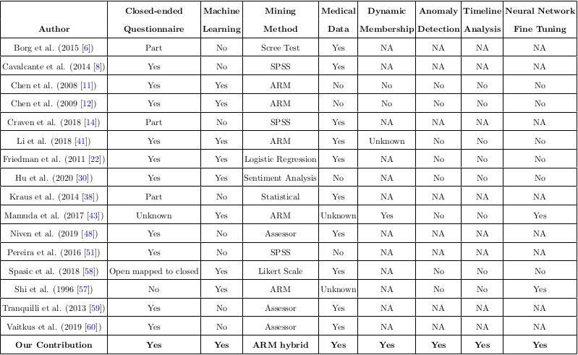
Literature Review
Comparative Analysis

Slide 15
Literature limitations
1. Very little research that is able to mine association rules from closed-ended questionnaire data and none that supports medical questionnaires
2. The work that has been undertaken use static membership functions that are both time consuming and expensive to create
3. There is a real lack of analysing associations between such questionnaire’s over time from the same individual
4. No relevant work builds on the accuracy of mined rules through fine tuning of parameters using machine learning techniques
Notes:
From our comparative anaylsis previously shown we have discovered a number of gaps within the research community
<click>
1. Very little research that is able to mine association rules from closed-ended questionnaire data and none that supports medical questionnaires
<click>
2. The work that has been undertaken use static membership functions that are both time consuming and expensive to create
<click>
3. There is a real lack of analysing associations between such questionnaire’s over time from the same individual
<click>
4. No relevant work builds on the accuracy of mined rules through fine tuning of parameters using machine learning techniques
36

Slide 16
Research Questions
1. Is it possible, in a timely manner, to reduce the need for a physical medical assessment for a job role by introducing a suitability predictor using only responses given in a medical questionnaire?
2. Is it possible to improve upon the suitability predictor by allowing actual medical assessment results to be fed back into the live system?
3. Would removing rare or anomalous candidates from the pool of candidates create a better suitability predictor?
4. How to analyse and compare the results of repeat medical assessments from the same candidate for different job roles over time?
5. How to verify and validate the above aims?
Notes:
1. Is it possible, in a timely manner, to reduce the need for a physical medical assessment for a job role by introducing a suitability predictor using only responses given in a medical questionnaire?
2. Is it possible to improve upon the suitability predictor by allowing actual medical assessment results to be fed back into the live system?
3. Would removing rare or anomalous candidates from the pool of candidates create a better suitability predictor?
4. How to analyse and compare the results of repeat medical assessments from the same candidate for different job roles over time?
5. How to verify and validate the above aims?

Slide 17
Research Objectives
1. To classify a candidate into a small number of groups that give a sliding suitability score.
2. To define a mechanism whereby results of physical medical assessments are fed back into the system for a better predictor
3. To build an anomaly detection routine to predict a list of candidates of concern.
4. To build a model whereby assessments maybe compared along a timeline so that assessments taken multiple times maybe analysed.
5. To evaluate the developed artefacts from the previous objectives.
Notes:
1. To classify a candidate into a small number of groups that give a sliding suitability score.
2. To define a mechanism whereby results of physical medical assessments are fed back into the system for a better predictor
3. To build an anomaly detection routine to predict a list of candidates of concern.
4. To build a model whereby assessments maybe compared along a timeline so that assessments taken multiple times maybe analysed.
5. To evaluate the developed artefacts from the previous objectives.

Slide 18
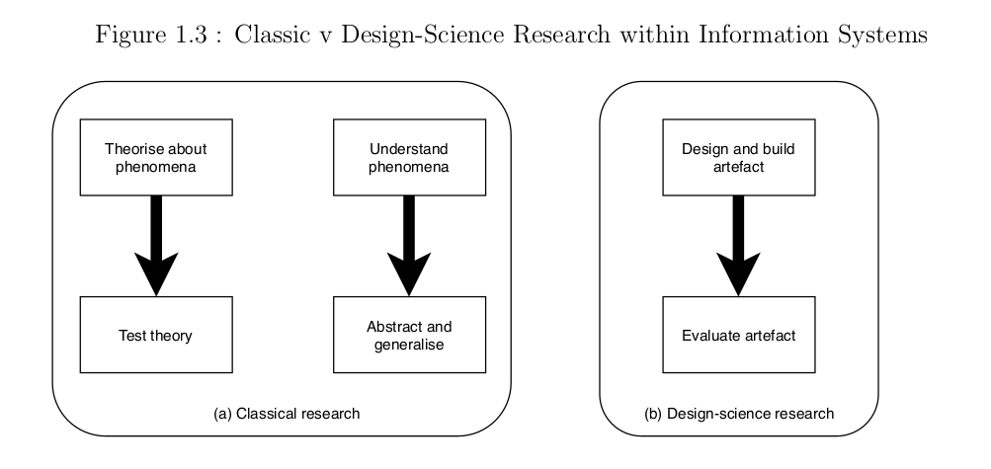
Methodology
Design Science Research Method
Figure 1.3 shows the differences between the classic approach, which creates artefacts to attempt to build or test a theory and the DSR approach which builds artefacts that are useful to certain stakeholders.
Notes:
Babbie (2015) states that research is a ”systematic and orderly approach taken towards the collection and analysis of data so that information can be obtained from those data” A research methodology establishes the framework for research, amongst other things it defines strategy, approach and components for the research.
Over time certain methodologies have been put forward that suite the field of Information Systems which is the chosen field of this work. It is Design Study Research (DSR) which has been selected as the most suitable of these for this particular work. In DSR ”researchers focus on building some kind of artefact they believe will be useful to a particular stakeholder community. They then evaluate the merits of the artefact in various ways” (Williamson & Johanson (2017, [51])).
Figure 1.3 shows the differences between the classic approach, which creates artefacts to attempt to build or test a theory and the DSR approach which builds artefacts that are useful to certain stakeholders.
36

Slide 19
Methodology
Overview solution for RQ1
Many research methodologies have been put forward within Design Science Research and each at some point has attracted there own share of praise and criticism and a number of practitioners advise to simply choose one that fits your research and then simply adhere
to it rigorously.
The specific methodology that this research will undertake is that proposed by Peffers et al. (2007 [42]) shown in the following 6 steps
1. Identify, define, and motivate the focal problem
As previously mentioned in the background of today our industry partner has learnt through experience that candidates may
fail at a very late stage of the recruitment process causing potential opportunity losses for both the client and candidate. It is this late failure that brings rise to the core problem of this research. How can a potential candidate be assessed on some medical criteria without involving an actual medical assessment?
2. Define objectives that a solution (possibly partial) to the focal problem must achieve
In order to address the focal problem any potential solution should garner useful information from the candidate’s answers to a preselection questionnaire that they are required to complete. The questions contained within any such questionnaire
should take into account the specific role for which the candidate is applying and any typical risks or needs that are associated with that role.
3. Design and develop the artefact
The developed artefact will initially encompass individual classifications for each role from the associated question groups. The classification will allow for human override for a candidate that has been flagged as borderline. Once sufficient data has been collected the ability to include some transfer or cluster learning would remove the need to train all the roles separately. This however is not the initial goal of the work.
Notes:
36

Slide 20
Methodology
Overview solution for RQ1
Many research methodologies have been put forward within Design Science Research and each at some point has attracted there own share of praise and criticism and a number of practitioners advise to simply choose one that fits your research and then simply adhere
to it rigorously.
The specific methodology that this research will undertake is that proposed by Peffers et al. (2007 [42]) shown in the following 6 steps
1. Identify, define, and motivate the focal problem
As previously mentioned in the background of today our industry partner has learnt through experience that candidates may
fail at a very late stage of the recruitment process causing potential opportunity losses for both the client and candidate. It is this late failure that brings rise to the core problem of this research. How can a potential candidate be assessed on some medical criteria without involving an actual medical assessment?
2. Define objectives that a solution (possibly partial) to the focal problem must achieve
In order to address the focal problem any potential solution should garner useful information from the candidate’s answers to a preselection questionnaire that they are required to complete. The questions contained within any such questionnaire
should take into account the specific role for which the candidate is applying and any typical risks or needs that are associated with that role.
3. Design and develop the artefact
The developed artefact will initially encompass individual classifications for each role from the associated question groups. The classification will allow for human override for a candidate that has been flagged as borderline. Once sufficient data has been collected the ability to include some transfer or cluster learning would remove the need to train all the roles separately. This however is not the initial goal of the work.
Notes:
36

Slide 21
Methodology
Overview solution for RQ1
4. Demonstrate the artefact can be used to help solve the focal problem
5. Evaluate how well the artefact solves the focal problem
My research paper explains in reasonable detail the industry standard way that we will verify the “correctness” of our solution which include measures such as confusion matrix, area under the ROC curve and F1 score. Please refer to it for further detail.
The specific example shown earlier shows an example of a job requirement for “lifting heavy weights from floor to waist”.
Of particular note are the edges for heavy weight, hip and flexor. It is on these edges that properties will initially be attached such as the value for the actual weight considered ”heavy” by an expert in the field. As our classifier begins to acquire data it is these properties that will dynamically be altered in order to solve our core problem of classifying a candidate.
Notes:
36

Slide 22
Methodology
Overview solution for RQ1
6. Communicate the outcomes of the research
Amongst the outcomes of this research will be the development of a number of novel algorithms to be incorporated into a commercial software product. It is the algorithms that are developed during the design phase that will satisfy the artefact requirement of DSR. The stakeholder community will initially involve the industry partner of the university but will ultimately be useful to anyone dealing with the problem of classifying the answers to closed survey/questionnaire data.
Through progressing the research to completion the communication of the outcomes will satisfy the industry partner. The wider research community will become aware of the outcomes through publishing a number of papers at recognised conferences as set out in the research plan at the end of this talk.
Notes:
36

Slide 23
Methodology
Design Science Research
Peffers et al. (2007 [42]) shown in the following 6 steps
1. Identify, define, and motivate the focal problem
Notes:
Many research methodologies have been put forward within Design Science Research and each at some point has attracted there own share of praise and criticism and a number of practitioners advise to simply choose one that fits your research and then simply adhere
to it rigorously.
The specific methodology that this research will undertake is that proposed by Peffers et al. shown in the following 6 steps
<click>
Step 1 – Identify, define, and motivate the focal problem
As previously mentioned in the background of today our industry partner has learnt through experience that candidates may fail at a very late stage of the recruitment process causing potential opportunity losses for both the client and candidate. It is this late failure that brings rise to the core problem of this research. How can a potential candidate be assessed on some medical criteria without involving an actual medical assessment?
36

Slide 24
Methodology
Design Science Research
Peffers et al. (2007 [42]) shown in the following 6 steps
1. Identify, define, and motivate the focal problem
2. Define objectives that a solution (possibly partial) to the focal problem must achieve
Notes:
Step 2- Define objectives that a solution to the focal problem must achieve
In order to address the focal problem any potential solution should garner useful information from the candidate’s answers to a preselection questionnaire that they are required to complete. The questions contained within any such questionnaire
should take into account the specific role for which the candidate is applying and any typical risks or needs that are associated with that role.
36

Slide 25
Methodology
Design Science Research
Peffers et al. (2007 [42]) shown in the following 6 steps
1. Identify, define, and motivate the focal problem
2. Define objectives that a solution (possibly partial) to the focal problem must achieve
3. Design and develop the artefact
Notes:
Step 3. Design and develop the artefact
The developed artefact will initially encompass individual classifications for each role from the associated question groups. The classification will allow for human override for a candidate that has been flagged as borderline. Once sufficient data has been collected the ability to include some transfer or cluster learning would remove the need to train all the roles separately. This however is not the initial goal of the work.
36

Slide 26
Methodology
Design Science Research
Peffers et al. (2007 [42]) shown in the following 6 steps
1. Identify, define, and motivate the focal problem
2. Define objectives that a solution (possibly partial) to the focal problem must achieve
3. Design and develop the artefact
4. Demonstrate the artefact can be used to help solve the focal problem
Notes:
Step 4. Demonstrate the artefact can be used to help solve the focal problem
The specific example shown earlier shows an example of a job requirement for “lifting heavy weights from floor to waist”.
Of particular note are the edges for heavy weight, hip and flexor. It is on these edges that properties will initially be attached such as the value for the actual weight considered ”heavy” by an expert in the field. As our classifier begins to acquire data it is these properties that will dynamically be altered in order to solve our core problem of classifying a candidate.
36

Slide 27
Methodology
Design Science Research
Peffers et al. (2007 [42]) shown in the following 6 steps
1. Identify, define, and motivate the focal problem
2. Define objectives that a solution (possibly partial) to the focal problem must achieve
3. Design and develop the artefact
4. Demonstrate the artefact can be used to help solve the focal problem
5. Evaluate how well the artefact solves the focal problem
Notes:
Step 5. Evaluate how well the artefact solves the focal problem
My research paper explains in reasonable detail the industry standard way that we will verify the “correctness” of our solution which include measures such as confusion matrix, area under the ROC curve and F1 score. Please refer to it for further detail.
36

Slide 28
Methodology
Design Science Research
Peffers et al. (2007 [42]) shown in the following 6 steps
1. Identify, define, and motivate the focal problem
2. Define objectives that a solution (possibly partial) to the focal problem must achieve
3. Design and develop the artefact
4. Demonstrate the artefact can be used to help solve the focal problem
5. Evaluate how well the artefact solves the focal problem
6. Communicate the outcomes of the research
Notes:
Step 6. Communicate the outcomes of the research
Amongst the outcomes of this research will be the development of a number of novel algorithms to be incorporated into a commercial software product. It is the algorithms that are developed during the design phase that will satisfy the artefact requirement of DSR. The stakeholder community will initially involve the industry partner of the university but will ultimately be useful to anyone dealing with the problem of classifying the answers to closed survey/questionnaire data.
Through progressing the research to completion the communication of the outcomes will satisfy the industry partner. The wider research community will become aware of the outcomes through publishing a number of papers at recognised conferences as set out in the research plan at the end of this talk.
36

Slide 29


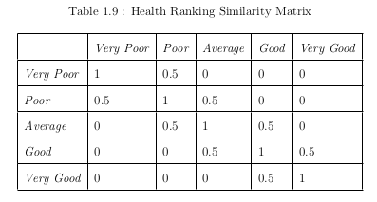
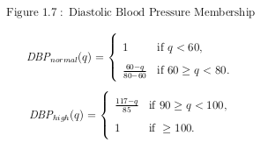
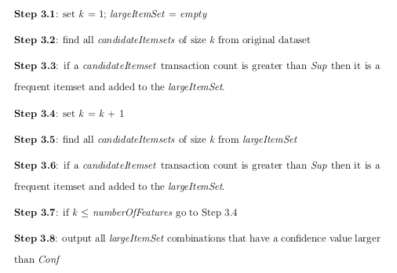
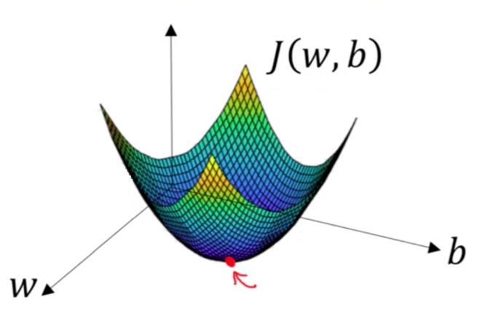
Methodology
Overview solution for RQ1
Objective 1 - To classify a candidate into a small number of groups that give a sliding suitability score.
Step 1 –Create distinct linguistic
definitions/similarities to describe
our domain
Step 2 – Define initial membership
Functions that describes the degree
Of truth of some feature
Step 3 – Select most noteworthy classification rules
Step 4 – Apply gradient
descent to fine tune the
given result
Mamuda et al. (2017 [43])
Notes:
Step 1 allows us to create distinct linguistic definitions that describe our domain feature in a fuzzy way.
We introduce similarity matrix which allows us to compare two terms fuzzily.
For instance if we had a health rating table 1.9 shown here we could describe a Very poor rating to have a similarity of 0.5 when compared to poor.
Step 2 will define our initial membership functions that define the degree of truth of a feature. Here we are considering diastolic blood pressure and deciding which value would be considered high or normal The 3rd step goes on to select noteworthy classification rules rules using the constructs from step 1 and 2 along with any crisp values. The basic idea of step 3 is to mine a series of rules based on their calculated support and confidence values.
Unlike traditional association rule mining however our questionnaire’s may contain any of the answer types described by Marshall in the background part of this presentation.
36

Slide 30
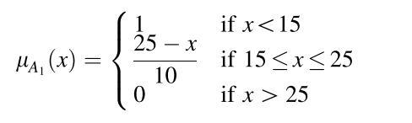
Methodology
Overview solution for RQ2
Objective 2 - To define a mechanism whereby results of physical medical assessments are fed back into the system for a better predictor.
Step 1 – Select membership
functions that we will
receive feedback on
Step 2 – Implement mechanism
where external assessors
may feed data back into
these functions
Step 3 – Apply the work of Kostikova et al. (2016 [7]) and
Marasini et al. (2016 [44] to make functions dynamic
Notes:
The physical medical as-
sessment is outside the core architectural boundaries of the current system. There
are many factors to this including geographic remoteness or the use of third party
independent assessors. In order for any selected candidate to be both accurately
determined and done so in a timely fashion it is vitally important that results of
physical assessments are fed back into the system promptly. In fulfilling this the
research will not only complete a design criteria but will also help to fill another
literature gap. Chen et al. concluded that their design proved to be slow
as the fuzzy membership routines were static. In feeding back this assessment infor-
mation from clinical experts into the system the membership functions themselves
will be altered over time and in doing so become dynamic.
36

Slide 31
Methodology
Overview solution for RQ3
Objective 3 - To build an anomaly detection routine to predict a list of candidates of concern.
Step 1 – Select features used to
consider candidate anomalous
Step 2 – Load explore and clean
data (includes normalisation,
distribution analysis ...)
Step 3 – Define network
architecture
Step 4 – Specify training options
Step 5 – Train the network
Step 6 – Predict labels and
analyse results
Notes:
We have to date implemented an anomaly detection technique originally in Octave and later ported into MATLAB.
The implemented work uses a current pro-
duction system that has a lot of data but lacks some integrity constraints to ensure
that data is always correct. A similar approach will be undertaken with the system
currently being developed once sufficient data becomes available
36

Slide 32
Methodology
Overview solution for RQ4
Objective 4 - To build a model whereby assessments maybe compared along a timeline so that assessments taken multiple times maybe analysed.
Step 1 – Select representative questions from each question
group that are able to be
transferred
Step 2 – Split the representative questions into global (global attributes)
and local (local attributes). Apply
local representative-based matrix
factorisation as outlined in the work
of Shi et al. (2017, [56]).
Step 3 – If sufficient local
representatives of an unsuccessful
candidate from one role match those
of a successful candidate from another
recommend the candidate for this role
Notes:
This objective will use a lot of the work proposed in recommender systems and in particular the work regarding local reprresentative-based matrix factorization of LRMF
36

Slide 33
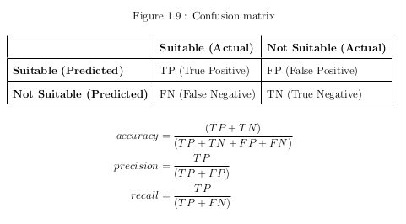
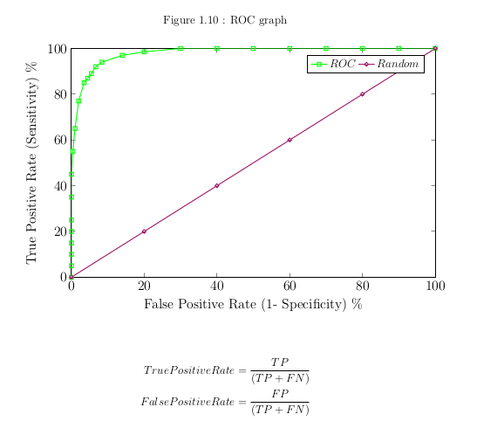

Methodology
Overview solution for RQ5
Objective 5 - To evaluate the developed artefacts from the previous objectives.
Confusion Matrix
Area under the ROC curve
F1 Score
Notes:
We will use a number of publicly available tests to indicate the correctness of our classification
<number>

Slide 34

Significance
Scientific Significance
We will add to the very sparse representation of machine learning techniques that specifically target closed-data questionnaires.
The research will apply non static membership functions to the developed Association Rule Mining solution through real-time feedback of subject matter experts assessments back into the system.
We will develop a hybrid solution whereby any rule parameters that are mined will be further tuned through the use of gradient descent with the aim of thereby demonstrating a better solution.
Notes:
1 We will add to the very sparse representation of machine learning techniques that specifically target closed-data questionnaires.
2. The research will apply non static membership functions to the developed Association Rule Mining solution through real-time feedback of subject matter experts assessments back into the system.
3. We will develop a hybrid solution whereby any rule parameters that are mined will be further tuned through the use of gradient descent with the aim of thereby demonstrating a better solution.

Slide 35
Significance
Practical Significance
1. Medical assessments are a bottle-neck in a candidate’s selection process because of their late placement in any recruitment campaign. This lengthening represents a potential missed opportunity for the candidate of missing other company campaigns.
2. The added physical assessment time is also a potential missed opportunity for an employer as a final decision on a promising candidate may arrive too late as the candidate has already been picked up in an entirely different role. Indeed if this is the only chosen candidate the whole selection process may have to begin again.
3. The cost of physical medical assessments may also prove prohibitive to an employer.
Notes:
1. Medical assessments are a bottle-neck in a candidate’s selection process because of their late placement in any recruitment campaign. This lengthening represents a potential missed opportunity for the candidate of missing other company campaigns.
2. The added physical assessment time is also a potential missed opportunity for an employer as a final decision on a promising candidate may arrive too late as the candidate has already been picked up in an entirely different role. Indeed if this is the only chosen candidate the whole selection process may have to begin again.
3. The cost of physical medical assessments may also prove prohibitive to an employer.

Slide 36
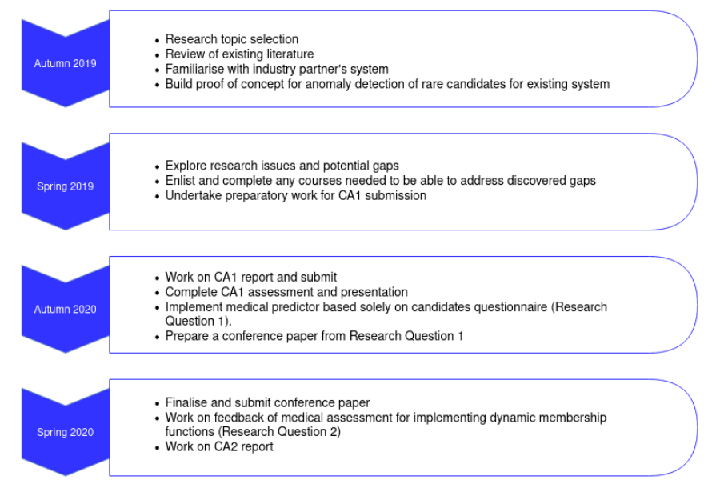
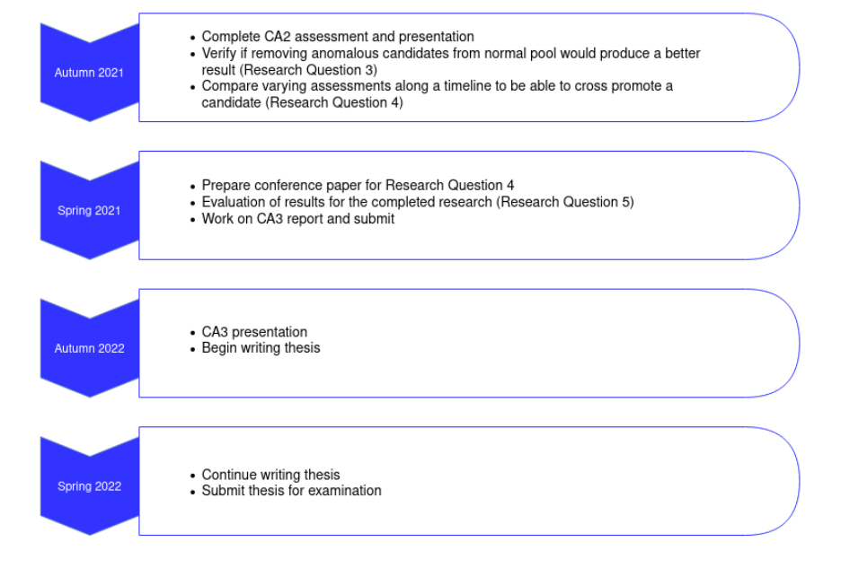
Research Plan
Timeline

Slide 37
Progress To Date
1. An initial POC using both the Linear regression (Seber & Lee, 2012 [45]) and SVM (Noble, 2006 [41]) algorithms.
Test Population | Actual Rejections | Predicted Rejections
2834 | 20 | 0
Notes:
1. An initial POC has been developed solely from an initial system that WHO was already using in order to get an idea of the completeness of the data. At this point in the research the decision was made to use both the Linear regression and SVM as having the ability to exclude rare occurrences was considered more important than the accuracy of those decisions. Moving forward it is the intention of the research to introduce a Deep Neural Network architecture
The current system although lacking integrity does contain sufficient data for a classic split of the data into training, cross validation and test data. When the new system comes on line a less rigid split will need to be used involving some kind of k-fold cross validation to cater for the initial lack of data. To date some work has
been done using a leave-one-out technique to gain familiarity with the approach.
We attempted to predict the labels of new data and calculate the classification accuracy. Both linear regression and SVM struggled to correctly classify anomalous candidates. In total from a test population of 2834 there were actually 20 candidates rejected however our solution predicted none of these. Upon closer examination of these 20 however it became apparent that these candidates had been rejected for reasons outside of the questionnaire. For example one candidate was rejected after the assessor discovered that they had only one arm which was a question not asked through the particular job questionnaire but the job had required both arms. Other candidates were rejected for reasons that the company gave to the assessor directly
and not through the questionnaire process. These findings will be fed back into giving the next iteration of the system more data integrity.
The solution originally was written in Octave and later was ported to into MATLAB

Slide 38
Progress To Date
1. An initial POC using both the Linear regression (Seber & Lee, 2012 [45]) and SVM (Noble, 2006 [41]) algorithms.
Test Population | Actual Rejections | Predicted Rejections
2834 | 20 | 0
2. Reproduced the ARM results on closed-ended data of Chen et al. (2008 [11] and Chen et al. (2009 [12]) .
Notes:
2. In order to verify that fuzzy Association Rule Mining is suitable for our solution the results of a few research papers have been reproduced even though no formal means of reproduction exists.
The research studies have been developed using a neo4j graph database so that the implementation of other studies and indeed our own work should be able to be fast tracked as it is only the data of the work that needs to be created and the subsequent extraction of rules has already been implemented.

Slide 39
Work To Date
2. In order to verify that fuzzy Association Rule Mining is suitable for our solution the results of a few research papers have been reproduced even though no formal means of reproduction exists.
The research studies have been developed using a neo4j graph database so that the implementation of other studies and indeed our own work should be able to be fast tracked as it is only the data of the work that needs to be created and the subsequent extraction of rules has already been implemented.
The system was written in Python and a front end developed in a Jupyter Notebook

Slide 40
References
[1] R. Agrawal, T. Imieliński, and A. Swami, “Mining association rules between sets of items in large databases,” in Proceedings of the 1993 ACM SIGMOD international conference on Management of data, 1993, pp. 207–216.
[2] A. Ali, S. M. Shamsuddin, A. L. Ralescu et al., “Classification with class imbalance problem: a review,” Int. J. Advance Soft Compu. Appl, vol. 7, no. 3, pp. 176–204, 2015.
[3] R. Anand, K. G. Mehrotra, C. K. Mohan, and S. Ranka, “An improved algorithm for neural network classification of imbalanced training sets,” IEEE Transactions on Neural Networks, vol. 4, no. 6, pp. 962–969, 1993.
[4] S. Ando and C. Y. Huang, “Deep over-sampling framework for classifying imbalanced data,” in Joint European Conference on Machine Learning and Knowledge Discovery in Databases. Springer, 2017, pp. 770–785.
[5] E. R. Babbie, The practice of social research. Nelson Education, 2015.
[6] M. Buda, A. Maki, and M. A. Mazurowski, “A systematic study of the class imbalance problem in convolutional neural networks,” Neural Networks, vol. 106, pp. 249–259, 2018.
[7] N. V. Chawla, K. W. Bowyer, L. O. Hall, and W. P. Kegelmeyer, “Smote: synthetic minority over-sampling technique,” Journal of artificial intelligence research, vol. 16, pp. 321–357, 2002.
[8] N. V. Chawla, A. Lazarevic, L. O. Hall, and K. W. Bowyer, “Smoteboost:Improving prediction of the minority class in boosting,” in European conference on principles of data mining and knowledge discovery. Springer, 2003, pp. 107–119.
[9] Y.-L. Chen and C.-H. Weng, “Mining association rules from imprecise ordinal data,” Fuzzy Sets and Systems, vol. 159, no. 4, pp. 460–474, 2008.
[10] ——, “Mining fuzzy association rules from questionnaire data,” Knowledge Based Systems, vol. 22, no. 1, pp. 46–56, 2009.
[11] Z. Chi, H. Yan, and T. Pham, Fuzzy algorithms: with applications to image processing and pattern recognition. World Scientific, 1996, vol. 10.
[12] P. Domingos, “Metacost: A general method for making classifiers cost sensitive,” in KDD, vol. 99, 1999, pp. 155–164.
[13] Q. Dong, S. Gong, and X. Zhu, “Imbalanced deep learning by minority class incremental rectification,” IEEE transactions on pattern analysis and machine intelligence, vol. 41, no. 6, pp. 1367–1381, 2018.
[14] C. Elkan, “The foundations of cost-sensitive learning,” in International joint conference on artificial intelligence, vol. 17, no. 1. Lawrence Erlbaum Associates Ltd, 2001, pp. 973–978.
[15] A. Estabrooks and N. Japkowicz, “A mixture-of-experts framework for learning from imbalanced data sets,” in International Symposium on Intelligent Data Analysis. Springer, 2001, pp. 34–43.
[16] T. Fawcett, “An introduction to roc analysis,” Pattern recognition letters, vol. 27, no. 8, pp. 861–874, 2006.
[17] T. Fawcett and F. Provost, “Adaptive fraud detection,” Data mining and knowledge discovery, vol. 1, no. 3, pp. 291–316, 1997.
[18] A. Fernández, S. del Rı́o, N. V. Chawla, and F. Herrera, “An insight into imbalanced big data classification: outcomes and challenges,” Complex & Intelligent Systems, vol. 3, no. 2, pp. 105–120, 2017.
[19] R. H. Gault, “A history of the questionnaire method of research in psychology,” The Pedagogical Seminary, vol. 14, no. 3, pp. 366–383, 1907.
[20] P. O. Gislason, J. A. Benediktsson, and J. R. Sveinsson, “Random forests for land cover classification,” Pattern Recognition Letters, vol. 27, no. 4, pp. 294–300, 2006.
[21] M. Graczyk, T. Lasota, B. Trawiński, and K. Trawiński, “Comparison of bagging, boosting and stacking ensembles applied to real estate appraisal,” in Asian conference on intelligent information and database systems.
Springer, 2010, pp. 340–350.
[22] S. Gregor, D. Jones et al., “The anatomy of a design theory.” Association for Information Systems, 2007.

Slide 41
References
[23] H. Han, W.-Y. Wang, and B.-H. Mao, “Borderline-smote: a new over-sampling method in imbalanced data sets learning,” in International conference on intelligent computing. Springer, 2005, pp. 878–887.
[24] H. He and E. A. Garcia, “Learning from imbalanced data,” IEEE Transactions on Knowledge & Data Engineering, no. 9, pp. 1263–1284, 2008.
[25] A. R. Hevner, S. T. March, J. Park, and S. Ram, “Design science in information systems research,” MIS quarterly, pp. 75–105, 2004.
[26] C. Huang, Y. Li, C. Change Loy, and X. Tang, “Learning deep representation for imbalanced classification,” in Proceedings of the IEEE conference on computer vision and pattern recognition, 2016, pp. 5375–5384.
[27] N. Japkowicz and S. Stephen, “The class imbalance problem: A systematic study,” Intelligent Data Analysis, vol. 6, no. 5, pp. 429–449, 2002.
[28] J. M. Johnson and T. M. Khoshgoftaar, “Survey on deep learning with class imbalance,” Journal of Big Data, vol. 6, no. 1, p. 27, 2019.
[29] A. Katal, M. Wazid, and R. Goudar, “Big data: issues, challenges, tools and good practices,” in 2013 Sixth international conference on contemporary computing (IC3). IEEE, 2013, pp. 404–409.
[30] S. H. Khan, M. Hayat, M. Bennamoun, F. A. Sohel, and R. Togneri, “Cost sensitive learning of deep feature representations from imbalanced data,” IEEE transactions on neural networks and learning systems, vol. 29, no. 8, pp. 3573–3587, 2017.
[31] T. M. Khoshgoftaar, C. Seiffert, J. Van Hulse, A. Napolitano, and A. Folleco, “Learning with limited minority class data,” in Sixth International Conference on Machine Learning and Applications (ICMLA 2007). IEEE, 2007, pp. 348–
353.
[32] A. V. Kostikova, P. V. Tereliansky, A. V. Shuvaev, V. N. Parakhina, and P. N. Timoshenko, “Expert fuzzy modeling of dynamic properties of complex systems,” ARPN Journal of Engineering and Applied Sciences, vol. 11, no. 17, pp.
10 601–10 608, 2016.
[33] R. Krusaa, C. Kloster, and V. Kamp, “Transfer learning for better cold-start recommendation using multiple domains.”
[34] H. Lee, M. Park, and J. Kim, “Plankton classification on imbalanced large scale database via convolutional neural networks with transfer learning,” in 2016 IEEE international conference on image processing (ICIP). IEEE, 2016,
pp. 3713–3717.
[35] T.-Y. Lin, P. Goyal, R. Girshick, K. He, and P. Dollár, “Focal loss for dense object detection,” in Proceedings of the IEEE international conference on computer vision, 2017, pp. 2980–2988.
[36] M. Mamuda and S. Sathasivam, “On the fusion of tuning parameters of fuzzy rules and neural network,” in AIP Conference Proceedings, vol. 1870, no. 1. AIP Publishing LLC, 2017, p. 040045.
[37] D. Marasini, P. Quatto, and E. Ripamonti, “Intuitionistic fuzzy sets in questionnaire analysis,” Quality & Quantity, vol. 50, no. 2, pp. 767–790, 2016.
[38] G. Marshall, “The purpose, design and administration of a questionnaire for data collection,” Radiography, vol. 11, no. 2, pp. 131–136, 2005.
[39] D. Masko and P. Hensman, “The impact of imbalanced training data for convolutional neural networks,” 2015.
[40] D. Mladenic and M. Grobelnik, “Feature selection for unbalanced class distribution and naive bayes,” in ICML, vol. 99, 1999, pp. 258–267.
[41] W. S. Noble, “What is a support vector machine?” Nature biotechnology, vol. 24, no. 12, pp. 1565–1567, 2006.
[42] K. Peffers, T. Tuunanen, M. A. Rothenberger, and S. Chatterjee, “A design science research methodology for information systems research,” Journal of management information systems, vol. 24, no. 3, pp. 45–77, 2007.
[43] S. Pouyanfar, Y. Tao, A. Mohan, H. Tian, A. S. Kaseb, K. Gauen, R. Dailey, S. Aghajanzadeh, Y.-H. Lu, S.-C. Chen et al., “Dynamic sampling in convolutional neural networks for imbalanced data classification,” in 2018 IEEE
conference on multimedia information processing and retrieval (MIPR). IEEE, 2018, pp. 112–117.

Slide 42
References
[44] H. Schuman and S. Presser, “The open and closed question,” American Sociological Review, vol. 44, no. 5, pp. 692–712, 1979. [Online]. Available: http://www.jstor.org/stable/2094521
[45] G. A. Seber and A. J. Lee, Linear regression analysis. John Wiley & Sons, 2012, vol. 329.
[46] C. Seiffert, T. M. Khoshgoftaar, J. Van Hulse, and A. Napolitano, “Rusboost: A hybrid approach to alleviating class imbalance,” IEEE Transactions on Systems, Man, and Cybernetics-Part A: Systems and Humans, vol. 40, no. 1, pp.
185–197, 2009.
[47] L. Shi, W. X. Zhao, and Y.-D. Shen, “Local representative-based matrix factorization for cold-start recommendation,” ACM Transactions on Information Systems (TOIS), vol. 36, no. 2, pp. 1–28, 2017.
[48] J. Van Hulse, T. M. Khoshgoftaar, and A. Napolitano, “Experimental perspectives on learning from imbalanced data,” in Proceedings of the 24th international conference on Machine learning. ACM, 2007, pp. 935–942.
[49] H. Wang, Z. Cui, Y. Chen, M. Avidan, A. B. Abdallah, and A. Kronzer, “Predicting hospital readmission via cost-sensitive deep learning,” IEEE/ACM Transactions on Computational Biology and Bioinformatics (TCBB), vol. 15,
no. 6, pp. 1968–1978, 2018.
[50] S. Wang, W. Liu, J. Wu, L. Cao, Q. Meng, and P. J. Kennedy, “Training deep neural networks on imbalanced data sets,” in 2016 international joint conference on neural networks (IJCNN). IEEE, 2016, pp. 4368–4374.
[51] K. Williamson and G. Johanson, Research methods: information, systems, and contexts. Chandos Publishing, 2017.
[52] L. Yin, Y. Ge, K. Xiao, X. Wang, and X. Quan, “Feature selection for highdimensional imbalanced data,” Neurocomputing, vol. 105, pp. 3–11, 2013.
[53] C. Zhang, K. C. Tan, and R. Ren, “Training cost-sensitive deep belief networks on imbalance data problems,” in 2016 international joint conference on neural networks (IJCNN). IEEE, 2016, pp. 4362–4367.
[54] H. Zhang and M. Li, “Rwo-sampling: A random walk over-sampling approach to imbalanced data classification,” Information Fusion, vol. 20, pp. 99–116, 2014.
[55] Y. Zhang, L. Shuai, Y. Ren, and H. Chen, “Image classification with category centers in class imbalance situation,” in 2018 33rd Youth Academic annual conference of Chinese Association of Automation (YAC). 359–363.

Slide 43
THANK YOU

