Slide 1

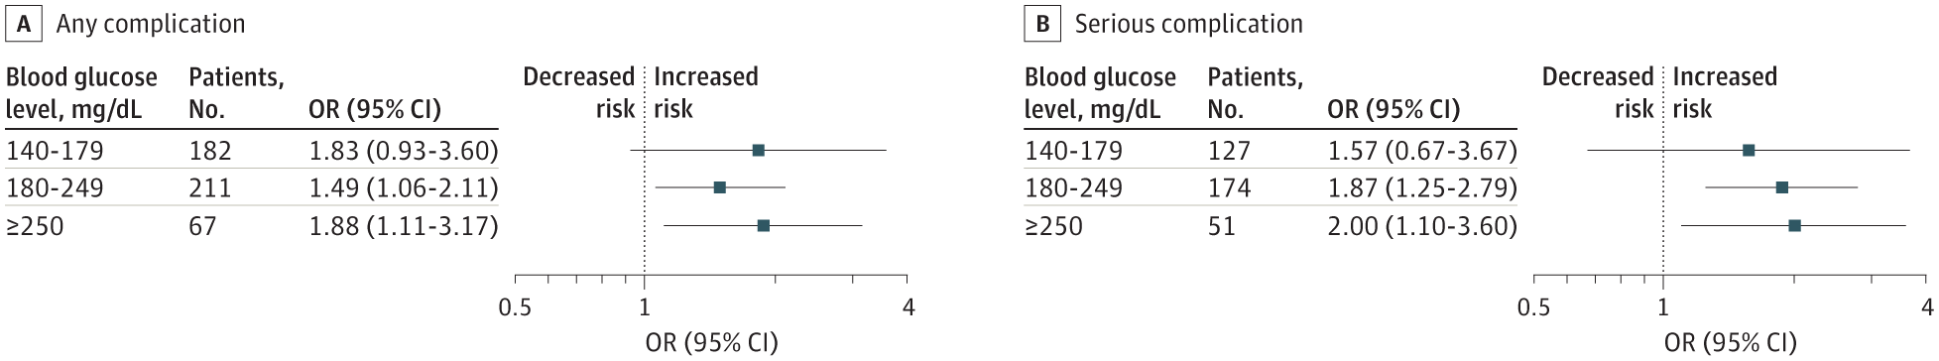
From: Paradoxical Association of Hyperglycemia and Surgical Complications Among Patients With and Without Diabetes
JAMA Surg. Published online June 15, 2022. doi:10.1001/jamasurg.2021.5561
^{Figure Legend:}
Adjusted Odds Ratio (OR) of American College of Surgeons National Surgical Quality Improvement Program (NSQIP) Event Among Patients Without DiabetesReference is the OR of an event among patients with diabetes. Model adjusted for age, American Society of Anesthesiologists physical status class, body mass index group, comorbidities (smoking status, dyspnea, chronic obstructive pulmonary disease, congestive heart failure, hypertension, dialysis, cancer, chronic steroid use, weight loss, and bleeding disorder), need for preoperative transfusion, acute preoperative kidney failure, surgical specialty, and year of operation.
^{Date of download: 9/3/2022}
Copyright 2022 American Medical Association. All Rights Reserved.

