Slide 1

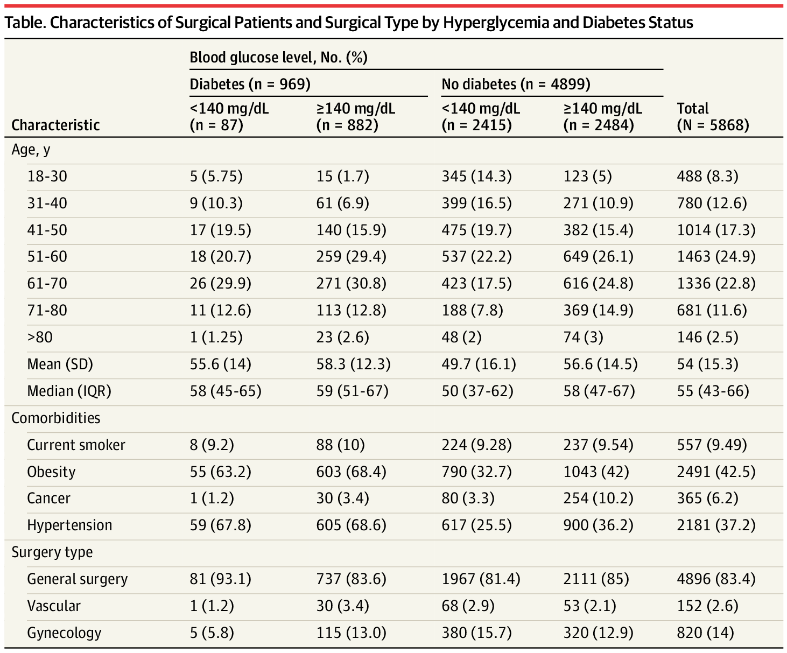
From: Paradoxical Association of Hyperglycemia and Surgical Complications Among Patients With and Without Diabetes
JAMA Surg. Published online June 15, 2022. doi:10.1001/jamasurg.2021.5561
Table Title:
Characteristics of Surgical Patients and Surgical Type by Hyperglycemia and Diabetes StatusSI conversion factor: To convert blood glucose level to millimoles per liter, multiply by 0.0555.
Date of download: 9/3/2022
Copyright 2022 American Medical Association. All Rights Reserved.

