Slide 1

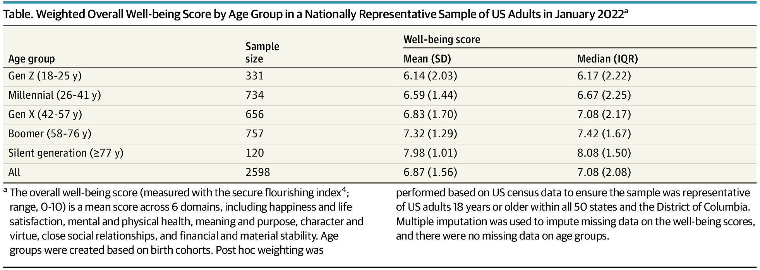
From: National Data on Age Gradients in Well-being Among US Adults
JAMA Psychiatry. 2022;79(10):1046-1047. doi:10.1001/jamapsychiatry.2022.2473
Table Title:
Weighted Overall Well-being Score by Age Group in a Nationally Representative Sample of US Adults in January 2022^{aa} The overall well-being score (measured with the secure flourishing index; range, 0-10) is a mean score across 6 domains, including happiness and life satisfaction, mental and physical health, meaning and purpose, character and virtue, close social relationships, and financial and material stability. Age groups were created based on birth cohorts. Post hoc weighting was performed based on US census data to ensure the sample was representative of US adults 18 years or older within all 50 states and the District of Columbia. Multiple imputation was used to impute missing data on the well-being scores, and there were no missing data on age groups.
Date of download: 10/12/2022

