Slide 1

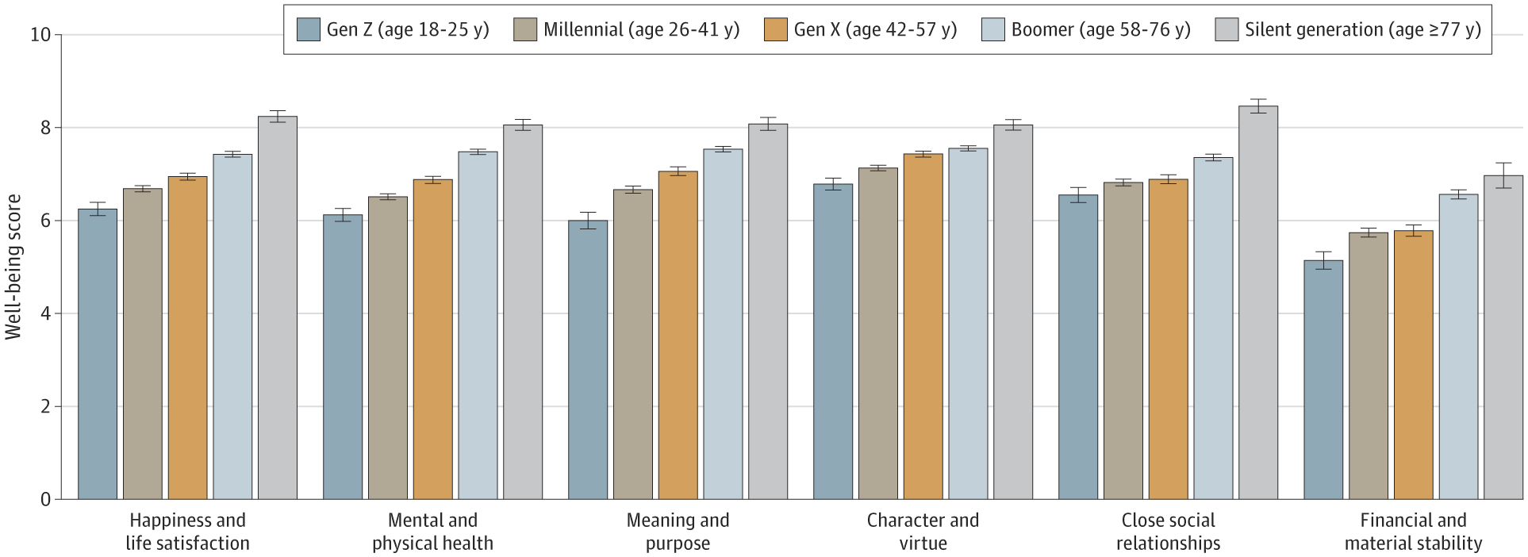
From: National Data on Age Gradients in Well-being Among US Adults
JAMA Psychiatry. 2022;79(10):1046-1047. doi:10.1001/jamapsychiatry.2022.2473
Figure Legend:
Weighted Domain-Specific Well-being Scores by Age Group in a Nationally Representative Sample of US Adults in January 2022 Age groups were created based on birth cohorts. Post hoc weighting was performed based on US census data to ensure the sample was representative of US adults 18 years or older within all 50 states and the District of Columbia. Multiple imputation was used to impute missing data on well-being scores, and there were no missing data on age groups. Error bars represent SEs.
Date of download: 10/12/2022

