Slide 1

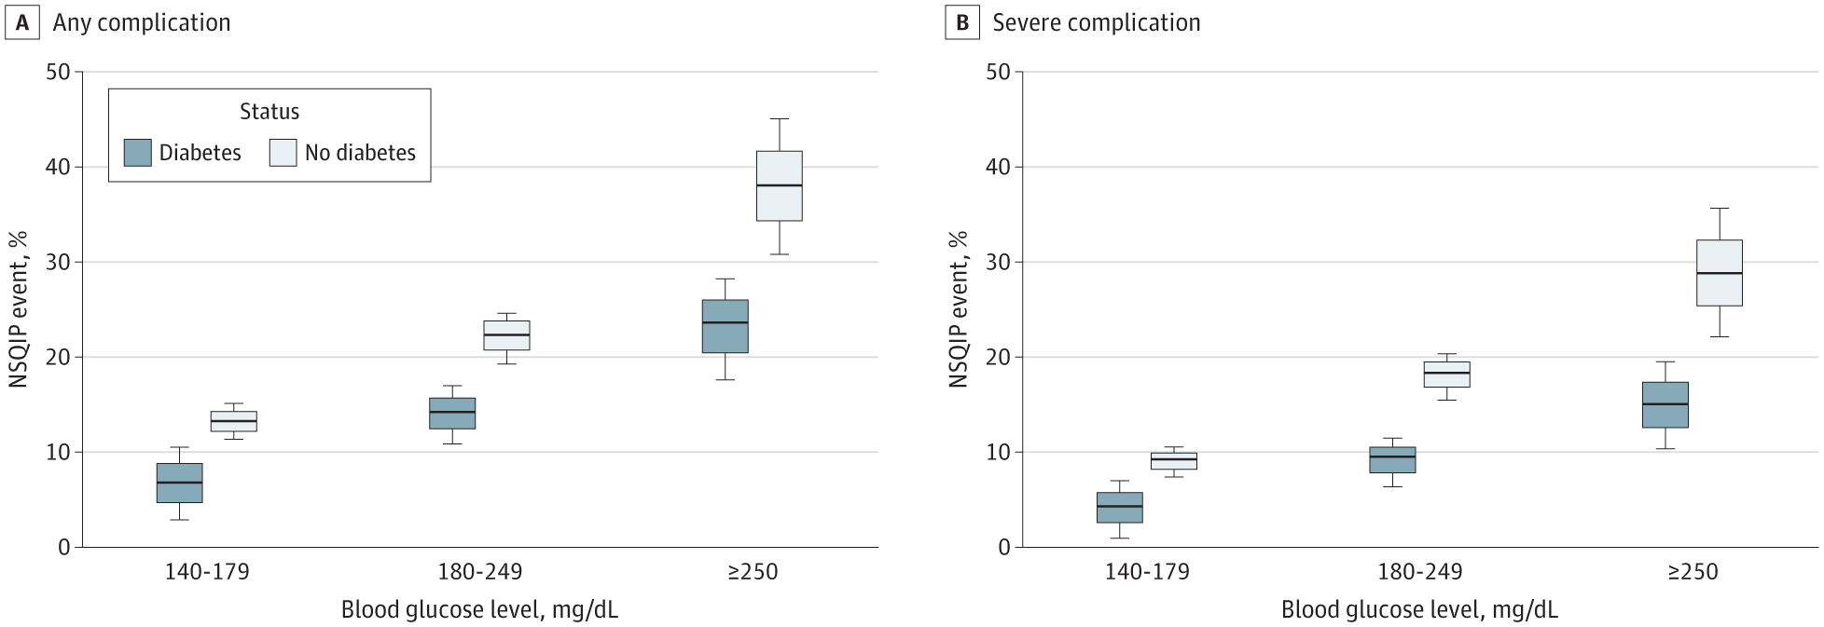
From: Paradoxical Association of Hyperglycemia and Surgical Complications Among Patients With and Without Diabetes
JAMA Surg. Published online June 15, 2022. doi:10.1001/jamasurg.2021.5561
^{Figure Legend:}
Percentage of National Surgical Quality Improvement Program (NSQIP) Events by Diabetes Status and Level of Hyperglycemia (N = 5686)
^{Date of download: 9/3/2022}
Copyright 2022 American Medical Association. All Rights Reserved.

