Slide 1

Cloud Data Centers: Finding the Balance Between Energy Savings and System Speed
CSCI 6093 – Final Project
By: Mirnary Carbajal

Slide 2
Introduction
Artificial Intelligence (AI) cloud computing infrastructures are known to consume massive amounts of energy to operate.
As national infrastructure continues to build at a rapid pace, the power required to maintain these servers is hitting unprecedented levels.
Reducing this energy footprint is important not only for environmental sustainability, but also for the economic viability of the businesses that rely on these services.

Slide 3
Objectives
Evaluating the trade-offs in power, efficiency and cost in cloud infrastructures.
Learning about CloudSim Plus, a framework for creating simulations of cloud computing infrastructures.

Slide 4
Background
The total power needed to keep data centers running is reaching record highs, in a “race to build national AI infrastructure.”
By 2030, AI data centers will account for 3% of total global electricity consumption.
CloudSim Plus
A widely used simulation framework in cloud computing research
Popular fork of CloudSim, the first open-source specialized cloud simulation framework
Users can specify parameters about the hardware

Slide 5
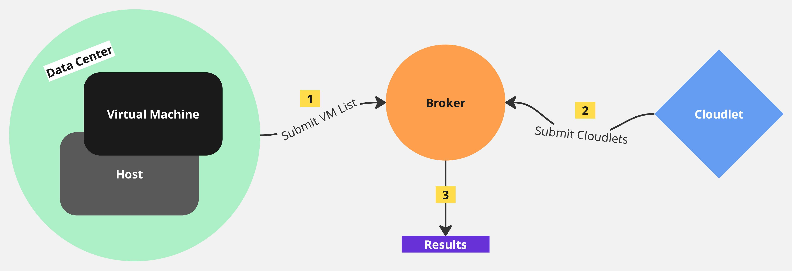
CloudSim Plus

Slide 6
Methodology
A comparison of 2000s, 2010s, and 2020s data centers, using CloudSim Plus to simulate each type
Collected specs for each server type, from SPECpower_ssj2008 benchmarks
Each data center has the same number of hosts (servers), and the same number of tasks to complete
100 hosts each
10,000 tasks each with a length of 50,000 MI (Millions of Instructions)
3 million rows of results then exported as a CSV file and analyzed in Power BI

Slide 7
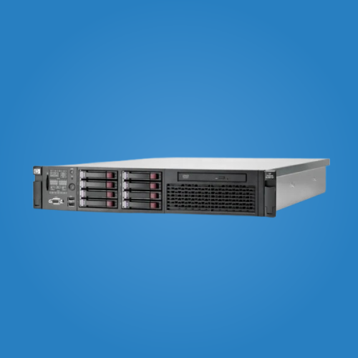
Methodology - Legacy Data Center
HP ProLiant DL360 G1
Enterprise Server
Benchmarked in 2000
Specs:
RAM: 2,048 MB
Storage: 36,000 MB
BW: 10 Mbps
PE / Cores (x2): 1,000 MIPS each
Active power draw: 292 W
Idle power draw: 204 W

Slide 8
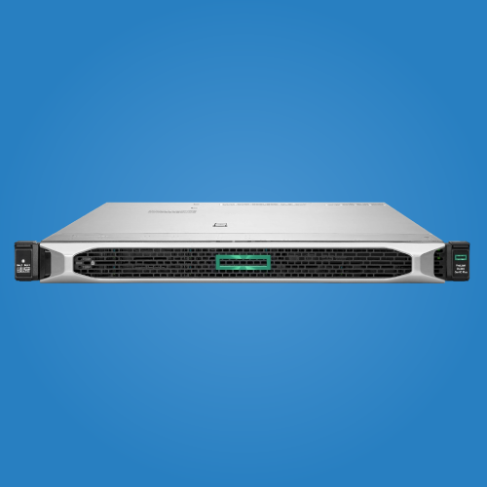
Methodology - Modern Data Center
HPE ProLiant DL360 Gen10
Enterprise Server
Benchmarked in 2017
Specs:
RAM: 98,304 MB
Storage: 340,000 MB
BW: 4,000 Mbps
PE (x56): 2,500 MIPS each (two processors with 28 cores each)
Active power draw: 451 W
Idle power draw: 48 W

Slide 9
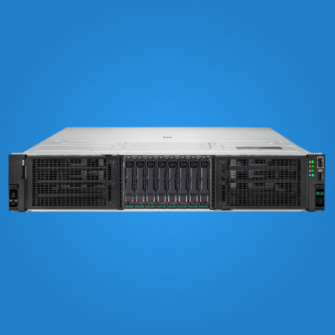
Methodology - AI Data Center
HPE ProLiant DL380a Gen11
Enterprise Server
Benchmarked in 2024
Specs:
RAM: 262,144 MB
Storage: 122,880,000 MB
BW: 4,000 Mbps
PE (x128): 15,000 MIPS each (two processors with 64 cores each)
Active power draw: 736 W
Idle power draw: 235 W

Slide 10
Energy Evaluation Metrics
Operational Cost
Hardware cost
Total energy consumption (E) = (Execution time × Max Active Power) × 100
Legacy = 1,460,000 J
Modern = 902,000 J
AI = 220,800 J
Cost = E × Rate
GA Power Commercial Rate: estimated at $0.115 per kilowatt-hour
Power Usage Effectiveness = Data center energy / Server energy
Legacy = 2.5 PUE
Modern = 1.58 PUE
AI = 1.56 PUE
Estimated physical hardware costs
Legacy = $56,000
Modern = $650,000
AI = $15,000,000

Slide 11


Microsoft Power BI

Slide 12
Conclusion
The AI data center demonstrated superior energy efficiency, but was offset by significantly higher hardware cost
The modern data center is the most practical middle ground, at least while AI hardware costs remain exorbitant
Raw energy consumption alone is a misleading metric
Future work can:
Incorporate software and environmental costs
Apply server cost amortization for a more long-term financial picture
Use the schedulers class to add server idle times
Use the addOnCloudletFinishListener() method to allow dynamic task submission

