Slide 1
Fifteen Puzzle
By: Morgan Miller, Mirnary Carbajal, Rashidat Akande

Slide 2
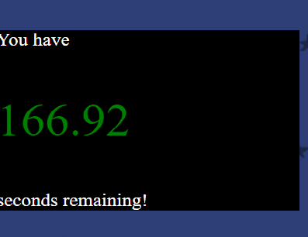
Features We Used
Timer
End game notification
Mutiple Images for the game puzzle

Slide 3
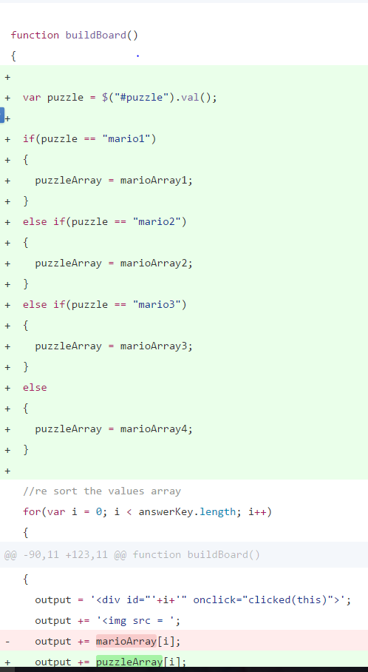
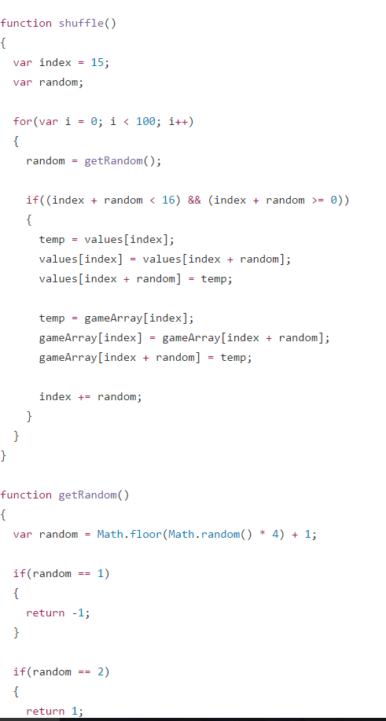
JavaScript Building the Board Function

Slide 4
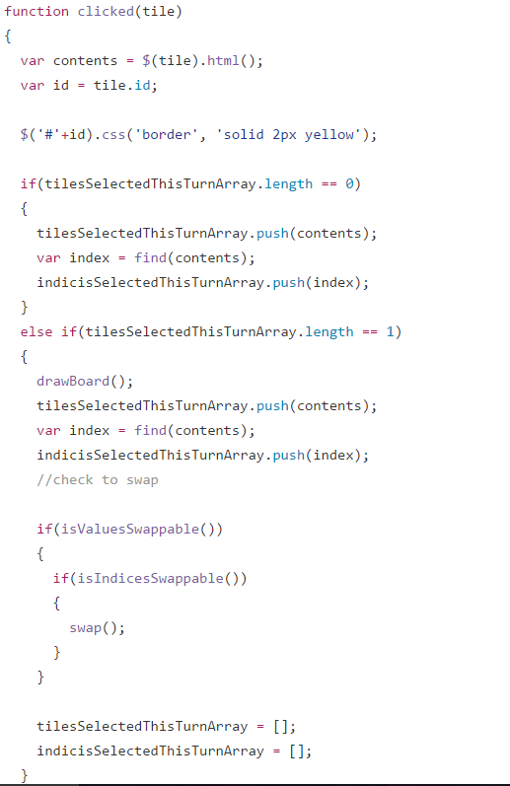
More JavaScript

Slide 5
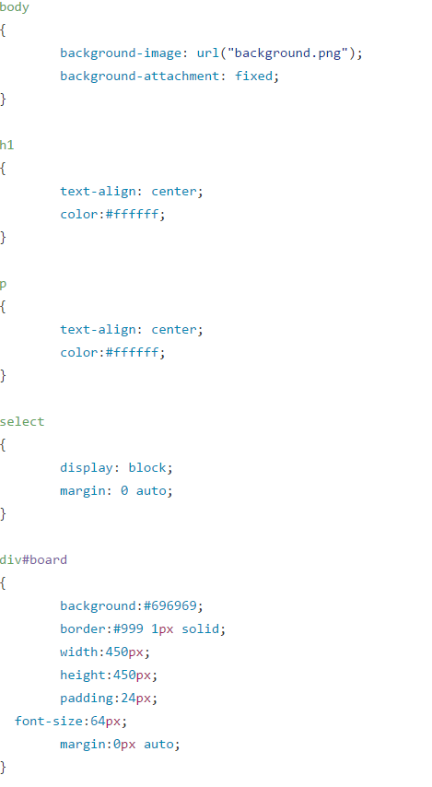
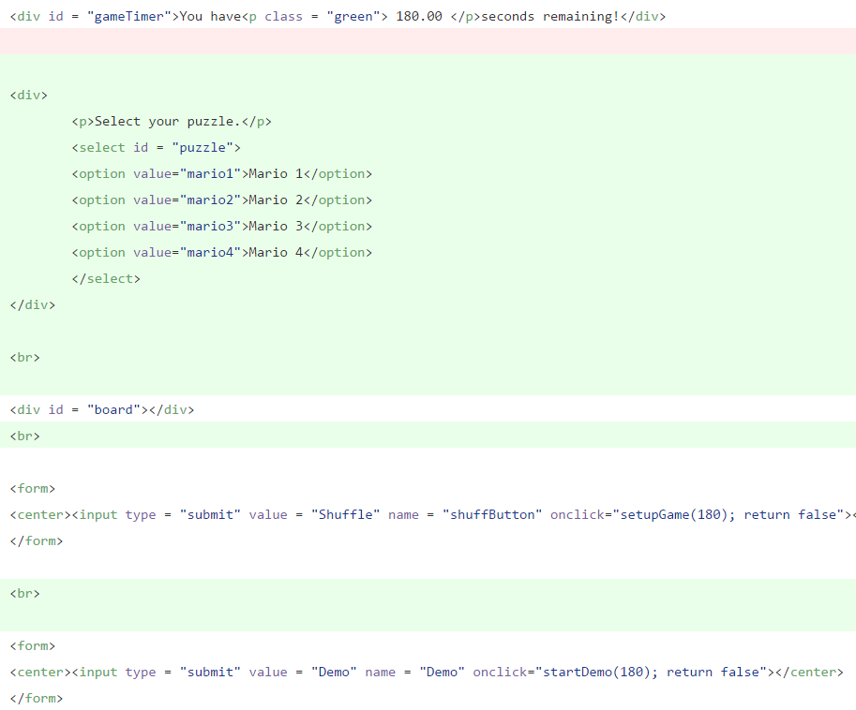
HTML/CSS

Slide 6
Demo
http://codd.cs.gsu.edu/~mmiller78/Project3/fifteen.html

