Slide 1
Building a Movie
Recommender System
Michael Carnival and Hector R. Gavilanes
Data Mining - CAP6771
University of West Florida
Summer 2024
Notes:
Have you ever wondered how Netflix recommends movies?
In this video we’ll be presenting Movie Recommendation systems.
My name is Hector Gavilanes, and I'm here with Michael Carnival.
Our focus will be on how these systems operate and
their potential to improve viewing experiences across various platforms.

Slide 2
Agenda
Background
Types of Recommender
Exploratory Data Analysis
Data Preprocessing
Model Selection
Limitations
Solution
Conclusion
Notes:
On the agenda, we’ll cover the basics of recommendation algorithms, including different types of recommenders. Our EDA/data pre-processing/ choosing a model. We’ll also discuss limitations, and our solution. By the end of this video, you’ll have a basic understanding of how recommender systems work.

Slide 3






Why do we need recommenders?
Notes:
Recommender systems help users discover new products and services by analyzing data.
They are used to generate personalized recommendations on platforms
like Amazon for products to buy,
Netflix and YouTube for movies and videos,
Spotify for music, among others use cases.
Recommender systems enhance user experiences by making it easier to find relevant content.

Slide 4
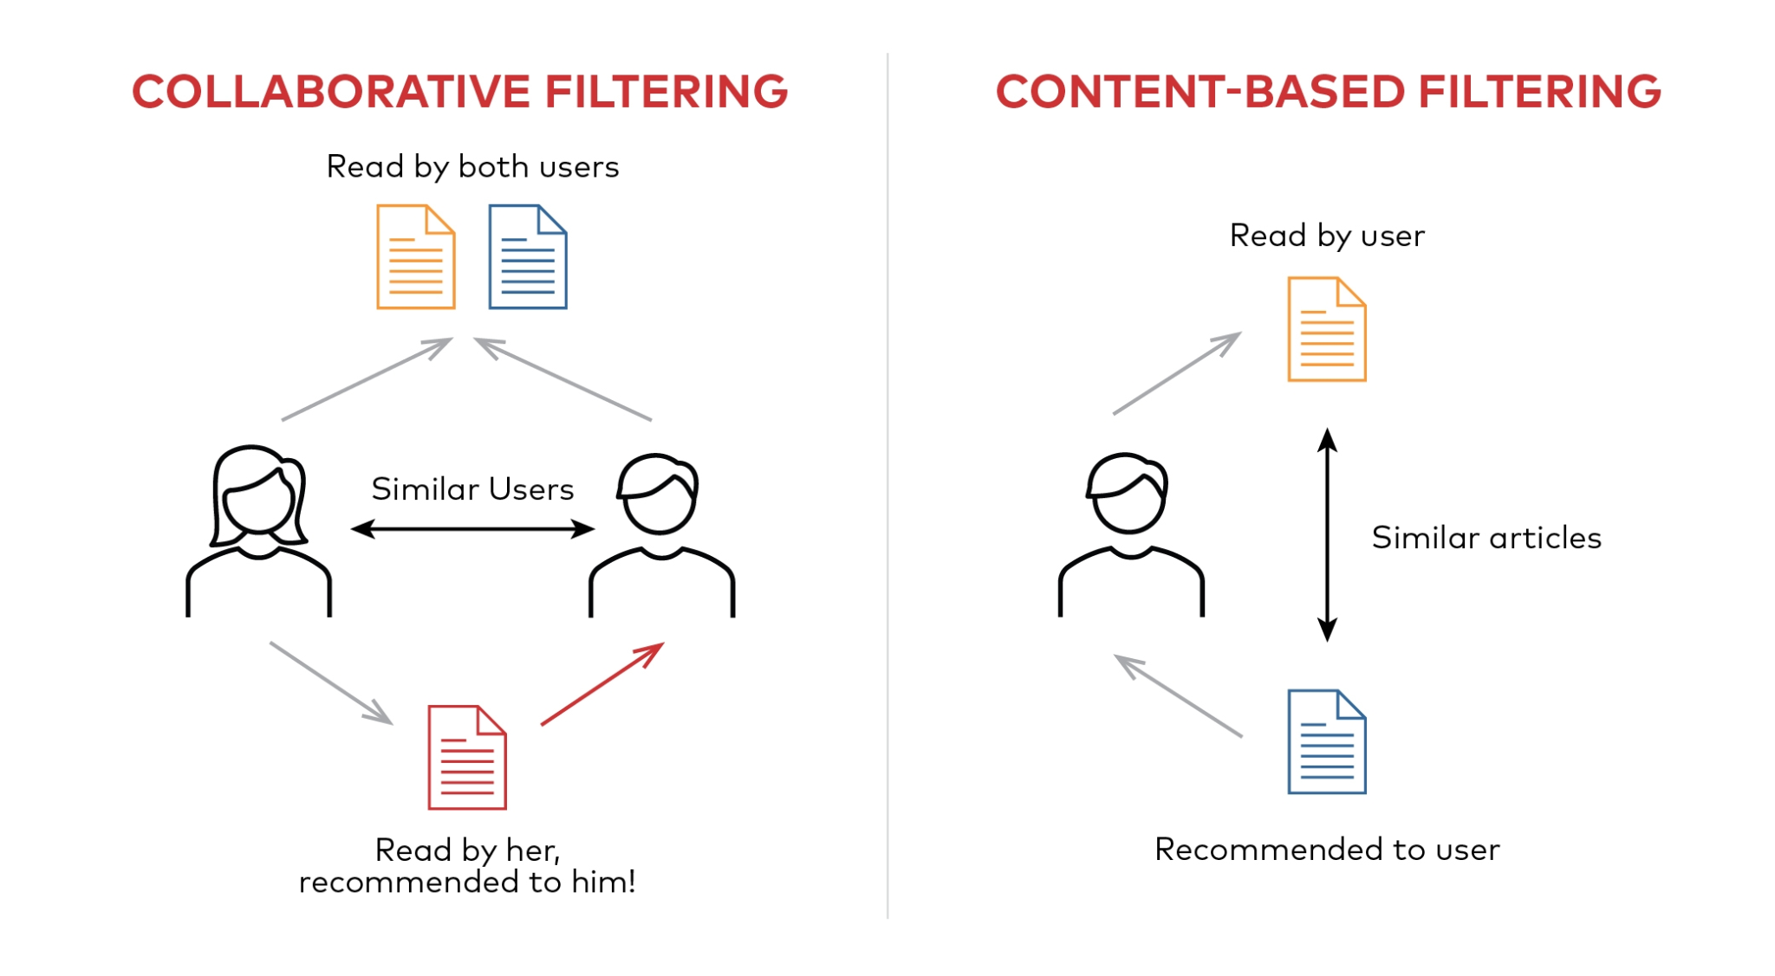
Types of recommenders
Popularity-Based
Collaborative-Based
Content-Based
Hybrid Methods
Notes:
Popularity-Based Filtering: Recommends items based on their overall popularity or frequency of interaction across all users.
Collaborative Filtering: it is based on user behavior and similar decisions by others.
Content-Based Filtering: Uses item attributes to recommend similar products.
Hybrid Methods: Combines multiple approaches for better recommendations.

Slide 5
Exploratory Data Analysis
Number of ratings: 100,836
Number of unique movies: 9,742
Number of unique users: 610
Average number of ratings per user: 165.3
Average number of ratings per movie: 10.35
Notes:
Through exploring the small movie dataset gathered by grouplens research group at the university of minnesota. There are 100k number of ratings/ 9,700 unique movies, 610 unique users,
There are an average 165.3 number of ratings per user
There are an average 10.35 number of ratings per movie

Slide 6
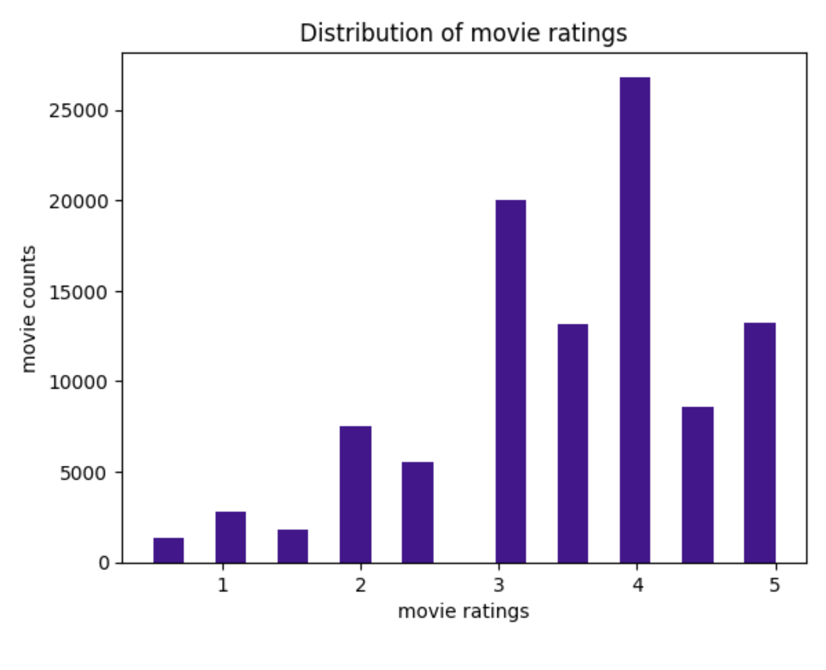
Notes:
The distribution of movie ratings shows that most movies receive ratings of 3 or 4, with 4 being the most common. Ratings of 1 and 2 are less frequent, and ratings of 5 are also relatively low. The overall average movie rating of 3.5 further supports that people tend to rate on the higher end.
This pattern suggests that moviegoers tend to rate movies moderately rather than extremely.

Slide 7
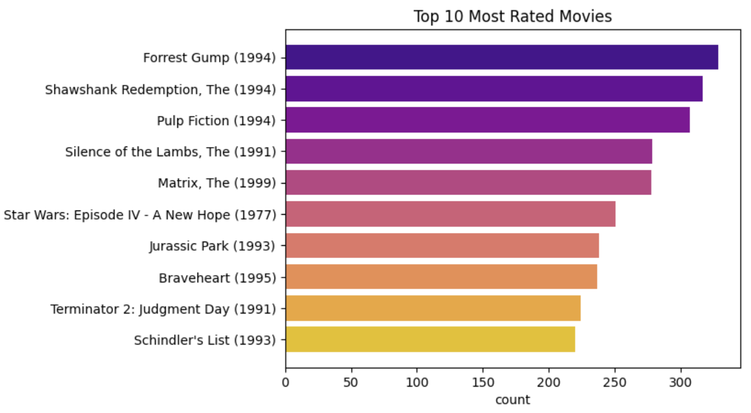
Notes:
What are the top rated movies?
the horizontal bar chart showing the top 10 most rated movies, highlighting ‘Forrest Gump (1994)’ as the most rated, followed by ‘Shawshank Redemption,

Slide 8
What is the problem with highest and lowest rating scores?
Highest rated movies | Lamerica (1994)
Lowest rated movies | Gypsy (1962)
Low Quantity of Ratings
Notes:
What is the problem with highest/lowest rated?
'Gypsy' and 'Lamerica' are the lowest and highest-rated movies respectively. However, both movies have low quantity of ratings.

Slide 9
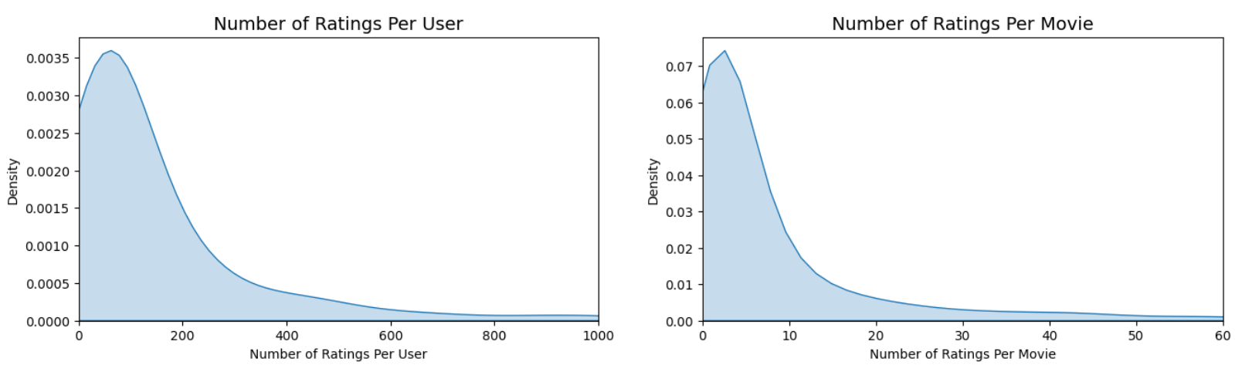
Low Quantity of Ratings
Notes:
The two graphs illustrate that the majority of users rate only a limited number of items and most movies receive only a handful of ratings. This is a common issue of sparsity in user-item interaction datasets, where a small subset of users and movies generates the bulk of ratings.

Slide 10
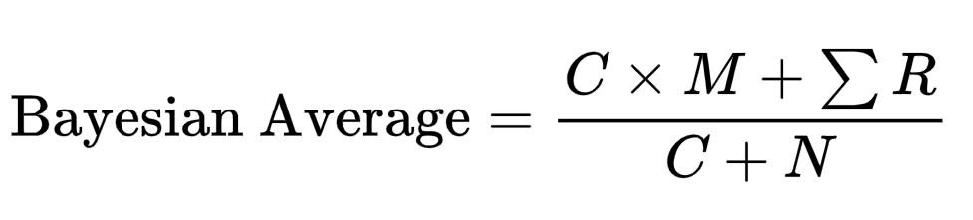

How to deal with low quantity of ratings?
Where:
C is the confidence, or prior weight
M represents the prior mean
R represents the sum of all rating scores
N is total number of reviews, or observations
Notes:
To Address Low Quantity Ratings:
We’ve have used Bayesian Average. This method helps by lowering artificially high ratings, weighing them down to the lower catalog average.
By applying a weighted calculation, the Bayesian average accounts for the number of ratings a movie has received, giving more weight to movies with more ratings. In other words, it provides a more stable estimate of movie ratings by incorporating both observed data and prior information.
This helps in identifying movies that are genuinely popular or well-received. A popularity-Based filtering.

Slide 11
Bayesian Average Results
Lamerica
Forrest Gump
Original average Rating: | 5
Bayesian Average Rating: | 3.5
Original average Rating: | 4.16
Bayesian Average Rating: | 4.1
Notes:
The Bayesian average enhances the credibility of the recommendation system by producing more accurate and reliable movie ratings. It reduces the impact of outliers and extreme ratings, leading to better recommendations.
For our specific case, the rating for “Lamerica” decreased from 5.0 to 3.5. In contrast, the rating for “Forrest Gump” remained largely unchanged, staying close to its original score of 4.1.

Slide 12
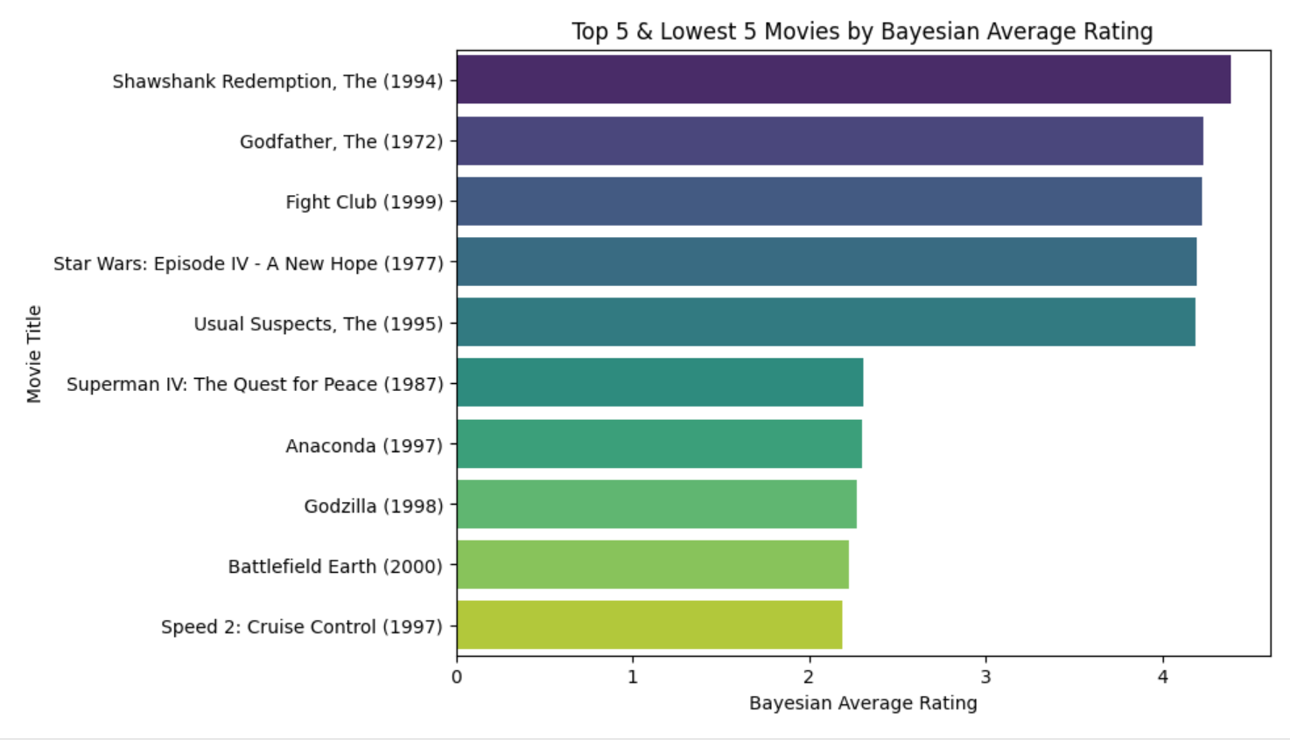
Bayesian Average Results
Notes:
After Applying Bayesian Average to all Movie Ratings dataset
Highest-Rated Movies:
"The Shawshank Redemption," "The Godfather," and "Fight Club" top the list.
These films are critically acclaimed, aligning with expectations.
Lowest-Rated Movies:
"Speed 2: Cruise Control," "Battlefield Earth," and "Godzilla" are among the lowest.
"Gypsy" is not as poorly rated as initially thought.
Credibility of Results:
Bayesian averaging provides a weighted calculation.
Helps identify more relevant movies, offering a validated assessment.

Slide 13
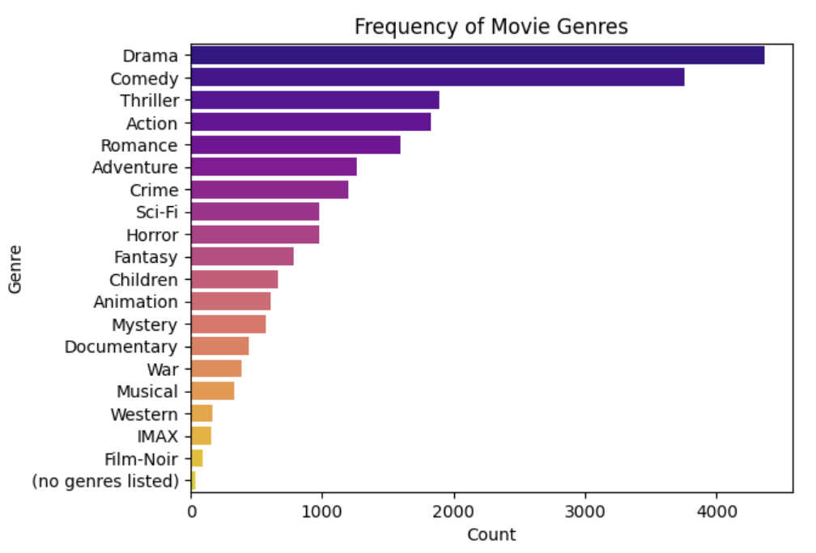
What is the pattern for movie genres?
Notes:
The bar graph shows the count of different movie genres. Here are the key points:
Drama is the most frequent genre, with over 4000 counts.
Comedy and Thriller follow, with counts around 3500.
IMAX and Film-Noir are the least frequent genre.

Slide 14
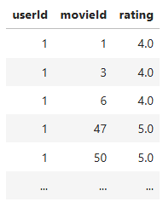
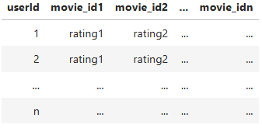
Data Pre-processing
Current data matrix
Target data matrix
Notes:
Current Data Matrix: Our data matrix currently has user and movie IDs as column vectors.
User-Based Collaborative Filtering works by finding users with similar tastes in products or movies as the current user.
To do this, we need to transform our data into a user-item matrix where rows represent users and columns represent movies shown on the right table.

Slide 15
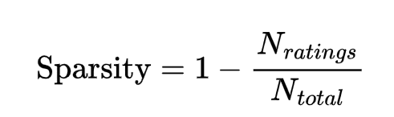
Why should Sparsity be evaluated?
How do Sparsity is evaluated?
{
User — Item, Sparsity ≤ 99.5%
Content-Based, otherwise
Notes:
Importance of Sparsity Value:
When the sparsity value is too high, the user-item interaction matrix becomes extremely sparse, with very few interactions recorded.
Preferred Sparsity Value: A sparsity value of ≤99.5% is preferred to ensure enough interactions between users and items for meaningful recommendations.

Slide 16

Why normalize the user-item data matrix?
Remove Systematic Biases
Different Rating Scales
Notes:
Why normalize the data?
The Purpose of Normalization:
Remove Systematic Biases: Normalization helps to remove biases from ratings, making the data more suitable for collaborative filtering.
Different Rating Scales: Users may have different rating scales, and items may receive consistently high or low ratings due to unrelated factors
How to normalize?
We need to calculate the global mean, user bias, and item bias

Slide 17
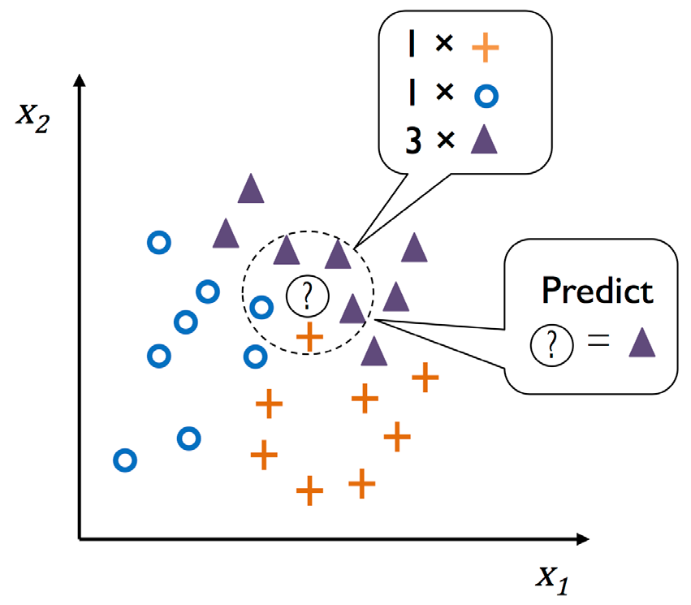
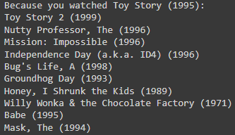
Model Implementation
Results
k-Nearest Neighbors (kNN)
Notes:
k-Nearest Neighbors (kNN) is used to find movies similar to a given movie. It uses cosine similarity to identify nearest neighbors. The algorithm is simple to implement and handles sparse data effectively. By transposing the user-item matrix, kNN finds similar movies based on user ratings. This approach efficiently recommends similar movies using kNN.

Slide 18
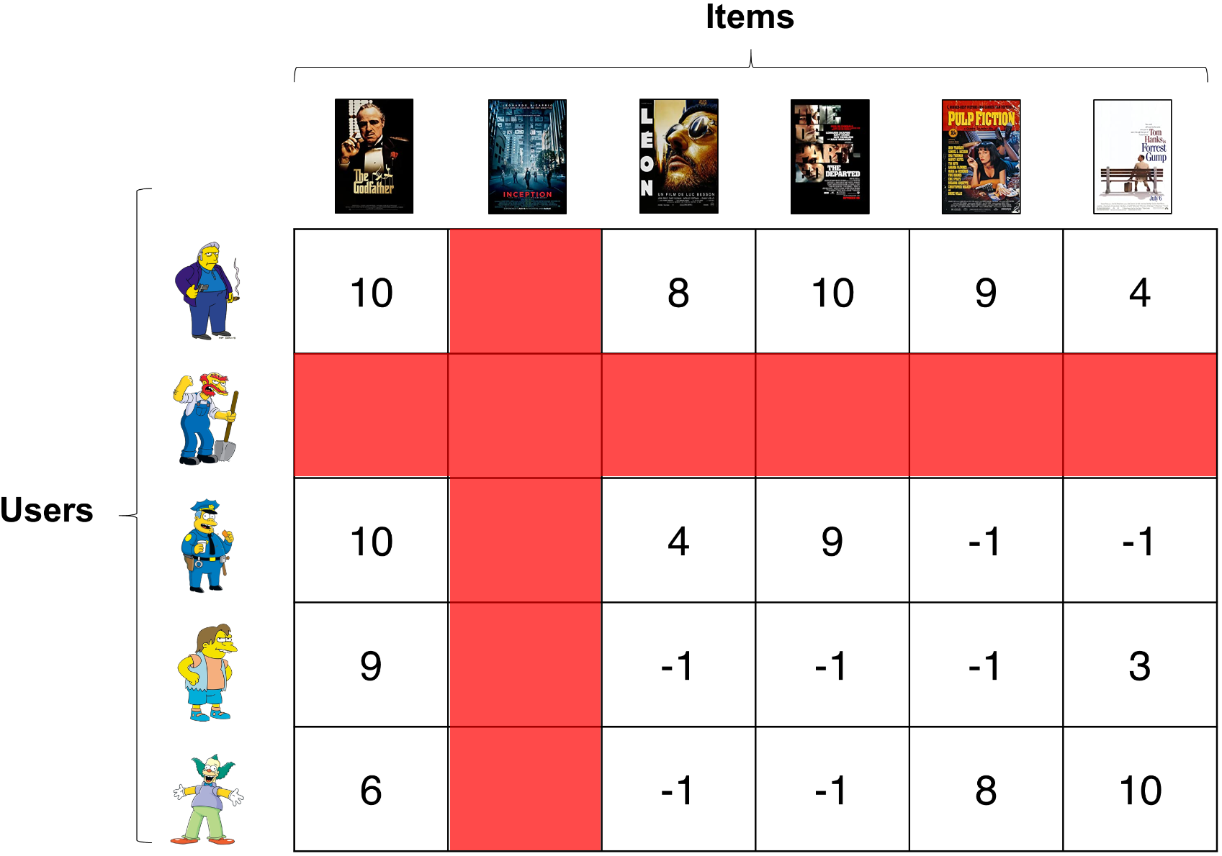
Limitations of User-Based Collaborative Filtering
Cold-Start issue
Struggles new users/items Insufficient historical data
Notes:
Issue with collaborative filtering?
The cold-start problem is a common issue in collaborative filtering. It occurs when new users or items with no prior interactions are excluded from the recommendation system. This happens because collaborative filtering relies solely on user-item interactions within the utility matrix

Slide 19
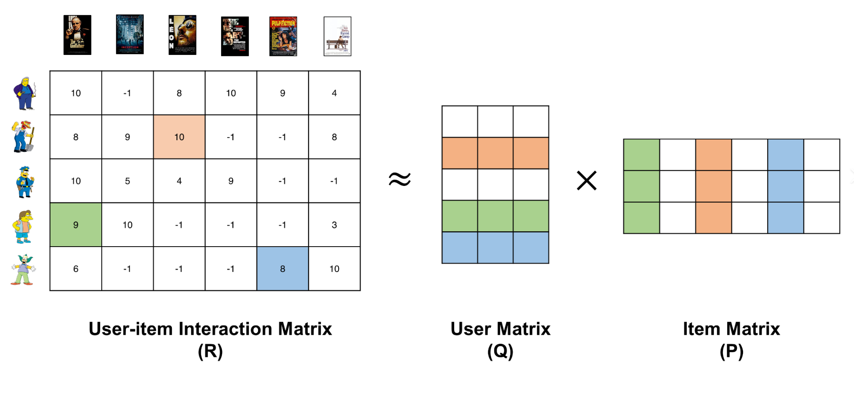
Content-Based Filtering as a Solution
Recommends items based on their attributes, independent of user ratings
Effectively addresses cold-start issues by leveraging item features
Notes:
Solutions
To address this issue, we can use content-based filtering, which generates recommendations based on user and item features. This method involves creating profiles for each item using a set of attributes, such as genre, director, and keywords for movies. A user profile is then built based on the features of items the user has shown interest in. The system calculates the similarity between the user profile and item profiles, often using techniques like cosine similarity. Items that are most similar to the user's profile are recommended

Slide 20
Hybrid Approach
Combines user-based and content-based filtering for a comprehensive system
Balances user preferences with item characteristics for improved relevance
Leverages the strengths of both methods to provide more accurate and personalized recommendations.

Slide 21
Summary
Focused on hybrid filtering: User-Based Collaborative & Content-Based
Constructed user-item matrix
Evaluated sparsity and normalize ratings
Addressed Cold-Start limitations
Used content-based recommendations with movie genre features
Computed Cosine Similarity to identified similar movies

Slide 22
Conclusion
Enhance user experiences across platforms: social media, e-commerce, healthcare
Engage users by providing personalized content and suggestions
Valuable for applications in various fields
Ensure relevant recommendations are up-to-date with new content
Essential for maintaining user engagement and satisfaction

Slide 23
Citations
[1] A. Handžić, "Online evaluation of recommender system with MovieLens dataset," Faculty of information Technologies Pan-European University, 2016.
[2] B. M. Sarwar, G. Karypis, J. A. Konstan and J. T. Riedl, "Application of Dimensionality Reduction in Recommender System -- A Case Study," GroupLens Research Group / Army HPC Research Center.
[3] Y. Ji, A. Sun, J. Zhang and C. Li, "On Offline Evaluation of Recommender Systems," ArXiv, vol. abs/2010.11060, 2020.
[4] D. Bahl, V. Kain, A. Sharma and M. Sharma, "A novel hybrid approach towards movie recommender systems," Journal of Statistics and Management Systems, vol. 23, pp. 1049 - 1058, 2020.
[5] S. N. Salloum and D. Rajamanthri, "Implementation and Evaluation of Movie Recommender Systems Using Collaborative Filtering," Journal of Advances in Information Technology, 2021.
[6] N. a. G. S. Shrivastava, "Analysis on Item-Based and User-Based Collaborative Filtering for Movie Recommendation System," 2021 5th International Conference on Electrical, Electronics, Communication, Computer Technologies and Optimization Techniques (ICEECCOT), pp. 654-656, 2021.
[7] P. Masurel, "Of Bayesian Average and Star Ratings," 17 03 2013. [Online]. Available: https://fulmicoton.com/posts/bayesian_rating/. [Accessed 7 08 2024].

