Slide 1
Bacchus Winery Case Study Solution

Slide 2

Group Introduction
Group Members:
Tanner Elston
Madilyn Carpenter
Workflow:
We worked collaboratively throughout the case study. Tanner typically began the initial drafts, and Madilyn revised and finalized the work for submission.

Slide 3
Case Study Description
Bacchus Winery Overview: A family-owned winery recently inherited by Stan and Davis Bacchus. They aim to modernize operations, such as delivery tracking, employee time monitoring, and wine sales reporting, while maintaining their father George’s traditional approach.
Key business needs:
Better tracking of deliveries
Monitoring employee time
Improved sales reporting by distributor

Slide 4
Design Assumptions
Delivery records have expected and actual dates for delay calculation
Distributors can carry multiple wines
Employees belong to one department and clock in/out once daily
Only last 12 months of employee time logs considered
Inventory data entered manually for now, future automation possible

Slide 5
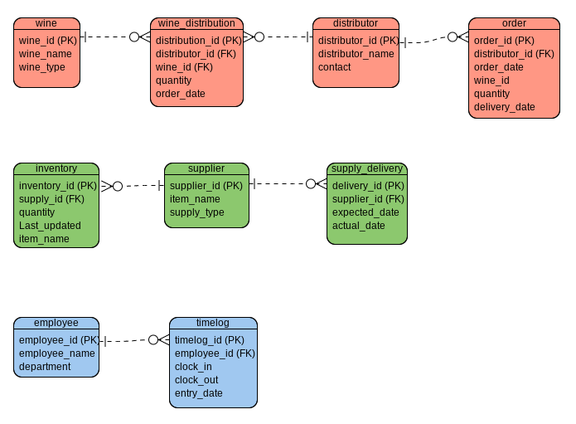
Entity Relationship Diagram
Our ERD outlines the structure of the winery’s data, covering wine production, distribution, inventory, supply management, and employee tracking.
Key Entities:
wine, distributor, order, wine_distribution
supplier, inventory, supply_delivery
employee, timelog
Relationships:
Distributors ↔ Orders & Shipments
Suppliers ↔ Inventory & Deliveries
Employees ↔ Timelogs

Slide 6
Entity Relationship Diagram
Our ERD outlines the structure of the winery’s data, covering wine production, distribution, inventory, supply management, and employee tracking.
Key Entities:
wine, distributor, order, wine_distribution
supplier, inventory, supply_delivery
employee, timelog
Relationships:
Distributors ↔ Orders & Shipments
Suppliers ↔ Inventory & Deliveries
Employees ↔ Timelogs

Slide 7
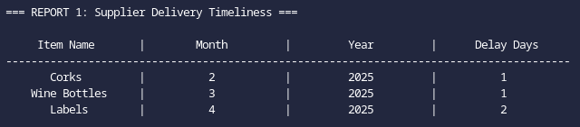
Report 1 Supplier Delivery Timeliness
Tracks delivery delays month-by-month to identify problem suppliers or late deliveries
Example:

Slide 8
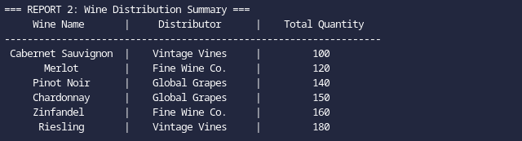
Report 2 Wine Distribution Summary
Shows total quantity of each wine sold by each distributor to spot slow movers
Example:

Slide 9
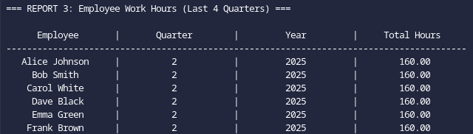
Report 3 Employee Work Hours (Last 4 Quarters)
Summarizes hours worked by employee per quarter to track labor distribution
Example:

Slide 10
Conclusion
Our database provides Bacchus Winery with a solid foundation for organizing data and generating clear, mock reports.
While not a full system, it supports key business areas and can be expanded in the future.

