Slide 1
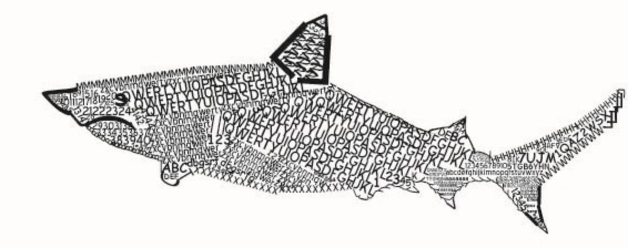
User
><>
Instance of the fish module
(represented as a thread)
Second thread, used for displaying the board
Retrieve board
Update
board
Instance of the shark module
(represented as a thread)
Retrieve board
Update
board
The game board
Update
board
Retrieve board
Retrieve board
Update
board
User
><>
Instance of the fish module
(represented as a thread)
Second thread, used for displaying the board
Instance of the shark module
(represented as a thread)

