Slide 1
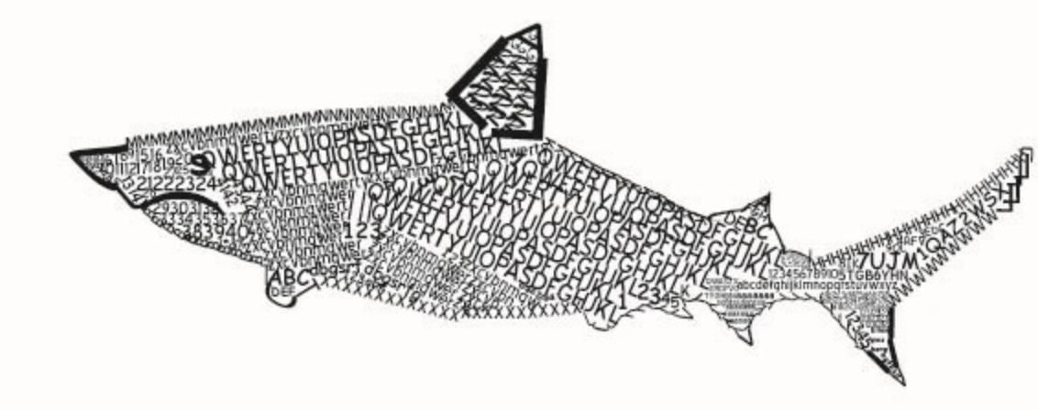
User
><>
Instance of the fish module
(represented as a thread)
Second thread, used for displaying the board
SharkManager
Update
board
List of n sharks…
Retrieve board
Whether current wave has finished
The game board
Stores general game information:
Board itself (dimensions and state)
List of players (and total count) / same with client connections
Single write for all sharks
Update
board
Retrieve board
User
><>
Instance of the fish module
(represented as a thread)
Second thread, used for displaying the board

