Slide 1
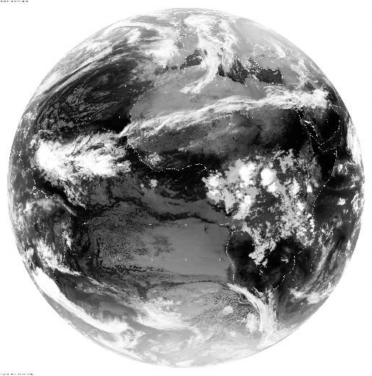
SECOND YEAR: 2604 PLANETARY REMOTE SENSING 3 ELECTROMAGNETIC RADIATION: a journey from the Sun to planet Earth Dr. A. Battaglia ab474@le.ac.uk EOS-SRC, Dept. of Physics and Astronomy, University of Leicester, U.K. http://www2.le.ac.uk/departments/physics/research/earth-observation-science

Slide 2
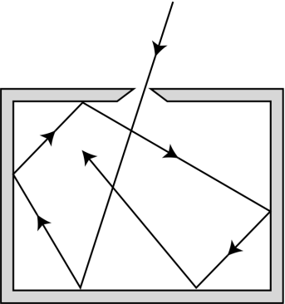

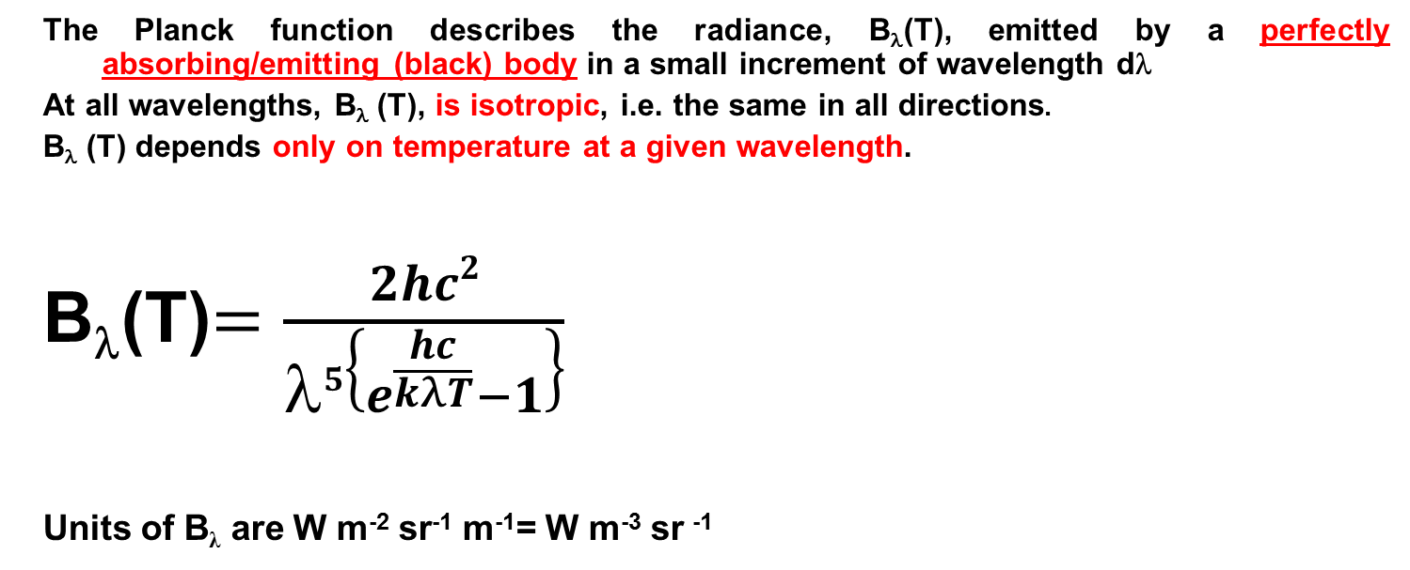
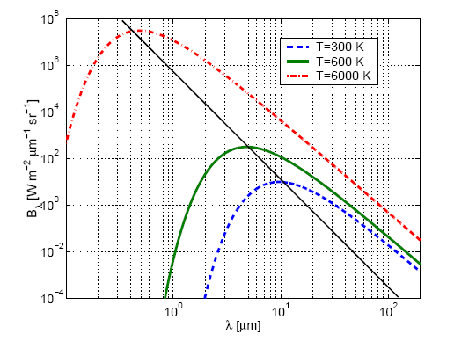
Radiation at sun surface
B_{λ}(T=6000K)
B_{λ} (T)

Slide 3

Other forms of Planck’s Law
A number of forms (inter-convert using c = λν)
Standard Frequency (ν)
B_{ν} (T) d ν = 2hν ³ d ν
c²{exp(hν/kT) – 1}
Units of B are W m⁻² sr⁻¹ s⁻¹= W m⁻² sr ^{–1} Hz
Infra-red physicists tend to use the spectroscopic wavenumber ( in cm⁻¹)
Wavenumber form is the one you are expected to be familiar with when dealing with spectroscopy.
Units of are W m⁻² sr⁻¹/m⁻¹ =W m⁻¹ sr⁻¹
To pass from one to the other use the fact that B_{λ} (T) dλ is the same as B_{ν} (T) dν!
$$B_{\tilde{ν}}(T)$$
Notes:
Explain calc. hc2 is a constant. Same wavelength so lambda will cancel.

Slide 4
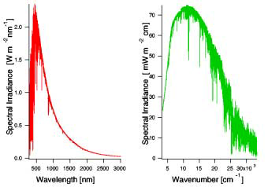
Spectral irradiance
Solar Flux
Example:
λ=1μm=1000nm
= 10,000 cm⁻¹

Slide 5
Planck’s function: Wien law
By differentiating the Planck function B_{λ} and equating the result to zero we find the wavelength corresponding to the maximum:
λ_{max} [μm] T[K] = 2,897.8
_{always}
_{increasing}
_{with T}
T(sun) ≈6000 K (peaks at approx. 0.5 μm or 500 nm)
T (Earth surface mean)≈ 288 K (peaks at approx. 10 μm)

Slide 6
Spectral flux at the sun surface
B_{λ}(T=6000K)
The Radiance field is isotropic
I_{λ} (θ,φ) = B_{λ}(T=5600K) = const for 0<θ<π/2
Integral over one hemisphere
Black body emission or reflection from ‘Lambert’ surface
N.B. The intensity remains constant along a ray upon reflection by any mirror

Slide 7
Total flux at sun surface: Planck law
B_{λ}(T=6000K)
_{always}
_{increasing}
_{with T}
_{σ = 5.67 X 10} ⁻ ⁸ _{W m} ⁻ ² _{K} ^{– 4}
By integrating the blackbody flux over all frequencies we get F_{BB} = σ_{B}T⁴ Stefan-Boltzmann Law
T=300 ➔ F=460 W/m²
T=6000 ➔ F=460 *160000W/m²

Slide 8

Now travelling to Earth’s TOA
In a transparent medium, the radiance is constant along a ray.
B_{λ}(T=6000K)
B_{λ}(T=6000K) i.e. same as
at the Sun surface
At TOA The field is very collimated. Inside the atmosphere the radiation field is more diffuse.
How much radiation is impinging at TOA? ➔Sun ‘constant’
How is it spectrally distributed? Sun spectrum

Slide 9
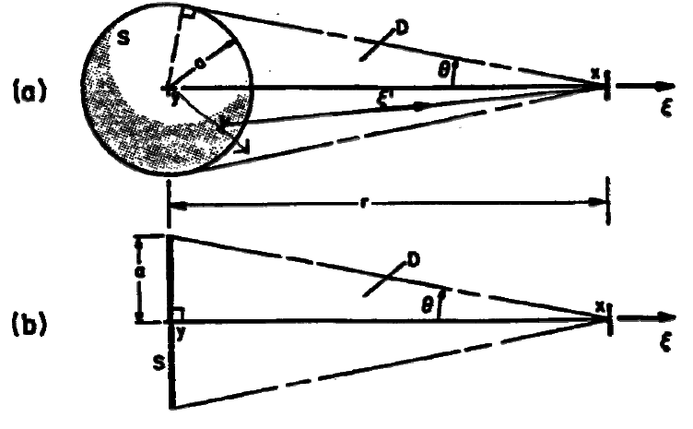
Flux from Sun at distance D
Assume isotropic emission with intensity I₀ from extend source. Compute the flux incident on a surface (with normal in direction of source) at distance D
Thus F(D) ~ 1/D²
Which is the expected 1/r² dependence:
fluxes are preserved
Notes:
Sinxcosx = ½ sin2x
Stefan boltzmann law: sigma= 5.67x10^-8 J s-1 m-2 K-4

Slide 10
Example: the solar constant=flux from sun at TOA
Sun is approximately blackbody with T=5790K
Intensity from sun:
Flux observed on Earth:
F_{Earth} = I_{sun} Ω_{sun}= I_{sun} * 0.68*10⁻⁴ sr ~ 1368 W/m²
(Stefan-Boltzman law for BB)
Finally ending the 10-minute boring travel in the vacuum
Notes:
Sinxcosx = ½ sin2x
Stefan boltzmann law: sigma= 5.67x10^-8 J s-1 m-2 K-4

Slide 11


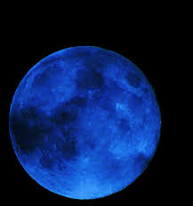
Home thinking
Can you explain these phenomena?

Slide 12
Trying to understand the complete Picture
sun
Ideally, we want to know intensity at any point in any direction !
Absorption
Atmosphere
Scattering from a cloud
Emission from a cloud
Scattering
Cloud
Aerosol / Molecules
Scattering within a cloud
Emission
Scattering / reflection from a cloud
Transmission through a cloud
Absorption on the ground
Emission from the ground
Reflection on the ground
So what is the problem ?

Slide 13
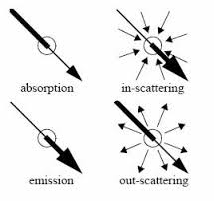
Interaction of Light and Matter
Light (EM radiation) can interact with matter in the following ways:
Emission: add (generates) photons
Absorption: removes photons
Scattering: changes direction of photons (and sometimes energy) e.g. when impinging onto a surface, a cloud or an aerosol layer
In such conditions (the medium is non transparent)
radiance is not constant
along the ray

Slide 14
Emission and Absorption of E/M Radiation
Emission:
Radiation emitted from a body due to its temperature
Emission of a medium is governed by the Planck function of the medium and the emissivity ε
Emission signal = ε(λ) x B(λ,T)
Black body: ε(λ) = 1
Absorption:
Radiation absorbed by a body
Absorptivity: a(λ)= ε(λ) [Kirchoff’s law in local thermal equilibrium]
Emission and absorption are fundamentally driven by quantum mechanics of molecules (or matter).

Slide 15
BEER-LAMBERT LAW: absorption
The Beer-Lambert (-Bouget) Law: if a signal of intensity I_{λ} travelling in direction Ω penetrates a distance, dL, in a homogenous medium with absorption coefficient, k_{a} (per unit distance):
L
I_{λ} (0)
I_{λ} (L)
GAS: k_{a}(λ), c

Slide 16
BEER-LAMBERT LAW
The Beer-Lambert Law: if a signal of intensity I_{λ} penetrates a distance, dL, in a homogenous medium with absorption coefficient, k_{a} (dimensionally L⁻¹):
dI_{λ} = – k_{a}(λ) I_{λ} dL
Observed experimentally
Then if k_{a} = constant along the path L
I_{λ} (L) = I_{λ}(0) exp {- k_{a}(λ) L }
transmissivity: T(λ) = I_{λ} (L) / I_{λ} (0) = exp {- k_{a}(λ) L } = exp {-τ}
with τ = optical depth
L
I_{λ} (0)
I_{λ} (L)
GAS: k_{a}(λ), c
Radiance is not
constant along the ray!

Slide 17
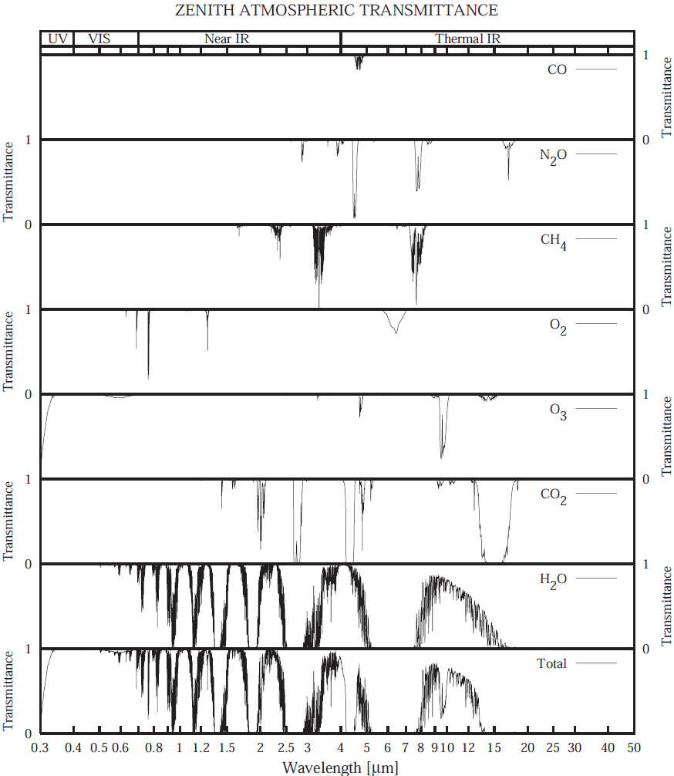
Atmospheric Transmittance Spectrum (UV, VIS, NIR, TIR)
<0.3µm opaque due to O₂ and O₃ at UV-C
VIS most transparent except minor abs. by O₂ and O₃
NIR many lines by H₂O, CO₂, CH₄, N₂O
Thermal IR many lines/bands by H₂O, CO₂, O₃
IR window between 8 and 12 µm
Far IR (50µm-1mm) completely opaque with H₂O main absorber; only useful for sensing upper atmosphere from space

Slide 18
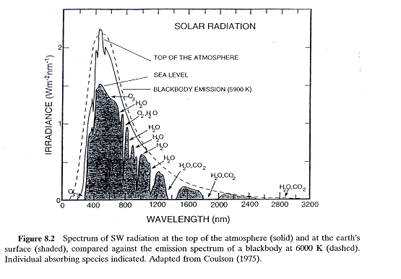
SOLAR SPECTRUM AND ATMOSPHERIC GASES
Main gas: O₃
Other gases: O₂, H₂O, CO₂ [NO₂, OClO, BrO]
0.4 μm
3.2 μm

Slide 19
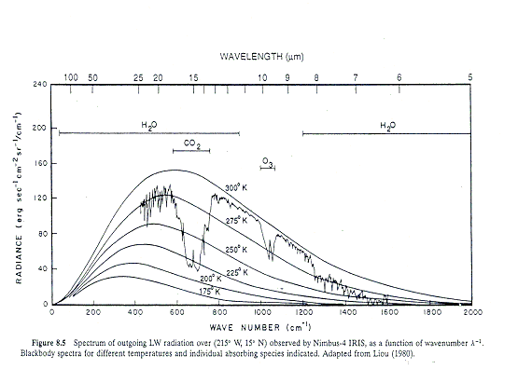
EARTH SPECTRUM AND ATMOSPHERIC GASES
Main gases: CO₂, H₂O, O₃, [CH₄, N₂O, CFCs,…]
50 μm
5 μm

Slide 20
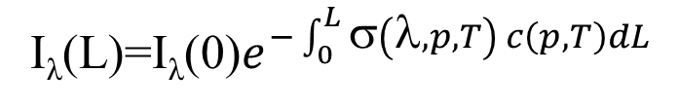
Optical thickness: contributors
L
I_{λ} (L) = I_{λ}(0) exp {- k_{a}(λ) L }= I_{λ}(0) exp [ – σ(λ) c L ]
with c = the density of molecules per unit volume.
Three factors affects the optical thickness:
Spectroscopy: absorption cross section σ(λ) [cm²/molecule]
Composition/density: c = χ c_{air} [molecules/cm³]
Photon path-length: geometrical distance = L [km]
I_{λ} (0)
I_{λ} (L)
GAS: k_{a}(λ), c, T
mixing ratio of the gas
General form with k_{a} changing in space:

Slide 21
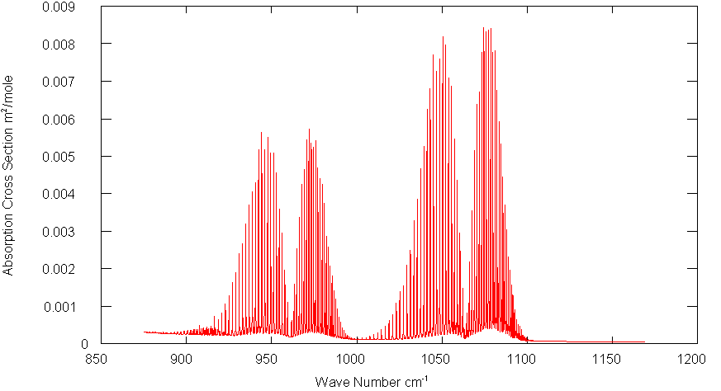
Transmission of gases
Example
Calculate the transmission of CO₂ lines over a range of 10 km line for different absorption cross sections of a) 10⁻¹⁹ cm²; b) 10⁻²¹ cm²; c) 10⁻²³ cm². Assume CO₂ has the concentrations given by 2.7 * 10¹⁵ molecules cm⁻³ .
T_{g}(ν) = exp [ – k_{n}(ν)N l ]
a) = exp [ – 10⁻¹⁹ cm²/mol * 2.7 * 10¹⁵ mol cm⁻³* 10 *10⁵ cm]
= exp [ – 2.7 * 10¹] ≈ 0.0
b) = exp [ – 2.7 * 10⁻¹] ≈ 0.76
c) = exp [ – 2.7 * 10⁻³] ≈ 0.997
is opaque
has mid-range transmission
Is nearly transparent.
1 mole=6x10²³ molecules
=10⁻²² cm²/molecule
10 micron
Notes:
21
Explain calc. hc2 is a constant. Same wavelength so lambda will cancel.

Slide 22
Accounting for emission
L
I_{λ} (L)
There are 2 signals emerging:
Radiance transmitted by the gas in the cell: T(λ) I_{o} (λ)
Radiance emitted by the gas in the cell: ε(λ) x B(λ,T)
Emissivity is related to absorptance a(λ) of the layer (fraction of radiance being absorbed)
We neglect scattering (valid for gases in the IR)
I_{λ} (0)
GAS k_{a}(λ), c, T
T(λ) + a(λ) = 1 ➔ a(λ) = 1- T(λ)
Radiation is either transmitted or absorbed
In thermal equilibrium
(Kirchhoff’s law)
ε(λ)=a(λ) = 1- T(λ)

Slide 23
IR TRANSMISSION FOR ISOTHERMAL LAYER
Total Signal
Hence, Total Signal, I(λ) is given by
==> I_{λ} (L) = T(λ) I_{λ}(0) + ( 1- T(λ) ) x B(λ, T)
Limiting cases:
1) T(λ) ≈ 1 → I_{λ} (L) ≈ T(λ) I_{λ}(0) [Known as a WINDOW]
T(λ) = 0 → I_{λ} (L) =B(λ, T) [Known as 100% absorption or saturation]
N.B. : If: a) term 1 >> term 2 or b) if T_{gas} = 0 K (!)
then Eqn. 1) would be true and conventional use of T(λ) alone is fine, e.g. uv-visible on Earth or hot source relative to cold gas.
L
I_{λ} (0)
I_{λ} (L)
GAS k_{a}(λ), c, T

Slide 24
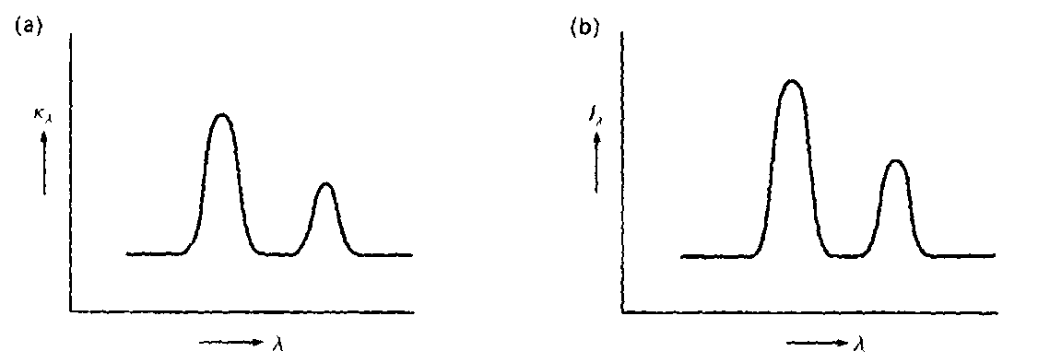
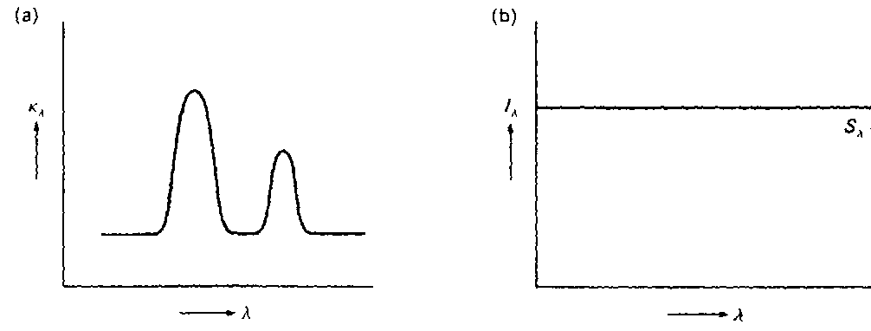
Hot nebula
L
I_{λ} (L)
I_{λ} (0)
GAS k_{a}(λ), c, T
I_{λ}(L) = T(λ) I_{λ}(0) + ( 1- T(λ) ) x B(λ, T)
Imagine first the case in which I_{λ}(0)=0, i.e. solely emission from the volume of gas (with constant source function).
We have two limiting cases:
Optically thin case ( τ_{λ}<<1)
Optically thick case (τ_{λ}>>1)
Opacity τ versus λ ➔ Intensity versus λ
τ_{λ}
Ι_{λ}
τ_{λ}
Ι_{λ}
It behaves like a black body

Slide 25
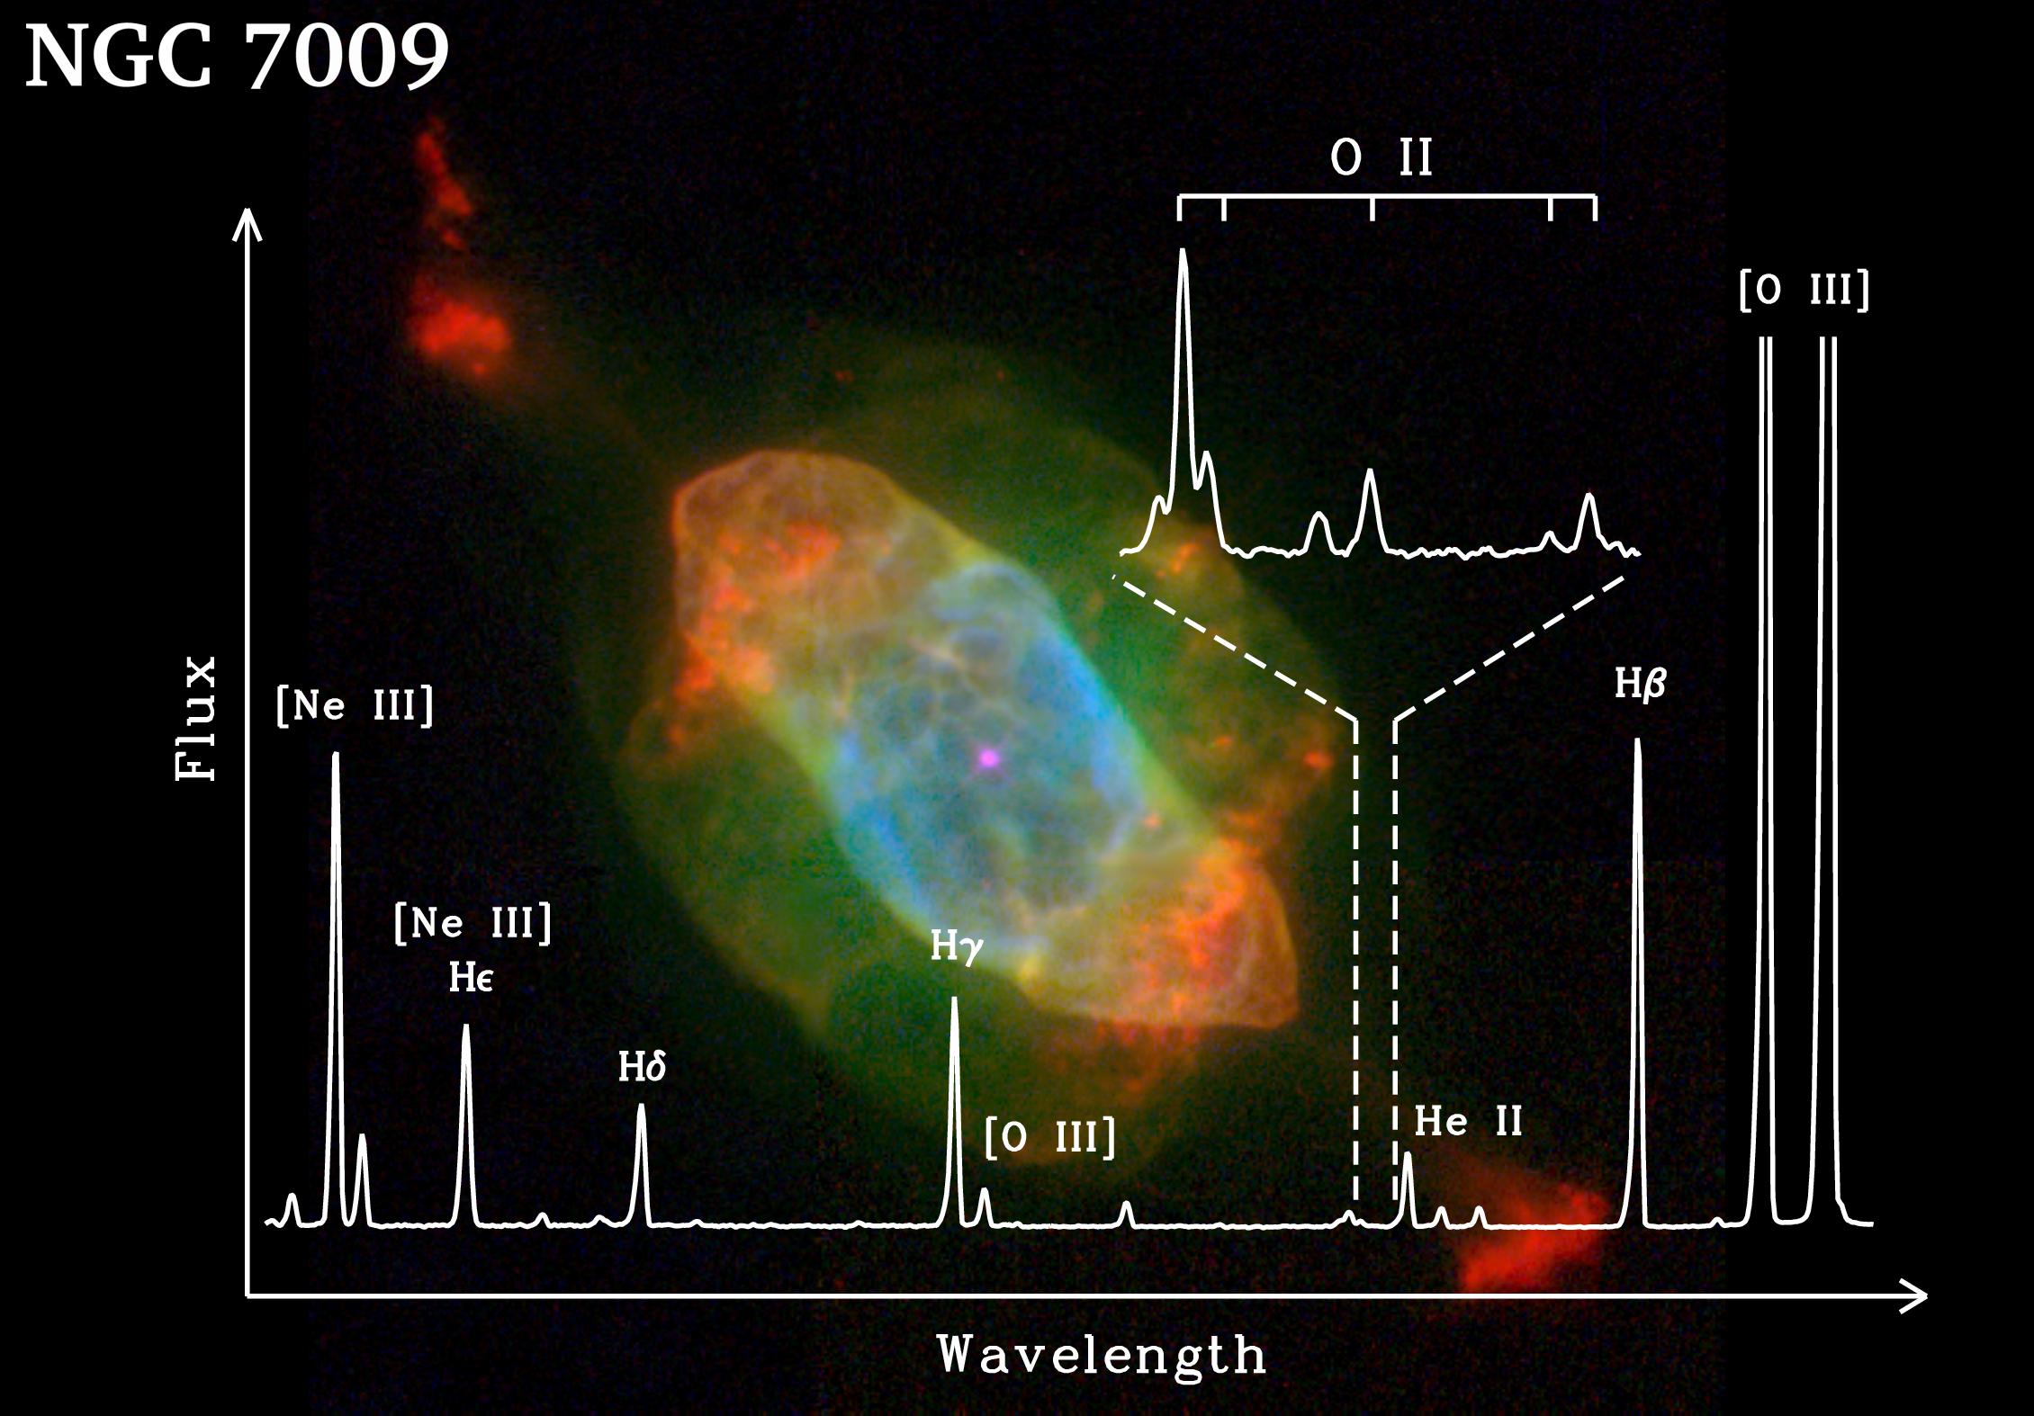
Hot low density nebular gas
Example of emission lines for optically thin nebulae
The optical thickness is strongly dependent on wavelength ➔ peaks corresponding to absorption bands of different elements in the nebula

Slide 26

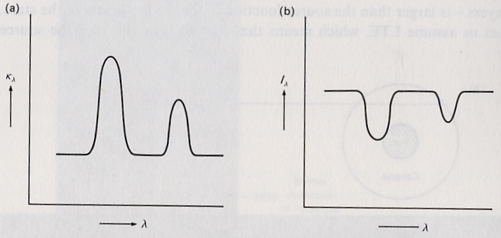

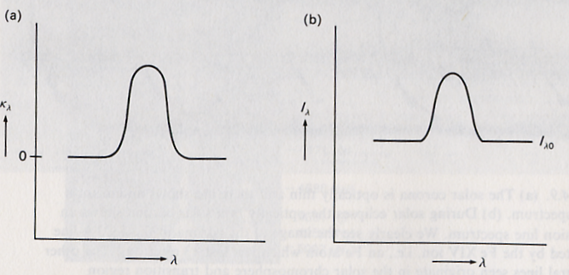


Absorption versus emission
Imagine now I_{λ}(0)≠0, again with two extreme cases:
Optically thin case (τ_{λ}<<1)
If I_{λ0}>B_{λ}, so there is something subtracted from the original intensity which is proportional to the optical depth – we see absorption lines on the continuum intensity I_{λ.} EXAMPLE: stellar photospheres
If I_{λ0}<B_{λ}, we will see emission lines on top of the background intensity.
Example: Solar UV spectrum
Optically thick case (τ_{λ}>>1):
Planck function as before.
τ_{λ}
Ι_{λ}(L)
τ_{λ}
Ι_{λ}(L)
Opacity τ versus λ ➔Intensity versus λ

Slide 27
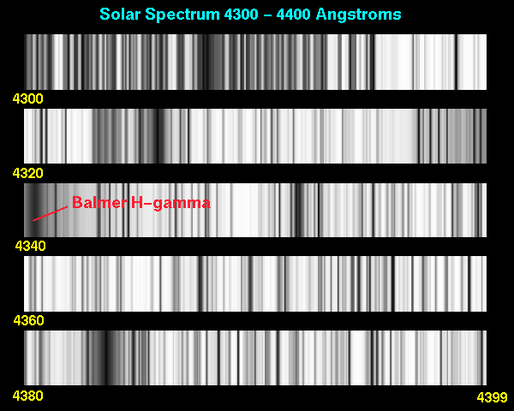
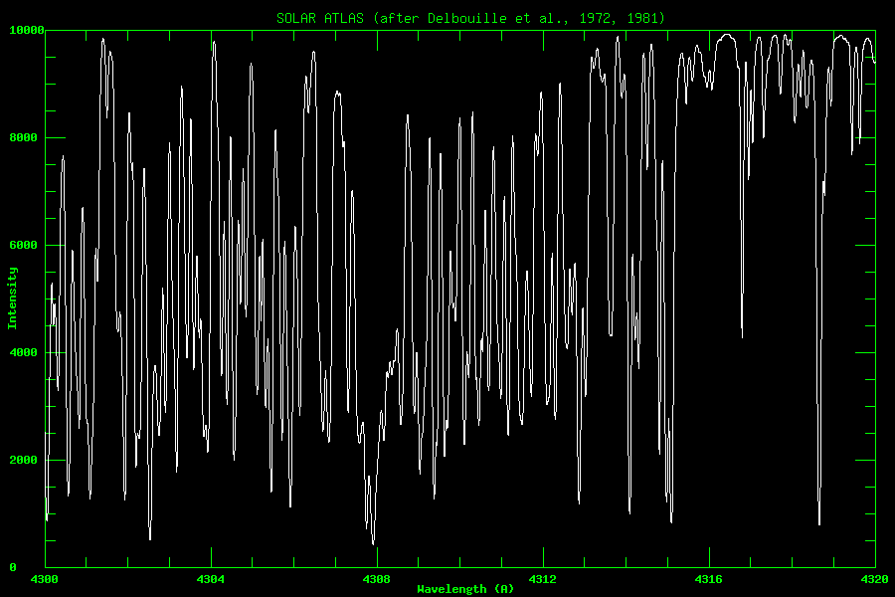
Absorption lines? Outward decreasing temperature
In a star absorption lines are produced if
I_{λ0} > B_{λ} i.e. the intensity from deep layers is larger than the source function from top layers.
In LTE, the source function is B_{λ}(T), so the Planck function for the deeper layers is larger than the shallower layers. Consequently the deeper layers have a higher temperature than the top layers (since the Planck function increases at all wavelengths with T).
(Instances occur where LTE is not valid, and the source function declines outward in parallel with an increasing temperature).
Solar Spectrum (4300-4320 angstrom=0.43-0.432 micron) ➔ absorption lines

Slide 28
Absorption versus emission spectra
Emission line spectra
Optically thin volume of gas with no background illumination (emission nebula)
Optically thick gas in which the source function increases outwards (UV solar spectrum)
Absorption line spectra
Optically thick gas in which source function declines outward, generally T decreases outwards (Stellar photospheres)
Optically thin cold gas penetrated by background radiation (Interstellar matter between us and the star)

Slide 29
BEER-LAMBERT LAW: EXTINCTION LAW
Homogenous non-absorbing medium with scattering coefficient, k_{s} (per unit distance)
dI_{λ} = – k_{s}(λ) I_{λ} dL
and I_{λ} (L) = I_{λ}(0) exp {- k_{s}(λ) L } (compare absorbing case)
Scattering and absorbing media: I_{λ} (L) = I_{λ}(0) exp {- k_{e}(λ) L }
with extinction coefficient: k_{e} = k_{s}+ k_{a}
Extinction: total loss of light due to absorption and scattering of light out of path
L
I_{λ} (0)
I_{λ} (L)

Slide 30
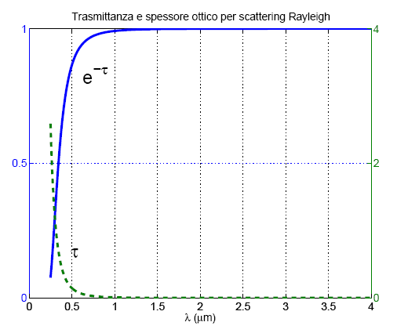
The scattering optical thickness of our atmosphere
Compare the atmospheric transmissivity for Rayleigh scattering in UV with larger wavelength (600nm, 900 nm)
λ, nm | σ, cm²
300 | 6.00 x 10⁻²⁶
400 | 1.90 x 10⁻²⁶
600 | 3.80 x 10⁻²⁷
1000 | 4.90 x 10⁻²⁸
10,000 | 4.85 x 10⁻³²
Transmission
T(λ) = I_{λ} (L) / I_{λ}(0)
= exp(-τ) = exp {- k_{s}(λ) L }
= exp {- σ c L } = exp {- σ VCD }
with Vertical Column Density of air (VCD) = 2.3x10²⁵ molec/cm²
Transmissivity: T(λ=300nm) = 0.25 τ = 1.4
T(λ=600nm) = 0.92 τ = 0.08
T(λ=1000nm) = 0.99 τ = 0.01
Only 25% of direct light reaches surfaces in UV at 300 nm but 99% at 1000nm.

Slide 31
Extinction: Scattering plus Absorption
Absorption removes radiant energy from an E/M field, converting it to other forms of energy.
(Effect on transmittance is the same)
Scattering does not remove energy from an E/M field, but can redirect it, thereby making it a “source” of radiation for another direction.
Single scatter albedo (SSA): fraction of extinction (absorption + scattering) due to scattering processes:
ω_{o} = σ_{s} /σ_{e}
ω_{o} = 1 all scattering (conservative)
ω_{o} = 0 all absorption (non - conservative)
σ_{e =} σ_{a +} σ_{s}
How can we compute scattering and absorption cross sections of single particles?
How can we relate them to scattering and absorption coefficients?

Slide 32
Spectroscopy&scattering theory
The study of interaction of a medium with radiation is known as spectroscopy. The spectral properties of gases, liquids and solids are determined fundamentally by quantum mechanics.
Hence k(ν) is fundamentally due to quantised transitions between energy levels in molecules.
In the infra-red, the transitions occur as distinct bands unique to each gas (specifically due to the vibration and rotation of each molecule).
Light gas molecules – distinct line structure grouped in bands e.g. CO, CO₂, H₂O,CH₄
Heavy gas molecules – densely structured bands that appear apparently smooth (cross sections) e.g.CFCs
Liquids – simple broad features (droplets, aerosols, surface)
Solids – simple,broad features (ice, aerosols, surface)

Slide 33
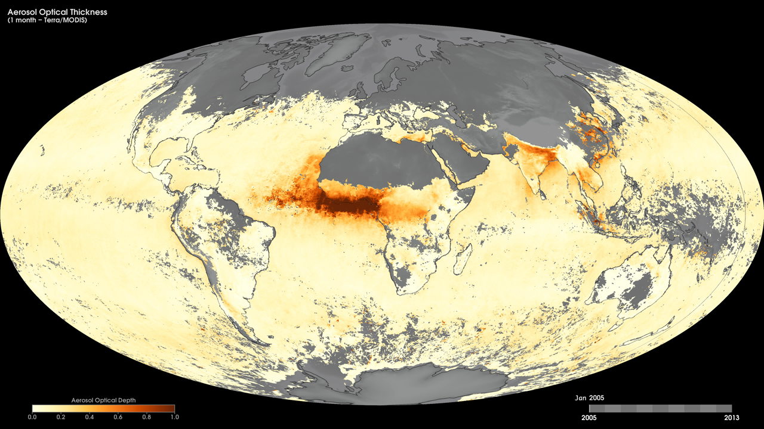
Notes:
Tiny solid and liquid particles suspended in the atmosphere are called aerosols. These particles are important to scientists because they represent an area of great uncertainty in their efforts to understand Earth's climate system.
These maps show monthly aerosol optical thickness, derived using measurements from the Moderate Resolution Imaging Spectroradiometer (MODIS) sensor onboard NASA’s Terra satellite, from January 2005 to the present. Aerosol optical thickness is a measure of how much light the airborne particles prevent from traveling through the atmosphere. Aerosols absorb and scatter incoming sunlight, thus reducing visibility and increasing optical thickness. Dark orange pixels show high aerosol concentrations, while light orange pixels show lower concentrations, and light yellow areas show little or no aerosols. Black shows where the sensor could not make its measurement. An optical thickness of less than 0.1 (light yellow) indicates a crystal clear sky with maximum visibility, whereas a value of 1 (dark orange) indicates the presence of aerosols so dense that people would have difficulty seeing the sun.
Satellite: Terra
Instrument: MODIS

Slide 34
What do you need to know?
Converting from Radiance to Fluxes
Black body radiation and related laws
Emission and Absorption
Isothermal layer model
Lambert Beer Law (optical depth, transmissivity)
Good textbooks (available in the university library) :
G.W. Petty – A first introduction in atmospheric radiation
G.L. Stephens – Remote sensing of the lower atmosphere – an introduction
I_{o} (λ)
I_{λ} (L)
GAS k_{a}(λ), T
I_{λ} (L) = T(λ) I_{λ}(0) + ( 1- T(λ) ) x B(λ, T)

Slide 35
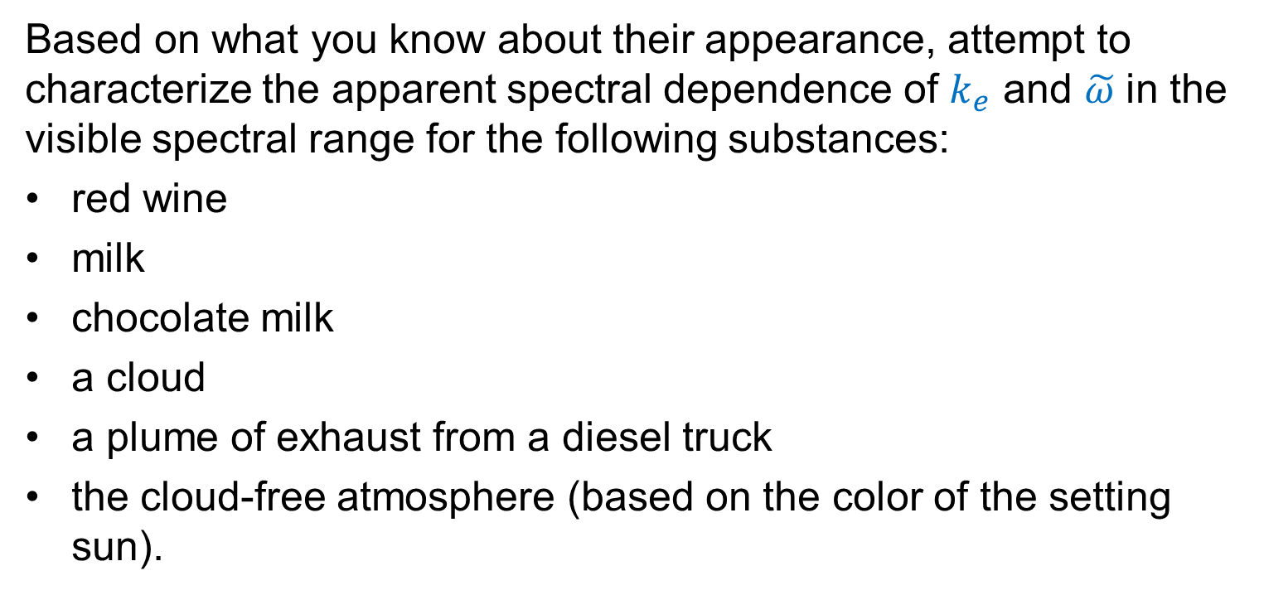
Problem I
Red wine: wine is not turbid (milky), therefore there's not much scattering going on in comparison to extinction. The SSA is likely close to zero, but extinction is relatively strong, depends on λ, so that red light is transmitted far more readily than shorter λs.
Chocolate milk: Like milk, chocolate milk is rather opaque (extinction coefficient is large), and the opacity is mostly due to scattering. Unlike pure milk, chocolate milk is not white but brownish gray. This suggests that the SSA is somewhat less than one (there is some absorption) and that absorption is slightly stronger for shorter (bluer) wavelengths.

Slide 36
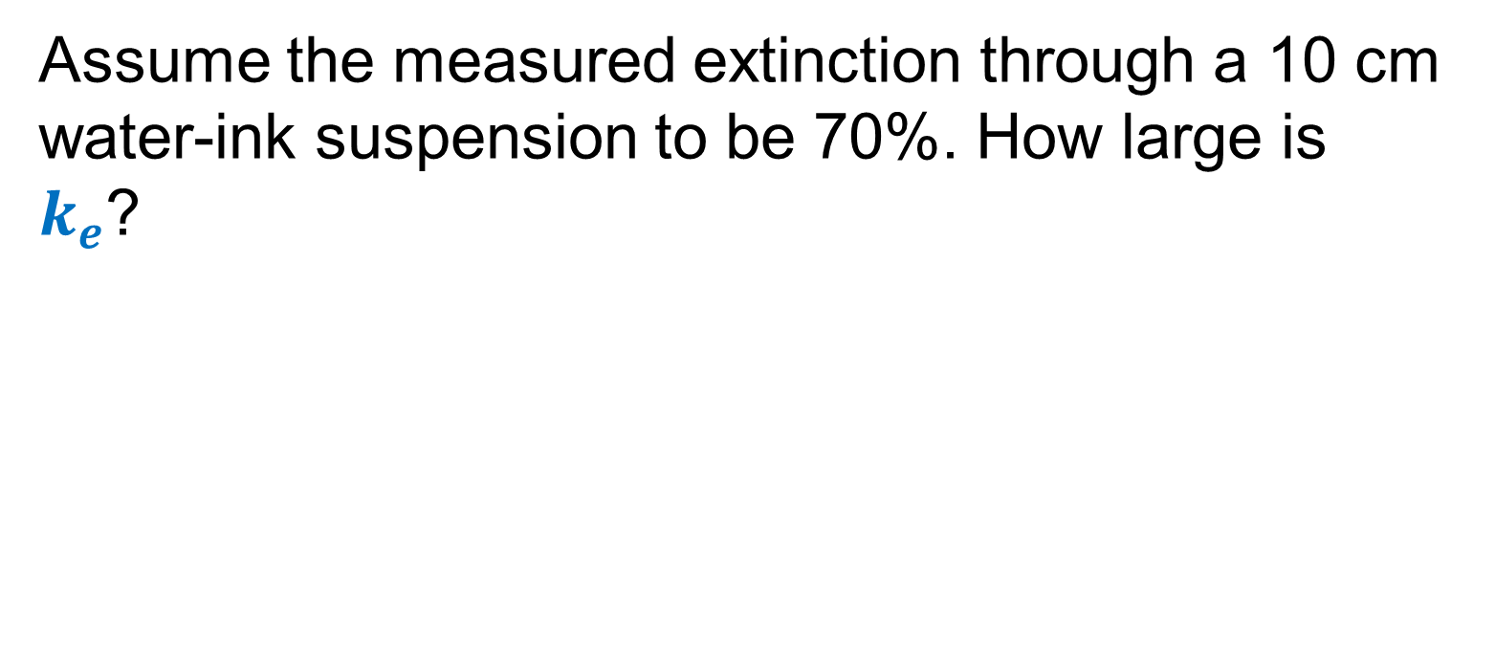
Problem II

Slide 37
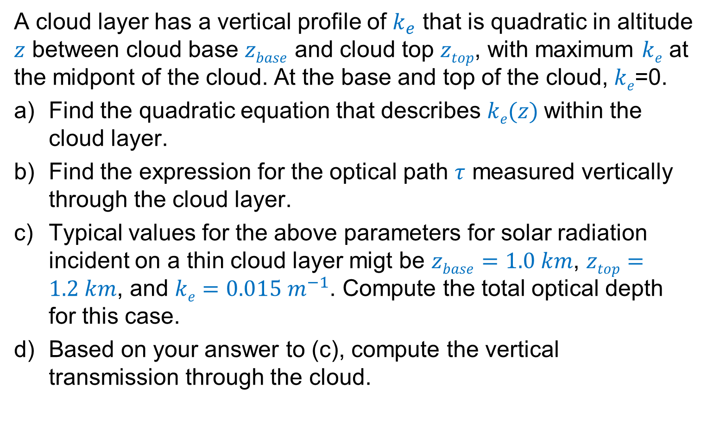
Problem III

Slide 38
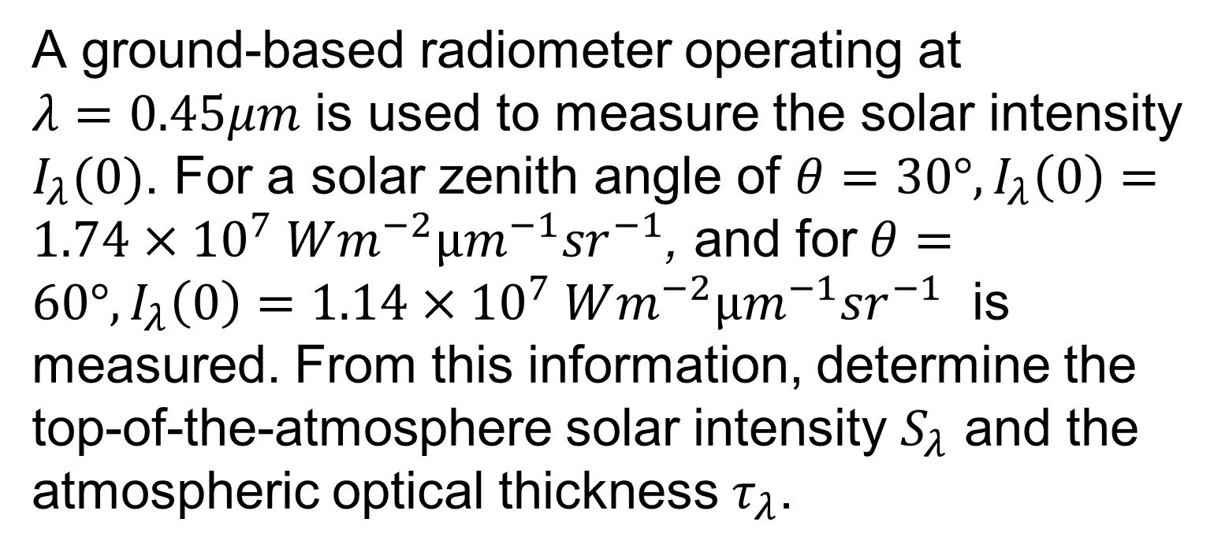
Problem IV

