Slide 1
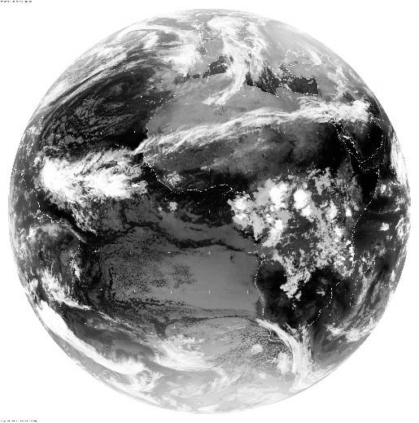
SECOND YEAR: 2604 PLANETARY REMOTE SENSING 4 ELECTROMAGNETIC RADIATION: emission and extinction processes Dr. A. Battaglia ab474@le.ac.uk EOS-SRC, Dept. of Physics and Astronomy, University of Leicester, U.K. http://www2.le.ac.uk/departments/physics/research/earth-observation-science

Slide 2
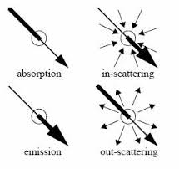
Interaction of Light and Matter
Light (EM radiation) can interact with matter in the following ways:
Emission: add (generates) photons
Absorption: removes photons
Scattering: changes direction of photons (and sometimes energy) e.g. when impinging onto a surface, a cloud or an aerosol layer
In such conditions (the medium is non transparent)
radiance is not constant
along the ray

Slide 3
BEER-LAMBERT LAW
The Beer-Lambert Law: if a signal of intensity I_{λ} penetrates a distance, dL, in a homogenous medium with absorption coefficient, k_{a} (dimensionally L⁻¹):
dI_{λ} = – k_{a}(λ) I_{λ} dL
Observed experimentally
Then if k_{a} = constant along the path L
I_{λ} (L) = I_{λ}(0) exp {- k_{a}(λ) L }
transmissivity: T(λ) = I_{λ} (L) / I_{λ} (0) = exp {- k_{a}(λ) L } = exp {-τ}
with τ = optical depth
L
I_{λ} (0)
I_{λ} (L)
GAS: k_{a}(λ), c
Radiance is not
constant along the ray!

Slide 4
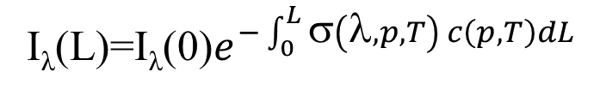
Optical thickness: contributors
L
I_{λ} (L) = I_{λ}(0) exp {- k_{a}(λ) L }= I_{λ}(0) exp [ – σ(λ) c L ]
with c = the density of molecules per unit volume.
Three factors affects the optical thickness:
Spectroscopy: absorption cross section σ(λ) [cm²/molecule]
Composition/density: c = χ c_{air} [molecules/cm³]
Photon path-length: geometrical distance = L [km]
I_{λ} (0)
I_{λ} (L)
GAS: k_{a}(λ), c, T
mixing ratio of the gas
General form with k_{a} changing in space:

Slide 5
Interaction of Particle with E/M Radiation: cross sections
Sphere, radius r,
complex refractive index m=m_{r} + im_{i}
Particle scattering/absorption is defined in terms of cross-sectional areas σ & efficiency factors Q
σ_{a} = effective area projected
by the particle that
determines absorption
Similarly σ_{s}, σ_{e}
F_{inc}
Geometric
cross-section
πr²
The particles is absorbing and/or scattering some of the incident radiation ➔absorbed/scattered power
The efficiency factor then follows
N.B.: Q can be larger than 1!!!

Slide 6
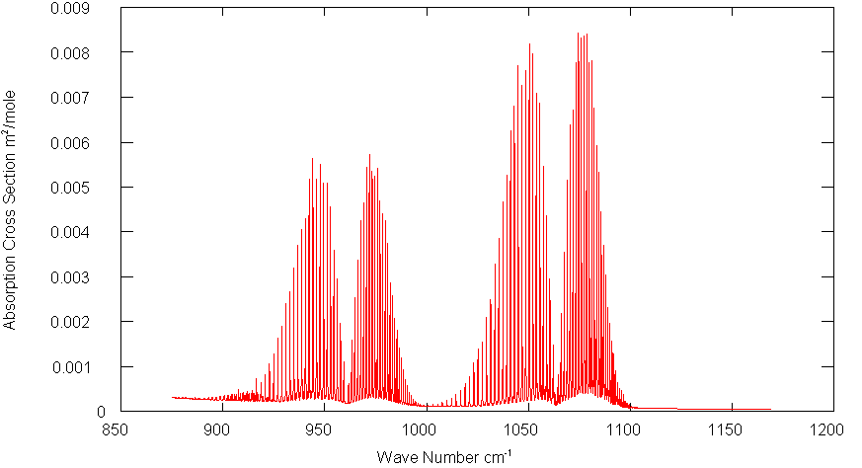
Transmission of gases
Example
Calculate the transmission of CO₂ lines over a range of 10 km line for different absorption cross sections of a) 10⁻¹⁹ cm²; b) 10⁻²¹ cm²; c) 10⁻²³ cm². Assume CO₂ has the concentrations given by 2.7 * 10¹⁵ molecules cm⁻³ .
T_{g}(ν) = exp [ – k_{n}(ν)N l ]
a) = exp [ – 10⁻¹⁹ cm²/mol * 2.7 * 10¹⁵ mol cm⁻³* 10 *10⁵ cm]
= exp [ – 2.7 * 10¹] ≈ 0.0
b) = exp [ – 2.7 * 10⁻¹] ≈ 0.76
c) = exp [ – 2.7 * 10⁻³] ≈ 0.997
is opaque
has mid-range transmission
Is nearly transparent.
1 mole=6x10²³ molecules
=10⁻²² cm²/molecule
10 micron
Notes:
6
Explain calc. hc2 is a constant. Same wavelength so lambda will cancel.

Slide 7
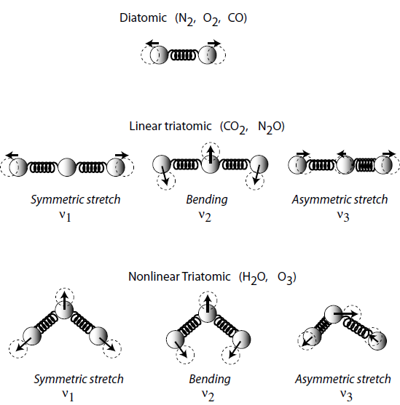
Spectroscopy
The study of the interaction of a medium with radiation is known as spectroscopy. The spectral properties of gases, liquids and solids are determined fundamentally by quantum mechanics.
Hence σ_{a}(ν) is fundamentally due to quantised transitions between energy levels in molecules.
In the infra-red, the transitions occur as distinct bands unique to each gas (specifically due to the vibration and rotation of each molecule).
Light gas molecules – distinct line structure grouped in bands e.g. CO, CO₂, H₂O,CH₄
Heavy gas molecules – densely structured bands that appear apparently smooth (e.g.CFCs)
Liquids – simple broad features (droplets, aerosols, surface)
Solids – simple,broad features (ice, aerosols, surface)
Scattering theory
Notes:
Model with spring

Slide 8
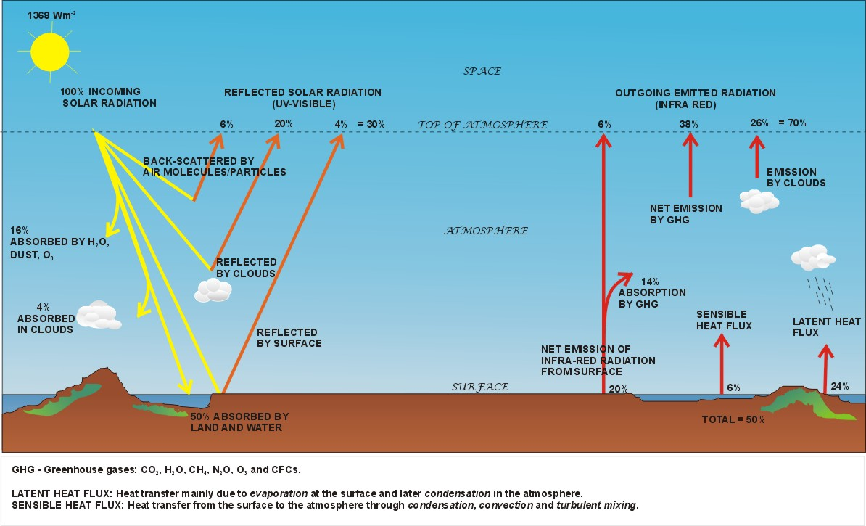
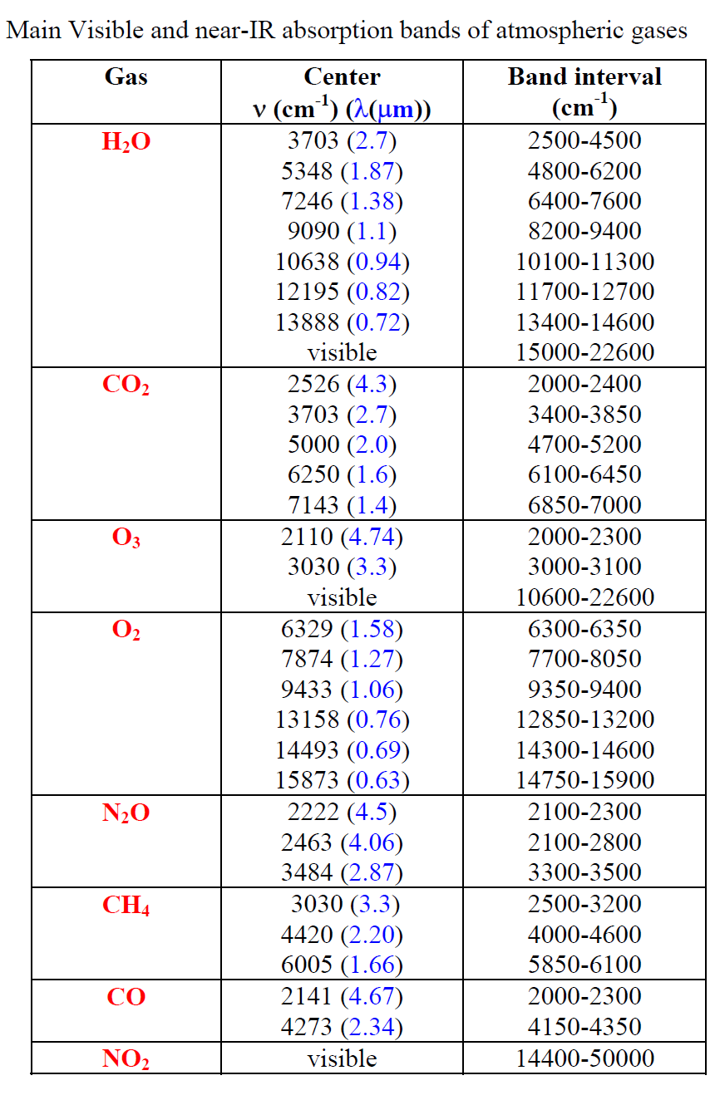
Gas absorption in the Earth’s atmosphere
In the ultra-violet and visible, incident light from the Sun is absorbed and/or scattered. A principal absorber is ozone in the stratosphere. UV-visible radiation ➔ heating wherever it is absorbed. As a result less solar radiation reaches the surface.

Slide 9
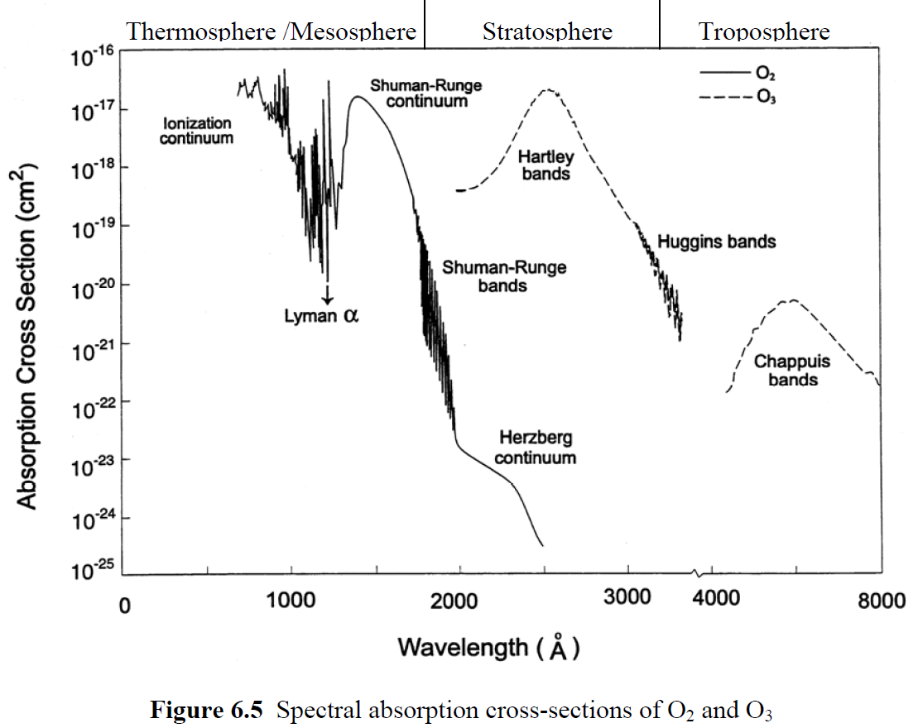
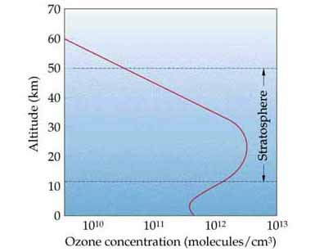
Spectral absorption cross-sections of O₂ and O₃
k_{a}(ν)=σ_{a}(ν)N
Peak at 24 km
5.4x10¹²/cm³
VIS
Bands of O₂ and O₃ at wavelengths < 1 μm are electronic transitions.
These absorption bands cover a continuum because practically all absorption results in dissociation of the molecule (so the upper state is not quantized);
Despite the small amount of O₃, no solar radiation penetrates to the lower atmosphere at wavelengths < 310 nm (because of large absorption cross-sections of O₃);

Slide 10
Transmissivity due to gases
Example
Calculate the transmission of O₃ lines over a range of 40 km for a line strengths of a) 10⁻¹⁷ cm²/mol; b) 10⁻¹⁹ cm²/mol; c) 10⁻²¹ cm²/mol. Assume O₃ has a constant concentration given by 3 * 10¹² molecules cm⁻³ .
T_{g}(ν) = exp [ – σ_{a}(ν)N L ]
a) = exp [ – 10⁻¹⁷ cm²/mol * 3 * 10¹² mol cm⁻³* 40 *10⁵ cm]
= exp [ – 120] ≈ 0.0 λ=0.25 μm
b) = exp [ – 1.2] ≈ 0.3 λ=0.3 μm
c) = exp [ – 0.012] ≈ 0.988 λ=0.35 μm
is opaque
has mid-range transmission
Is nearly transparent.
Ozone is really screening out near UV radiation ➔ relevance of ozone hole for skin cancer
Notes:
10
Explain calc. hc2 is a constant. Same wavelength so lambda will cancel.

Slide 11
BEER-LAMBERT LAW: EXTINCTION LAW
Homogenous non-absorbing medium with scattering coefficient, k_{s} (per unit distance)
dI_{λ} = – k_{s}(λ) I_{λ} dL
and I_{λ} (L) = I_{λ}(0) exp {- k_{s}(λ) L } (compare absorbing case)
Scattering and absorbing media: I_{λ} (L) = I_{λ}(0) exp {- k_{e}(λ) L }
with extinction coefficient: k_{e} = k_{s}+ k_{a}
Extinction: total loss of light due to absorption and scattering of light out of path
L
I_{λ} (0)
I_{λ} (L)

Slide 12
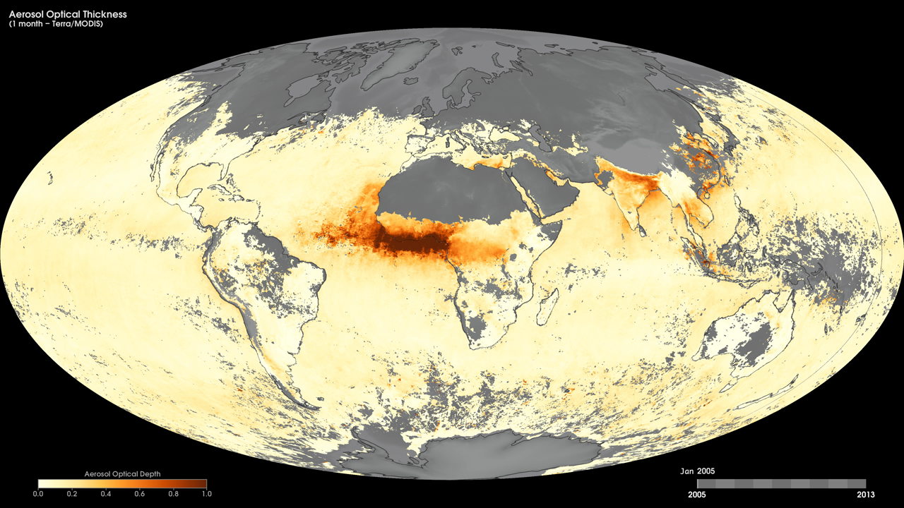
https://svs.gsfc.nasa.gov/12302
Notes:
Tiny solid and liquid particles suspended in the atmosphere are called aerosols. These particles are important to scientists because they represent an area of great uncertainty in their efforts to understand Earth's climate system.
These maps show monthly aerosol optical thickness, derived using measurements from the Moderate Resolution Imaging Spectroradiometer (MODIS) sensor onboard NASA’s Terra satellite, from January 2005 to the present. Aerosol optical thickness is a measure of how much light the airborne particles prevent from traveling through the atmosphere. Aerosols absorb and scatter incoming sunlight, thus reducing visibility and increasing optical thickness. Dark orange pixels show high aerosol concentrations, while light orange pixels show lower concentrations, and light yellow areas show little or no aerosols. Black shows where the sensor could not make its measurement. An optical thickness of less than 0.1 (light yellow) indicates a crystal clear sky with maximum visibility, whereas a value of 1 (dark orange) indicates the presence of aerosols so dense that people would have difficulty seeing the sun.
Satellite: Terra
Instrument: MODIS

Slide 13
Extinction: Scattering plus Absorption
Absorption removes radiant energy from an E/M field, converting it to other forms of energy.
(Effect on transmittance is the same)
Scattering does not remove energy from an E/M field, but can redirect it, thereby making it a “source” of radiation for another direction.
Single scatter albedo (SSA): fraction of extinction (absorption + scattering) due to scattering processes:
ω_{o} = σ_{s} /σ_{e}
ω_{o} = 1 all scattering (conservative)
ω_{o} = 0 all absorption (non - conservative)
σ_{e =} σ_{a +} σ_{s}
How can we compute scattering and absorption cross sections of single particles?
How can we relate them to scattering and absorption coefficients?

Slide 14
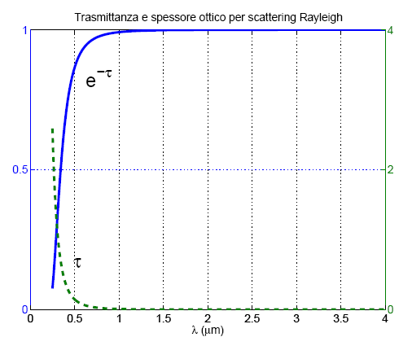
The scattering optical thickness of our atmosphere
Compare the atmospheric transmissivity for Rayleigh scattering in UV with larger wavelength (600nm, 900 nm)
λ, nm | σ, cm²
300 | 6.00 x 10⁻²⁶
400 | 1.90 x 10⁻²⁶
600 | 3.80 x 10⁻²⁷
1000 | 4.90 x 10⁻²⁸
10,000 | 4.85 x 10⁻³²
Transmission
T(λ) = I_{λ} (L) / I_{λ}(0)
= exp(-τ) = exp {- k_{s}(λ) L }
= exp {- σ c L } = exp {- σ VCD }
with Vertical Column Density of air (VCD) = 2.3x10²⁵ molec/cm²
Transmittance and τ for Rayleigh scattering
Transmissivity: T(λ=300nm) = 0.25 τ = 1.4
T(λ=600nm) = 0.92 τ = 0.08
T(λ=1000nm) = 0.99 τ = 0.01
Only 25% of direct light reaches surfaces in UV at 300 nm but 99% at 1000nm.

Slide 15
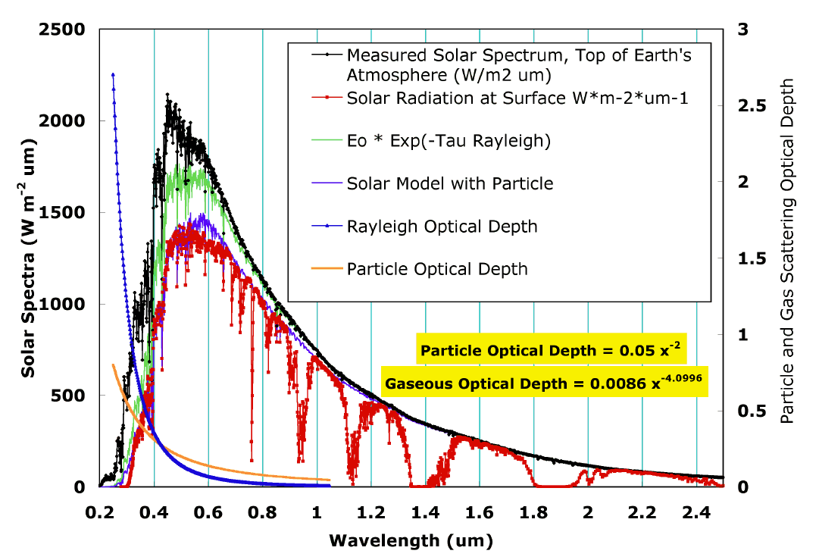
SOLAR SPECTRUM
Rayleigh (gas) scattering,
O₂, N₂, water vapour absorption
Aerosol particles extinction
Contributions to extinction of
solar radiation from TOA to surface
Gas optical depth ∝1/λ⁴
Aerosol optical depth ∝1/λ²

Slide 16
Accounting for emission
L
I_{λ} (L)
There are 2 signals emerging:
Radiance transmitted by the gas in the cell: T(λ) I_{o} (λ)
Radiance emitted by the gas in the cell: ε(λ) x B(λ,T)
Emissivity is related to absorptance a(λ) of the layer (fraction of radiance being absorbed)
We neglect scattering (valid for gases in the IR)
I_{λ} (0)
GAS k_{a}(λ), c, T
T(λ) + a(λ) = 1 ➔ a(λ) = 1- T(λ)
Radiation is either transmitted or absorbed
In thermal equilibrium
(Kirchhoff’s law)
ε(λ)=a(λ) = 1- T(λ)

Slide 17
IR TRANSMISSION FOR ISOTHERMAL LAYER
Total Signal
Hence, Total Signal, I(λ) is given by
==> I_{λ} (L) = T(λ) I_{λ}(0) + ( 1- T(λ) ) x B(λ, T)
Limiting cases:
1) T(λ) ≈ 1 → I_{λ} (L) ≈ T(λ) I_{λ}(0) [Known as a WINDOW]
T(λ) = 0 → I_{λ} (L) =B(λ, T) [Known as 100% absorption or saturation]
N.B. : If: a) term 1 >> term 2 or b) if T_{gas} = 0 K (!)
then Eqn. 1) would be true and conventional use of T(λ) alone is fine, e.g. uv-visible on Earth or hot source relative to cold gas.
L
I_{λ} (0)
I_{λ} (L)
GAS k_{a}(λ), c, T

Slide 18
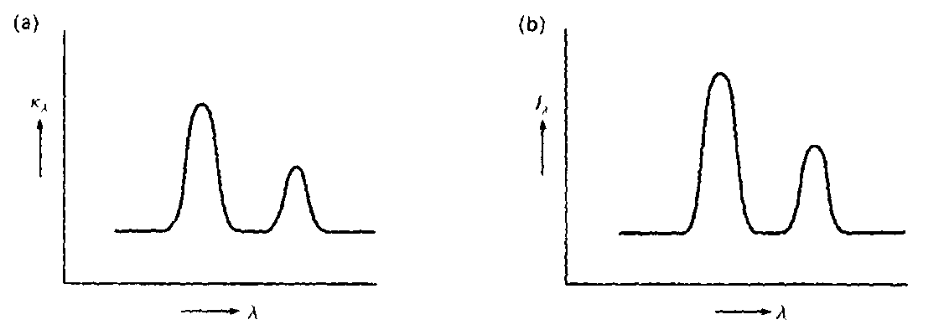
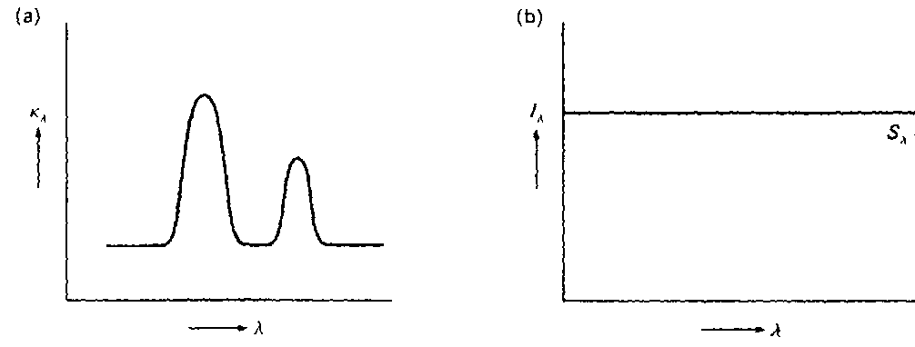
Hot nebula
L
I_{λ} (L)
I_{λ} (0)
GAS k_{a}(λ), c, T
I_{λ}(L) = T(λ) I_{λ}(0) + ( 1- T(λ) ) x B(λ, T)
Imagine first the case in which I_{λ}(0)=0, i.e. solely emission from the volume of gas (with constant source function).
We have two limiting cases:
Optically thin case ( τ_{λ}<<1)
Optically thick case (τ_{λ}>>1)
Opacity τ versus λ ➔ Intensity versus λ
τ_{λ}
Ι_{λ}
τ_{λ}
Ι_{λ}
It behaves like a black body

Slide 19
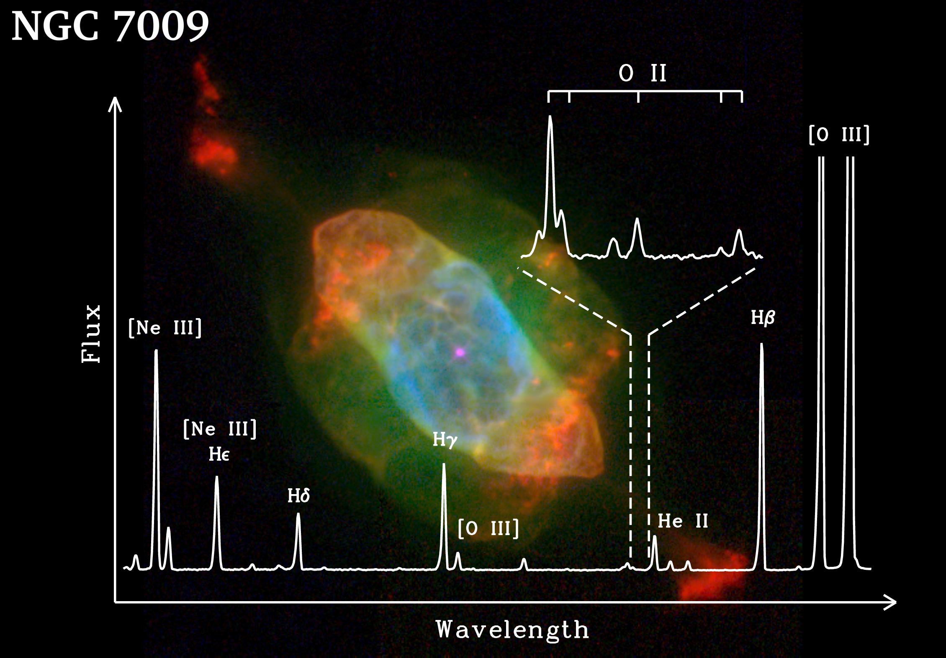
Hot low density nebular gas
Example of emission lines for optically thin nebulae
The optical thickness is strongly dependent on wavelength ➔ peaks corresponding to absorption bands of different elements in the nebula

Slide 20

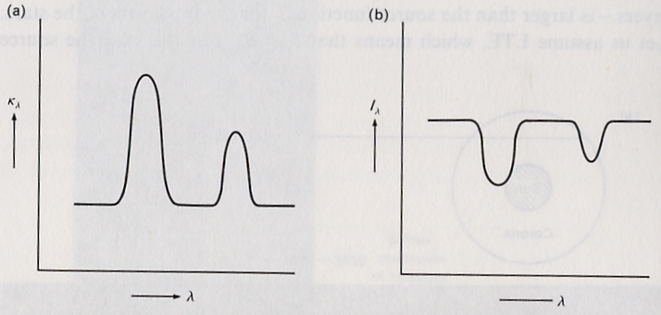

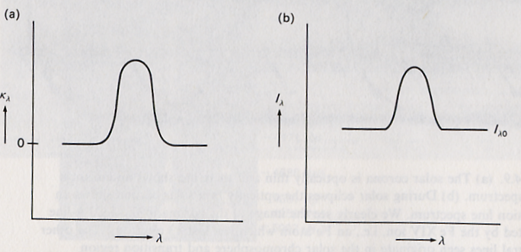


Absorption versus emission
Imagine now I_{λ}(0)≠0, again with two extreme cases:
Optically thin case (τ_{λ}<<1)
If I_{λ0}>B_{λ}, so there is something subtracted from the original intensity which is proportional to the optical depth – we see absorption lines on the continuum intensity I_{λ.} EXAMPLE: stellar photospheres
If I_{λ0}<B_{λ}, we will see emission lines on top of the background intensity.
Example: Solar UV spectrum
Optically thick case (τ_{λ}>>1):
Planck function as before.
τ_{λ}
Ι_{λ}(L)
τ_{λ}
Ι_{λ}(L)
Opacity τ versus λ ➔Intensity versus λ

Slide 21
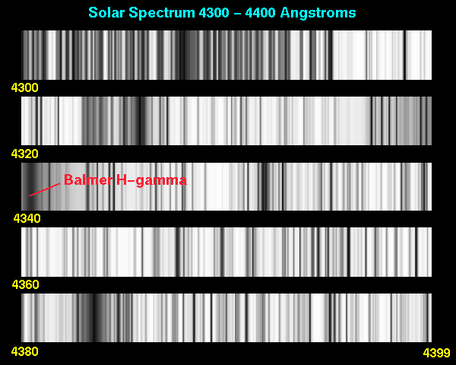
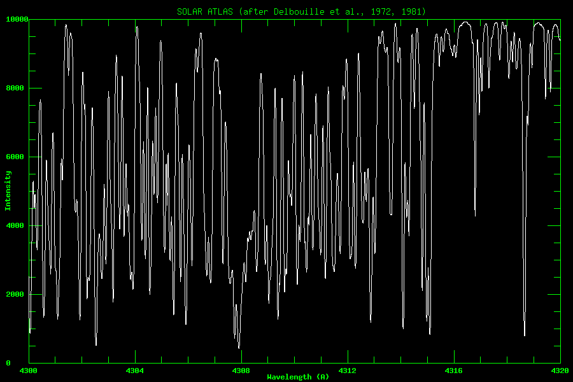
Absorption lines? Outward decreasing temperature
In a star absorption lines are produced if
I_{λ0} > B_{λ} i.e. the intensity from deep layers is larger than the source function from top layers.
In LTE, the source function is B_{λ}(T), so the Planck function for the deeper layers is larger than the shallower layers. Consequently the deeper layers have a higher temperature than the top layers (since the Planck function increases at all wavelengths with T).
(Instances occur where LTE is not valid, and the source function declines outward in parallel with an increasing temperature).
Solar Spectrum (4300-4320 angstrom=0.43-0.432 micron) ➔ absorption lines

Slide 22
Absorption versus emission spectra
Emission line spectra
Optically thin volume of gas with no background illumination (emission nebula)
Optically thick gas in which the source function increases outwards (UV solar spectrum)
Absorption line spectra
Optically thick gas in which source function declines outward, generally T decreases outwards (Stellar photospheres)
Optically thin cold gas penetrated by background radiation (Interstellar matter between us and the star)

Slide 23
What do you need to know?
Emission and Absorption
Isothermal layer model
Lambert Beer Law (optical depth, transmissivity)
I_{λ} (0)
I_{λ} (L)
GAS k_{e}(λ)= k_{a}(λ)+k_{s}(λ), T
I_{λ} (L) = T(λ) I_{λ}(0) + ( 1- T(λ) ) B_{λ} (T)
transmissivity: T(λ) = exp {- k_{e}(λ) L } = exp {-τ}

