Slide 1
Neural Network

Slide 2

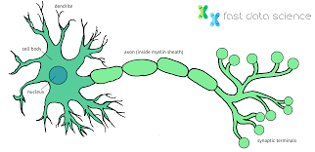
Human Brain
HUMAN BRAIN NEURAL NETWORK
SINGLE NEURON

Slide 3
Topology
HIDDEN NEURON
INPUT NEURON
OUTPUT NEURON

Slide 4
Forward Propagation
HIDDEN NEURON
INPUT NEURON
OUTPUT NEURON

Slide 5
Forward Propagation
HIDDEN NEURON
INPUT NEURON
OUTPUT NEURON

Slide 6
Forward Propagation
HIDDEN NEURON
INPUT NEURON
OUTPUT NEURON

Slide 7
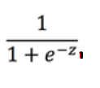
Forward Propagation
Z1 = W11 * X1 + W12 * X2 + B1
H1
W 11 * X 1
H1 =
W 12 * X 2

Slide 8

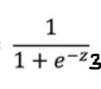
Forward Propagation
Z1 = W11 * X1 + W12 * X2 + B1
H11
W 11 * X 1
H11 =
W 12 * X 2
Z2 = W21 * X1 + W22 * X2 + B2
W21 * X1
H21
W22 * X2
H2 1=
W31 * x1
W32 * x2
Z3 = W31 * X1 + W32 * X2 + B3
H31
H31 =

Slide 9
Forward Propagation
W 11 * H 11
H12
Z1 = W11 * H11 + W12 * H21 + W13 * H31 + B1
W 12 * H 21
W 13 * H31
H12 =
W22 * H11
W22 * H21
H22
Z2 = W21 * H11 + W22 * H21 + W23 * H31 + B2
W23 * H31
H22=
W31 * H11
W32 * H21
H32
Z3 = W31 * H11 + W32 * H21 + W33 * H31 + B3
W33 * H31
H32 =

Slide 10
Forward Propagation
W 11 * H 12
Z1 = W11 * H12 + W12 * H22 + W13 * H32 + B1
W 12 * H 22
O1
W 13 * H 32
W21 * H12
Z2 = W21 * H12 + W22 * H22 + W23 * H32 + B2
W22 * H22
O2 =
W23 * H32

Slide 11
Forward Propagation
I1
H1
O1
0.05
0.1
I2
H2
O2
0.10
0.99

Slide 12
Forward Propagation
Z1 = 0.15 * 0.05 + 0.20 * 0.10 + 0.35 = 0.3775
W1 = 0.15
I1
H1
H1 = 1/ (1+ E ^-z)
O1
0.05
= 0.5932
W2 = 0.20
I2
H2
O2
0.10
B1 = 0.35

Slide 13
Forward Propagation
I1
H1
O1
0.05
= 0.5932
W3 = 0.20
Z2 = 0.20 * 0.05 + 0.30 * 0.10 + 0.35 = 0.39
I2
W4 = 0.30
H2
O2
0.10
H2 = 1/ (1+ E ^-z)
= 0.5968
B1 = 0.35

Slide 14
Forward Propagation
Z1 = 0.4 * 0.5932 + 0.45 * 0.5968 + 0.60 = 1.1059
= 0.5932
I1
H1
W5 = 0.40
O1
O1 = 1 / (1 + E ^ -z)
0.05
= 0.7512
W6 = 0.45
= 0.5968
I2
H2
O2
0.10
B2 = 0.60

Slide 15
Forward Propagation
= 0.5932
I1
H1
O1
= 0.7512
0.05
W7 = 0.50
= 0.5968
O2 = 1 / (1 + E ^ -z)
W8 = 0.55
= 0.7729
I2
H2
O2
0.10
Z1 = 0.50 * 0.5932 + 0.55 * 0.5968 + 0.60 = 1.22484
B2 = 0.60

Slide 16
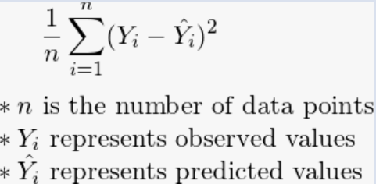
Error calculation
Predicted Output = 0.7512
Actual output = 0.1
I1
H1
O1
0.05
= ½ (0.1 – 0.7712) ^2
TOTAL ERROR
= 0.274811 + 0.02356
= 0.29837
= 0.274811
Predicted Output = 0.7729
I2
H2
O2
0.10
Actual output = 0.99
= ½ ( 0.99 – 0.7729) ^2
= 0.02356

Slide 17
Learning Parameters
I1
w1
H1
w5
O1
0.05
0.1
w2
w6
w3
w7
w4
w8
I2
H2
O2
0.10
0.99
B1
B2

Slide 18
HOW TO
UPDATE
ALL
LEARNING PARAMETERS
WITH
RESPECT TO LOSS
?????
?????
?????
?????

Slide 19
Let’s Break Forward Pass
I1
w1
z1
H1
w5
z3
O1
P1
0.05
w3
w7
0.1
L
w2
w6
I2
w4
H2
z4
O2
P2
0.10
z2
w8
0.99
B1
B2

Slide 20
Backward Propagation
I1
w1
z1
H1
w5
z3
O1
0.05
LOSS
w3
w7
0.1
w2
w6
I2
w4
H2
z4
O2
0.10
z2
w8
B1
B2
0.99

Slide 21
Backward Propagation
dl/dw5 = dl/do * do/dz * dz/dw5
W5 = w5 – (L.R * DL/DW5)
I1
w1
z1
H1
w5
z3
O1
0.05
dz/dw5
do/dz
dl/do
LOSS
w3
w7
w2
w6
I2
w4
H2
z4
O2
0.10
z2
w8
B1
B2

Slide 22
dl/dw5 = dl/do * do/dz * dz/dw5
L = ½(y-p)^2
dl/do = y-p (or) p-y

Slide 23
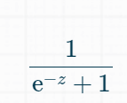


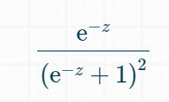




=
=
=

Slide 24
z = wx + b
dz/dw = x
Putting all-together
dl/dw5 = dl/do * do/dz * dz/dw5
dl/dw5 = (p-y) * o(1-o) * h1
= (0.7513 – 0.01) * 0.7513(1-0.7513) *0.5932
= 0.0821

Slide 25
W5 = w5 – (L.R * dL/dw5)
= 0.4 – (0.5 * 0.08216)
= 0.35891
Similarly we have identified for others
W6 = 0.40866 ; w7 = 0.5113 ; w8 = 0.5613

Slide 26
Backward Propagation
dl/dw5 = dl/do * do/dz * dz/dw5
dl/dw1 = dl/do * do/dz3 *dz/dh1 * dh1/dz1 * dz1/dw1
W5 = w5 – (L.R * DL/DW5)
W1 = W1 – (L.R * dl/dw1)
I1
w1
z1
H1
w5
z3
O1
0.05
dz1/dw1
dh1/dz1
dz3/dh1
do/dz3
dl/do
LOSS
w3
w7
w2
w6
I2
w4
H2
z4
O2
0.10
z2
w8
B1
B2

Slide 27
dl/dw1 = dl/do * do/dz3 *dz/dh1 * dh1/dz1 * dz1/dw1
dl/do = p - y
do/dz3 = o(1-o)
dz/dh1 = w5 (Skipping the derivation part)
dh1/dz1 = h1(1-h1)
dz1/dw1= x1
dl/dw1 = (p-y) * o(1-o) * W5 * h1(1-h1) * x1
dl/dw1 =(0.7513 – 0.01) * 0.7513(1-0.7513) * 0.40 * 0.593(1-0.593) * 0.05
dl/dw1 = 0.0004385

Slide 28
W1 = W1 – L.R (dl/dw1)
W1 = 0.15 – 0.5(0.0004385)
W1 =0.149

