Slide 1
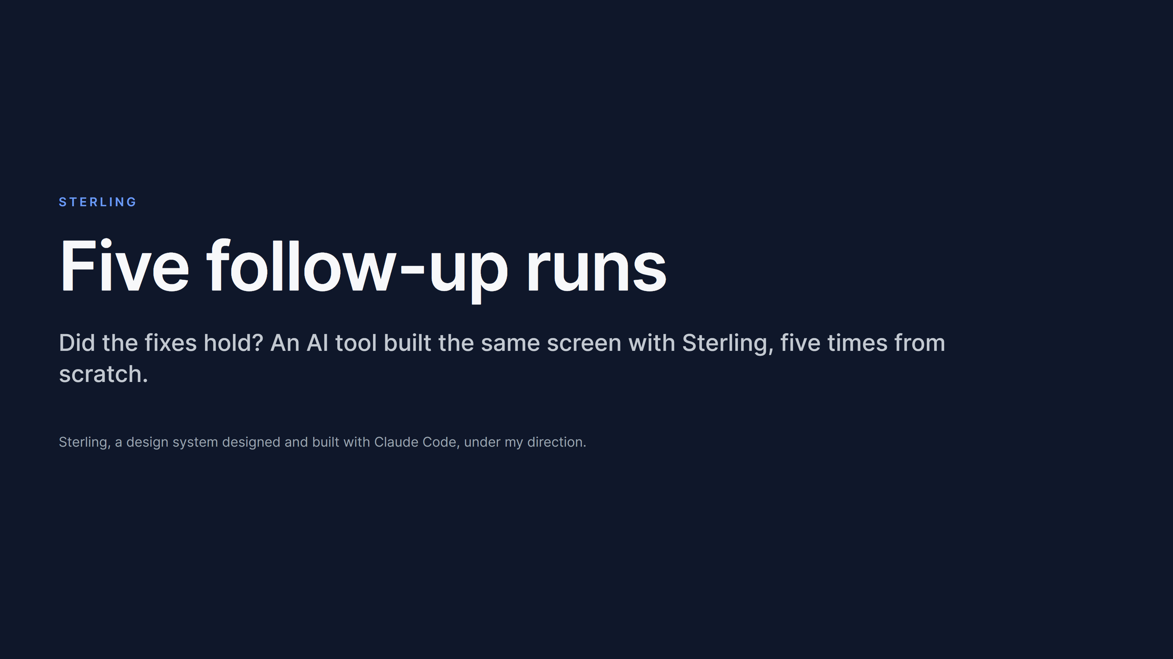
mcasey10.github.io/sterling-design-system/runs/

Slide 2
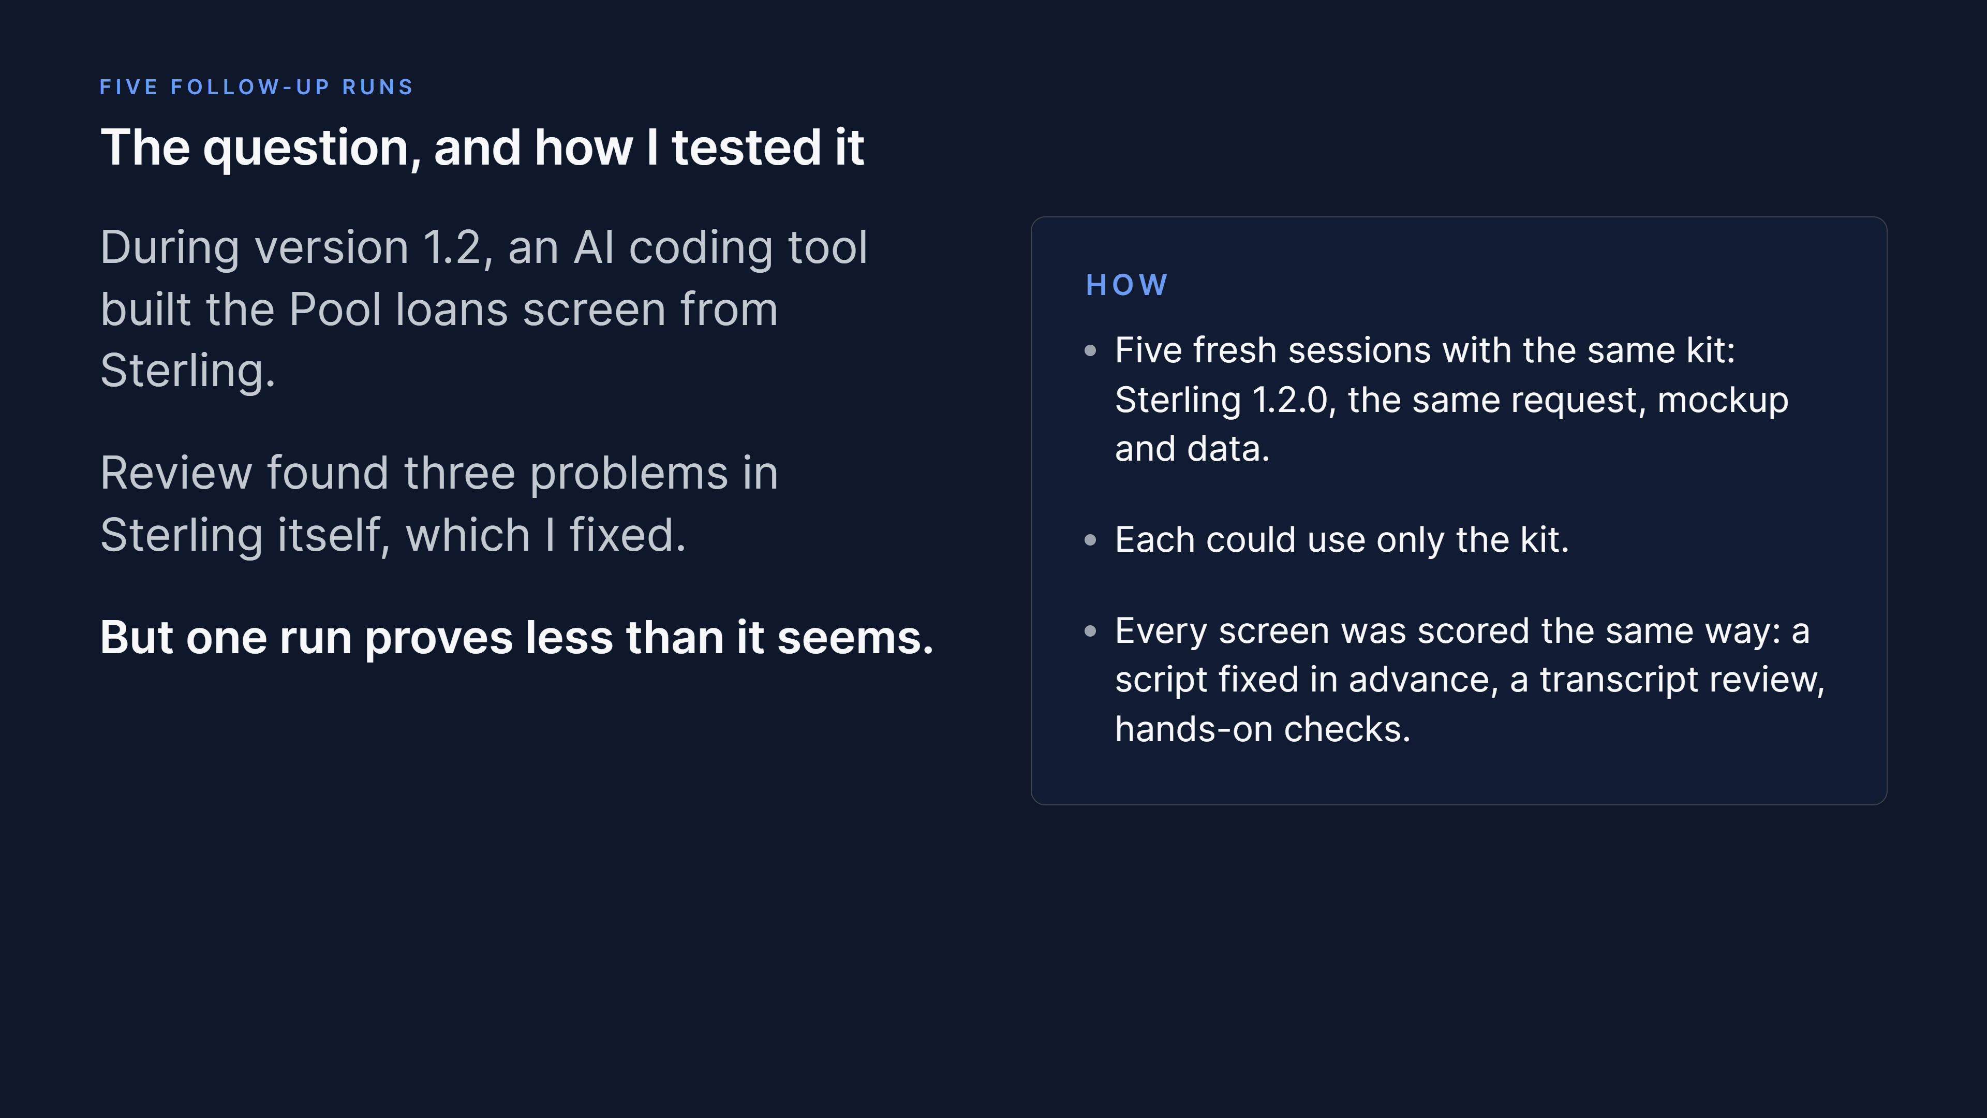
mcasey10.github.io/sterling-design-system/demo/

Slide 3
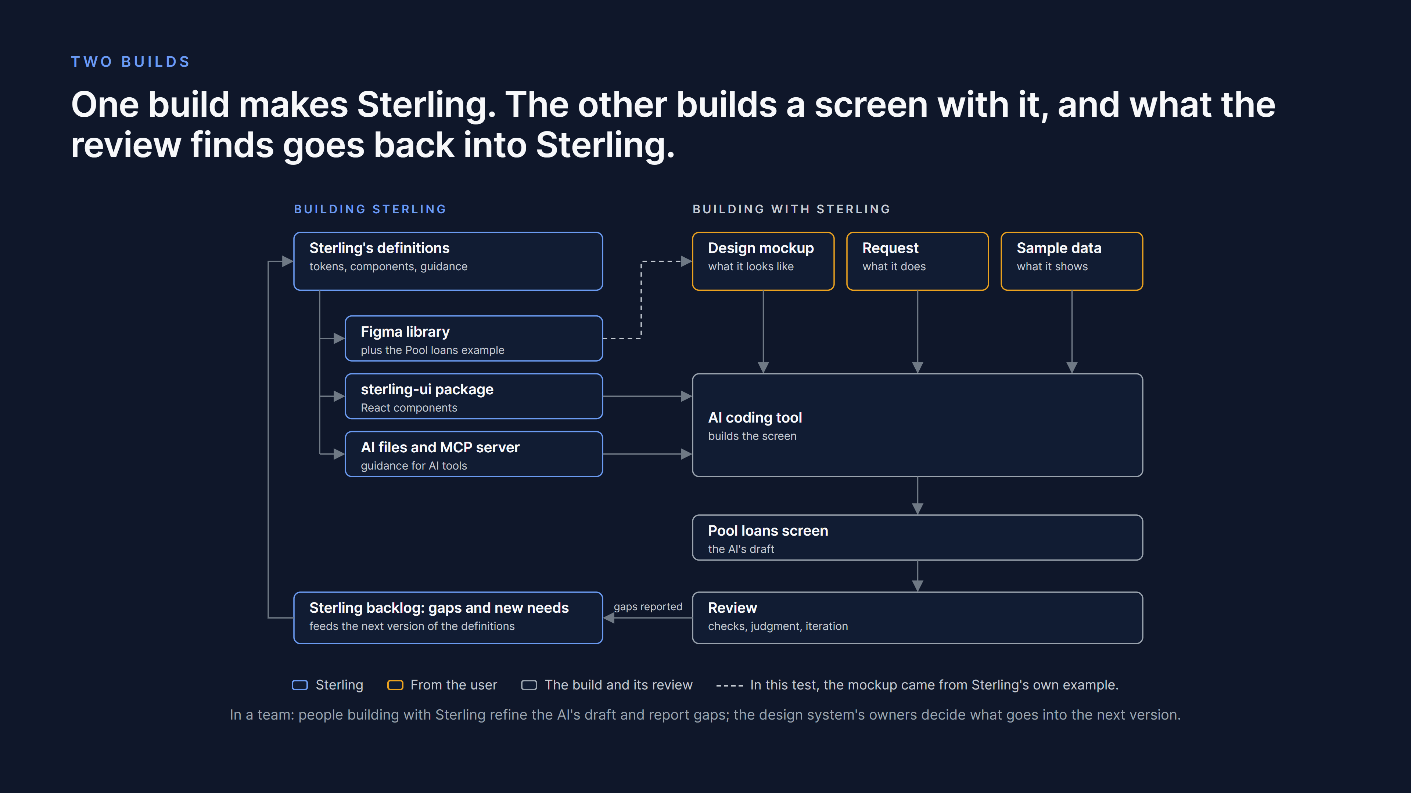
mcasey10.github.io/sterling-design-system/#two-builds

Slide 4
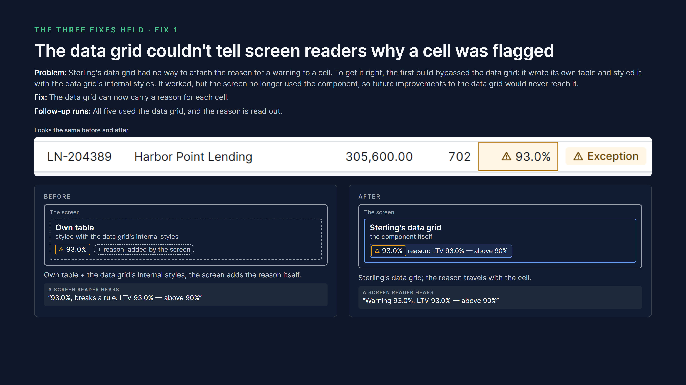
mcasey10.github.io/sterling-design-system/runs/

Slide 5
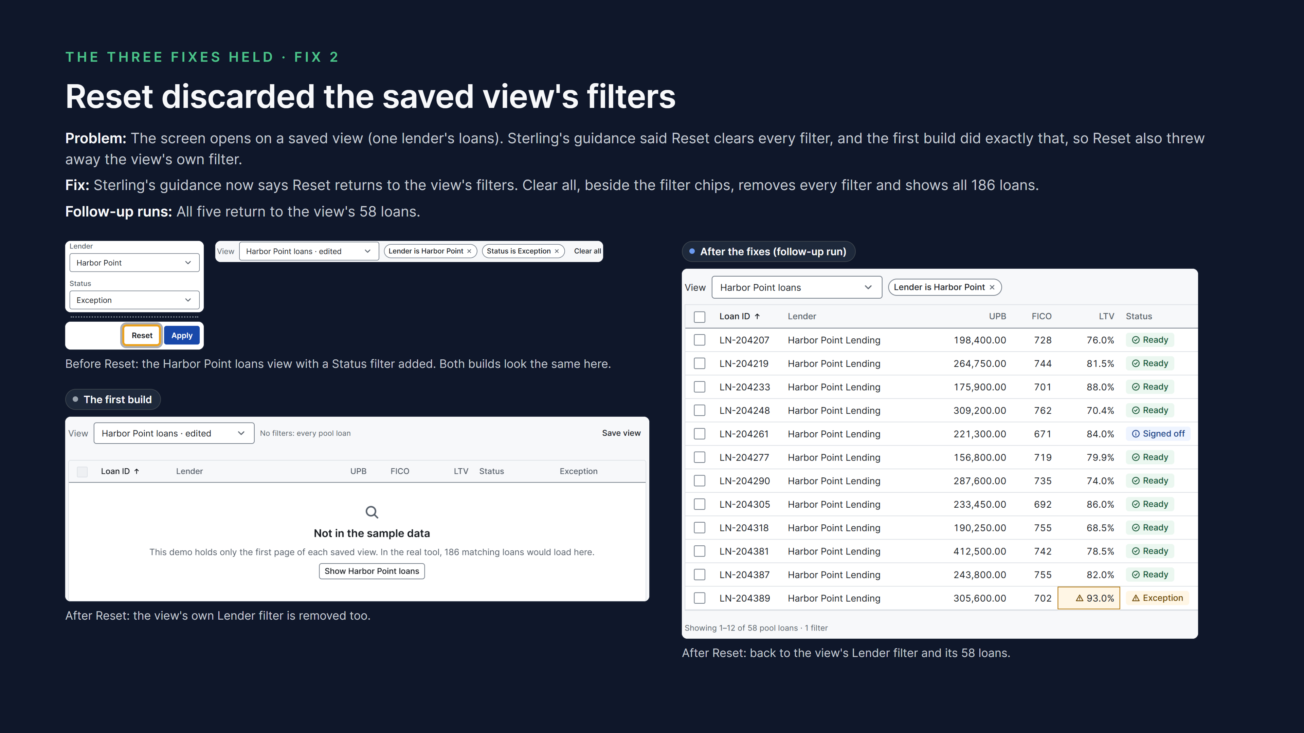
mcasey10.github.io/sterling-design-system/runs/

Slide 6
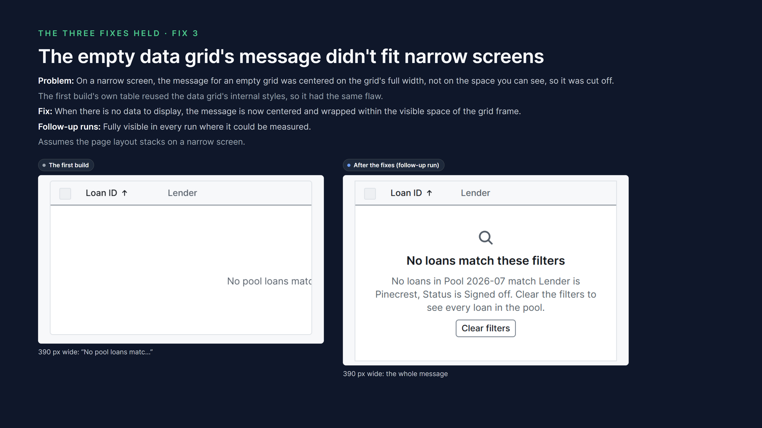
mcasey10.github.io/sterling-design-system/runs/

Slide 7
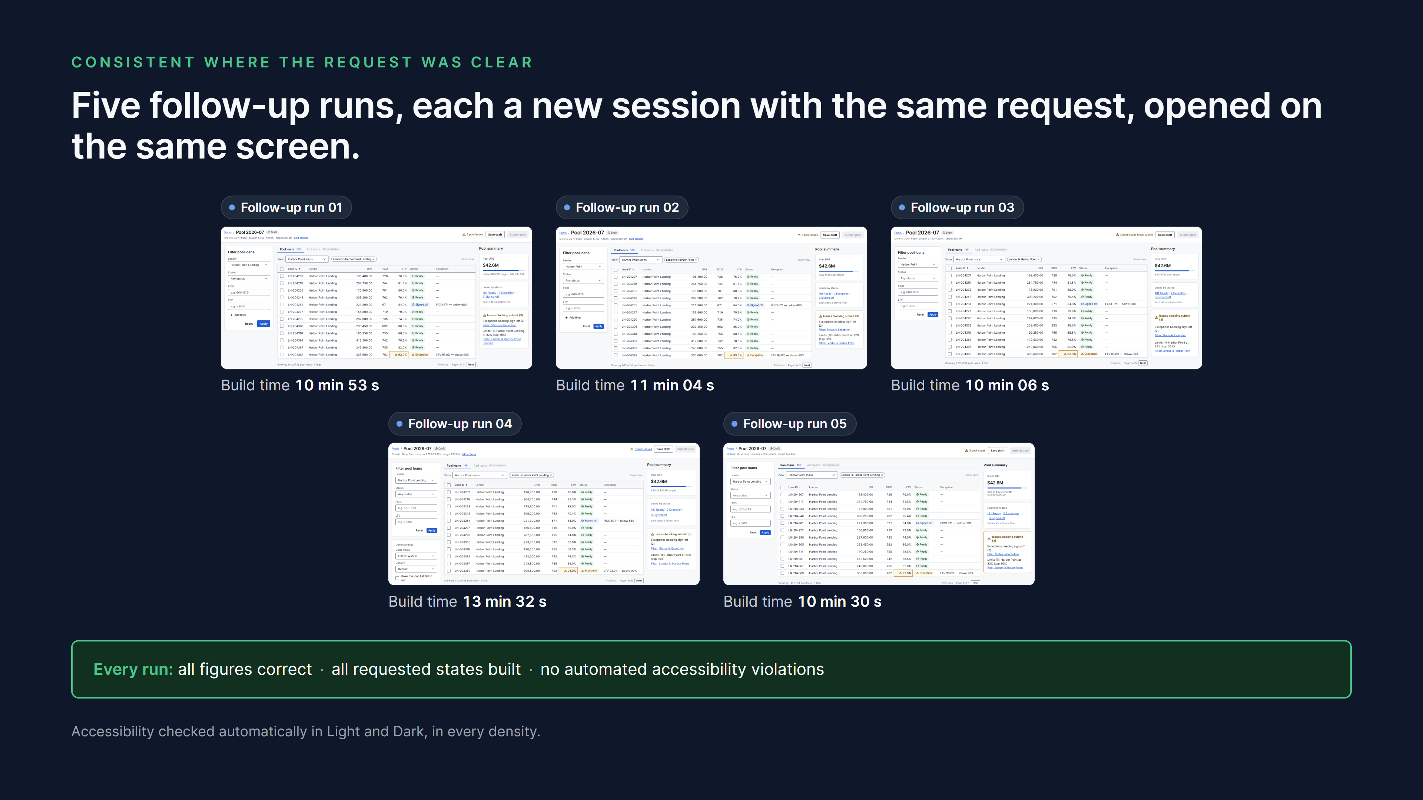
mcasey10.github.io/sterling-design-system/runs/

Slide 8
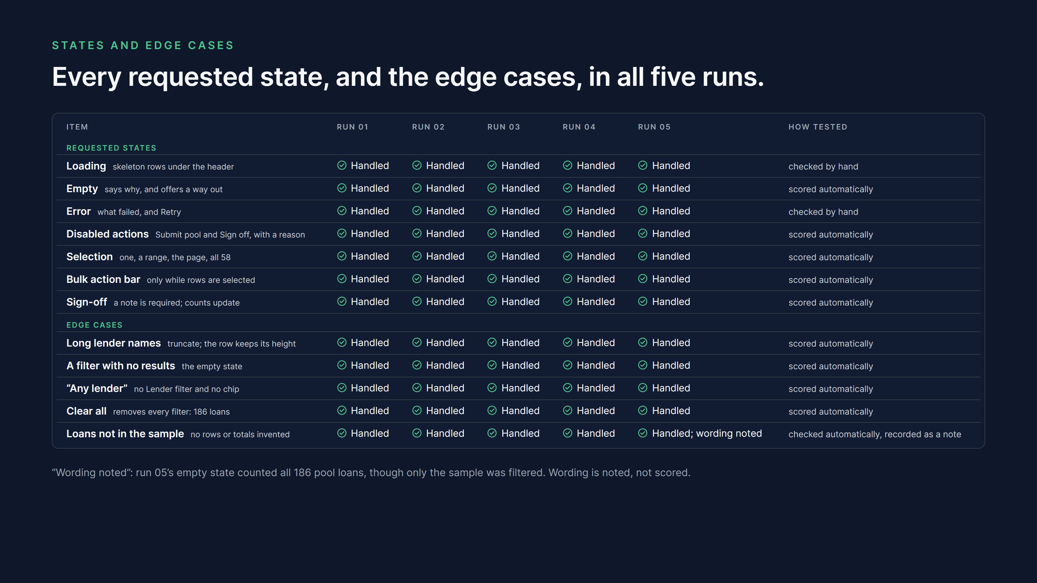
mcasey10.github.io/sterling-design-system/runs/

Slide 9
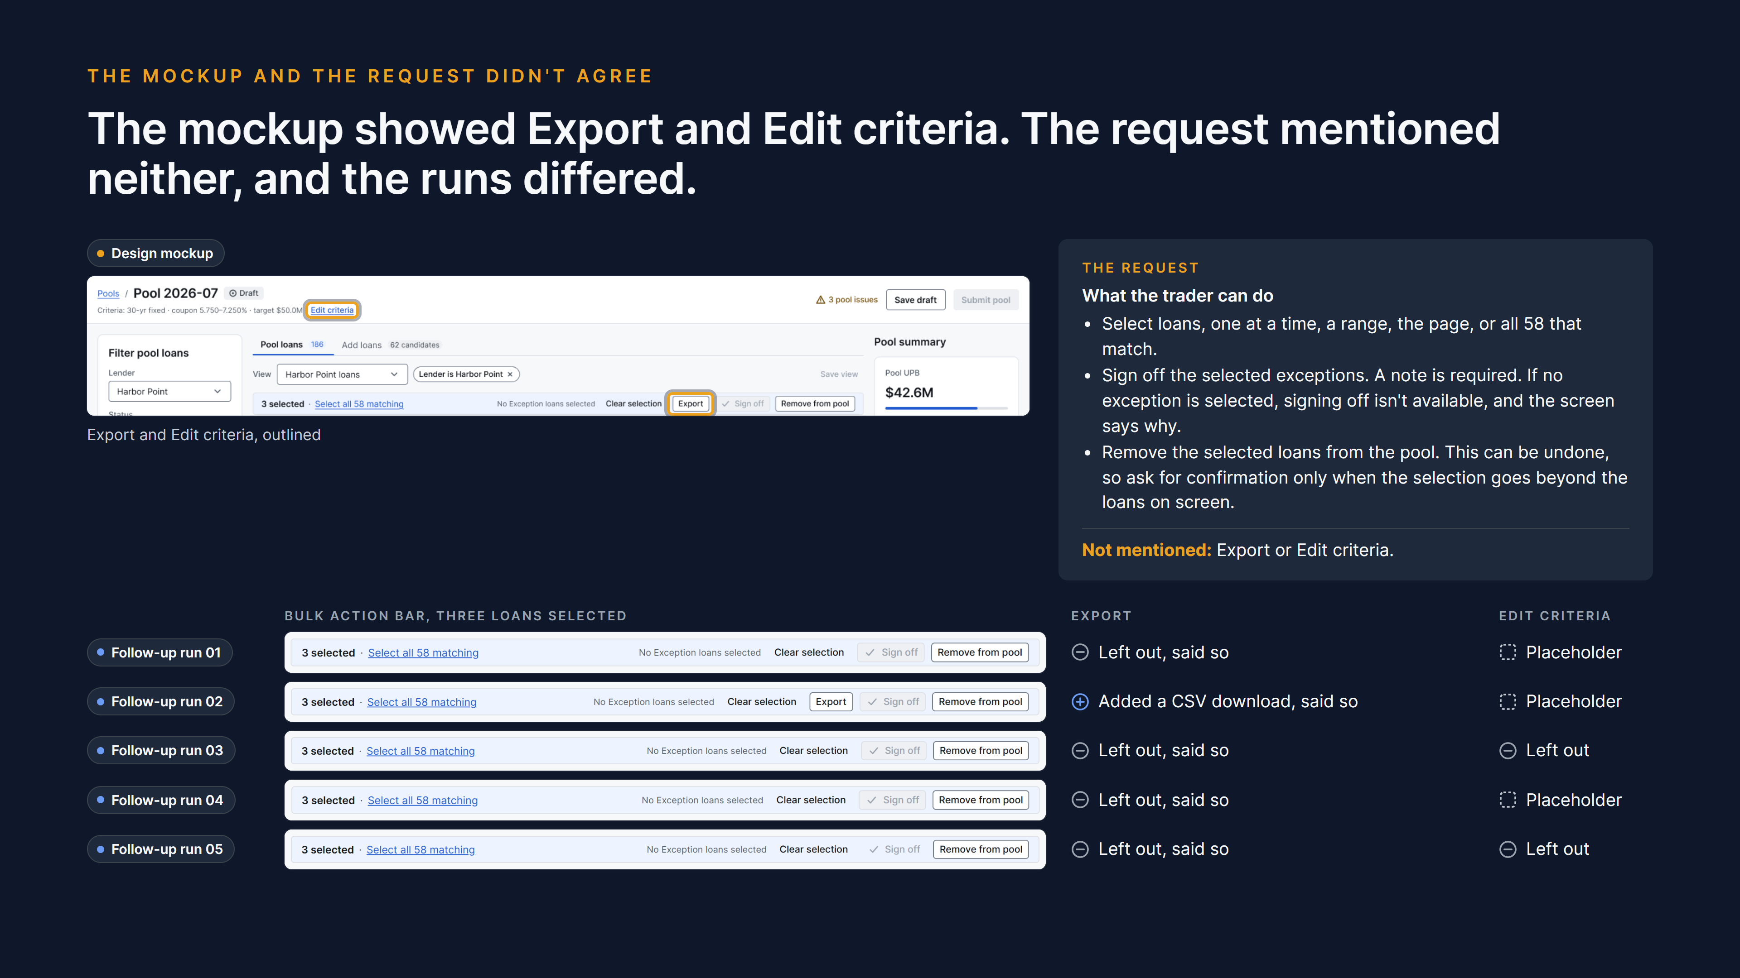
mcasey10.github.io/sterling-design-system/runs/

Slide 10
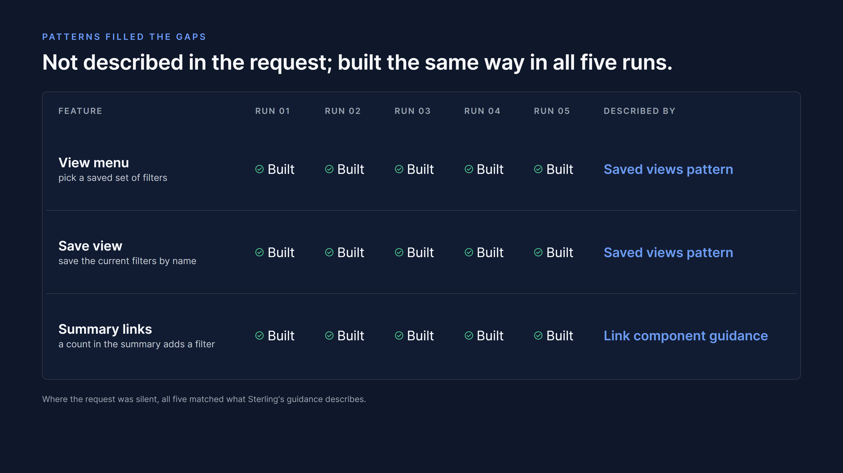
mcasey10.github.io/sterling-design-system/runs/

Slide 11
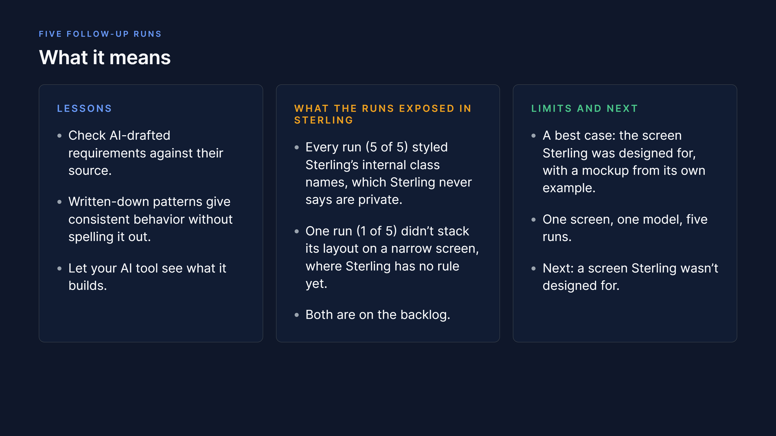
The full record: github.com/mcasey10/sterling-design-system/tree/main/docs/demo/runs · mcasey10.github.io/sterling-design-system/runs/

